Slide 1
ApexPlanet Sales Performance Analysis
Data Analytics Internship Project
J.Thirumalesh

Slide 2

Project Overview
• Analyzed sales performance data
• Created SQL queries for business insights
• Built interactive Power BI dashboard
• Identified top products, categories and cities
• Generated actionable business recommendations

Slide 3
Dataset Overview
Metric | Value
Orders | 1000
Categories | 5
Cities | 8
Products | 6

Slide 4
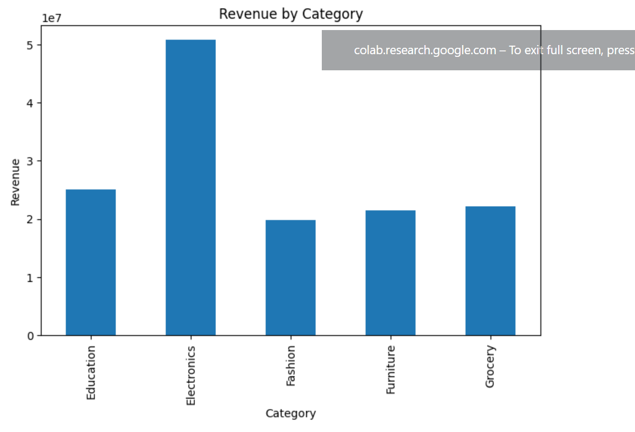
SQL Analysis
Key Queries Performed:
• Total Revenue
• Total Orders
• Average Order Value
• Revenue by Category
• Revenue by Product
• Revenue by City

Slide 5
Key Performance Indicators
💰 Total Revenue = 139.40M
📦 Total Orders = 1000
📈 Average Order Value = 139.40K

Slide 6
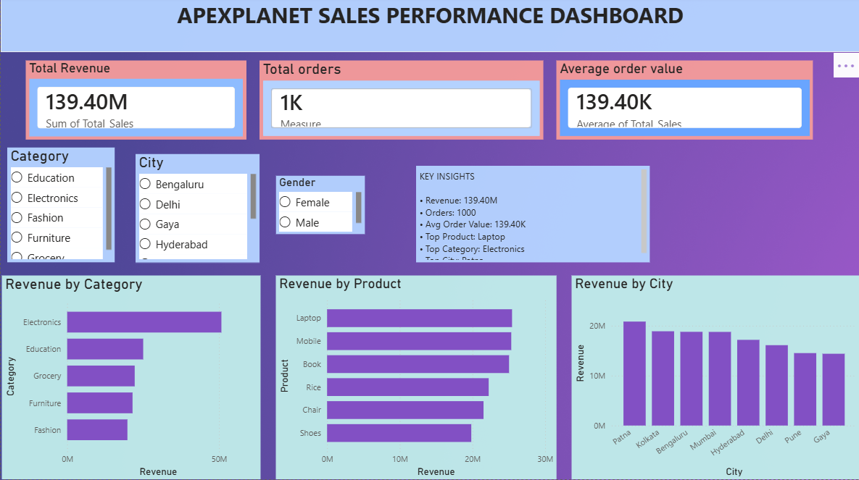
Power BI Dashboard

Slide 7
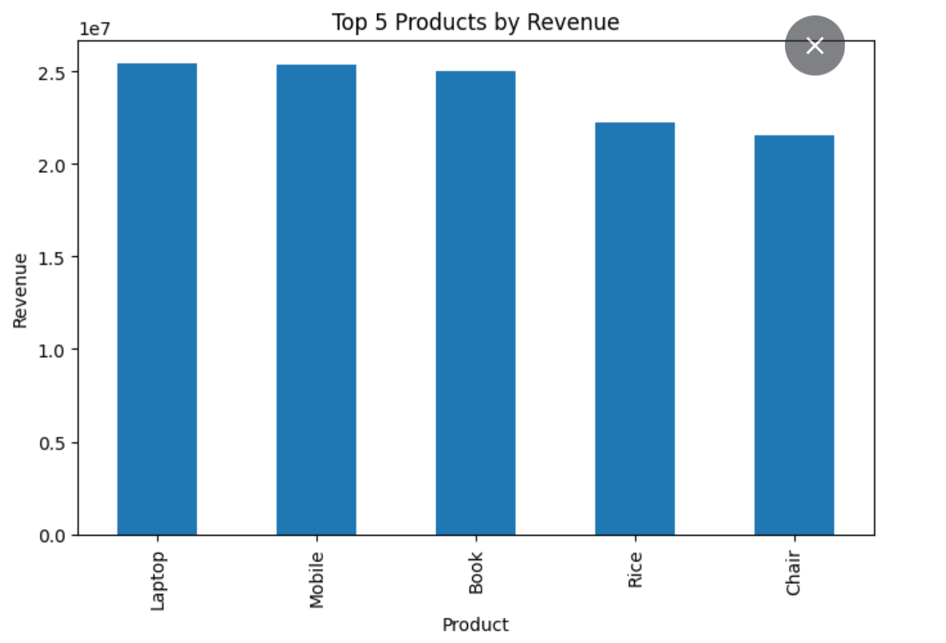
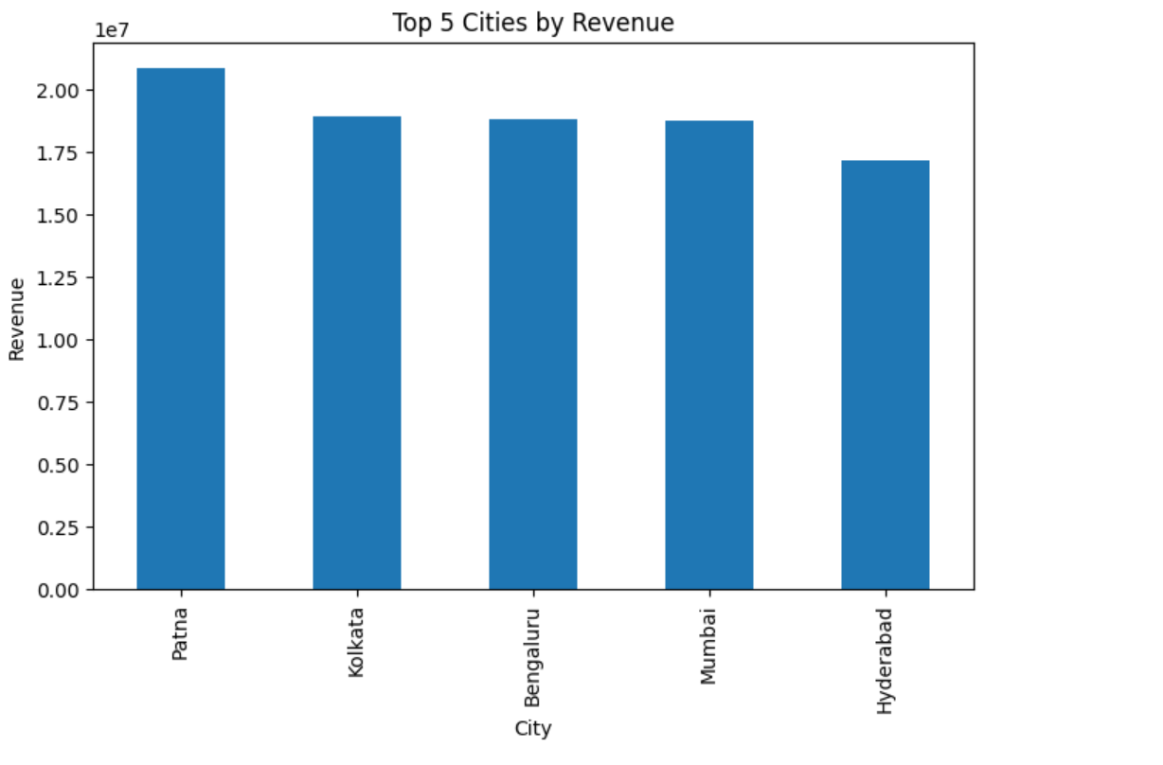
Business Insights
Electronics generated highest revenue
Laptop was top selling product
Patna generated highest city revenue
Male customers contributed significant revenue
Top 3 categories contributed majority of sales

Slide 8
Recommendations
• Increase Electronics inventory
• Promote Laptop products
• Focus marketing on high-performing cities
• Introduce customer loyalty programs
• Improve low-performing category sales

Slide 9
Hypothesis Testing
Hypothesis
H0:
Electronics category does not generate significantly higher revenue.
H1:
Electronics category generates significantly higher revenue.
Observation:
Electronics recorded the highest sales revenue among all categories.
Conclusion:
Analysis supports H1.

Slide 10
Conclusion
• Successfully analyzed sales data
• Built interactive Power BI dashboard
• Generated business insights
• Provided actionable recommendations
• Improved decision-making using data analytics

Slide 11
Thank you

