Slide 1
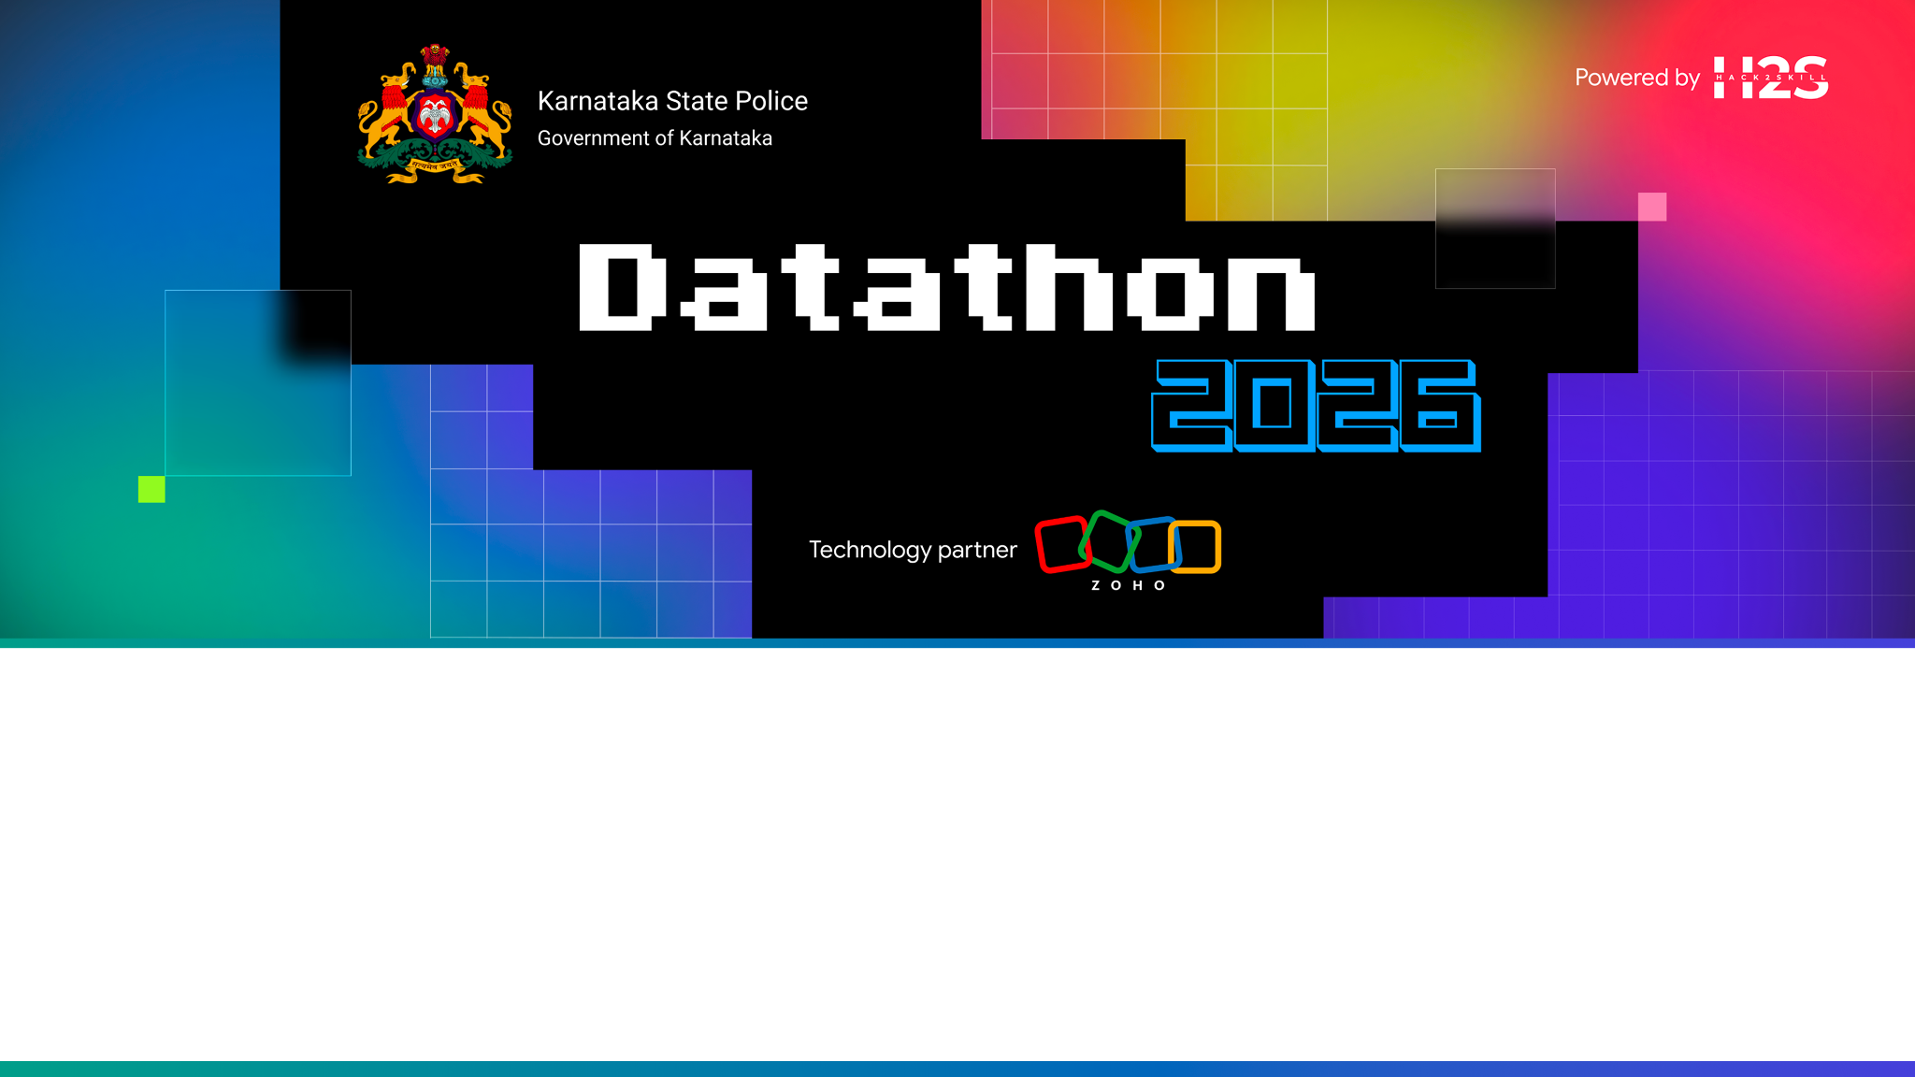
KSP Crime Intelligence Platform
Conversational AI + crime analytics over the Karnataka State Police FIR database
Team name: ________________________
Problem Statement: PS-1
Conversational AI & Crime Analytics over the KSP FIR Database
Team leader name: ________________________
Team size: ______
Notes:
Fill in team name, leader and size. Problem Statement 1: a conversational AI plus a crime-analytics engine over the Karnataka State Police FIR database.

Slide 2

Brief about the solution
Ask in plain language. Get only tool-verified facts, with the evidence attached.
Any officer — from a station SHO to an SCRB analyst — asks a question in plain language and gets an answer assembled only from typed tool results. The assistant never writes SQL and never authors a fact; when no tool can answer, it says so instead of guessing.
Its core is an entity-resolution engine that reconstructs the real person behind dozens of misspelt, transliterated and aliased FIR name variants — the person entity the source schema never stored.
On that spine sit 21 tools for case retrieval, co-offender networks, hotspots & trends, MO fingerprinting and compliance — each answer carrying a clickable evidence trail and enforced by role-based access control.
21
typed tools in one chat loop
50,000
synthetic FIRs, seed-reproducible
0
facts authored by the LLM
everything is tool-sourced
Notes:
The one-line pitch: grounded conversational intelligence over FIRs, with entity resolution as the differentiator and provenance on every answer.

Slide 3
Opportunities
How different is it from any of the other existing ideas?
How will it be able to solve the problem?
USP of the proposed solution
Why this is different, how it solves the problem, and what only we do.
1
HOW IT'S DIFFERENT
2
HOW IT SOLVES IT
3
USP
AccusedMasterID in the KSP schema is a per-FIR row id, not a person. Every naive approach treats it as identity and silently mis-counts. We resolve the real person across FIRs — the schema's missing entity — and only then analyse.
Officers get instant, jurisdiction-scoped answers. Repeat offenders and cross-station gangs invisible to any single station surface automatically. Chargesheet deadlines and registration delays are watched continuously.
Grounded (never fabricates), Explainable (clickable provenance to the source FIR), Governed (RBAC + audit at the tool boundary, not the prompt), and Measured (entity-resolution B³ F1 = 0.687 against hidden ground truth).
Notes:
The differentiator is entity resolution; the moat is that everything is grounded, explainable, governed and measured.

Slide 4
List of features offered by the solution
21 typed tools, grouped into eight capability areas.
Conversational Q&A
Entity Resolution
Co-offender Networks
Hotspots & Trends
Grounded answers; refuses when no tool fits
The person behind dozens of name variants
Gangs & cross-jurisdiction groups (Louvain)
DBSCAN hotspots, red-zone z-score, seasonality
MO Fingerprinting
Compliance
RBAC
Evidence & Audit
Similar cases returned with their outcomes
Chargesheet-deadline board, registration delay
5 roles, scope enforced at the tool boundary
Provenance on every answer; every call logged
Notes:
Every feature is a typed tool the LLM can call; adding a tool auto-registers it into the chat.

Slide 5
Process flow diagram or Use-case diagram
The LLM only selects tools — it never writes SQL and never authors a fact.
Officer question
Orchestration loop (LLM)
Selects a typed tool
RBAC + k-anon at the boundary
Parameterized SQL / ML
Grounded answer + provenance
Use case “Show me repeat offenders in my district and the gangs they run in.”
→ get_repeat_offenders → get_person_network → detect_communities, each scoped to the officer’s jurisdiction, each row traceable to its CrimeNos.
Notes:
The loop: question -> tool selection -> RBAC-checked parameterized execution -> grounded answer with provenance.

Slide 6
Wireframes/Mock diagrams of the proposed solution (optional)
Dark, dense, operational — a police tool, not a consumer app.
KSP Crime Intelligence
Acting as: SP ▾
Evidence
Network
Map
Who are the repeat offenders?
8 people with ≥3 FIRs in your district; top is linked to a 4-station group.
get_repeat_offenders
detect_communities
Ask the assistant…
Send
co-offending network · node size = linked FIRs
Notes:
Left: streaming chat with tool chips. Right: Evidence / Network / Map panes that repaint from each answer. Role switcher drives RBAC live.

Slide 7
Architecture diagram of the proposed solution
Everything above the database runs on Zoho Catalyst.
FRONTEND
React + Vite + TypeScript — streaming chat, evidence / network / map panes
CATALYST SERVICES
AppSail — backend
Slate — frontend
QuickML — LLM
Job Scheduling — alerts
SmartBrowz — PDF
Stratus — files
Cache · Auth
API / ORCHESTRATION
FastAPI tool-calling loop — LLM selects typed tools, never writes SQL
TOOL LAYER (21 tools)
RBAC + provenance + audit + k-anonymity enforced at the boundary
INTELLIGENCE
Entity resolution · MO clustering · networks · trends (scikit-learn, networkx)
DATA
PostgreSQL 16 + PostGIS + pgvector + pg_trgm — ksp (source) / derived (computed)
Notes:
Layered: Slate frontend -> AppSail FastAPI orchestration -> tool layer -> intelligence (sklearn/networkx) -> external Postgres+PostGIS+pgvector. Catalyst services wrap it; Postgres stays external because ZCQL lacks CTEs/PostGIS/pgvector.

Slide 8
Technologies to be used in the solution
Proven, open components — plus Catalyst-native AI.
Backend
Data
Python 3.12 · FastAPI · Pydantic v2 · SQLAlchemy · psycopg3
PostgreSQL 16 · PostGIS · pgvector · pg_trgm · fuzzystrmatch
ML & Analytics
LLM
scikit-learn (HDBSCAN, DBSCAN, TF-IDF/SVD) · networkx · jellyfish · Double Metaphone · indic-transliteration
Catalyst QuickML LLM Serving (Qwen 2.5) · OpenAI-compatible tool calling · prompted + native modes
Frontend
Language & Export
React 18 · Vite · TypeScript · SVG panes (Cytoscape / MapLibre upgrade planned)
Bhashini (Kannada ASR/TTS) · Catalyst SmartBrowz PDF [planned]
Notes:
Standard, defensible stack; the only Catalyst-specific piece is the LLM via QuickML serving.

Slide 9
List down Catalyst Services being used in the solution
Hosting maximised on the platform partner; only the database stays external.
AppSail
Slate
FastAPI backend (Python runtime or Docker OCI)
React single-page frontend hosting
QuickML LLM Serving
Job Scheduling
The conversational LLM (Qwen 2.5, BYOK)
Proactive alert engine (deadline / red-zone)
SmartBrowz
Stratus
Server-side PDF / briefing export
Object storage for generated reports
Cache
Authentication
Hot lookups & rate limiting
Officer identity upstream of RBAC
Notes:
AppSail, Slate, QuickML, Job Scheduling, SmartBrowz, Stratus, Cache, Auth. Postgres stays external because ZCQL has no recursive CTEs, PostGIS or pgvector.

Slide 10
Estimated implementation cost (optional)
Indicative pilot-scale monthly estimate (one district, ~50k FIRs).
Component
Scope
Cost driver
Catalyst AppSail
1–2 always-on instances (backend)
Per-instance runtime
Catalyst QuickML LLM
Conversational queries, BYOK
Per-token / per-call
Catalyst Slate
Static frontend hosting
Low / included
Job Scheduling
Nightly alert sweeps
Per-invocation
Stratus + Cache
Report storage + hot lookups
Usage-based
External PostgreSQL
Managed PG w/ PostGIS + pgvector
Fixed instance
Serverless components scale to near-zero when idle; the fixed cost is the managed Postgres instance. Figures are indicative for a pilot and finalised against Catalyst usage tiers.
Notes:
Cost is dominated by the always-on backend instance and the managed Postgres; LLM and storage are usage-based and scale with query volume.

Slide 11
Snapshots of the prototype
Representative prototype screens (dark operational UI).
Chat + Evidence trail
Trends + Hotspot map
Give me the profile of person #1864
109
13
0.69
Linked to 6 FIRs across 3 stations; earliest 2022, undetected. Confidence 0.91.
MO clusters
red-zone districts
MO V-measure
PROVENANCE — tap a CrimeNo to open the FIR
1002…2201
1002…2202
1002…2203
1002…2204
get_person ✓ → 6 rows, 6 CrimeNos. RBAC: 30 out-of-scope FIRs hidden.
hotspots on precise-coordinate cases only (42% coverage, stated openly)
Notes:
Left: a grounded person profile with a clickable provenance trail and RBAC hiding out-of-scope FIRs. Right: MO/trend stats and an honest hotspot map. Live screenshots can replace these once the Catalyst LLM key is wired.

Slide 12
Prototype Performance report/Benchmarking
Measured against hidden ground truth and a 40-question evaluation.
0.687
Entity-resolution B³ F1
P 0.83 / R 0.59
1.000
MO cluster homogeneity
V-measure 0.681
40/40
orchestration eval passed
incl. must-refuse cases
Entity Resolution
MO & System
• 55,716 accused rows → 35,122 resolved persons
• +887 extra merges from the co-offending network
• 4,395 predicted recurring vs 4,013 true
• 4.58M candidate pairs scored in ~30 s
• 109 MO clusters over 50,000 FIRs (4.9% noise)
• 21 typed tools, 158 automated tests passing
• Graph build 1.6 s · MO clustering ~30 s
• Every answer carries a provenance chain
Notes:
Headline: ER B-cubed F1 0.687 vs hidden ground truth (the hard, measurable ML result); MO homogeneity 1.000; 40/40 grounding eval including questions that must be refused; 158 tests green.

Slide 13
Provide links to your:
GitHub Public Repository
Demo Video Link (3 Minutes)
Deployed Link
Repository, demo and deployment.
GitHub Public Repository
✓
github.com/thirumurugan-12/claux
Demo Video (3 minutes)
…
________________________ (to be added)
Deployed Link
…
________________________ (Catalyst AppSail / Slate)
Notes:
Add the 3-minute demo video and the deployed Catalyst URL before submitting.

Slide 14
Additional Details/Future Development (if any)
The roadmap, and the boundaries we deliberately keep.
NEXT ON THE ROADMAP
PRINCIPLED BOUNDARIES
• Undetected-case & offender-risk models (prioritise open cases, never predict people)
• Proactive early-warning alerts on Catalyst Job Scheduling
• Hotspot forecasting; MapLibre + Cytoscape rich panes
• Kannada voice via Bhashini; PDF briefings via SmartBrowz
• Real-FIR ingest pipeline (schema & tools are already real-data-ready)
• No individual-level crime prediction — we predict places, times and case outcomes, never people.
• Financial-crime integration is a declared stub: no account / txn data exists in the FIR schema, so we never fabricate it.
• The LLM never authors a fact.
Notes:
Roadmap plus the ethical lines: no person-level prediction, no fabricated financial data, no LLM-authored facts.

Slide 15
Blank slide

Slide 16
