Slide 1

IMAGE RECOGNITION USING PYTHON
Final Review
Batch No. :2
DATE : 24-01-2023
Presented by
AHAMAD THOWFEEK B-410620243301
THIRUMURUGAN-410620243029
MOHAMED SAKEEL-410620243016
Supervisor
Mrs.A.THENMOZHI
Associate Professor

Slide 2
Objective
Image recognition allows machines to identify objects, people, entities, and other variables in images.
The main objective of image processing is to transform an image into digital form and perform certain operations on it in order to obtain specific models or to extract useful information from the image
It involves retrieving the image from a source, usually a hardware-based soruce
This is one of the many reasons why image processing is so important in any computer vision application
Goal – to simplify the subsequent image analysis and recognition.

Slide 3
Domain Description
Image processing operations can be performed in the spatial domain and frequency domain of an image..
Spatial domain refers to the matrix of pixels composing an image (original pixels of the image
Frequency domain refers to the matrix of numbers making up a Fourier-transformed image (spectral).

Slide 4
Abstract
A growing interest in computer vision over the past decade. At a constant doubling rate every 13 months, With the constant doubling rate of computing power, face detection and recognition has grown from an esoteric to a popular research area in computer vision and one of the best and most successful applications of image analysis and algorithm-bas.
Due to the intrinsic nature of the problem, computer vision is not only an area of computer science research, but also the subject of neuro-science and psychology studies, mainly a general concept provided by advances in computer image processing and comprehension research. Insights into how our brains work and vice versa.
Due to the general interest and interest in this subject, the author proposes to develop an application that allows the user access to a specific machine based on an in-depth analysis of a person's facial features.
The application will be developed using Intel's open-source Computer Vision project, OpenCV, and Microsoft's .NET framework.
This research paper provides a better way for Human face detection and recognition using OpenCV, and Python, an area of deep learning.
In this report Deep learning approaches are an important part of AI

Slide 5
List of Modules
LANGUAGE
Low-level programming language
High-level programming language
PYTHON
Advantages
Disadvamtages
Version
PACKAGE
list of packages
OPENCV
working procedure
DATASET or IMAGES

Slide 6
Modules Description
1. Language:
A programming language is a computer language that is used by programmers (developers) to communicate with computers. It is a set of instructions written in any specific language ( C, C++, Java, Python) to perform a specific task. A programming language is mainly used to develop desktop applications, websites, and mobile applications.
Types of programming language
1. Low-level programming language
2. High-level programming language
1.1 Low-level programming language:
Low-level language is machine-dependent (0s and 1s) programming language. The processor runs low- level programs directly without the need of a compiler or interpreter, so the programs written in low-level language can be run very fast.
1.2 High-level programming language
High-level programming language (HLL) is designed for developing user-friendly software programs and websites. This programming language requires a compiler or interpreter to translate the program into machine language (execute the program).
The main advantage of a high-level language is that it is easy to read, write, and maintain.
High-level programming language includes Python, Java, JavaScript, PHP, C#, C++, Objective C, COBOL, Perl, Pascal, LISP, FORTRAN, and Swift programming language.

Slide 7
Modules Description
2. PYTHON:
Python is one of the most widely used user-friendly programming languages. It is an open-source and easy to learn programming language developed in the 1990s. It is mostly used in Machine
learning, Artificial intelligence, Big Data, GUI based desktop applications, and Robotics.
2.1. ADVANTAGES:
Python is easy to read, easy to understand, and easy to write.
It integrates with other programming languages like C, C++, and Java.
Python executes code line-by-line, so it is easy for the programmer to find the error that occurred in the code.
Python is platform-independent means you can write code once and run it anywhere.
2.2. DISADVANTAGES:
Python is not suitable for developing mobile applications and games.
Python works with the interpreter. That's why it is slower than other programming languages like C and C++.
Today a Python Programmer with 3-5 years of experience is asking for around $150,000 annual package and this is the most demanding programming language in America.

Slide 8
MODULE DESCRIPTION
Though it can vary depending on the location of the Job. It's impossible to list all of the companies using Python, to name a few big companies are:
Google
Intel
NASA
Python is Interpreted − Python is processed at runtime by the interpreter. You do not need to compile your program before executing it. This is similar to PERL and PHP.
Python is Interactive − You can actually sit at a Python prompt and interact with the interpreter directly to write your programs.
Python is Object-Oriented − Python supports Object-Oriented style or technique of programming that encapsulates code within objects.
Python is a Beginner's Language − Python is a great language for the beginner-level programmers and supports the development of a wide range of applications from simple text processing to WWW browsers to games.

Slide 9
MODULE DESCRIPTION
VERSION:
Download python in any one of the versions given below;
Python 3.11.0, documentation released on 24 October 2022.
Python 3.10.7, documentation released on 6 September 2022.
Python 3.10.6, documentation released on 8 August 2022.
Python 3.10.5, documentation released on 6 June 2022.
Python 3.10.4, documentation released on 24 March 2022.
Python 3.10.3, documentation released on 16 March 2022.
Python 3.10.2, documentation released on 14 January 2022.
Python 3.10.1, documentation released on 6 December 2021.
Python 3.10.0, documentation released on 4 October 2021.
Python 3.9.14, documentation released on 6 September 2022.
Python 3.9.13, documentation released on 17 May 2022.
Python 3.9.12, documentation released on 24 March 2022.
Python 3.9.11, documentation released on 16 March 2022.
Python 3.9.10, documentation released on 14 January 2022.

Slide 10
Modules Description
3. PACKAGE:
We usually organize our files in different folders and subfolders based on some criteria, so that they can be managed easily and efficiently. For example, we keep all our games in a Games folder and we can even subcategorize according to the genre of the game or something like this. The same analogy is followed by the Python package.
A Python module may contain several classes, functions, variables, etc. whereas a Python package can contains several module. In simpler terms a package is folder that contains various modules as files.
1. Creating Package
Let’s create a package named my package that will contain two modules mod1 and mod2. To create this module follow the below steps –
2. Create a folder named my package.
Inside this folder create an empty Python file i.e. __init__.py . Then create two modules mod1 and mod2 in this folder. After creating the package start the process to train a data set which is helpful for storing the training data.
3.1. PACKAGES:
1. OpenCV 5. Numpy
2. Scikit-Image 6. Mahotas
3. SciPy 7. SimpleTK
4 . Pillow/PIL 8. Pgmagik

Slide 11
Modules Description
4. OpenCV:
OpenCV is an open-source library that was developed by Intel in the year 2000. It is mostly used in computer vision tasks such as image classification, object detection, face detection, face recognition, image segmentation, etc but also contains a lot of useful functions that you may need in Machine Learning.
Here we are using the OpenCV package to identify the object Present in the image.
4.1. WORKING PROCEDURE:
You require the following software’s for the creation of your own classifier.
Step 1: Software’s required:
1) OpenCV: the version i used is 3.4.2. The version is easily available on the internet.
2) Python: The version is used is 3.6.2. Can be downloaded from python.org
3) Moreover you require a webcam (of course).
Step 2: Downloading the Images:
1) The first step is to take a clear picture of the object to be classified.
2) The size should not be very large as it takes larger time for the computer to process. I took 50 by 50 size.
3) Next we download the negative and positive images. You can find them online. But we use the python code to download images from 'http: //image-net.org'

Slide 12
Modules Description
MODULE DESCRIPTION
Modules Description
Step 3: Creating Positive Samples in OpenCV
Now go to opencv_createsamples directory and add all the above mentioned content in commad prompt go to
C:\opencv342\build\x64\vc14\bin
to find opencv_createsamples and opencv_traincascade apps now execute the following commands opencv_createsamples
-img watch5050.jpg -bg bg.txt -info info/info.lst -pngoutput info -maxxangle 0.5 -maxyangle 0.5 maxzangle 0.5 -num 1950.
This command is for creating the positive samples of the object 1950 to be exact and the description file info.lst of the positive images the description should be like this
0001_0014_0045_0028_0028.jpg 1 14 45 28 28
Now the folder contains
>info
>neg images folder
>bg.txt file
>empty data folder.
Step 4: Creating Positive Vector File Now create the positive vector file that provides the path to the positive images the description file

Slide 13
MODULE DESCRIPTION
Use the following command opencv_createsamples -info info/info.lst -num 1950 -w 20 -h 20 -vec positives.vec
By now the contents of the directory must be the follow:
--neg
----negimages.jpg
--opencv
--info
--data
--positives.vec
--bg.txt
--watch5050.jpg (the required object image).
Step 5: Training the Classifier:
Now lets train the haar cascade and create the xml file Use the following command opencv_traincascade -data data -vec positives.vec -bg bg.txt numPos 1800 -numNeg 900 -numStages 10 -w 20 -h 20 stages are 10 Increasing the stages takes more processing but the classifier is way more efficient.

Slide 14
MODULE DESCRIPTION
Now haarcascade is created It takes about two hours to complete Open the data folder there you will find cascade.xml This the classifier that has been created.
Step 6: Testing the Classifier
The data folder contains the files as shown in the image above.
After creation of the classifier we see if the classifier is working or not by running the object_detect.py program. Don’t forget to place the classifier.xml file in the python directory.
DATASET OR IMAGES:
Next we have to add the required data set and images what we need to identifies and train the current data set with particular amount of data.so by training a model, it get better trained and give the output properly.

Slide 15
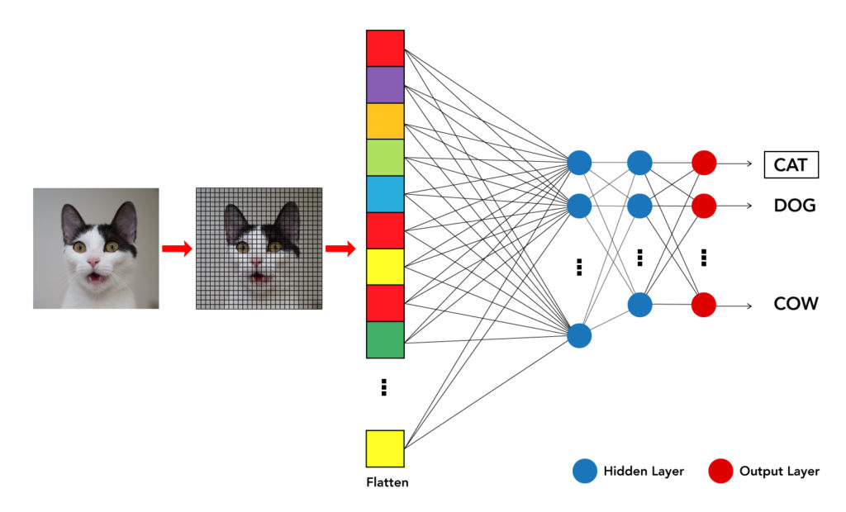
Functional Block Diagrams

Slide 16
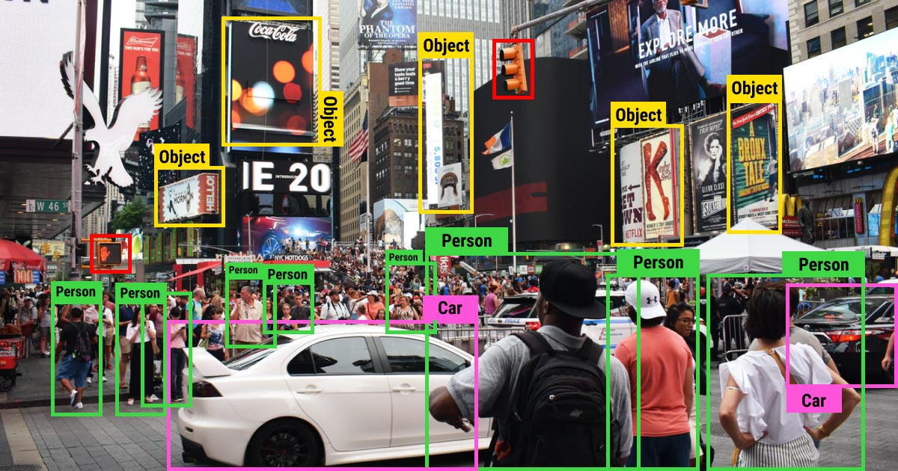
Screen Shots

Slide 17
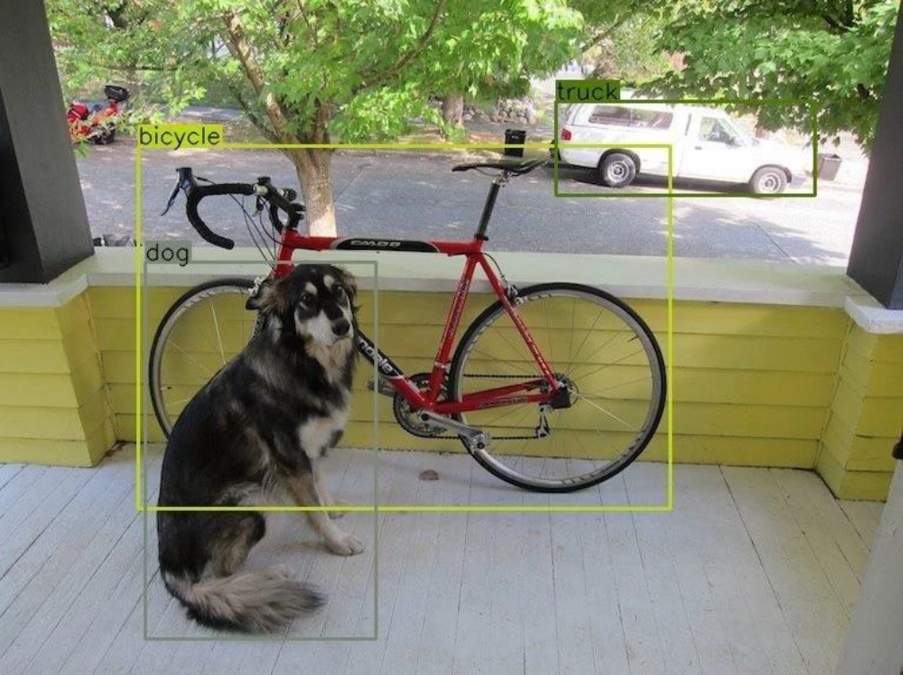
Screen Shots

Slide 18
Conclusion
Conclusion
Image Classification Some years ago, the primary use cases of image classification could be mainly found in security applications. But today, applications of image classification are becoming important across a wide range of industries, use cases are popular in health care, industrial manufacturing, smart city, insurance, and even space exploration. So Image recognition is future Detection method.

Slide 19
THANK YOU

