Slide 1
History Of Mulesoft:
MuleSoft, LLC. is a software company headquartered in San Francisco, California, that provides integration software for connecting applications, data and devices. Started in 2006, the company's Anypoint Platform of integration products is designed to integrate software as a service (SaaS), on-premises software, legacy systems and other platforms.
On May 2, 2018, Salesforce acquired Mulesoft for $6.5 billion in a cash and stock deal.

Slide 2
What is Mulesoft:
MuleSoft is a vendor that provides an integration platform to help businesses connect data, applications and devices across on-premises and cloud computing environments.
The company originally provided middleware and messaging, and later expanded to provide an integration platform as a service (iPaaS) approach for companies through its main product, Anypoint Platform.

Slide 3
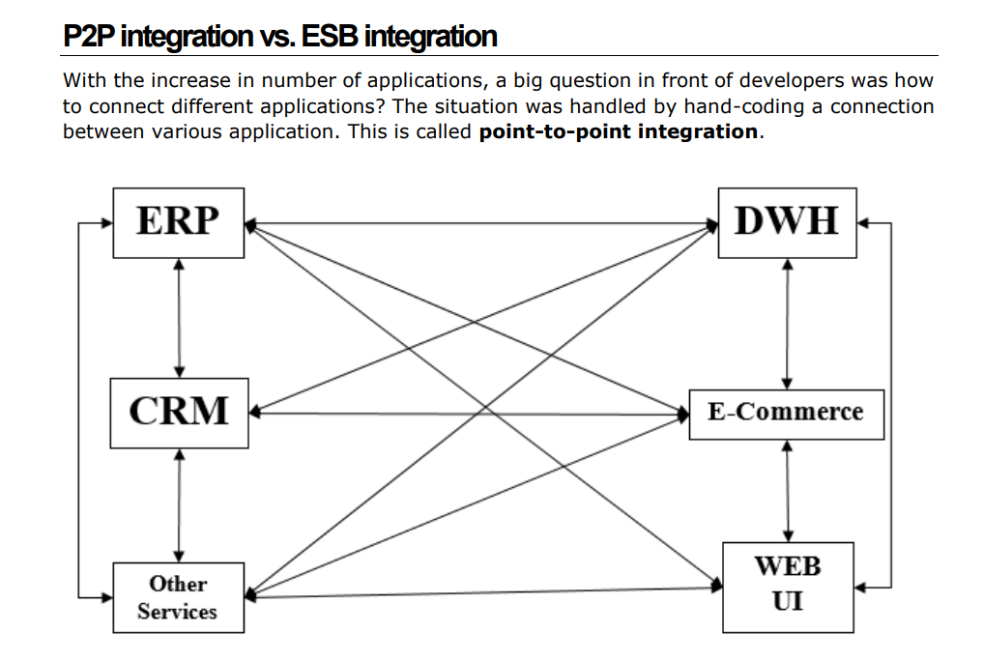
Point To Point Integration

Slide 4
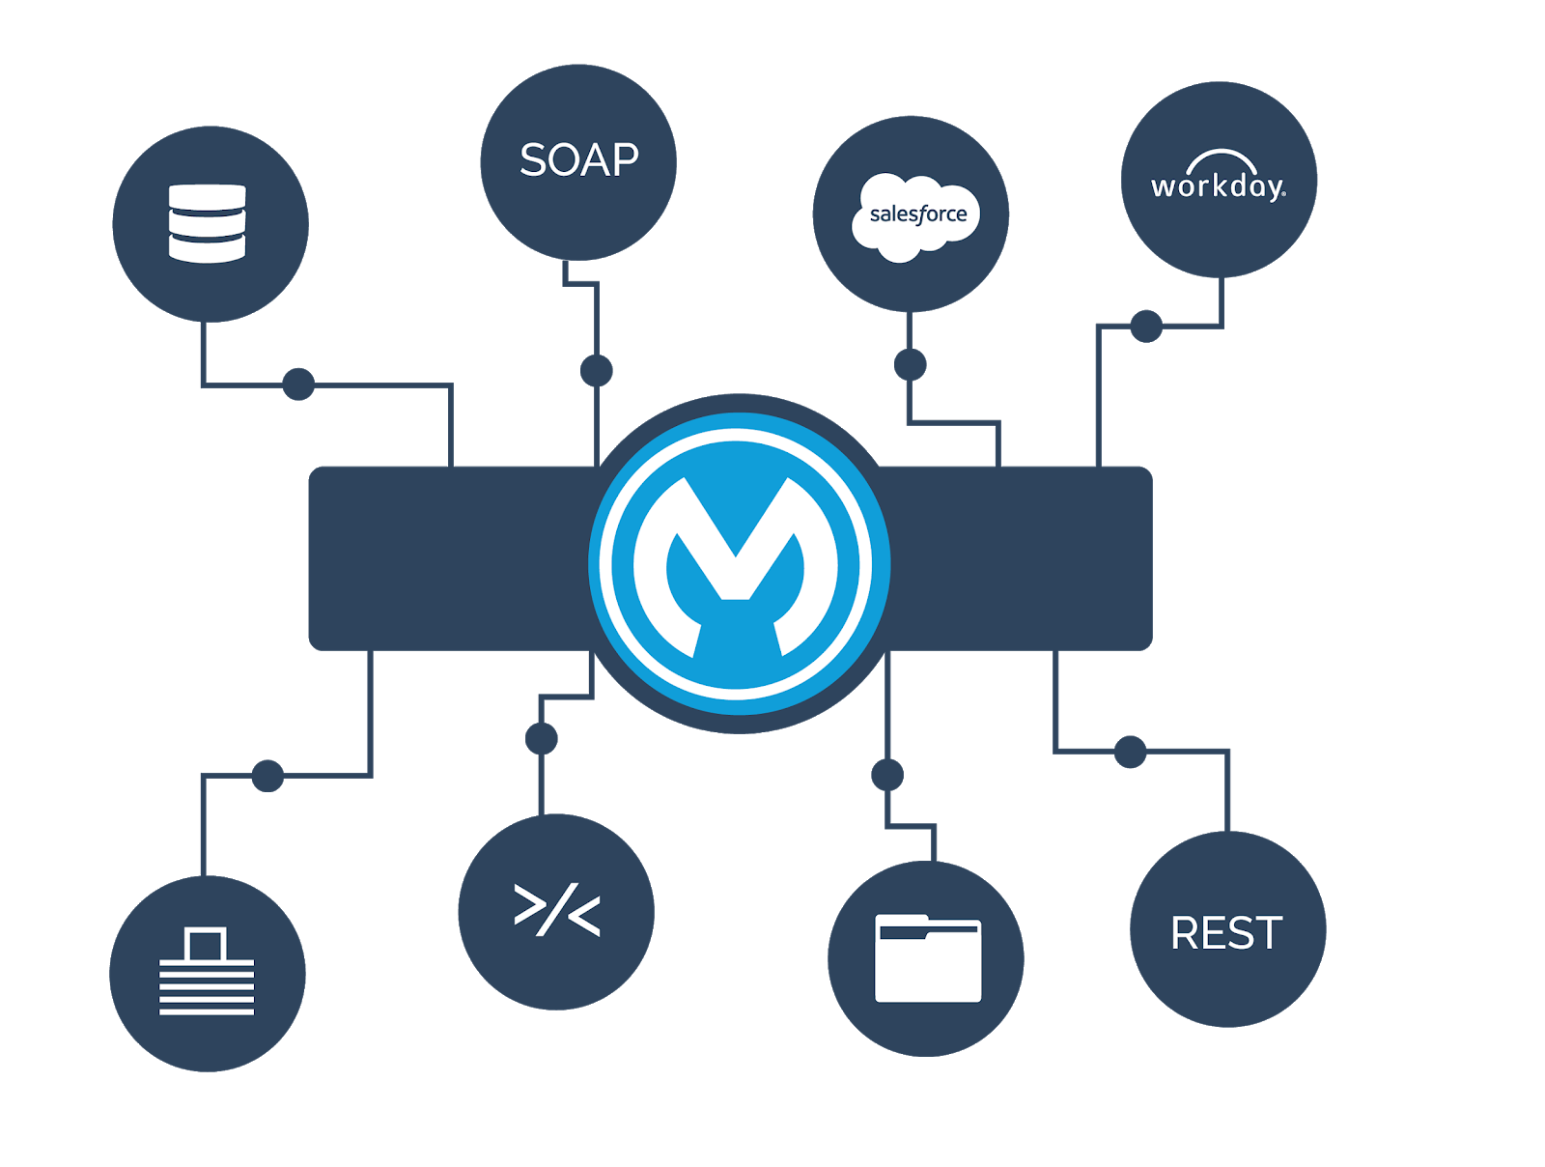
Mule ESB:
Mule ESB is a Lightweught Java-Based enterprise service Bus and Integration platform that allows developers to connect applications together and easily, enabling them to exchange data

Slide 5
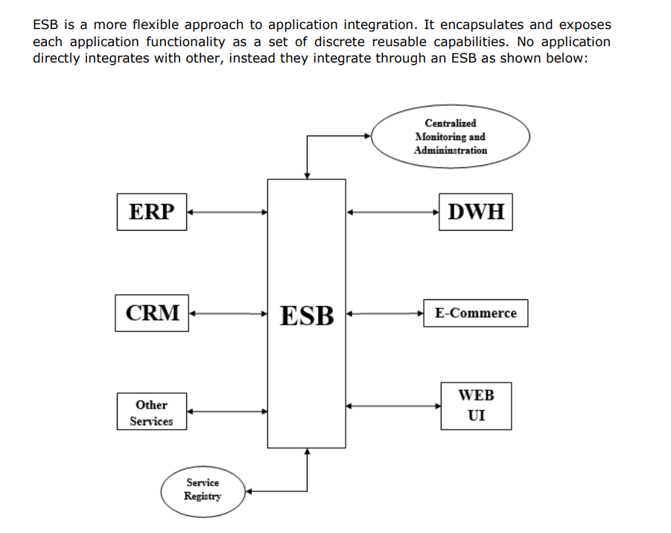
Mule ESB(Enterprise Servise Bus):

Slide 6
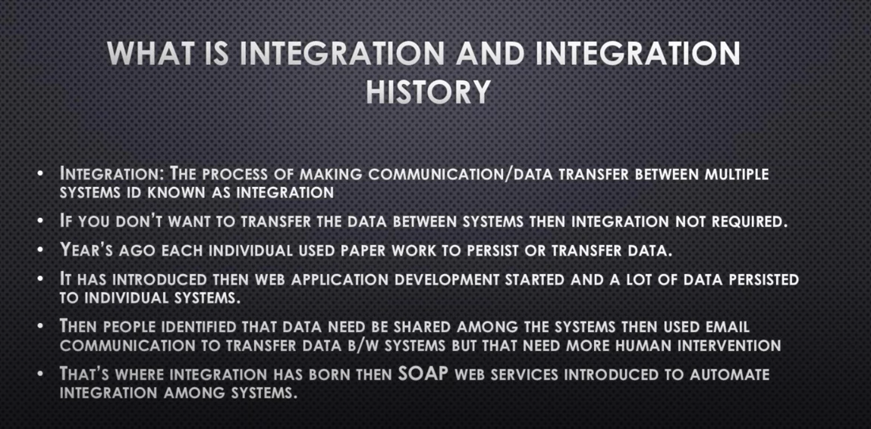

Slide 7
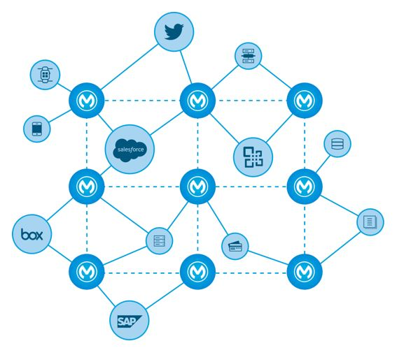

Slide 8
Anypoint Platform:
MuleSoft's Anypoint Platform includes various components such as Anypoint Design Center, which allows API developers to design and build APIs; Anypoint Exchange, a library for API providers to share APIs, templates, and assets; and Anypoint Management Center, a centralized web interface to analyze, manage, and monitor APIs and integrations.
MuleSoft also offers the Mule runtime engine, a runtime solution for connecting enterprise applications on-premises and to the cloud, designed to eliminate the need for custom point-to-point integration code.

Slide 9
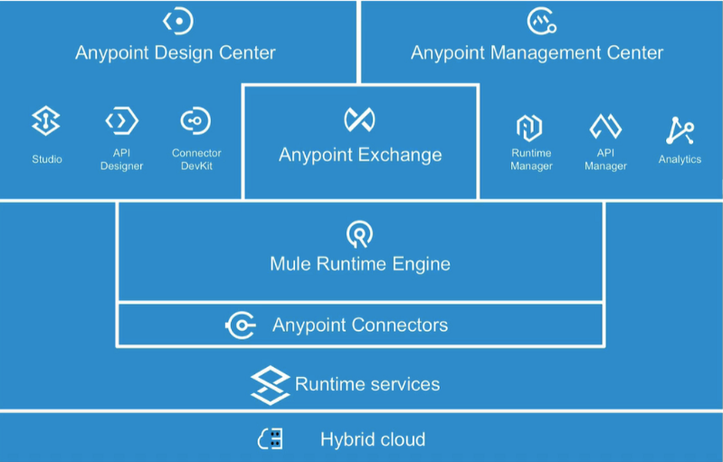

Slide 10
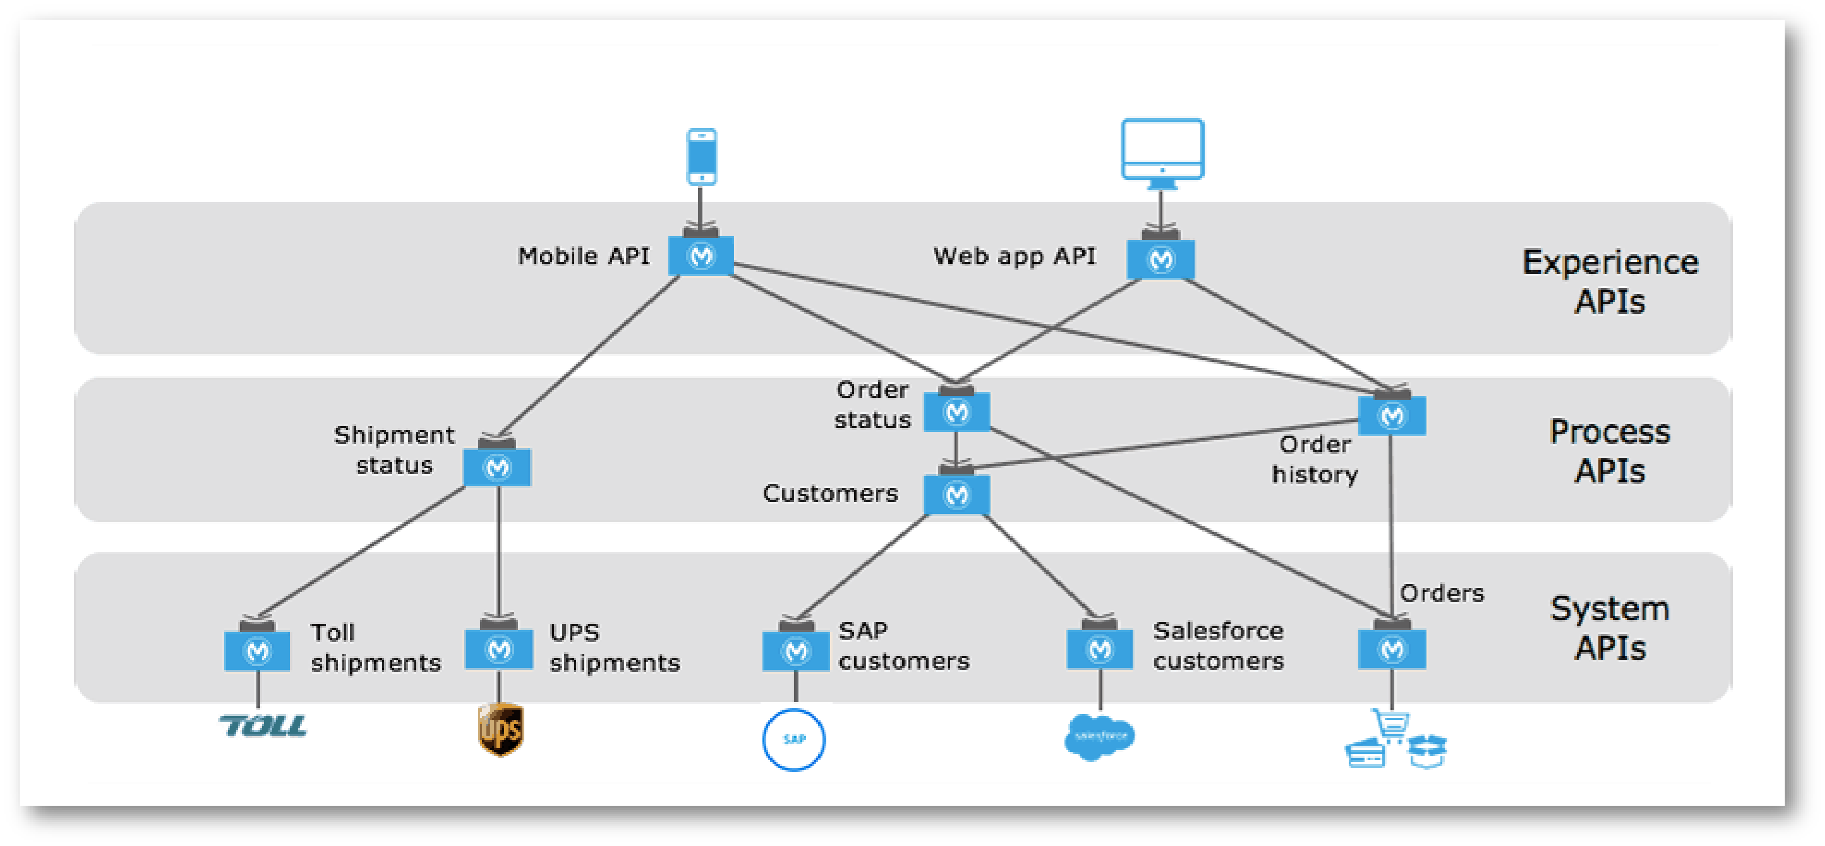
API-Led Connectivity:

Slide 11
What is an API?
An API provides an interface between two applications so that they can talk to each other.
Application Programming Interface, which is a software intermediary that allows two applications to talk each other. Each time you use an app like
Facebook, send an instant message, or check the weather on your phone, you're using an API.

Slide 12
