Slide 1
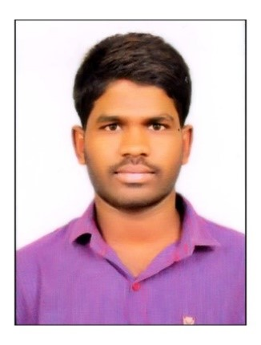
Thirupathi Bommishetty, MuleSoft Developer
Thirupathi is a MuleSoft Developer having 3 years of IT experience in design, development, deployment, testing in Mulesoft.
Areas of Expertise Have 2 years of experience in MuleSoft Enterprise Application integration platform and its products like Mule 4.x, Anypoint Studio, Mule Runtime Manager, API Manager, Access Management, MQ, Exchange etc and deploying apps in hybrid environment (Cloudhub, On-premise). Hands on experience in using various mule connectors like HTTP, Database, Salesforce, Transformers, SFTP/FTP, JMS, File, VM, SMTP and many other during development of integration applications. Experience in design, development and management of RAML based APIs using MuleSoft Anypoint platform by applying MuleSoft Suggested best practices and design approach. Experience in using CI/CD tools like Jenkins. | Previous Employers Capgemini Inida Pvt Ltd ENIQUE Solutions Pvt Ltd | Industry Sectors Media Banking​​ Automobile​ FMCG​ Energy & Utilities Telecommunications Previous Clients ABC Broadcasting Macquarie Bank ANZ Bank Volkswagen & Audi CIMB Bank Xcel Energy Royal Bank of Canada | Industry Sectors Banking​​ Health Domain Manufacturing Previous Clients Ascensia Diabetes Care Novelis Manufacturing HRMS ATM Banking Transactions | Education / Certifications Bachelor in Computer Science Engineering (April 2018), JNTU University​ MuleSoft Certified Developer in Mule 4 MCPA Level-1. Tools MuleSoft – Mule 4 JMS, Jenkins, GIT,MySql, Postman, SOAP UI
Recent Experience and Accomplishments
Ascensia Diabetes Care– MuleSoft Developer Implemented scheduler based APIs to move various files like employee data, contractor data files between SFTP server and Salesforce. Developed RAML based API for HRMS project and ATM banking transactions Delivered Cloudhub notifications, JSON Logging, Common security vault and custom error handling common flows to improvise the mule common library. Created munits for all applications and documented in confluence. |  | ATM Banking Transactions – MuleSoft Developer Implemented RAML based Restful API’s to create, withdraw, Unblock and check Balance resources using Mule 4. Implemented Munit test cases with more than 95% of coverage Applied Non Functional requirements(Policies) Pushed the code into GitHub Pull the code from Git into Jenkins and deployed it into CloudHub

