Slide 1
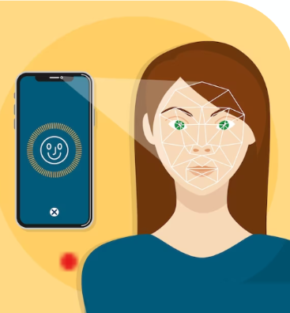
Face Recognition Attendance System
Presented By:
K.Haritha-Y20ACS463
D. Thirupathi Rao- Y20ACS441
B.Nikitha-Y20ACS413
D.Supriya-Y20ACS443
Project Guide:
Mrs. M. Karuna Mam

Slide 2
Contents
Abstract
Existing System
Proposed System
Design
Implementation
Results
Conclusions

Slide 3
Abstract
Education institutes today are concerned about the consistency of students' performance.
There are several ways to mark your attendance, the most common ways to sign or call the students. It took longer and was problematic.
We have used an intelligent attendance system based on face recognition in this project.
We have proposed to implement a "Smart Attendance System for Face Recognition" through this large applications are incorporated.
The present implementation includes facial identification that is time saving and eradicates the possibilities of proxy attendance due to the facial authorization.
Raspberry Pi, Open CV and Dlib using python are the basic requirements for this system.
The system implemented uses LBPH face recognizer to identify the face of the person in real time.
This system compares the image of the test and the training image and determines who is and is not present.

Slide 4
Existing System
In face recognition technology each person to train a model, massive sample sizes of photos are needed (200 to at least 100 photos per person).
Unable to add additional person details to a trained model. Retraining the model with all the data is necessary.
As the number of people classified increases, the model's accuracy decreases. Prolonged processing time.
Tracking methods like swiping cards biometric scanners are error-prone, time consuming, and susceptible to proxy attendance manipulation.
Existing systems attendance systems often lack accuracy, efficiency, and security.
Capture attendance for individuals sequentially. Does not send monthly attendance reports to parents and does not notify parents promptly about absences.
Performs poorly in low lighting conditions, time-consuming due to sequential attendance capture.

Slide 5
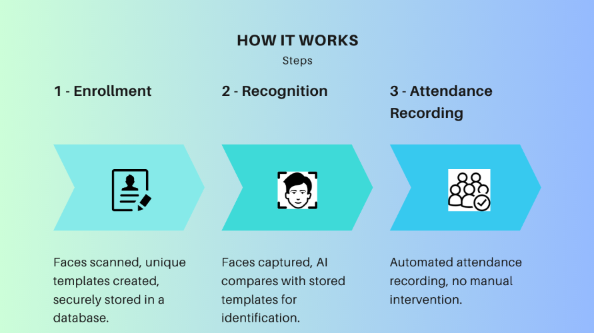
Proposed System

Slide 6
Enrollment: Initially, individuals' faces are scanned and registered into the system, creating unique digital face templates for each individual. These templates are securely stored in a database.
Recognition: When individuals subsequently access the attendance system, their faces are captured and analyzed by the system's algorithms. The AI compares the captured face with the stored templates to identify the individual.
Attendance Recording: Once the system confirms the identity, it records the attendance of the respective person with a timestamp, eliminating the need for manual intervention.
Monthly Reports: Sends automated monthly attendance reports to parents, reports can be crucial for tracking attendance trends, identifying patterns, and making informed decisions.
Time Complexity: Time complexity is crucial for the performance of any system, especially for real-time applications like face recognition attendance system reduced time complexity with single-shot attendance capture.

Slide 7
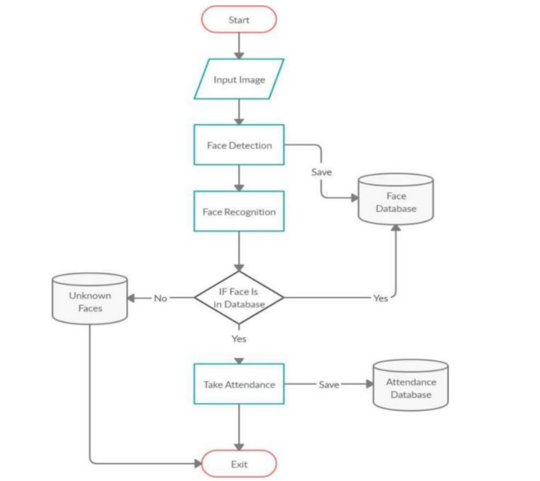
Design

Slide 8
Data Collection:
Gather a dataset of facial images for training the recognition model.
Ensure the dataset represents the diversity of faces that the system will encounter in real-world scenarios.
Preprocessing:
Preprocess the collected images to enhance quality and standardize them for training.
Techniques such as normalization, resizing, and noise reduction may be applied.
Face Detection:
Implement a face detection algorithm to locate faces within images or video streams.
Popular algorithms include Haar cascades, Histogram of Oriented Gradients (HOG), and deep learning-based methods like Single Shot Multibox Detector (SSD) or You Only Look Once (YOLO).
Feature Extraction:
Extract relevant features from detected faces.
Common techniques include Principal Component Analysis (PCA), Local Binary Patterns (LBP), or deep learning-based approaches like Convolutional Neural Networks (CNNs).

Slide 9
Model Training:
Train a face recognition model using the preprocessed data and extracted features.
Deep learning models such as Siamese networks or Triplet Loss networks are often used for face recognition tasks.
Utilize labeled data for supervised learning or employ techniques like contrastive or triplet loss for unsupervised or semi-supervised learning.
User Interface:
Design a user-friendly interface for system administrators and users.
Include features for registering new users, monitoring attendance, generating reports, etc.
Integration and Testing:
Integrate all components of the system and conduct thorough testing.
Test for accuracy, speed, scalability, and robustness under various conditions.
Perform user acceptance testing to ensure the system meets stakeholders' expectations.

Slide 10
Implementation
@app.route('/start',methods=['GET'])
def start():
with open('encodings.pkl', 'rb') as f:
known_encodings, known_names = pickle.load(f)
# Initialize video capture and face recognition process
video_capture = cv2.VideoCapture(0)
while True:
ret, frame = video_capture.read()
# Convert frame to RGB format for face recognition
# Convert frame to RGB format for face recognition
rgb_frame = frame[:, :, ::-1]
# Find all faces and encodings in the frame
face_locations = face_recognition.face_locations(rgb_frame)
face_encodings = face_recognition.face_encodings(rgb_frame, face_locations)

Slide 11
# Loop through each detected face
for face_encoding, face_location in zip(face_encodings, face_locations):
# Match the face encoding with the known face encodings
matches = face_recognition.compare_faces(known_encodings, face_encoding,tolerance=0.5)
name = "Unknown"
username="Unknown"
# If a match is found, get the name
if True in matches:
first_match_index = matches.index(True)
name = known_names[first_match_index]
username=name.split('_')[0]
# Mark attendance for the recognized person
add_attendance(name)
# Play sound notification on detection (Windows)
# Draw rectangle around the face and display name
top, right, bottom, left = face_location
if name=="Unknown":
cv2.rectangle(frame, (left, top), (right, bottom), (0, 0, 255), 2)
else:
cv2.rectangle(frame, (left, top), (right, bottom), (0, 255, 0), 2)

Slide 12
# Display name below the face rectangle
font_scale = 1.0
font_thickness = 2
cv2.putText(frame,username, (left + 6, bottom - 6), cv2.FONT_HERSHEY_SIMPLEX,
font_scale, (255, 255, 255), font_thickness)
# Display the resulting frame
cv2.imshow('Attendance System', frame)
# Exit on 'q' key press
if cv2.waitKey(1) & 0xFF == ord('q'):
break
# Release video capture and close windows
video_capture.release()
cv2.destroyAllWindows()
names, rolls, times, l = extract_attendance()
MESSAGE = 'Attendence taken successfully'
print("attendence registered")
return render_template('home.html', names=names, rolls=rolls, times=times, l=l, totalreg=totalreg(),
datetoday2=datetoday2, mess=MESSAGE)

Slide 13
Results
Attendance Capture
Captures attendance for entire class simultaneously
Low Light Performance
Enhanced performance in low lighting conditions
Monthly Reports
Sends automated monthly attendance reports to parents.
Parent Notification
Sends automated notifications to parents for student absences

Slide 14
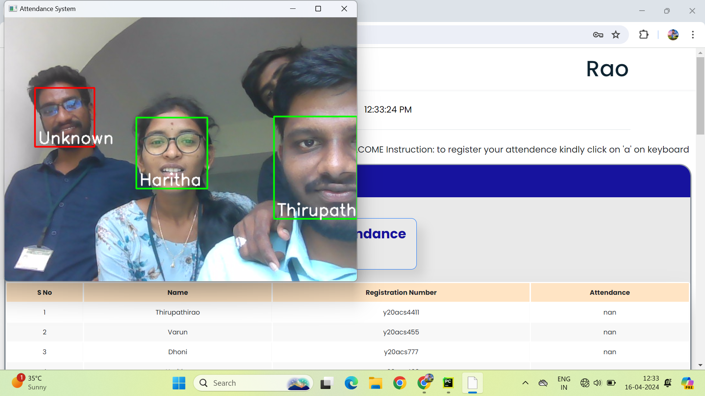

Slide 15
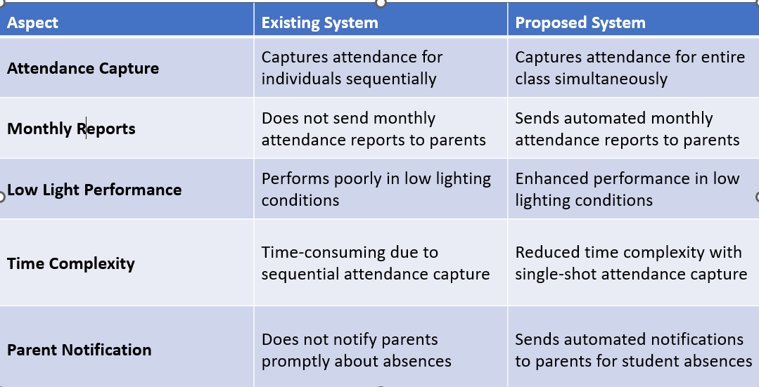
Difference between Existing System and Proposed System

Slide 16
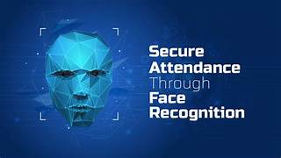
Conclusion
Face recognition system is very important in our daily life. It possesses a really great advantage. It was very costly but now new technologies have evolved and the cost of equipment is going down dramatically due to the integration and the increasing processing power. Certain applications of face recognition technology are now cost effective. reliable and highly accurate.

Slide 17


