Slide 1
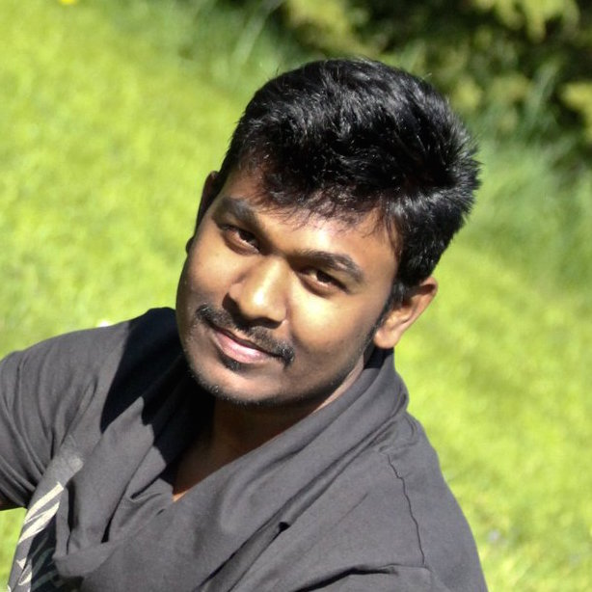
Thiruppathi Muthukumar - Web Developer
Profile
Skills and Expertise
8 years of IT experience in Requirement Gathering, Application Development, Maintenance & Testing.
Good Experience in designing for the web, and specialize in the areas of UI Design & Development, Interaction Design, Visual Design and Prototyping.
Experience in Functional, Reactive & Object Oriented Programming.
Have good knowledge on Accessibility Standards in UI Development.
Have experience in HTML5, CSS, JavaScript, Java, JSP, GWT, JSP
Enthusiastic learner who quickly grasps new concepts and technical skills. Read More…
UI Design & Development(HTML5, CSS3, JavaScript, Web Components, GWT, Polymer, React, Angular JS), Application Design & Development(Java/J2EE & MEAN Stack), Visual Design(Photoshop) & Prototyping, RIA, Responsive Web Design, Functional/Reactive Programming, Standards-complaint web development, Motion Graphics, Accessibility Standards.
Projects and Assignments
Web Developer – Everything Everywhere (EE) - Oct 2014 – Present
Developed modular, responsive UI Components using JSP, JSTL, CSS3, jQuery, Media Queires, Raphaël JS for various flows of My Account.
Integrated JSP pages with the AEM & Backend. Developed proof of concepts using Polymer, React-JS to upgrade the current system.
UI Developer – Unisys - April 2014 – Sep 2014
Contributed to Visual Design & Prototype for the LEIDA 3.0. Developed Pages using ZK, HTML 5, CSS 3 & JQuery. Created new Icons; Integrated prototypes with the front-end framework ZK. Fixed FOUC bugs on ZUL pages & Improved page performance by optimising the code. Created Visual Design & Prototype for CCHRI system. Developed Pages using HTML 5, CSS 3 & JQuery
GWT/Java Developer - Tokio Marine Kiln - May 2012 – Mar 2014
Created prototype & Visual Design for the entire CBS suite of products. Developed customised UI widgets using GWT; Developed the User Admin module. Played a major role in developing integration solution between the apps. Automated ActiveMQ Browser installation using PowerShell
Java Developer - Tokio Marine Kiln - Dec 2010 – Apr 2012
Contributed major part in IE6 to IE8 Migration of Forecasting & Binders applications. Created Custom JSTL tags. Automated UI Unit testing through Selenium.
Java Developer - McKesson Provider Technologies - Aug 2007 – Nov 2010
Developed Mapping for processing X12 type of Messaging. As a developer, I have done support and maintenance during all phases of development including Product Integration Testing and fixed the Trouble Reports and bugs. I was a part of some major enhancements in HMS. I have done Coding and Unit Testing for the enhanced modules. I have also worked in support and maintenance phase and deliver clean fixes for critical defects on time.
Projects & Assignments (extract)

