Slide 1

TECHTRECK
21PT14 - MANNE LOKESWAR CHOWDARY
21PW14 - MEENA S
21PW39 - THIRUSHA M

Slide 2

Problem Statement
2
For each request type, we have a set of tasks that need to be done to serve the customer request. For instance, if a customer would like to check the status of their flight, the system needs to ask the customer for their flight details, fetch the status of the flight (typically via an API) and return the status to the customer. Similarly the customer could ask a question about the flight policies like “are pets allowed on the flight”, for this the system needs to search through the airlines’ policy to find the answer.
For this problem you need to implement a system that is capable of handling a set of tasks that will be defined for each request type. Each task can be calling an Airline API, looking up an airline policy or asking customers for additional information. Handling a request type will involve performing a series of tasks.
This system provides a tooling backend to support bot(s).

Slide 3






3

Slide 4
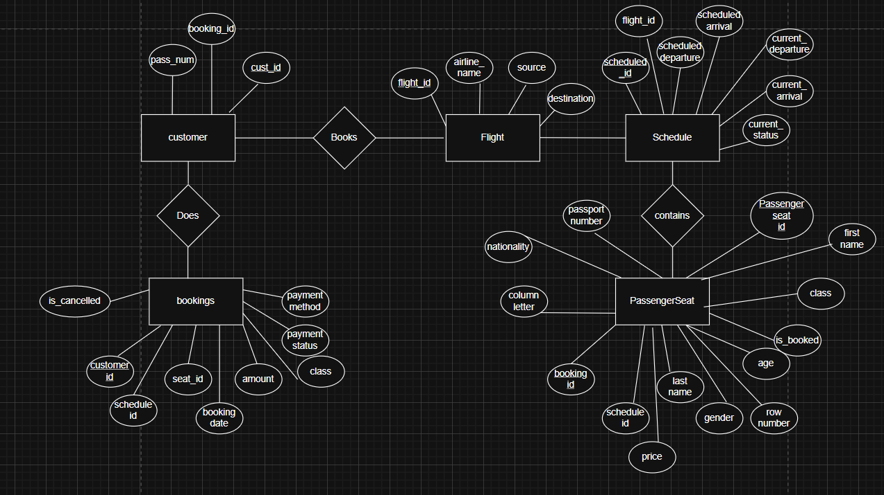
Architecture diagram
4

Slide 5
Input and request types
User input → intent detection
User sends a message, e.g., "book flight" or "cancel my flight AI202".
Intent Detector: Categorizes input into the following using keywords
from the user input:
Cancel Trip
Flight Status
Seat Availability
Book Ticket
Get Bookings
Unknown
4

Slide 6
Input and request types
Intent → function mapping
Task executor maps intent to function.
Example mapping:
IntentTask Function
Cancel Trip cancelBooking
Flight Status getFlightStatus
Seat Availability getSeatAvailability
Book Ticket getBookingsByCustomer
Unknown unknown
Handles generic input by returning Unknown message.
4

Slide 7
Example retrieval
Intent → function mapping
Flight Status Example
const schedule = await Schedule.findOne({ flight_no: flightNo });
return schedule
? { flight_no: flightNo, current_status: schedule.current_status }
: { message: `No schedule found for flight ${flightNo}` };
Retrieves flight info using flight_no.
Returns status, scheduled departure, arrival.
4

Slide 8
APIs USED
create-bookingAPI to initiate and finalize a new flight reservation for a customer.
create-flightAPI for registering a new specific flight route or designation into the system.
view-flightAPI for retrieving details about a specific flight or a list of available flights.
create-scheduleAPI to define a new flight schedule, linking a flight to a specific date and time.
view-scheduleAPI for retrieving the current schedule details for a specific flight or date range.
update-scheduleAPI to modify an existing flight schedule, such as changing departure times or dates.g flight reservation.New Request(Placeholder) A generic request placeholder for a yet-to-be-defined API endpoint.
4

Slide 9
APIs USED
create-customer API to register a new customer profile into the airline's database.
update-customer API to modify an existing customer's contact or personal information.
view-customer API for retrieving a specific customer's profile and booking history.
cancel-booking API to process the cancellation of an existing flight reservation.
4

Slide 10
The RAG Pipeline
The first system built was a Retrieval-Augmented Generation (RAG) pipeline, ideal for "how-to" questions.
Scraping: policy_scraper.py used Selenium to fetch policy pages, including clicking all JavaScript tabs.
Indexing: Text was chunked, embedded with all-MiniLM-L6-v2, and stored in a FAISS vector database for fast semantic search.
Answering: flan-t5-large read the retrieved text chunks to generate a natural-language answer.

Slide 11
Thankyou

