Slide 1

Hexa Fresh
Footwear Odour Remover

Slide 2

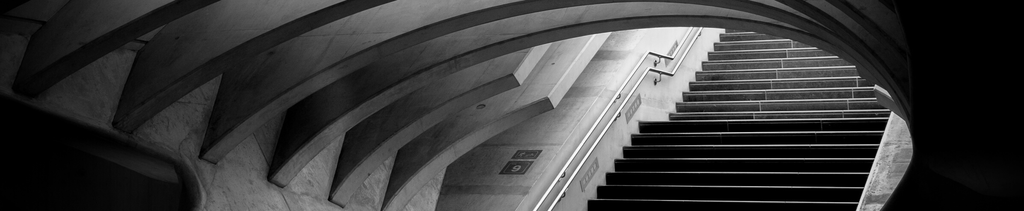
CONTENTS
Product Description
Aesthetic Considerations
Design
Optimization Techniques
Sidal’s Classification
Money Flow
Value Engineering
Economic Factors
Steps For Cost Reduction
Team Contribution

Slide 3

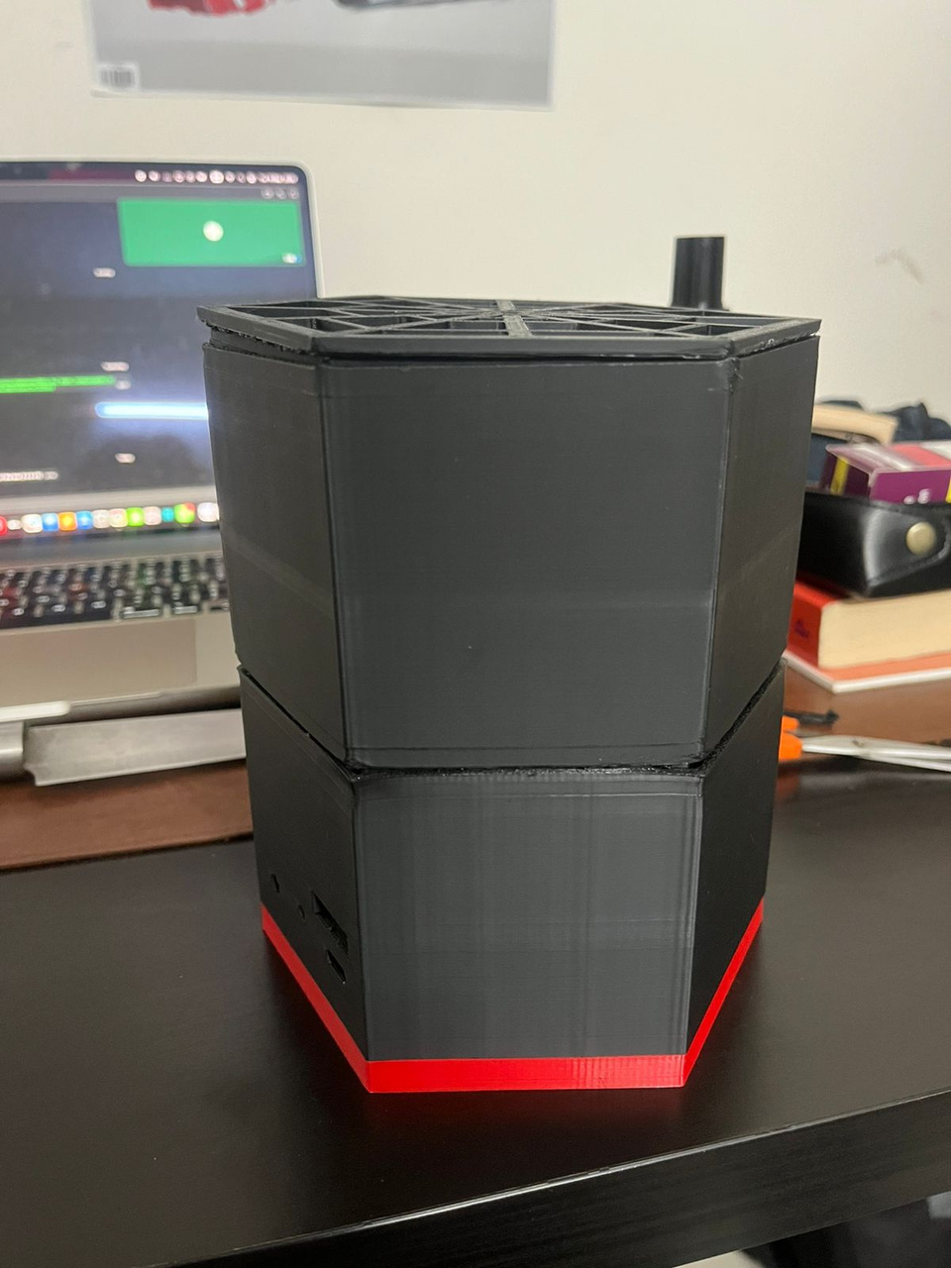
About HexaFresh
HexaFresh is a compact shoe odour removal device designed for everyday hygiene. Powered by a 80mm cooler fan, it ensures continuous airflow inside a dedicated chamber to eliminate moisture and odour-causing bacteria. Lightweight, energy-efficient, and user-friendly, HexaFresh keeps footwear fresh and provides a convenient solution for athletes, professionals, and daily users alike.​

Slide 4
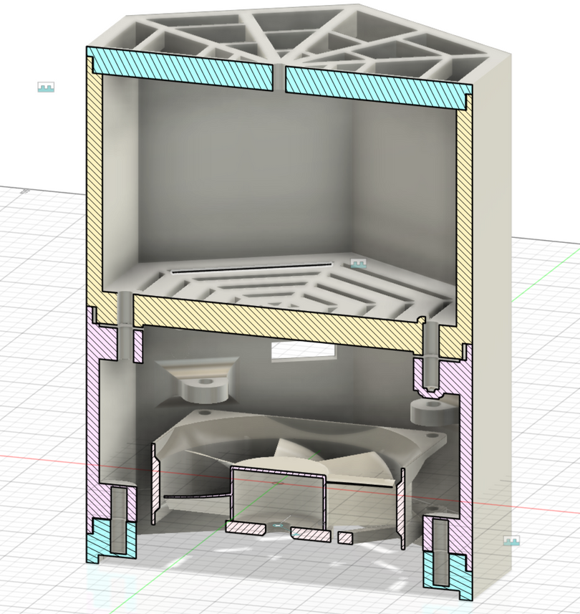
PRODUCT DESCRIPTION
⁠Hexagon-shaped modular casing
Compartment 1: Charcoal pouch for odour removal
Compartment 2: Electronics: 80mm cooler fan, 12–10 PWM regulator, 3mm green LED DIP, switch, Type-C module, wiring
Airflow = 15CFM
Airflow through mesh (top, middle, end)

Slide 5








AESTHETIC CONSIDERATIONS
MATERIAL SELECTION
Hexagonal Modular Design
PLA (3D-Printed Casing)
Two Detachable Comaprtments
Activated Charcoal (Odour Absorption)
Mesh Openings For Airflow
Electronics (Fan, Regulator, LED, Switches, Type-C module)
Compact and Minimal Look

Slide 6
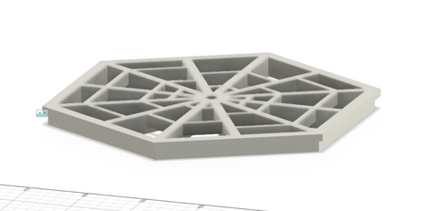
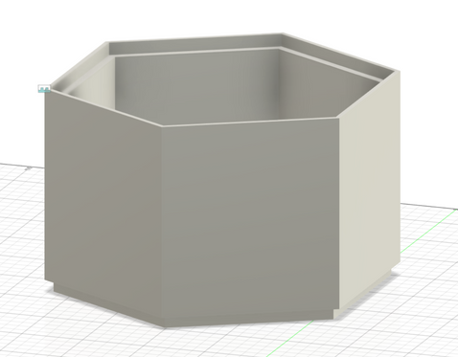
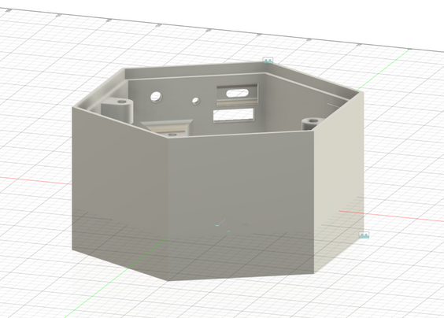
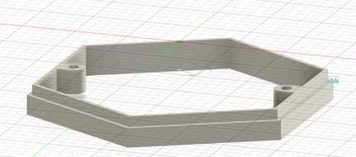
3D- Printed Casing
Two detachable compartments for easy replacement/maintenance
Structured Airflow System
Air Flow
DESIGN PART
Air Flow

Slide 7
Compact Layout of Electronics
Optimization Techniques
Modular compartments for easy upgrades
Fan and mesh for efficient airflow circulation

Slide 8
What it is ? : Standardized series for product dimensions & ratings
Common Sets: R5, R10, R20
Fan Diameter in Series:
R10: 63, 80, 100
Conclusion: 80mm is a preferred size → good for manufacturing & scaling
RENARD SERIES

Slide 9

Sidal’s Classification of Design Approach
Adaptive Design : Uses existing components(fans,regulators)
Variant Design : Hexagon modular casing for customization
Original Design : Unique integration of charcoal + electronics airflow system

Slide 10
STRATEGIES
CONCEPT
Identifying Problem : Shoe Odour
FEASIBILITY
CAD Design Airflow and Power check
PROTOTYPE
3D Print Casing + 80mm Fan + Charcoal
TESTING
Odour reduction, Airflow, Noise and Durability
ITERATION
Improve airflow path and filter usability
PILOT PRODUCTION
Small-batch runs, collects user feedbacks
MASS PRODUCTION
Injection moulding, standard fan/filter supply
ROLLOUT
Market as compact shoe deodoriser with refill packs

Slide 11
Cost Calculation
Cost Per Unit
Rs. 920
Selling Price
Rs. 1799
Mass Production Price Target
Rs. 1199
Expected Sales
200 - 500 Units
3D Printing = 600
Electronics = 320
Miscellaneous* = 579
Profit(40%) = 488
Casing = 120
Electronics = 260
Assembly & Packaging= 120
Marketing = 75
Distribution = 120
Warranty/Service = 100
Profit Margin(50%) = 405
Pilot Phase
Miscellaneous* - This includes packaging, marketing and transport charges

Slide 12
High performance at low cost
Value Engineering
Modular design reduces replacement costs
Charcoal pouch replacement is cheaper than full device replace

Slide 13
3D printing suitable for prototyping and low volumes
Economic Factors
Injection moulding for scaling reduces unit cost significantly
Affordable for households and small commercial use

Slide 14
HYPOTHESIS ON MONEY FLOW
Initial Phase(0-6 Months)​
Outflow:​
  R&D (CAD modeling, prototype building, CFD simulations)​
  Tooling & molds for injection molding​
  Small-batch production (50–100 units) → higher cost per unit​
  Marketing setup (branding, packaging, digital campaigns)​
​
Inflow: Minimal (limited pilot sales, early adopters, crowdfunding backers)
Growth Phase(6-18 Months)​
Outflow:​
  Scaling production to 500–1000 units per batch → lower cost per unit​
  Expansion in distribution (retail tie-ups, e-commerce platforms)​
  Customer service & warranty management​
​
Inflow:​
  Steady sales via online platforms & early partnerships​
  Potential B2B deals (sports clubs, gyms, hostels, defense camps, shoe brands)​
  Consumables/add-ons (activated carbon filters, UV cartridge replacement)

Slide 15
HYPOTHESIS ON MONEY FLOW
Expansion Phase(18-36 Months)​
Outflow:​
  Diversification (premium models with UV/IoT integration)​
  Regional expansion (exports, franchise tie-ups)​
  Marketing scale-up for mass visibility​
​
Inflow:​
  Large volume sales (5,000–10,000 units/year)​
  Recurring revenue from consumables (filters, deodorizing cartridges)​
  Licensing/partnerships with shoe brands for co-branded products
Sustained Phase (Beyond 3 Years)​
Outflow:​
  Maintenance of supply chain & customer support​
  Incremental product upgrades​
Inflow:​
  Established customer base ensuring repeat consumable sales​
  Bulk institutional contracts (schools, hotels, hospitals, military)​
  Potential expansion into adjacent markets (bag deodorizers, wardrobe fresheners, portable air purifiers)

Slide 16
Switching from 3D printing to industrial molding
Steps for
Cost Reduction
Source electronics in bulk
Simplify assembly with snap-fit, sturdy design instead of screws

Slide 17
Team Contribution
1 | THIRUPPATHI P
2 | SAMUEL SEBASTIAN
3 | JITHIN BOJ S
4 | TOBIN THOMAS
5 | JOEL MATHEW JENI
OVERALL COORDINATION AND ELECTRONICS
CAD MODELLING
DOCUMENTATION AND OPTIMIZATION
PROCUREMENT AND ASSEMBLY
3D PRINTING AND FABRICATION

Slide 18
THANK YOU

