Slide 1
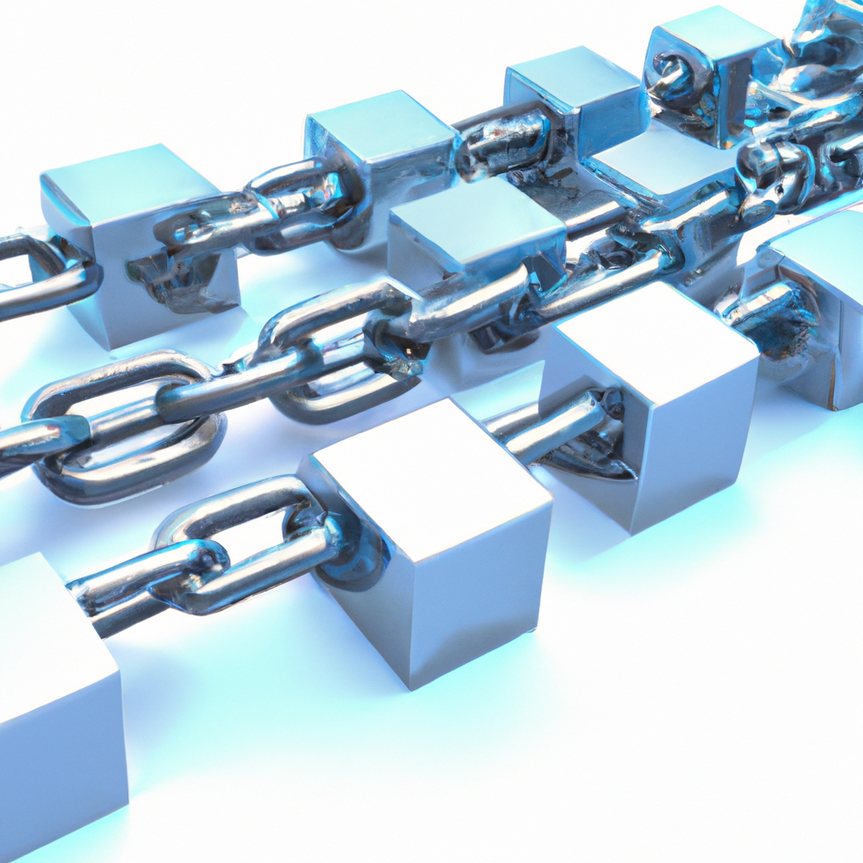
Introduction to Blockchain Technology
• Decentralized digital ledger system
• Transparent and immutable records
• Peer-to-peer network architecture
• Cryptographic security measures

Slide 2
Key Components of Blockchain
• Blocks containing transaction data
• Cryptographic hash functions
• Consensus mechanisms
• Smart contracts

Slide 3
Applications of Blockchain
• Cryptocurrency and digital payments
• Supply chain management
• Healthcare records
• Digital identity verification

Slide 4
Benefits of Blockchain Technology
• Enhanced security and transparency
• Reduced operational costs
• Elimination of intermediaries
• Improved traceability

Slide 5
Blockchain Security Features
Blockchain technology employs advanced cryptographic techniques to ensure data
security and integrity. Each transaction is encrypted and linked to previous
transactions, creating an unbreakable chain of information. This architecture
makes it virtually impossible to alter or hack the system, providing a secure
foundation for various applications.

Slide 6
Future of Blockchain
• Integration with IoT devices
• Government adoption
• Cross-border transactions
• Environmental sustainability solutions

Slide 7
Impact on Global Economy
Blockchain technology is revolutionizing the global economy by enabling faster,
more secure, and cost-effective transactions across borders. It's creating new
business models, improving financial inclusion, and transforming traditional
industries through decentralized solutions.

