Slide 1


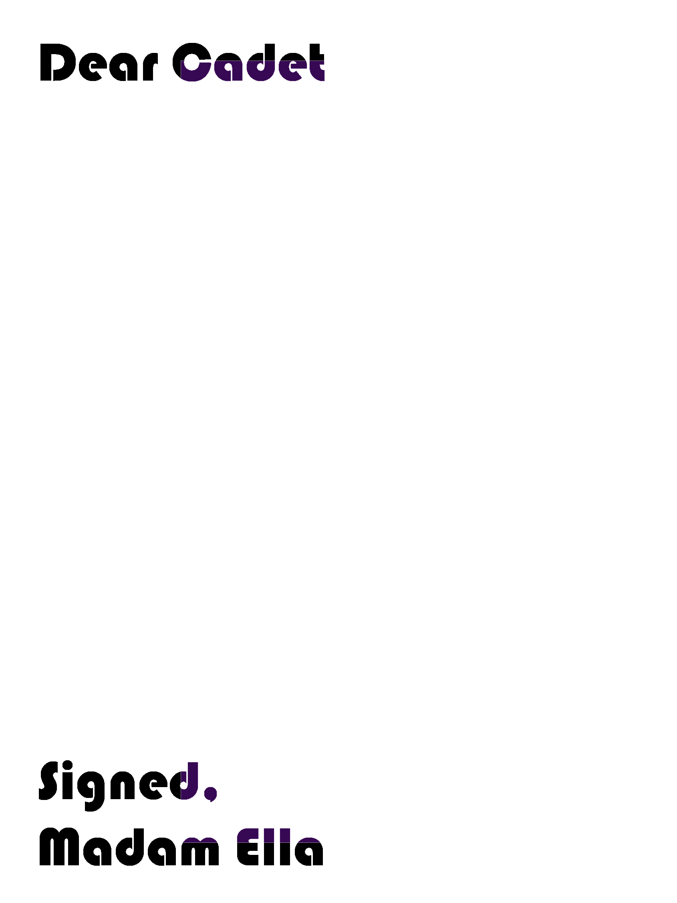

#MadamEllasLetters
B
Count the damsels in the
myths,
Count their names, Janes
or Judies,
In those tales of timeless
sense.
Weight the feminine
balance,
The wit of the cast chalice,
Amidst Artemis and Ada.
Does human fancy reflect
Strength and glory of the
“she”?
Have women lifted time’s
veil
To revive our history?
Call them “figures of
purple,”
Call the known and the
unknown,
Until names and faces
found.
Watch them walk on blue
water,
Bend winds, and beasts of
the sea,
In hegemonic power.
https://babylon19.org

Slide 2
#MadamEllasLetters
B
B
Praise us! We, daughters of Eve!
Mother Genesis gave all
The power of creation.
And SHE, bled with the full moon,
Then SHE, breathed giants to Earth.
Not even Prometheus could.
Not even Sisyphus would.
Cadet, my dear Cadet,
The phallus never thanked us!
Your duty, here and beyond,
To honor Madam and Eve,
Is to wake and bravely aim
For the light and distant sky.
All that it covers is yours.
Matriarchy's true blessing.
July 19, 2022
https://babylon19.org

