Slide 1
REGIONAL PERFORMANCE
Johnny, Miles & Rhi

Slide 2
THE PROBLEM
Limited or no ability to compare site performance two or three locations in a single view
Be able to compare high-level site performance in a defined Edinburgh, Glasgow and Inverness catchments

Slide 3
THE PLAN
Exploration of Data
Questions for Killian
Initial group meeting
Loose week plan
Saturday
Sunday
Brief with Killian
Plan Project
Begin Coding
Data cleaning finalised
Assigned catchment areas
Finalise Plots
Monday
Tuesday
Bring shiny app together
Wednesday
Finalising plots
Make it look nice
Setting out Dashboard
Thursday

Slide 4
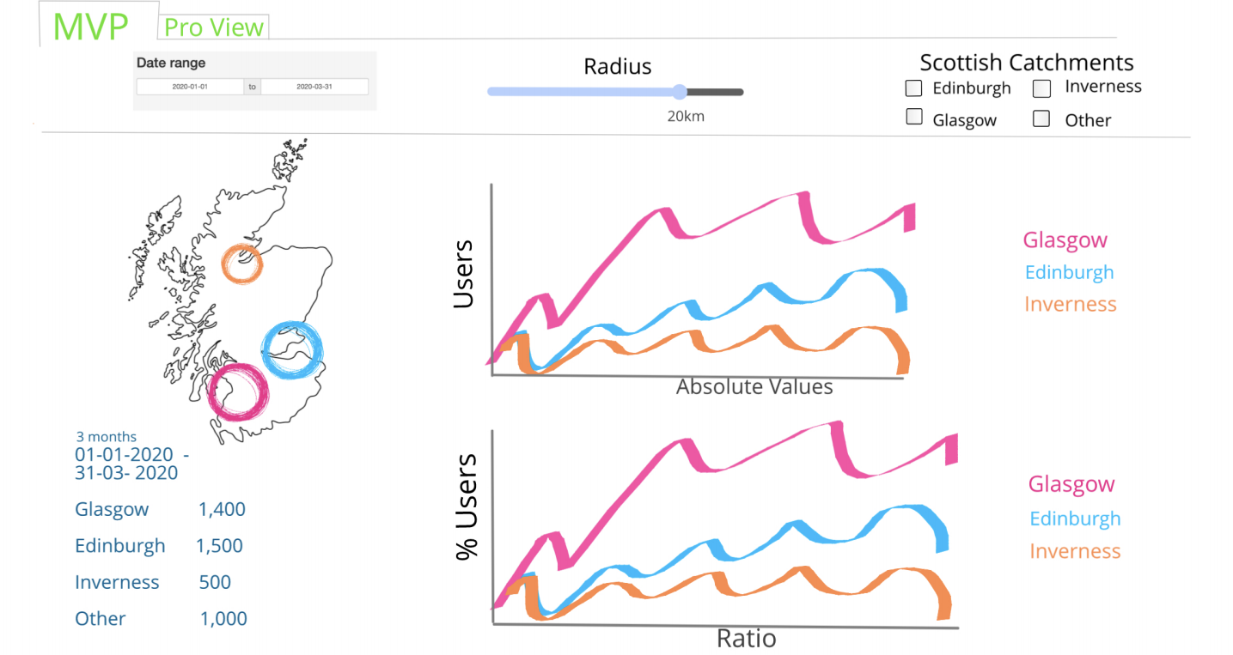

Slide 5
THE JOURNEY
Exploration of Data
Questions for Killian
Initial group meeting
Loose week plan
Saturday
Sunday
Data cleaning finalised
Assigned catchment areas
Brief with Killian
Plan Project
Begin Coding
Monday
Tuesday
Wednesday
Finalising plots
Setting out Dashboard
Bring shiny app together
Make it look nice
Thursday

Slide 6
Functionality & Components
MISSION STATEMENT

Slide 7
FEATURE GRAVEYARD
Monthly Data Insight
% Growth & Target plots
Map out user hotspots outside of catchments

Slide 8
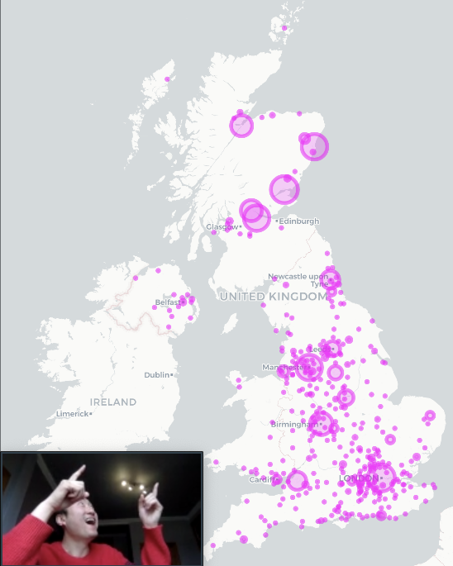
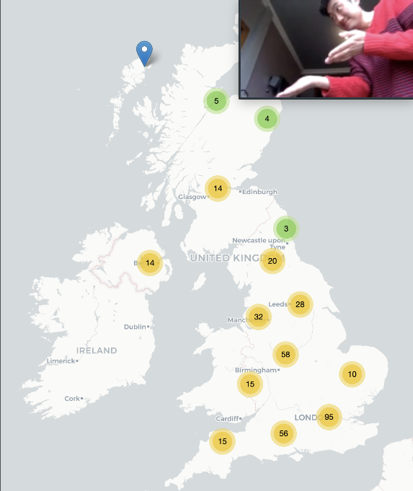
Map out user hotspots

Slide 9
Improvements
There would be a fully functional Pro View tab which allows for further drilling down of the data
More check-ins
Overcomplicating plots
Be more proactive with git commits

Slide 10
ANY QUESTIONS?

