Slide 1








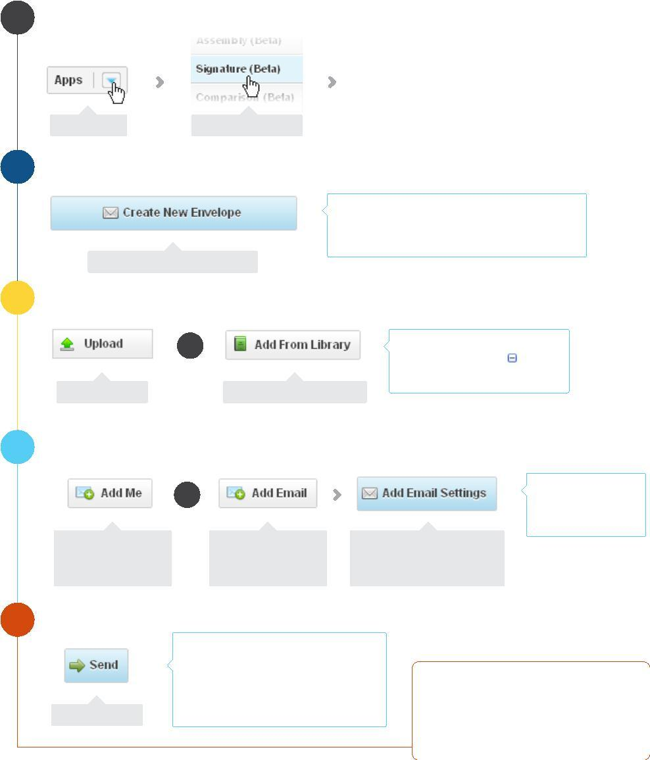
Evaluation Only. Created with Aspose.Words. Copyright 2003-2015 Aspose Pty Ltd.
Evaluation Only. Created with Aspose.Pdf. Copyright 2002-2015 Aspose Pty Ltd.
Signature
GroupDocs Signature allows you to put together a package (an envelope) of documents that others can then sign
electronically. It has endless uses, for example collecting signatures for NDAs, staff handbooks or new contracts.
Open Signature App Create an envelope
Add documents
Prepare email
Send
1
Select Signature from the Apps menu
The Signature Home page appears
Click Apps
Sellect Signature
Evaluation only.
Created with Aspose.Slides for .NET 2.0 15.10.0.0
Copyright 2004-2015 Aspose Pty Ltd.
2
3
Create an envelope
Evaluation only. Created with GroupDocs.Conversion for .NET. Copyright 2015 Aspose Pty Ltd.
Enter a full name into your proﬁle before sending
documents for signing or your name will not
appear in the interface.
Click Create New Envelope
Add documents (Repeat until you’ve added all the documents you want to include.)
To add from the library, click the
OR
node of the document
, not just
Click Upload
Click Add From Library
the document name.
4
5
Add recipients and prepare the email
OR
You can open any
dialog again to edit
before you send.
Click Add Me
to add yourself as
a signatory
Click Add Email
to add other
signatories or CCs
Click Add Email Settings
to enter a subject and a
message
Send Envelope
If your signatories don’t have an account,
they are asked to create one before
logging in to sign the document.
You are informed by email once
a document is signed.
Now just wait for the
Click Send
signatures to arrive. You'll get
an email when someone signs.

