Slide 1
AUTOMATIC ROOM LIGHTING SYSTEM
PRIYADHARSHANI N. 2020/E/120
PRIYATHARSINI S. 2020/E/122
RAVINDYA L.B.T. 2020/E/132

Slide 2
Table of Content
1
Problem statement, Solution and Scope
2
Final architecture and complete design
3
Software process
4
Final Product Cost
5
Next Step and the Problems Faced

Slide 3
Problem statement
In many homes and workplaces, lights are often left on even when no one is present, leading to unnecessary energy consumption. Manual operation of lights can be inconvenient and prone to human error, resulting in increased electricity bills and energy wastage. There is a need for a system that can automatically manage lighting based on room occupancy.

Slide 4
Solution
The proposed solution is an Automatic Room Lighting System using an Arduino Uno microcontroller. The system employs infrared (IR) sensors to detect human movement at the entry and exit points of the room. A bidirectional visitor counter tracks the number of people in the room. The lights turn on when the first person enters and turn off when the last person leaves, ensuring energy is used efficiently and only when needed.

Slide 5
Scope
Design and implement the Automatic Room Lighting System using an Arduino Uno, IR sensors, a relay module, and an LCD display.
Provide detailed instructions for setting up the hardware and wiring the components correctly.
Development & Implementation
Installation & setup
Write and upload the necessary Arduino code to manage the sensor readings, visitor count, and light control.
Software Development
Testing & Validation
Documentation
Test the system to ensure it reliably detects occupancy and controls the lighting as intended.
Create comprehensive documentation, including a user manual, to guide users in installing, operating, and maintaining the system.

Slide 6
Final detailed architecture
1.Overall system layout
2.Component functions
3.Wiring and connections
4.Logic and control flow
A clear diagram showing how all components are interconnected
Despite being red, Mars is actually a cold place
Saturn is a gas giant and has several rings
Neptune is the farthest planet from the Sun

Slide 7
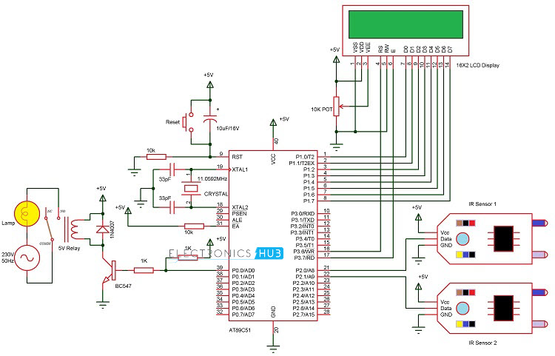
1.Overall system layout

Slide 8
2. Components functions
Arduino Uno: Acts as the central processing unit, controlling all operations.
IR Sensors: Detect human movement at entry and exit points.
LCD Display: Shows the number of people in the room and the system status.
Relay Module: Controls the light based on the occupancy detected.
9V Battery and Connector: Provides power to the Arduino and the connected components.

Slide 9
3. Wiring and connections
IR sensors
Connected to digital pins 8 and 9 of the Arduino Uno to detect the entry and exit of individuals.
LCD display
Connected to digital pins 8 and 9 of the Arduino Uno to detect the entry and exit of individuals.
Relay module
Connected to digital pin 10 to control the lighting

Slide 10
4. Logic and flow control
Initialization
Setting up pins and LCD
Occupancy count
2
4
Updating the count based on sensor inputs.
Sensor inputs
Reading IR sensor values to detect entry and exit
1
3
5
Relay control
Turning lights on/off based on occupancy.
LCD updates
Displaying real time occupancy status

Slide 11
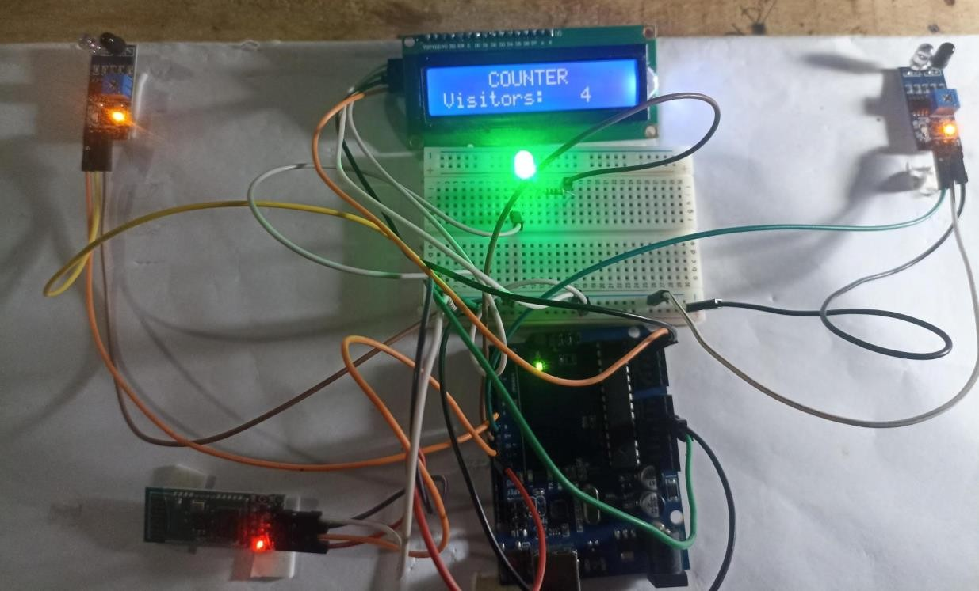
Complete design

Slide 12
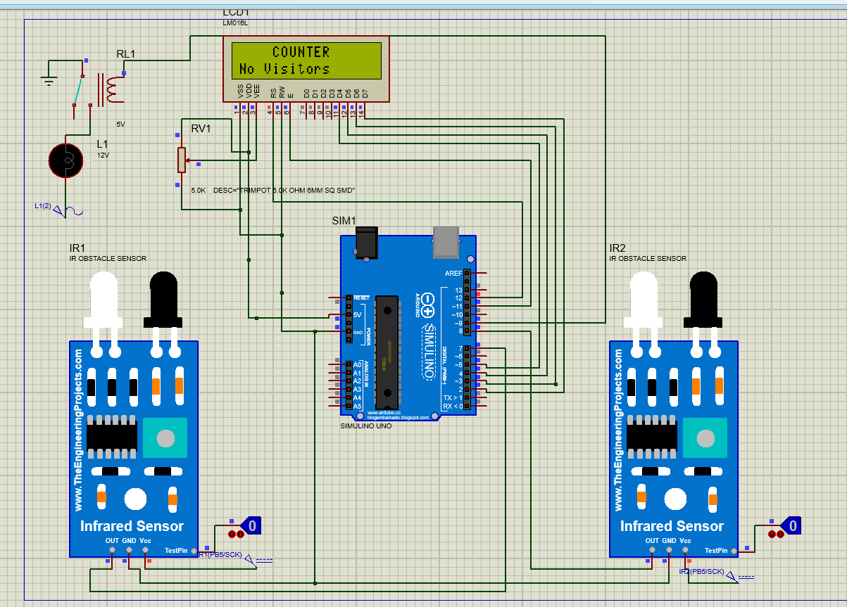

Slide 13
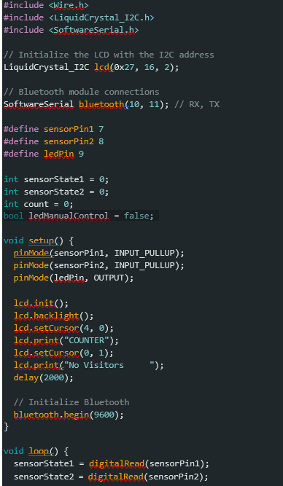
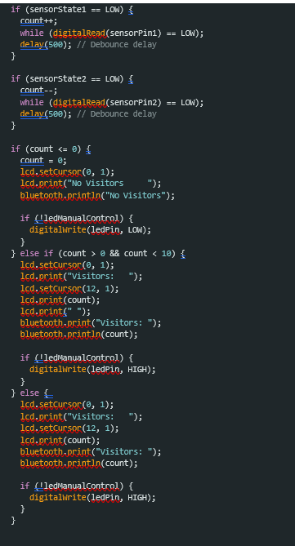
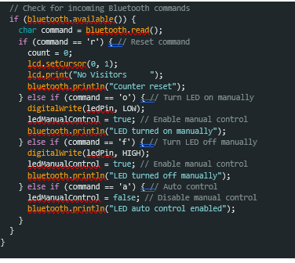
Software process

Slide 14
Final product cost
Component | Cost(LKR)
Arduino Uno | 2490.00
16/2 LCD Display | 340.00
IR Sensors(2) | 190.00
Relay module | 480.00
Breadboard | 125.00
Arduino Uno Data Cable | 90.00
9V Battery | 150.00
9V Battery Connector | 50.00
Male to Male Jumper Wires | 150.00
Female to Male Jumper Wires | 150.00
Light Bulb | 800.00
Light Bulb Socket | 150.00
Miscellaneous | 615.00
12C | 200.00
Bluetooth module | 520.00
Total cost = LKR 6500.00

Slide 15
What is the next step????
Product refinement
Certification and compliance
Enhance the IR sensor calibration, streamline the hardware design, and conduct thorough testing to ensure consistent performance.
Obtain certifications for electrical safety, electromagnetic compatibility, and other relevant standards.
Marketing and sales strategy
Develop a comprehensive marketing campaign, create sales materials, and establish partnerships with distributors and retailers. Utilize online platforms and attend trade shows to increase visibility.
Prototyping and testing
Develop and deploy prototypes in different settings such as homes, offices, and public buildings. Collect user feedback and make necessary adjustments.

Slide 16
Problems faced….
Handling multiple people exiting simultaneously
Effective use of Bluetooth module
Switching from 8051 microcontroller to Arduino Uno
IR sensor range for long door distances

Slide 17
THANK YOU
Jupiter
Jupiter is the biggest planet
Saturn has several rings
Mars
Earth is the the third planet
Mercury is the smallest planet
GROUP CG11

