Slide 1

HEART DISEASE ANALYSIS & PREDICTION USING MACHINE LEARNING
THISHONIA PREETHI.S
PRK19MS1107

Slide 2
Cardiovascular diseases are the leading cause of mortality globally, claiming the lives of an estimated 17.9 million people each year.
Coronary heart disease, cerebrovascular disease, rheumatic heart disease, and other heart and blood vessel disorders are all categorized as CVDs. Heart attacks and strokes account for four out of every five CVD deaths, with one-third of these deaths occurring before the age of 70.
The yearly number of deaths due to CVD in India is anticipated to rise from 2.26 million (1990) to 4.77 million (2020).
Coronary heart disease prevalence rates in India have been assessed over the past few decades and have extended from 1.6% to 7.4% in country populations and from 1% to 13.2% in urban populations.

Slide 3
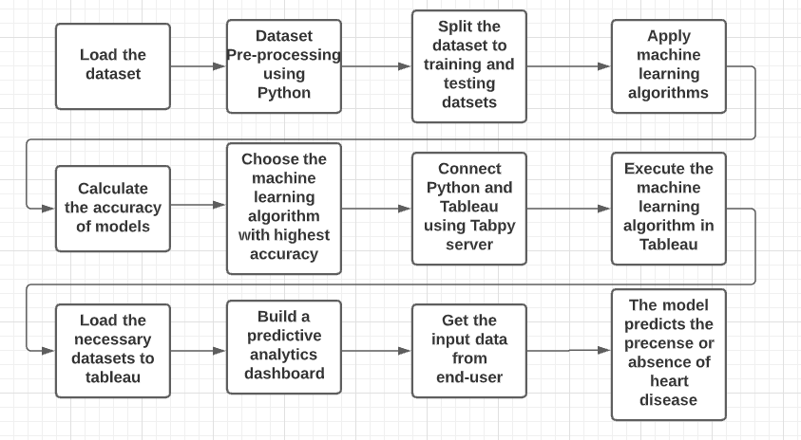
PROCESS FLOW

Slide 4
LITERATURE REVIEW

Slide 5
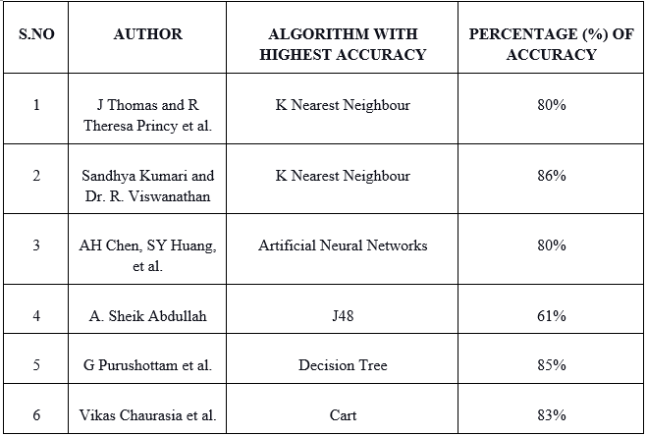

Slide 6
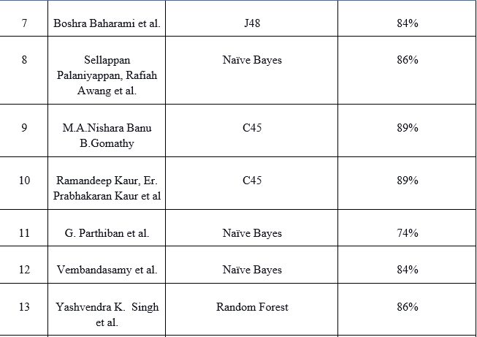

Slide 7
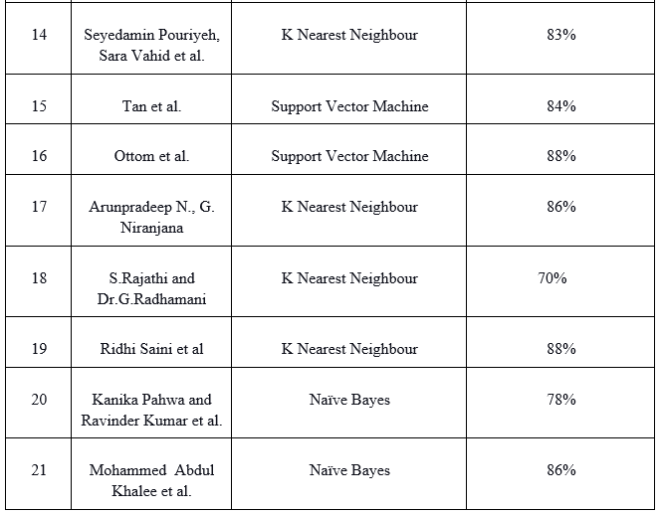

Slide 8
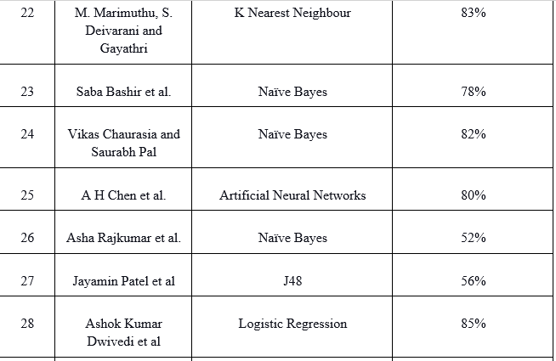

Slide 9
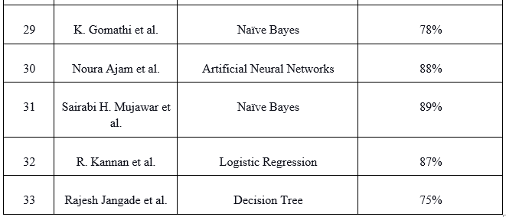

Slide 10
MACHINE LEARNING ALGORITHMS

Slide 11
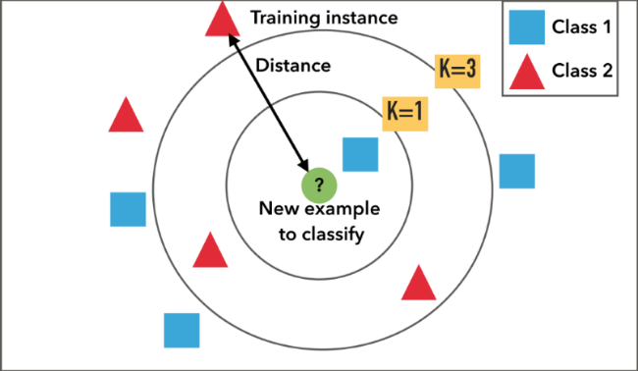
1.K NEAREST NEIGHBOUR
The k-nearest neighbors (KNN) algorithm is a simple, supervised machine learning algorithm that can be used to solve classification problems.

Slide 12
2.NAÏVE BAYES
Naïve Bayes algorithm is a supervised learning algorithm, which is based on Bayes theorem and used for solving classification problems.
It is called Naïve because it assumes that the occurrence of a certain feature is independent of the occurrence of other features. Such as if the heart disease is present on the bases of BP, family history, and cholesterol then it is recognized as presence of heart disease.
Hence each feature individually contributes to identification.

Slide 13

NAÏVE BAYES
P(B|A) is Likelihood probability: Probability of the evidence given that the probability of a hypothesis is true.
P(A) is Prior Probability: Probability of hypothesis before observing the evidence.
P(B) is Marginal Probability: Probability of Evidence.
If the individual has BP , then does the person have heart disease or not?

Slide 14
3.DECISION TREE
In a Decision tree, there are two nodes, which are the Decision Node and Leaf Node.
Decision nodes are used to make any decision and have multiple branches, whereas Leaf nodes are the output of those decisions and do not contain any further branches.
The decisions or the test are performed on the basis of features of the given dataset.
In order to build a tree, we use the CART algorithm, which stands for Classification and Regression Tree algorithm.

Slide 15
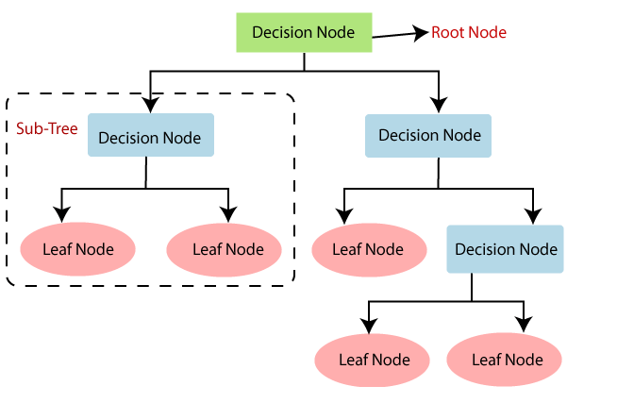

Slide 16
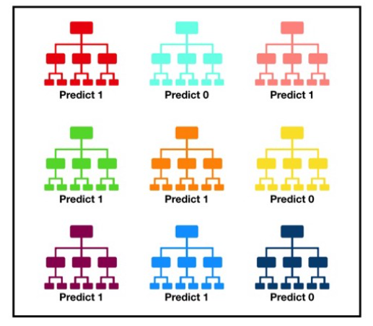
4.RANDOM FOREST
Random forest, like its name implies, consists of a large number of individual decision trees.

Slide 17
5. LOGISTIC REGRESSION
Logistic regression predicts the output of a categorical dependent variable. Therefore the outcome must be a categorical or discrete value.
It can be either Yes or No, 0 or 1, true or False, etc. but instead of giving the exact value as 0 and 1, it gives the probabilistic values which lie between 0 and 1.

Slide 18
LOGISTIC REGRESSION
Binomial: In binomial Logistic regression, there can be only two possible types of the dependent variables, such as 0 or 1
Data Pre-processing step
Fitting Logistic Regression to the Training set
Predicting the test result
Test accuracy of the result (Creation of Confusion matrix)

Slide 19
ATTRIBUTES
Age - Age of the individual in years ranging from 29 years to 77 years
Sex - Male or Female
1 - Male and 0 - Female
Chest pain type - 4 levels of chest pain
Resting BP
The first figure, systolic blood pressure, indicates how much pressure is in the arteries as the heart beats.
The second number, diastolic blood pressure, measures the pressure in the arteries between heartbeats. (120/80)

Slide 20
Serum Cholesterol in mg/dl
Cholesterol is often linked to heart disease. (bad cholesterol)
Since low-density lipoproteins (LDL) can build up in the arteries and obstruct or block blood flow, this is something one should be aware of.
Fasting blood sugar
Resting ECG results
The resting ECG is a straightforward, simple, and painless procedure.
The resting ECG can detect heart hypertrophy, ischemia, myocardial infarction, myocardial infarction sequelae, cardiac arrhythmias, and other heart disorders.

Slide 21
Maximum heart rate
Subtract age from 220 to get an approximation of the mean age-related heart rate. The estimated maximum age-related heart rate for a 50-year-old male, for example, would be 220 – 50 years = 170 beats per minute (bpm).
Maximum heart rate achieved - Maximum heart rate during strenuous activities (200)
Exercise-induced angina (chest discomfort)
1 - Yes, 0 – No
Tobacco (cumulative tobacco (kg))

Slide 22
Adiposity - BMI of a person
The BMI is a straightforward measure based on a person's height and weight. BMI = kg/m2, where kg represents a person's weight in kilograms and m2 represents their height in meters squared.
Overweight is described as a BMI of 25.0 or higher, while the healthy range is 18.5 to 24.9. Most adults between the ages of 18 and 65 have a BMI.
Famhist - Family history of heart disease, whether a family member has suffered from a heart disease or not.
A factor with levels "0 - Absent" and "1 - Present“

Slide 23
Typea
Type-A behavior intense striving for achievement, competition, easily provoked impatience, time urgency, the abruptness of gesture and speech (explosive voice), hyper-alert posture, overcommitment to vocation or profession
Alcohol - current alcohol consumption
Chd - coronary heart disease
0 - Absent, 1 - Present

Slide 24
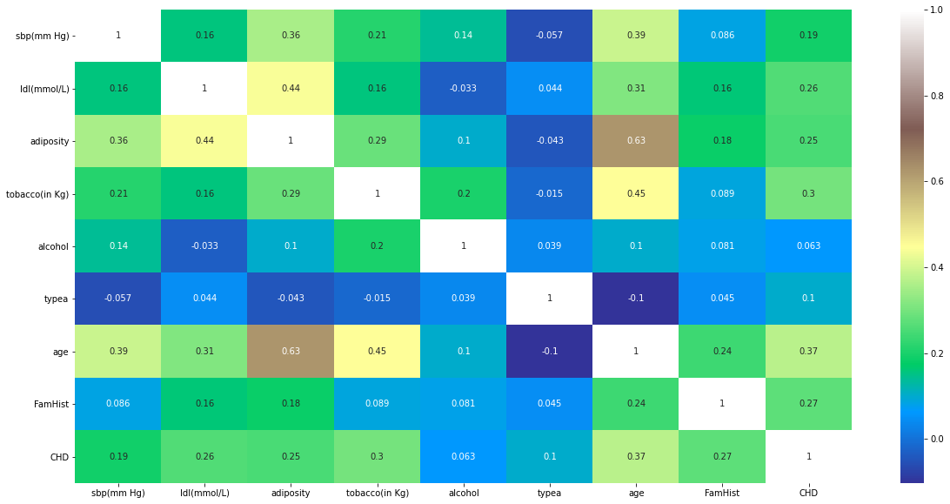

Slide 25
The observation of the coefficients of the correlation matrix above suggests that:
Age is strongly correlated with adiposity, tobacco consumption/smoking, systolic blood pressure and elevated LDL cholesterol.
Adiposity is strongly correlated with obesity.
LDL is strongly correlated with Obesity and Adiposity both.
To conclude Obesity (high BMI), Adiposity (excessive fats), Smoking (tobacco)Blood pressure and old age are all correlated with heart diseases

Slide 26
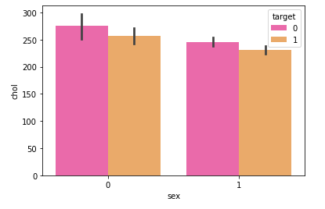
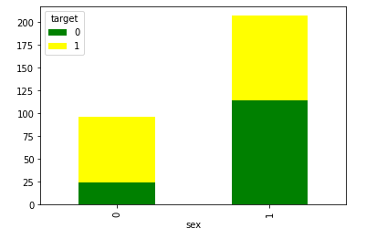
CHOLESTROL GENDER

Slide 27
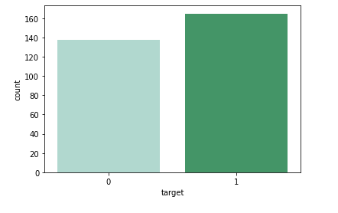
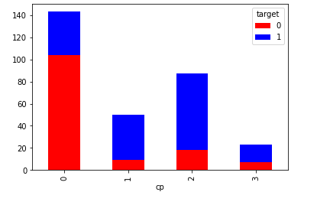
PRESENT/ABSENT CHEST PAIN LEVEL

Slide 28
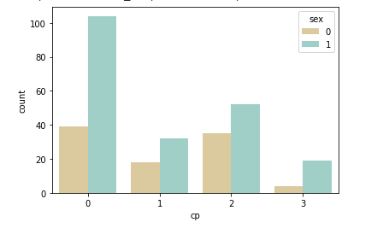
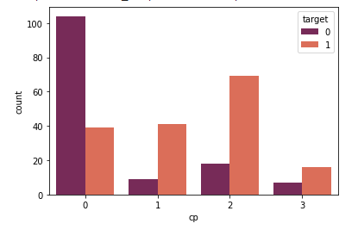
GENDER WISE CP CHEST PAIN AND DISEASE

Slide 29
ACCURACY ACHIEVED
Algorithm | Accuracy %
LOGISTIC REGRESSION | 92%
NAIVE BAYE | 89%
RANDOM FOREST | 86%
K NEAREST NEIGHBOUR | 86%
DECISION TREE | 76%

Slide 30
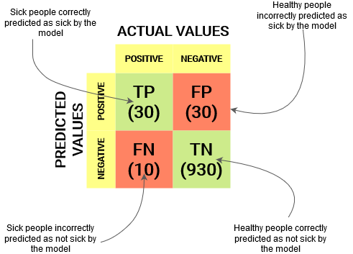
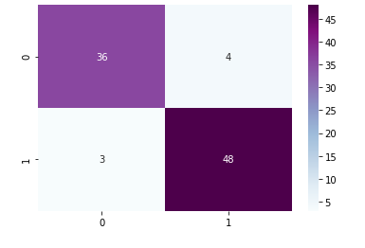
CONFUSION MATRIX

Slide 31
A PREDICTIVE DASHBOARD HAS BEEN BUILT IN TABLEAU
PYTHON CODE IS RUN ON TABLEAU USING THE TABPY SERVER
THE DASHBOARD TAKES INPUT FROM USER AND GIVES THE PRESENT/ABSENT PROBABILTY OF HEART DISEASE

Slide 32
SUGGESTIONS
Maintaining a healthy blood pressure level.
Maintaining a healthy cholesterol and triglyceride level.
Maintaining a balanced body weight. Obesity or being overweight can increase the risk of heart disease.
Eating a well-balanced diet that can help to lower blood pressure and cholesterol levels, two factors that can lower your risk of heart disease.

Slide 33
Getting any exercise on a daily basis
Alcohol should be consumed in moderation.
Avoid smoking.
Taking care of stress which is associated with Type A behaviour
Exercising, listening to music, concentrating on something calm or happy, and meditating are all good ways to relieve stress.
Taking care of diabetes.

Slide 34


