Slide 1
Course Code: 18ESC108A Course Title: Elements of Computer Science and Engineering
Ami Rai E.
Roopa G.
Chaitra S.
Department of Computer Science and Engineering
Faculty of Engineering and Technology
Ramaiah University of Applied Sciences

Slide 2
Course Details
Programme: B. Tech. In Computer Science & Engineering
Department: Computer Science and Engineering
Head of the Department: Dr.P.V.R Murthy
(hod.cs.et@msruas.ac.in )
Faculty: Engineering & Technology
Dean: Dr. M. Arulanantham (dean.et@msruas.ac.in)

Slide 3
Why this Course– CSE
The objectives of the programme are:
To facilitate the acquisition of knowledge in computing and information technology systems and their subsystems
To develop understanding of the underlying logical, algorithmic, architectural and programming principles of computing systems
To build the ability to design and implement computing and information systems to meet the specific application needs
To model, simulate and analyse the behaviour of computing and information systems to predict and improve their performance
To train students on development of software products to meet specific requirements and customer needs
To impart training on the processes and practice of engineering, deployment and operation of information technology infrastructure
To impart training on professional ethics, history, economics, social sciences and interactive skills relevant to professional practice
To provide a general perspective on lifelong learning and opportunities for a career in industry, business and commerce
The Course is being delivered to meet the highlighted objective of the programme to meet the programme aim.

Slide 4
Course Aim and Summary
This course is intended to provide an understanding of the elements of computer science and engineering and development of computer programs using algorithmic and programming constructs, for students across streams. Elements and methods of computer science and engineering and their applications to engineering computational problems are discussed using illustrative examples. Students are taught the methodology of solving computational problems algorithmically, programming concepts and constructs, basic algorithms and data structures. They are also exposed to the practice of software development, modern computing systems and their scope for engineering applications.

Slide 5
Course Intended Learning Outcomes
After undergoing this course students will be able to:
Describe the elements and methodology of Computer Science and Engineering
Explain the basic principles and techniques of algorithms and programming
Select appropriate approach to solve a computational problem
Design an algorithmic solution and draw a flow chart of the solution
Develop computer programs for moderately complex problems
Test and validate developed computer programs

Slide 6
Course Content
Introduction: Computers and other computing devices, interface between Computer Science and Engineering (CSE) and other disciplines, idea of computing, nature and purpose of CSE, software and computer programs, practice of CSE. Relationship between data, information and knowledge.
Problem Solving using Computers: Algorithmic problem solving. Flowcharts: symbols and meaning. Drawing flowcharts for simple problems. Fundamental algorithms, efficiency. Example of algorithms in practice: Illustration of algorithms for numerical computation, simulation and data processing in Engineering domains.

Slide 7
Course Content contd..
Building Blocks of Computer Programs: Programming languages and process of compiling and program execution. Data representation and storage. Python programming language, IDEs and Workbooks. Data types, variables and keywords. Program structure. Simple data manipulation and logical statements, lists, tuples, sets and dictionaries, conditional and looping control statements, functions, nested expressions, recursion. Plotting and other utility libraries.
Elements of Computer Programming: Elements of good programming style, decomposing problems, moving from algorithm to code, random number generation, testing and validation of programs.
Basic Algorithms and Data Structures: Iterative and recursive algorithms, algorithms for search, sorting algorithms, idea of a data structure, basic data structures and algorithms, and their use.

Slide 8
Course Content contd..
Algorithm Design: Recursion, Brute force, Divide and conquer, Greedy approaches. Introduction to Backtracking and Dynamic programming.
Modern Computing Systems: Software development process, operating systems, network of computers, distributed computing, high performance computing, Internet and Web technology, cloud computing.
Tutorials: Videos and demonstrations on computer.
Tutorials: Problem solving exercises.

Slide 9
Method of Assessment
There are two components for assessment in this subject:
Component ‐ 1: 50% weight It has two sub components.
Part A: Term Test: 25% Weight
Part B: Assignment: 25% Weight
Three term tests will be conducted during 5th week, 9th week and 13th week. The average marks of two term tests (best two) will be the marks scored in term test.
Every student is required to submit two word processed assignments as per the notified schedule. Each assignment is set for 50 marks and scored marks will be reduced to 25. The average marks of the two assignments will be the marks scored in assignment.

Slide 10
Method of Assessment
Component ‐ 2: 50% weight
A 3 hour duration Semester End Examination will be conducted for a maximum of 100 marks and will be reduced to 50% weight.
Both components will be moderated by a second examiner

Slide 11
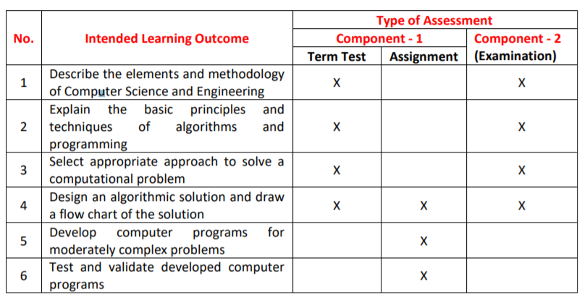
Method of Assessment
The following table illustrates the focus of learning outcome in each component assessed:

Slide 12
References
a. Essential Reading
1. Class Notes
2. Dromey, R. G., 1982, How to Solve It by Computer, New Delhi: Pearson Education
b. Recommended Reading
Downey, A. B., 2016, Think Python: How to Think Like a Computer Scientist, O’Rielly.
Polya, G., 1990, How to Solve It: A New Aspect of Mathematical Method, 2nd edn. New Delhi: Penguin Books.
Aho, A. V., Hopcropt, J. E., and Ulman, J. D., 1974, The Design and Analysis of Computer Algorithms, New Delhi: Pearson Education.

Slide 13
References contd.
c. Magazines and Journals
Quanta Magazine Computer Science Section, http://www.quantamagazine.org/ computerscience
Dr. Dobb’s Journal, http://drdobbs.com/
Lifehacker, https://lifehacker.com/
d. Websites
Association of Computing Machinery (ACM), http://www.acm.org/
IEEE Computer Society, http://www.computer.org/

Slide 14
Course Delivery Schedule
Lecture No. | Date | Topic | Delivered by | Additional Activity
1 |  | Introduction to CSE
2 |  | Fundamentals of algorithms
3 |  | Flowcharts
4 |  | Elements of Programming
5 |  | Number system
6 |  | Introduction to Python
7 |  | Basic data types
8 |  | Variables
9 |  | Operators and Expression

Slide 15
Course Delivery Schedule contd.
Lecture No. | Date | Topic | Delivered by | Additional Activity
10 |  | Operators and Expression
11 |  | IO Operations
12 |  | Conditional Statements
13 |  | Loop statements
14 |  | Lists
15 |  | Lists
16 |  | Strings
17 |  | Strings

Slide 16
Course Delivery Schedule contd.
Lecture No. | Date | Topic | Delivered by | Additional Activity
18 |  | Tuples
19 |  | Sets
20 |  | Dictionaries
21 |  | Functions
22 |  | Functions
23 |  | Recursion
24 |  | Files
25 |  | Exception handling

Slide 17
Course Delivery Schedule contd.
Lecture No. | Date | Topic | Delivered by | Additional Activity
26 |  | Testing and Validation
27 |  | Efficiency of algorithms
28 |  | Searching
29 |  | Sorting
30 |  | Classes and objects
31 |  | Introduction to data structures
32 |  | Queues and Stacks

Slide 18
Course Delivery Schedule contd.
Lecture No. | Date | Topic | Delivered by | Additional Activity
33 |  | Trees
34 |  | Algorithm design approaches
35 |  | Algorithm design approaches
36 |  | Plotting in Python
37 |  | SDLC
38 |  | Practice of CSE and DIK
39 |  | System Software
40 |  | Operating System
41 |  | Network of computers

