Slide 1
Elements of Computer Programming
18ESC108A Elements of Computer Science and Engineering
B. Tech. 2018
Ami Rai E.
Roopa G
Chaitra S
Department of Computer Science and Engineering
Faculty of Engineering and Technology
Ramaiah University of Applied Sciences

Slide 2
Objectives
At the end of this lecture, students will be able to
Identify categories of programming languages
Identify the tools used for software development

Slide 3
Contents
Categories of Programming Languages
Tools Used to Develop a Computer Program
Execution of a Python Program Using an IDE

Slide 4
Programming
Program
A well-defined set of instructions
Programming
Process of writing instructions in a language for a computer to solve a specific task
Programming languages
Medium of communication between the man and the machine

Slide 5
Question
What language does the computer understand?

Slide 6
Categories of Programming Languages
Machine language
Easily understood by the machine
0 and 1
Tedious for programmers
Assembly Language
Mnemonics (“add”, “sub”, etc.)
High Level Languages
High Level Language Instructions (closer to English)

Slide 7
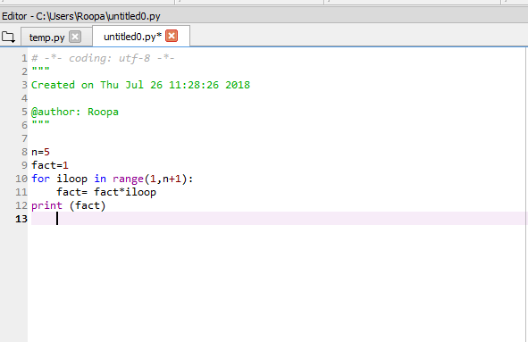
High Level Language - Python

Slide 8
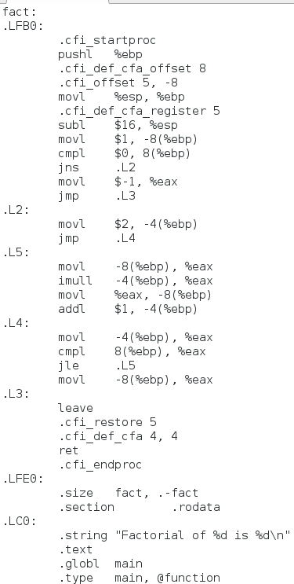
Assembly Language

Slide 9
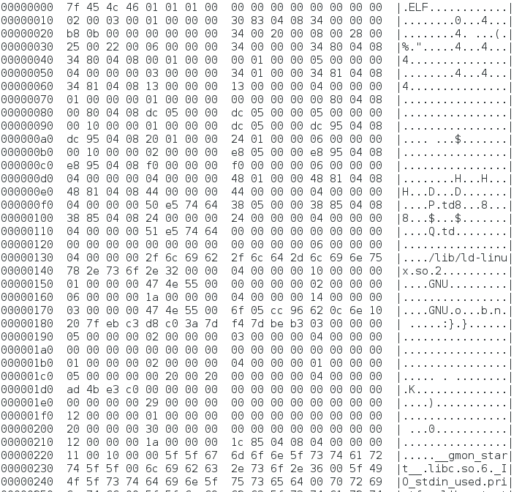
Machine Language

Slide 10
Tools Used to Develop a Computer Program

Slide 11
Compiler/Interpreter
Compiler / Interpreter

Slide 12
Compiler
Translates High Level Language programs to Operational Codes at one go
Compiled programs run faster as there is no translation during runtime
Example: gcc (GNU C Compiler)

Slide 13
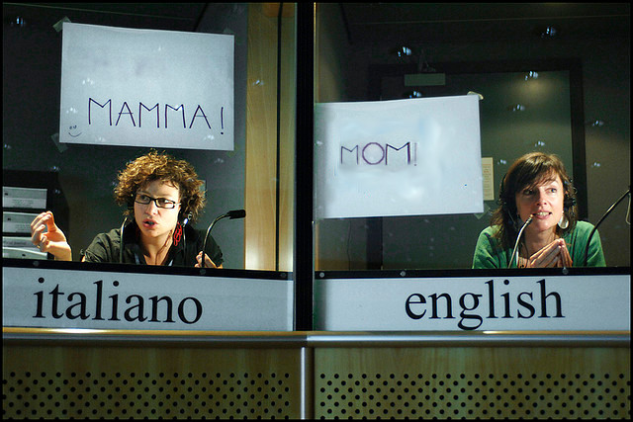
Interpreter

Slide 14
Interpreter
Reads High Level Language programs line by line and executes their equivalent operational codes
The process of interpretation makes the program execution slower
Example:
Java Virtual Machine: Works on object code generated by Java compiler

Slide 15
Assembler
Reads assembly language programs and translates into machine language
Example:
TASM (Turbo ASseMbler)

Slide 16

Debugger
Debugger

Slide 17
Debugger
Used for checking the run time condition of code
Variable values during execution can be evaluated
Useful in finding and removing ‘bugs’(errors in logic that cause unwanted results)
Example: pdb (Python Debugger)

Slide 18

Runtime Environment
Input
Runtime Environment
Output

Slide 19
Runtime Environment
The environment where the interpreted code executes
Consists of
a set of support libraries
operating system loader and scheduler
or
a program that starts the execution of the developed program

Slide 20
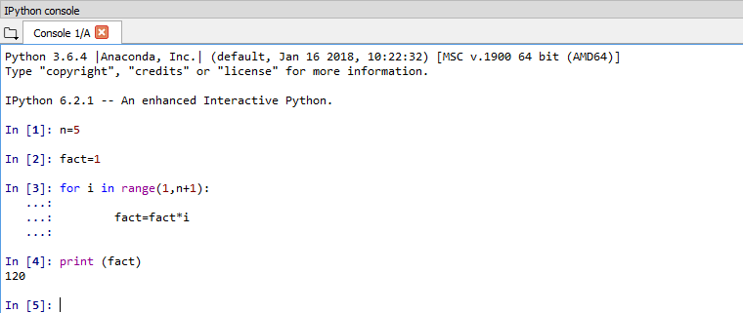
Runtime Environment contd.

Slide 21

Integrated Development Environment
One tool that integrates compiler/interpreter, debugger and runtime environment in a user friendly interface
Example: spyder

Slide 22
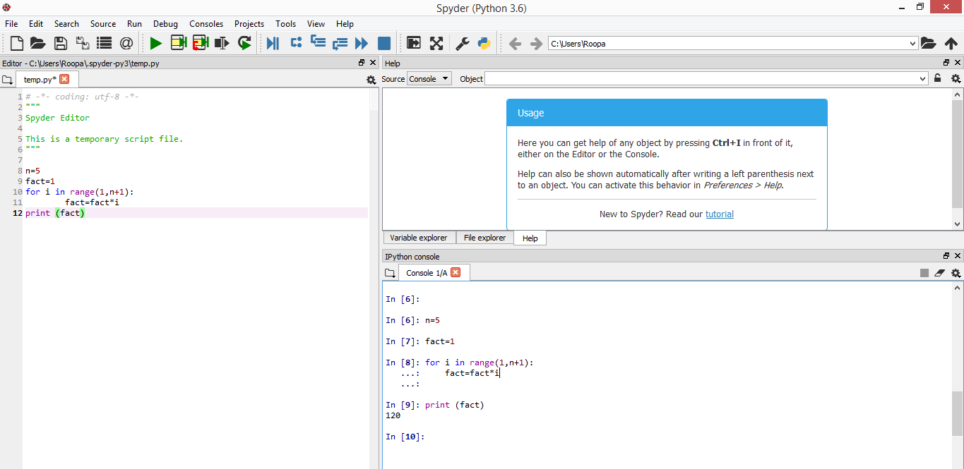
Execution of a Python Program Using IDE

Slide 23
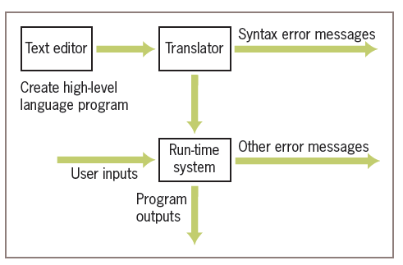
Software Used in the Coding Process
The figure shows the steps and software used in the coding process

Slide 24
Summary
Computer understands only numbers
A Compiler translates a high level language program in to an executable, while an interpreter translates it to machine code line by line
De-bugger helps in troubleshooting the program by running the executable and allowing the user to control the execution and watch the values in the variables
An IDE integrates all development tools and provides a simple interface

