Slide 1
Basic Data Types
18ESC108A Elements of Computer Science and Engineering
B. Tech. 2018
Ami Rai E.
Roopa G
Chaitra S
Department of Computer Science and Engineering
Faculty of Engineering and Technology
Ramaiah University of Applied Sciences

Slide 2
Objectives
At the end of this lecture, student will be able to
  explain the basic data types of Python

Slide 3
Topics
int type
float type
complex type
str type
bool type

Slide 4
Data Types
In the real world, we use data all the time without bothering to consider what kind of data we are using
For example, consider this sentence:
“In 2007, Micaela paid $120,000 for her house at 24 East Maple Street.”
This sentence includes at least four pieces of data
  Name
  Date
  Price
  Address

Slide 5
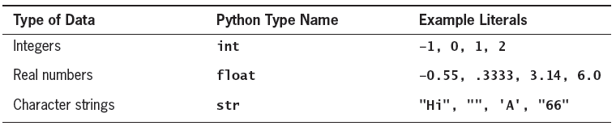
Data Types in Python
In programming,
  A data type defines a set of values and a set of operations that can be performed on those values
  A literal is the way a value of a data type looks to a programmer
The programmer can use a literal in a program to mention a data value
When Python interpreter evaluates a literal, the value it returns is simply that literal
Table shows sample literals of several Python data types

Slide 6
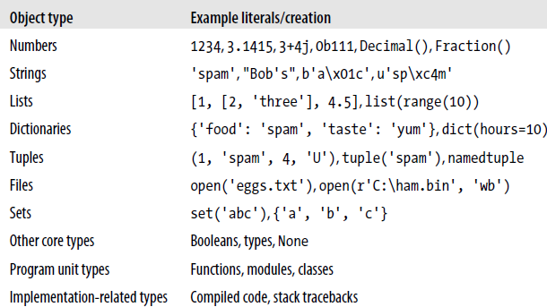
Python’s Core Data Types
The Table previews Python’s built-in types and some of the syntax used to code their literals

Slide 7
The int Type
The integers include 0, the positive whole numbers, and the negative whole numbers
The int class is designed to represent integer values
Object of this type represent integers (both positive and negative)
Cannot store a fractional part
The call int(), can be used to construct an object of type integer based on an existing value of another type
It is helpful for converting other types like float and string to the type int
  int(3.14) produce the value 3
  int(3.99) produce the value 3
  int(-3.9) produces the value -3
  int(‘137’) produces the value 137

Slide 8
The int Type - Examples
>>>15 #positive integer
15
>>> -15 #negative integer
-15
>>> -0o15 #negative octal integer; octal constant is represented with leading 0o and consists of numbers from 0 to 7
-13
>>>0x12abc4 #hexadecimal integer; hexadecimal constant is represented with leading 0X or 0x and consists of digits and alphabets (a-f) in upper case or lower case
1223620

Slide 9
Long Integers
Usually, in various programming languages such as C, the notion of int type and long int type exists based on the range of integers that they can represent
  for example, int type may represent -2**31 to 2**31 - 1 and long int may represent -2**63 to 2**63 -1
In older versions of Python (namely Python 2.X too), the above distinction is prevelant
In Python 3.X, there is only int type irrespective of the number of bits required to represent it
  For example, whatever may the number of bytes (or words) required to represent an integer, the necessary number of bytes is allocated by Python

Slide 10
Built in Functions on Type int
The following mathematical functions are available on type int
Expression | Meaning | Example | Result
pow(x,y) | returns (x ** y) | pow (2,3) | 8
divmod(x,y) | returns (x //y, x%y) | divmod(10,3) | (3,1)
abs(x) | absolute value | abs(-10) | 10
math.factorial(x) | factorial | math.factorial(5) | 120

Slide 11
Built in Functions on Type int contd.
Objects of type int can be converted to other bases using the below built in functions
Expression | Result | Meaning
bin(12) | ‘0b1100’ | Converts the integer to binary
oct(12) | ‘0o14’ | Converts the integer to octal
hex(12) | ‘0xc’ | Converts the integer to hexadecimal

Slide 12
The float Type
The float data type allows to store numbers that have a decimal part
Float constant
  Any literal constant made up only digits(with an optional leading sign) with either a decimal point (.) or an exponentiation (e/E)
Examples
  >>>123.5
  123.5
  >>> 123.0
  123.0
  >>>12e2
  1200.0
  >>>123.5e2
  12350.0

Slide 13
The float Type contd.
The float( ) is helpful for converting other types like int and string to the type float
  float(2) produces the floating point value 2.0
  float(‘3.14’) produces the floating point value 3.14

Slide 14
The complex Type
The complex Type allows us to represent complex numbers
The notation to represent complex numbers with real part x and imaginary part y
  x+yj or x+yJ
Examples
  >>> 2+3J
  (2+3j)
  >>> (2+3j).real
  2.0
  >>> (2+3j).imag
  3.0

Slide 15
The complex Type contd.
Objects of type complex can be constructed using the constructor call complex()
The following statements are identical in function
  x= 2+3j
  x= complex(2,3)
complex() is helpful for converting other types like int and string to the type float
  >>> complex()
  0j
  >>> complex(2)
  (2+0j)
  >>> complex(“2+3j”)
  (2+3j)

Slide 16
The str Type
The string type (str) allows to store sequence of characters in addition to numeric values
The string literals can be enclosed in single, double or triple quotes
The following statements display the same output Hello
  >>>print('Hello')
  >>>print("Hello")
  >>>print('''Hello''')
Empty string
  >>> ''
  ''
  >>> ""
  ''

Slide 17
The bool Type
The bool class is used to manipulate logical (Boolean) values
The only two instances of that class are expressed as the literals
  True
  False
Numbers evaluate to False if zero, and True if nonzero
Sequences and other container types, such as strings and lists, evaluate to False if empty and True if nonempty

Slide 18
The bool Type contd.
The bool() is helpful for converting other types like int and string to the type bool
Examples
  >>>bool(0)
  False
  >>>bool(10)
  True
  >>>bool(-12.5)
  True
  >>>bool(“hello”)
  True
  >>>bool(“”)
  False
  >>>bool()
  False

Slide 19
Summary
The basic data types of Python are int, float, complex, str and bool
The int class is designed to represent integer values
The float data type allows to store numbers that have a decimal part
The complex Type allows to represent complex numbers
The str type allow to represent a sequence of characters
The bool class is used to manipulate logical (Boolean) values

