Slide 1
Operators and Expressions
18ESC108A Elements of Computer Science and Engineering
B. Tech. 2018
Ami Rai E.
Roopa G
Chaitra S
Department of Computer Science and Engineering
Faculty of Engineering and Technology
Ramaiah University of Applied Sciences

Slide 2
Objectives
At the end of this lecture, student will be able to
Explain the different types of operators used in Python
Use operators in simple Python programs
Use integers and floating-point numbers in arithmetic operations
Use logical operators to construct compound Boolean expressions
Construct arithmetic expressions

Slide 3
Topics
Expressions
Operators and Operands
Types of operators
Operator precedence and associativity

Slide 4
Expressions
An expression is a combination of values, variables, and operators
A value by itself is considered an expression, and so is a variable
Examples of an expression in Python
5
5+6
6.5 * 8.5
X+7 (assuming that the variable x has been assigned a value)
An expression has a value; a statement does not

Slide 5
Operators and Operands
Consider the expression
a = b + 5
Operator: Symbol representing the operation
= and +
Operand: The data items (variables and constant) on which the operation is performed
a, b and 5
In case of + operator, operands are b and 5
In case of = operator, operands are a and the value of expression b+5

Slide 6
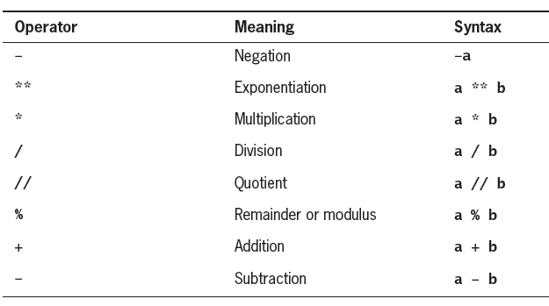
Arithmetic Operators
The following operations can be applied to numeric types
For complex numbers, the modulo (%) and truncating division operators (//) are invalid

Slide 7
Arithmetic Operators - Examples
Expression | Result
2 + 3 | 5
2 - 3 | -1
2 * 3 | 6
15/6 | Exact Division yielding approximately 2.5
15//6 | Integer division yielding quotient equal to 2
2 ** 3 | 8
10 % 3 | 1
8.2 // 3.14 | 2.0
8.2 % 3.14 | 1.91999999999, as 2.0 ∗ 3.14+1.92 = 8.2

Slide 8
Comparison Operators
Comparison or relational operators
Return a Boolean value of True for true values, False for false values
The following comparison operators have the standard mathematical interpretation
Operation Description
x==y x is equal to y
x != y x is not equal to y
x > y x is greater than y
x < y x is less than y
x >= y x is greater than or equal to y
x <= y x is less than or equal to y

Slide 9
Comparison Operators - Examples
Expression | Result
2 < 3 | True
2 <= 3 | True
2 > 3 | False
2 >= 3 | False
2 ==3 | False
2 != 3 | True

Slide 10
Chaining of Comparison Operators
Python allows a chained assignment, such as
x = y = 0, to assign multiple identifiers to the rightmost value
Comparisons can be chained together
w < x < y < z
The above expression is evaluated as w < x and x < y and y < z
Expressions such as
x < y > z
are legal, but confusing

Slide 11
Assignment Operator
Variables receive their initial values and can be reset to new values with an assignment statement
Assignment Operator =
a = 1;
Do not confuse with equality Operator ==

Slide 12
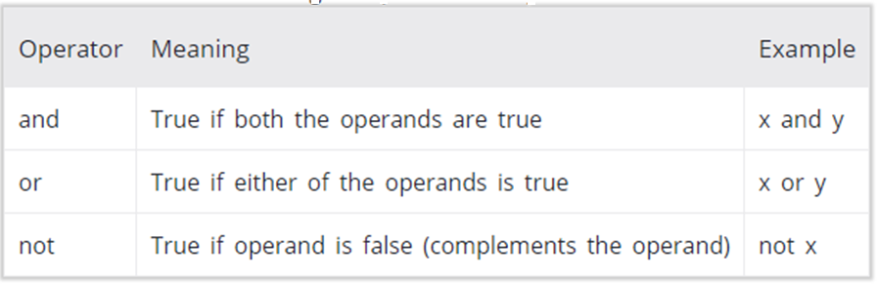
Logical Operators
Three logical operators
and
or
not

Slide 13
Logical Operators - Examples
and operator
True and False False
False and True False
False and False False
True and True True
>>>2 and 5
5
>>>5 and 2
2
>>>0 and 5
0
or operator
True or False True
False or True True
True or True True
False or False False
>>>2 or 5
2
>>>5 or 2
5
>>>0 or 5
5

Slide 14
Logical Operators contd.
not operator
not False True
not True False
>>>not 2
False
>>>not 0
True

Slide 15
Boolean Expressions
The and, or, and not keywords can form Boolean expressions
When an expression is used to determine a true or false value
True, any nonzero number, nonempty string, list, tuple, or dictionary is taken to be true
False, zero, None, and empty lists, tuples, and dictionaries evaluate as false

Slide 16
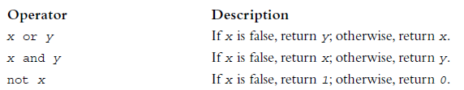
Short-Circuit Evaluation
The Python virtual machine sometimes knows the value of a Boolean expression before it has evaluated all of its operands
In the expression A and B, if A is false, then so is the expression, and there is no need to evaluate B
In the expression A or B, if A is true, then so is the expression, and again there is no need to evaluate B
This approach, in which evaluation stops as soon as possible, is called short-circuit evaluation

Slide 17
Short-Circuit Evaluation - Example
There are times when short-circuit evaluation is advantageous
Consider the following example:
count = int(input("Enter the count: "))
theSum = int(input("Enter the sum: "))
if count > 0 and theSum // count > 10:
print("average > 10")
else:
print("count = 0 or average <= 10")
If the user enters 0 for the count, the condition contains a potential division by zero; however, because of short-circuit evaluation the division by zero is avoided

Slide 18
Operators - Examples
x > 0 and x < 10
is true only if x is greater than 0 and less than 10
n%2 == 0 or n%3 == 0
is true if either of the conditions is true, that is, if the number is divisible by 2 or 3
not (x > y)
is true if x > y is false, that is, if x is less than or equal to y

Slide 19
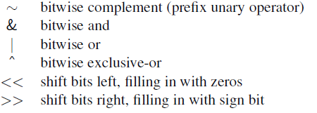
Bitwise Operators
Python provides the following bitwise operators for integers
The bitwise operators assume that integers are represented in a 2’s complement binary representation

Slide 20
Bitwise Operators - Examples
Expression | Result
2 & 3 | 2
2 | 3 | 3
2 ^ 3 | 1
~2 | -3
2 << 3 | 16
2 >> 3 | 0

Slide 21
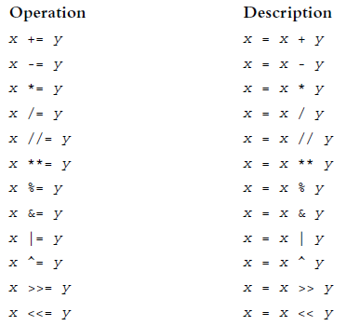
Augmented Assignment
The assignment symbol can be combined with the arithmetic and concatenation operators

Slide 22
Operator Precedence
Consider the compound expression
a + b* c
which rely on the evaluation of two or more operations
The order in which the operations of a compound expression are evaluated can affect the overall value of the expression
For this reason, Python defines a specific order of precedence for evaluating operators
Python allows a programmer to override this order by using explicit parentheses to group subexpressions

Slide 23
Order of Operations
For mathematical operators, Python follows mathematical convention
Parentheses have the highest precedence and can be used to force an expression to evaluate in the order you want
2 * (3-1) is 4
(1+1)**(5-2) is 8
Exponentiation has the next highest precedence
2**1+1 is 3, not 4
3*1**3 is 3, not 27

Slide 24
Order of Operations contd.
Multiplication and Division have the same precedence, which is higher than Addition and Subtraction, which also have the same precedence
2*3-1 is 5, not 4
6+4/2 is 8, not 5
Operators with the same precedence are evaluated from left to right (except exponentiation and assignment operations)
In the expression degrees/2*pi, the division happens first and the result is multiplied by pi
To divide by 2p, use parentheses or write degrees/2/pi

Slide 25
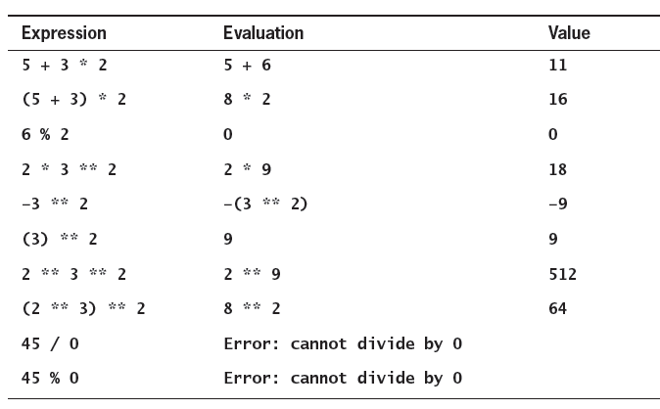
Some Arithmetic Expressions and Their Value

Slide 26
Mixed-Mode Arithmetic
Performing calculations involving both integers and floating-point numbers is called mixed-mode arithmetic
For instance, if a circle has radius 3, compute the area as follows:
>>> 3.14 * 3 ** 2
28.26
How does Python perform this type of calculation?
In a binary operation on operands of different numeric types, the less general type (int) is temporarily and automatically converted to the more general type (float) before the operation is performed
In the example expression, the value 9 is converted to 9.0 before the multiplication

Slide 27
Coercion Operation
Operations involving numbers are valid only if the operands are of the same type
Coercion happens in the case of binary operations
If the types differ, a coercion operation is performed to convert one of the types to the other, as follows:
If either operand is a complex number, the other operand is converted to a complex number
If either operand is a floating-point number, the other is converted to a float
If either operand is a long integer, the other is converted to a long integer
Otherwise, both numbers must be integers and no conversion is performed

Slide 28
Summary
Expressions consist of operators (the symbols that represent an operation) and operands (the data items on which the operation is applied)
Arithmetic operators are used to perform arithmetic operations such addition, subtraction and multiplication
Comparison or relational operators return a Boolean value after comparing values
Logical operators such as and, or and not are used to take logical decisions
Bitwise operators for integers works on bits
If the types of operands in a binary operation differ, a coercion operation is performed to convert one of the types to the other
Python provides a set of augmented assignment operators to update the value of a variable
Python defines a specific order of precedence for evaluating operators

