Slide 1
Conditional Statements
18ESC108A Elements of Computer Science and Engineering
B. Tech. 2018
Ami Rai E.
Roopa G
Chaitra S
Department of Computer Science and Engineering
Faculty of Engineering and Technology
Ramaiah University of Applied Sciences

Slide 2
Objectives
At the end of this lecture, student will be able to
Explain different types of conditional statements
Use selection statements to make choices in a program
Identify flow chart elements and connectors that are associated with branched control flow

Slide 3
Topics
Conditional Statements
Alternate Execution
Chained Conditionals
Nested conditionals

Slide 4

Conditions?
Why do we need them?

Slide 5
Conditional Statements
Conditional statements
Give the ability to check conditions and change the behavior of the program accordingly
Different types of conditional statements
if
If-else
If-elif-else
If-elif
Nested if

Slide 6
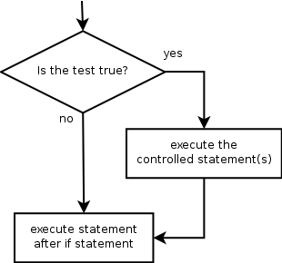
if Statement
The simplest form of the conditional execution is the if statement
Conditionally executes a statement or a block of statements

Slide 7
if Statement - Example
if x > 0:
print ('x is positive‘)
The boolean expression after if is called the condition
If it is true, then the indented statement gets executed
If not, nothing happens

Slide 8
Formatting Blocks in Python
Python uses indentation as a tool for formatting blocks
After any line ending in a colon : a block is required, and it is differentiated from the surrounding code by being consistently indented
if 43>42:
print(“hi”)

Slide 9
Pass Keyword
There is no limit on the number of statements that can appear in the body, but there has to be at least one
if x < 0:
#SyntaxError: unexpected EOF while parsing
Occasionally, it is useful to have a body with no statements (usually as a place keeper for the code that is not yet written)
In that case, use the pass statement, which does nothing
if x < 0:
pass # need to handle negative values!

Slide 10
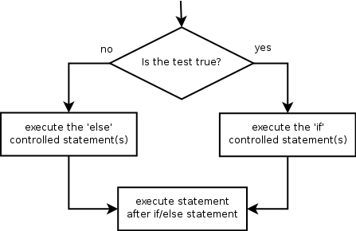
Alternate Execution
In alternative execution, there are two possibilities and the condition determines which one gets executed
A general if-then-else control structure
if boolean_expression:
statement_to_be_executed_on_true_condition
else:
statement_to_be_executed_on_false_condition
Example
if (valid_ticket) and (baggage_within_limit):
issue_boarding_pass()
else:
charge_fine()
issue_boarding_pass()

Slide 11
Alternate Execution - Example
if x%2 == 0:
print('x is even‘)
else:
print('x is odd‘)
If the remainder when x is divided by 2 is 0, then x is even, and the program displays a message to that effect
If the condition is false, the second set of statements is executed
Since the condition must be true or false, exactly one of the alternatives will be executed
The alternatives are called branches, because they are branches in the flow of execution

Slide 12
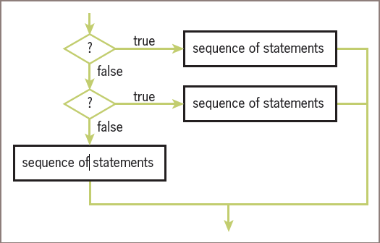
Chained Conditionals
Sometimes there are more than two possibilities and need more than two branches
if x < y:
print('x is less than y‘)
elif x > y:
print('x is greater than y‘)
else:
print('x and y are equal‘)
elif is an abbreviation of “else if”
Exactly one branch will be executed
There is no limit on the number of elif statements

Slide 13
Chained Conditionals contd.
If there is an else clause, it has to be at the end, but there doesn’t have to be one
if choice == 'a':
draw_a()
elif choice == 'b':
draw_b()
elif choice == 'c':
draw_c()
Each condition is checked in order; if the first is false, the next is checked, and so on
If one of them is true, the corresponding branch executes, and the statement ends
Even if more than one condition is true, only the first true branch executes

Slide 14
Nested Conditionals
One condition can be nested within another
if x == y:
print('x and y are equal‘)
else:
if x < y:
print('x is less than y‘)
else:
print('x is greater than y‘)
The outer condition contains two branches; the first branch contains a simple statement; the second branch contains another if statement, which has two branches of its own; those two branches are both simple statements

Slide 15
Nested Conditionals contd.
Although the indentation of the statements makes the structure apparent, nested conditionals become difficult to read very quickly
In general, it is a good idea to avoid them if possible
Logical operators often provide a way to simplify nested conditional statements
if x>0:
if x < 10:
Print('x is a positive single-digit number.‘)
The same effect with the and operator:
if x>0 and x < 10:
print('x is a positive single-digit number’)

Slide 16
Exercise
Draw a flowchart describing the logic of given nested conditional statements
if door is closed:
if door is locked:
unlock door( )
open door( )
advance()

Slide 17
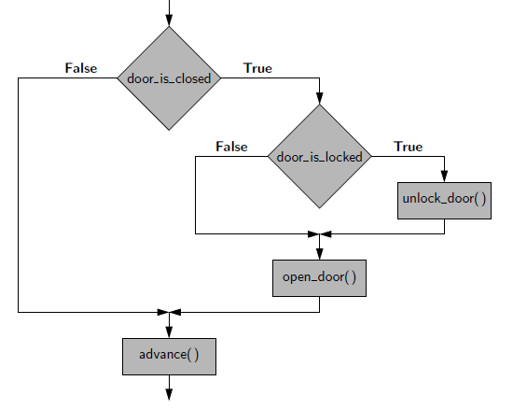
Exercise - Solution

Slide 18
Summary
The boolean expression in a conditional statement that determines which branch is executed
Conditional statements give the ability to check conditions and change the behavior of the program accordingly
if statement Conditionally executes a statement or a block of statements
In chained conditional, there are a series of alternative branches
In nested conditional, a conditional statement appears in one of the branches of another conditional statement
Python relies on indentation rules to figure out the body of any construct
Python does not permit empty block – such blocks should have at least the pass statement

