Slide 1
Lists
18ESC108A Elements of Computer Science and Engineering
B. Tech. 2018
Ami Rai E.
Roopa G
Chaitra S
Department of Computer Science and Engineering
Faculty of Engineering and Technology
Ramaiah University of Applied Sciences

Slide 2
Objectives
At the end of this lecture, student will be able to
Explain list operations
Construct lists and access items in those lists
Use methods to manipulate lists

Slide 3
Topics
Creating lists
Traversing a list
List methods
List and strings
List mutability

Slide 4
Lists
A list is an ordered sequence of values that can be dynamically altered
Ordered means that each item in a list has an index based on its position in the list
Sequence means that the elements are arranged in sequential order
Dynamically altered means that each item in the list can be changed and the list itself can be changed
some real-world examples of lists:
Shopping list for the grocery store
To-do list
Guest list for a wedding
Recipe, which is a list of instructions
Text document, which is a list of lines
The names in a phone book

Slide 5
Lists in Python
The values in a list are called elements or items
Enclose the elements in square brackets [ and ]
>>>[10, 20, 30, 40] # a list of four integers
>>>['crunchy frog', 'ram bladder', 'lark vomit'] # a list of three strings
>>> empty = [] #Empty list - A list that contains no elements

Slide 6
Creating Lists
While list is a data type, the contents of a list are objects
A list object can be created and assigned to a variable using the list() function
>>> cheeses = ['Cheddar', 'Edam', 'Gouda'] # a list of strings
>>> print(cheeses)
['Cheddar', 'Edam', 'Gouda']
>>> numbers = [17, 123] # a list of integers
>>> print(numbers)
[17, 123]

Slide 7
Creating Lists using range and list()
Building lists of integers using the range and list functions
>>> first = [1, 2, 3, 4]
>>> second = list(range(1, 5))
>>> first
[1, 2, 3, 4]
>>> second
[1, 2, 3, 4]
The list function can build a list from any iterable sequence of elements, such as a string:
>>> third = list("Hi there!")
>>> third
['H', 'i', ' ' , 't', 'h', 'e', 'r', 'e', '!']

Slide 8
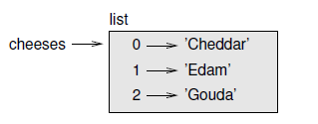
List Indices
The elements of a list is accessed using the bracket operator
The expression inside the brackets specifies the index
The indices start at 0
>>> cheeses = ['Cheddar', 'Edam', 'Gouda']
>>> print(cheeses[0])
Cheddar

Slide 9
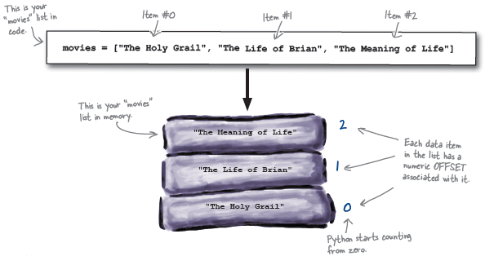
List Indices - Example

Slide 10
Data of Mixed Type
The elements of a list don’t have to be the same type
>>>['spam', 2.0, 5, [10, 20]]
#contains a string, a float, an integer, and another list

Slide 11
Nested List
A list within another list
Although a list can contain another list, the nested list still counts as a single element
>>>['spam', 1, ['Brie', 'Roquefort', 'Pol le Veq'], [1, 2, 3]]
# the length of this list is four

Slide 12
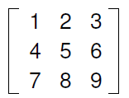
Nested List - Matrices
Nested lists are often used to represent matrices
For example, the matrix
might be represented as:
>>> matrix1 = [[1, 2, 3], [4, 5, 6], [7, 8, 9]]
matrix1 is a list with three elements, where each element is a row of the matrix

Slide 13
Nested List – Matrices contd.
An entire row from the matrix can be selected in the usual way:
>>> matrix[1]
[4, 5, 6]
A single element can be extracted from the matrix using the double-index form
>>> matrix[1][1]
5
The first index selects the row, and the second index selects the column
A small variation is to use a list of columns instead of a list of rows

Slide 14
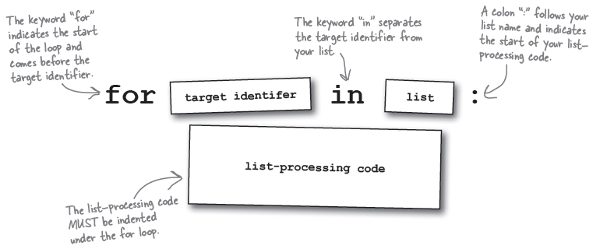
Traversing a List
The most common way to traverse the elements of a list is with a for loop

Slide 15
Traversing a List - Examples
Example1
cheeses = ['Cheddar', 'Edam', 'Gouda']
for cheese in cheeses:
print(cheese)
Cheddar
Edam
Gouda
Example2
for number in [1, 2, 3, 4]:
print(number, end = " ")
1 2 3 4

Slide 16
Traversing an Empty List
A for loop over an empty list never executes the body
for x in []:
print('This never happens.‘)

Slide 17
General and Index-based for Loops
#to compute the sum of elements in a list using general for loop
list = [1,2,3,4,5]
sum=0
for element in list:
sum=sum+element
print(sum)
#to compute the sum of elements in a list using index based for loop
list = [1,2,3,4,5]
sum=0
for index in range(0,len(list)):
sum=sum + list[index]
print(sum)

Slide 18
List Operations
The + operator concatenates lists
a = [1, 2, 3]
b = [4, 5, 6]
c = a + b
print(c)
[1, 2, 3, 4, 5, 6]
The * operator repeats a list a given number of times
>>> [0] * 4
[0, 0, 0, 0]
>>> [1, 2, 3] * 3
[1, 2, 3, 1, 2, 3, 1, 2, 3]

Slide 19
List Slices
A list slice is a sub list extracted from a list
>>> L = ['a', 'b', 'c', 'd', 'e', 'f']
>>> L[1:3] #slice of L from 1 to 3 (exclusive)
['b', 'c']
>>> L[:4] #slice of L from the beginning till 4
['a', 'b', 'c', 'd']
>>> L[3:] #slice of L from 3 till the end of the list
['d', 'e', 'f']
>>> t[:] # slice is a copy of the whole list
['a', 'b', 'c', 'd', 'e', 'f']

Slide 20
List Slices contd.
Since lists are mutable, it is often useful to make a copy before performing operations that fold, spindle or mutilate lists
A slice operator on the left side of an assignment can update multiple elements
L = ['a', 'b', 'c', 'd', 'e', 'f']
L[1:3] = ['x', 'y']
print(L)
['a', 'x', 'y', 'd', 'e', 'f']
L[1:3] = [‘w'] #fewer number of elements than the number of elements deleted
print(L)
['a', 'w', 'd', 'e', 'f']

Slide 21
Searching Elements Within a List
Checking for existence
The in and not in operators are used to verify whether a particular element is present in list or not
>>>L=[5,2,3]
>>>3 in L
True
>>> 4 in L
False
>>> 4 not in L
True

Slide 22
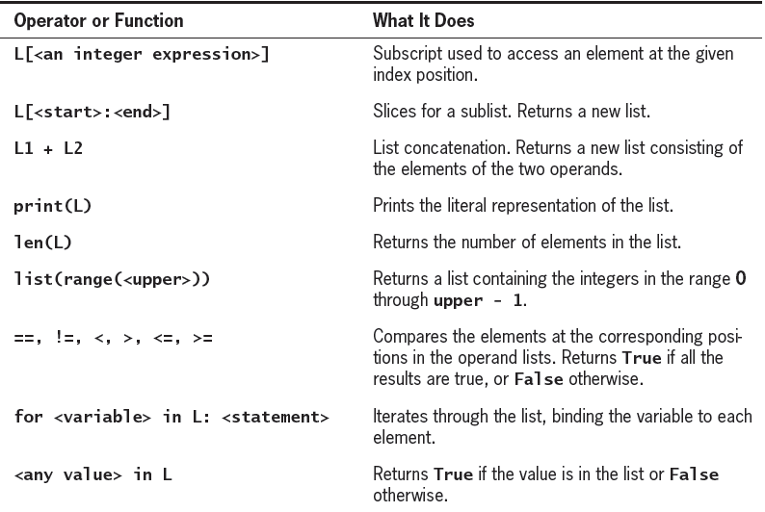
Some Operators and Functions Used with Lists

Slide 23
Searching Elements Within a List
Counting occurrences
The count() gives how many instances of the specified object is present in the list
>>>L=[5,2,3,2]
>>> L.count(3)
1
>>> L.count(4)
0
Locating elements
The index() searches for the first occurrence of an element within a list and returns the index where it was found
>>> L=[5,2,3,2]
>>> L.index(2)
1

Slide 24
Appending Elements
append() -adds a new element to the end of a list
>>> L = ['a', 'b', 'c']
>>> L.append('d')
>>> print(L)
['a', 'b', 'c', 'd']
extend() - takes a list as an argument and appends all of the elements
>>> t1 = ['a', 'b', 'c']
>>> t2 = ['d', 'e']
>>> t1.extend(t2)
>>> print(t1)
['a', 'b', 'c', 'd', 'e']

Slide 25
Inserting Elements
insert() - Add a data item before a specific slot location
>>> L = ['a', 'b', 'c']
>>> L.insert(2,‘x')
>>> print(L)
['a', 'b', 'x', 'c']

Slide 26
Deleting Elements
pop()
modifies the list and returns the element that was removed
>>> L = ['a', 'b', 'c', 'd', 'e']
>>> L.pop()
'e‘
to remove an element using index
>>> L = ['a', 'b', 'c']
>>> x = L.pop(1)
>>> print(L)
['a', 'c']
>>> print(x)
b

Slide 27
Deleting Elements contd.
To remove the value, use the del operator
>>> L = ['a', 'b', 'c']
>>> del L[1]
>>> print(L)
['a', 'c']
To remove more than one element, use del with a slice index
>>> L = ['a', 'b', 'c', 'd', 'e', 'f']
>>> del L[1:5]
>>> print(L)
['a', 'f']

Slide 28
Deleting Elements contd.
remove()
Remove a specific data from the list; not using the index
>>> L = ['a', 'b', 'c']
>>> L.remove('b')
>>> print(L)
['a', 'c']

Slide 29
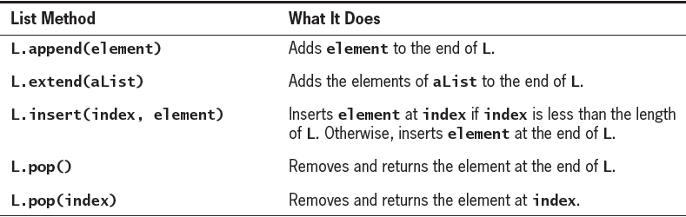
List Methods for Inserting and Removing Elements

Slide 30
Sorting Elements
sort() -arranges the elements of the list from low to high
>>> L = ['d', 'c', 'e', 'b', 'a']
>>> L.sort()
>>> print(L)
['a', 'b', 'c', 'd', 'e']

Slide 31
Smallest and Largest Element in a List
min()
Return the smallest element in the list
>>> L = [1,2,-3,2.5]
>>> print(min(L))
-3
max()
Return the largest element in the list
>>> L = [1,2,-3,2.5]
>>> print(max(L))
2.5

Slide 32
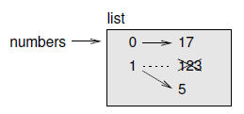
Lists are Mutable
When the bracket operator appears on the left side of an assignment, it identifies the element of the list that will be assigned
>>> numbers = [17, 123]
>>> numbers[1] = 5
>>> print(numbers)
[17, 5]
The one-eth element of numbers, which used to be 123, is now 5.

Slide 33
Replacing Elements in a List
At any point in a list’s lifetime, elements can be inserted, removed, or replaced
# Code to replace each number in a list with its square
>>> numbers = [2, 3, 4, 5]
>>> numbers
[2, 3, 4, 5]
>>> for index in range(len(numbers)): # len() is used to count the number of # elements in a list
… numbers[index] = numbers[index] ** 2
>>> numbers
[4, 9, 16, 25]

Slide 34

Objects and Values
Consider the two assignment statements:
a = 'banana'
b = 'banana'
a and b both refer to a string, but we don’t know whether they refer to the same string
There are two possible states
In one case, a and b refer to two different objects that have the same value
In the second case, they refer to the same object

Slide 35

Objects and Values contd.
To check whether two variables refer to the same object, use the is operator
>>> a = 'banana'
>>> b = 'banana'
>>> a is b
True
Python created one string object, and both a and b refer to it
Two objects are obtained while creating a list
>>> a = [1, 2, 3]
>>> b = [1, 2, 3]
>>> a is b
False

Slide 36

Aliasing
If a refers to an object and perform the assign statement b = a, then both variables refer to the same object:
>>> a = [1, 2, 3]
>>> b = a
>>> b is a
True
The association of a variable with an object is called a reference
In this example, there are two references to the same object
An object with more than one reference has more than one name, so we say that the object is aliased

Slide 37
Aliasing contd.
If the aliased object is mutable, changes made with one alias affect the other:
>>> b[0] = 17
>>> print(a)
[17, 2, 3]
Although this behavior can be useful, it is error-prone
In general, it is safer to avoid aliasing when working with mutable objects
For immutable objects like strings, aliasing is not as much of a problem
In this example:
a = 'banana'
b = 'banana'
It almost never makes a difference whether a and b refer to the same string or not

Slide 38
Program Based on List
# program to store country names and print the name of the countries whose
# length is greater than 5
countries = ["India","Pakistan","China"]
for country in countries:
if len(country)>5:
print(country)
Pakistan

Slide 39
Summary
A list is an ordered sequence of values that can be dynamically altered
A list contain any objects within it – including other lists
The len() gives the number of elements in a list
The for loop can be used to iterate through the elements of a list
A list slice is an independent list made up of elements taken from a list using the [:] syntax
Lists are mutable objects

