Slide 1
Recursion
18ESC108A Elements of Computer Science and Engineering
B. Tech. 2018
Ami Rai E.
Roopa G
Chaitra S
Department of Computer Science and Engineering
Faculty of Engineering and Technology
Ramaiah University of Applied Sciences

Slide 2
Objectives
At the end of this lecture, student will be able to
Define a recursive function
Apply the concept of recursion for solving problems

Slide 3
Topics
Recursion
Iteration and Recursion

Slide 4
Recursion
A function may call itself either directly or indirectly
A function that calls itself is recursive; the process is called recursion
When a function calls itself recursively, each invocation gets a fresh set of all the automatic variables, independent of the previous step
f1
f1
f2
…
fn

Slide 5
Factorial: In Mathematics
1 if N = 0
N! =
N*(N-1)! if N > 0
Example using Definition
4! = 4 * 3!
= 4 * 3 * 2!
= 4 * 3 * 2 * 1!
= 4 * 3 * 2 * 1 * 0!
= 4 * 3 * 2 * 1 * 1

Slide 6
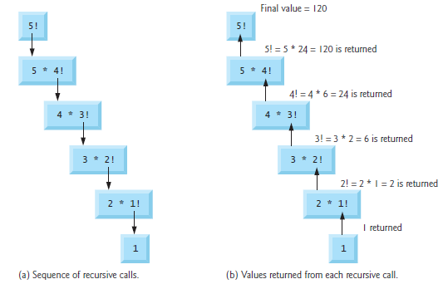
Recursion - Factorial

Slide 7
Recursion - Example
Example for recursion
def countdown(n):
if n <= 0: # base step
print('Blastoff!‘)
else:
print(n)
countdown(n-1) # recursive step
If n is 0 or negative, it outputs the word, “Blastoff!”
Otherwise, it outputs n and then calls a function named countdown—itself—passing n-1 as an argument

Slide 8
Recursion – Example contd.
What happens if we call this function like this?
>>> countdown(3)
The output looks like this:
3
2
1
Blastoff!

Slide 9
Stack Diagrams for Recursive Functions
A stack diagram is used to represent the state of a program during a function call
Every time a function gets called, Python creates a new function frame, which contains the function’s local variables and parameters
For a recursive function, there might be more than one frame on the stack at the same time

Slide 10
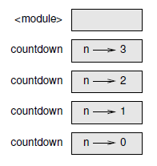
Stack Diagrams for Recursive Functions
The top of the stack is the frame for __main__
It is empty because no variables are created in __main__ or pass any arguments to it
The four countdown frames have different values for the parameter n
The bottom of the stack, where n=0, is called the base case
It does not make a recursive call, so there are no more frames

Slide 11
Infinite Recursion
If a recursion never reaches a base case, it goes on making recursive calls forever, and the program never terminates
A minimal program with an infinite recursion:
def recurse():
recurse()
Python reports an error message when the maximum recursion depth is reached:
File "<stdin>", line 2, in recurse
File "<stdin>", line 2, in recurse
.
File "<stdin>", line 2, in recurse
RuntimeError: Maximum recursion depth exceeded

Slide 12
Iteration and Recursion
Convert the following iterative algorithm to a recursive function
def displayRange(lower,upper):
while lower <= upper:
print(lower)
lower = lower + 1

Slide 13
Iteration and Recursion contd.
The equivalent recursive function performs similar primitive operations, but
the loop is replaced with a selection statement, and
the assignment statement is replaced with a recursive call of the function
def displayRange1(lower, upper):
if lower <= upper:
print(lower)
displayRange1(lower + 1, upper)

Slide 14
Iteration and Recursion contd.
Both Recursion and Iteration
Is based on a control structure
Iteration uses a repetition structure; recursion uses a selection structure
Involve repetition
Iteration explicitly uses a repetition structure; recursion achieves repetition through repeated function calls

Slide 15
Iteration and Recursion contd.
Both Recursion and Iteration
Involve a termination test
Iteration terminates when the loop-continuation condition fails; Recursion terminates when a base case is recognized
Can occur infinitely
An infinite loop occurs with iteration if the loop-continuation test never becomes false; infinite recursion occurs if the recursion step does not reduce the problem each time in a manner that converges on the base case

Slide 16
Recursive Definitions to Construct Recursive Functions
Recursive functions are frequently used to design algorithms for computing values that have a recursive definition
A recursive definition consists of equations that state what a value is for one or more base cases and one or more recursive cases
For example,
The Fibonacci sequence is a series of values with a recursive definition
The first and second numbers in the Fibonacci sequence are 1
Thereafter, each number in the sequence is the sum of its two predecessors, as follows:
1 1 2 3 5 8 13 . . .

Slide 17
Recursive Definitions to Construct Recursive Functions
More formally, a recursive definition of the nth Fibonacci number
Fib(n) = 1, when n = 1 or n = 2
Fib(n) = Fib(n - 1) + Fib(n - 2), for all n > 2
.
Given the recursive definition, a recursive function that computes and returns the nth Fibonacci number
def fib(n):
if n < 3: # base step
return 1
else:
return fib(n - 1) + fib(n - 2) # two recursive steps
The base case as well as the two recursive steps return values to the caller

Slide 18
Why Avoid Recursion?
What happens when the value of n increases?
How many variables will be there in memory?

Slide 19
Merits and Demerits of Recursion
Merits
Reduce unnecessary calling of function
Easier to write and understand than the non-recursive equivalent
Demerits
Take more time compared to iterative methods
A stack of the values being processed must be maintained
Consume additional memory
Recursive solution is always logical and it is very difficult to trace

Slide 20
Summary
Recursive design is a special case of top-down design, in which a complex problem is decomposed into smaller problems of the same form
A recursive function is a function that calls itself
A recursive function consists of at least two parts: a base case that ends the recursive process and a recursive step that continues it
These two parts are structured as alternative cases in a selection statement
Although it is a natural and elegant problem-solving strategy, recursion can be computationally expensive
Recursive functions can require extra overhead in memory and processing time to manage the information used in recursive calls
An infinite recursion arises as the result of a design error
The programmer has not specified the base case or reduced the size of the problem in such a way that the termination of the process is reached

