Slide 1
Files
18ESC108A Elements of Computer Science and Engineering
B. Tech. 2018
Ami Rai E.
Roopa G
Chaitra S
Department of Computer Science and Engineering
Faculty of Engineering and Technology
Ramaiah University of Applied Sciences

Slide 2
Objectives
At the end of this lecture, student will be able to
Use library functions to access and navigate a file system

Slide 3
Topics
Opening a file
Closing a file
Writing data to a file
Reading data from a file

Slide 4
Persistence
Most of the programs that are done in the previous sessions are transient
Run for a short time and produce some output, but when they end, their data disappears
When the program is executed again, it starts with a clean slate
Other programs are persistent
run for a long time (or all the time)
keep at least some of their data in permanent storage (a hard drive, for example)
if they shut down and restart, they pick up where they left off
Examples of persistent programs
operating systems, which run pretty much whenever a computer is on
web servers, which run all the time, waiting for requests to come in on the network

Slide 5
Text Files
One of the simplest ways for programs to maintain their data is by reading and writing text files
A text file
A sequence of characters stored on a permanent medium like a hard drive, flash memory, or CD-ROM
When compared to keyboard input from a human user, the main advantages of taking input data from a file
The data set can be much larger
The data can be input much more quickly and with less chance of error
The data can be used repeatedly with the same program or with different programs

Slide 6
Text Files and Their Format
Using a text editor such as Notepad or TextEdit, you can create, view, and save data in a text file
Python programs can output data to a text file
The data in a text file can be viewed as characters, words, numbers, or lines of text, depending on the text file’s format and on the purposes for which the data are used
All data output to or input from a text file must be strings
Numbers must be converted to strings before output, and these strings must be converted back to numbers after input

Slide 7
Text Files and Their Format contd.
A text file containing six floating-point numbers might look like
34.6 22.33
66.75 77.12
21.44 99.01
when examined with a text editor
This format includes a space or a newline as a separator of items in the text

Slide 8
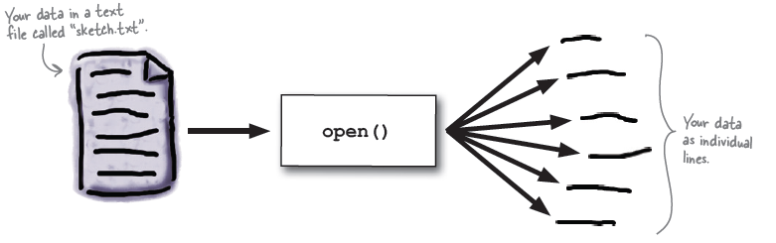
Opening a File
Python’s open function, which expects a file name and a mode string as arguments, opens a connection to the file on disk and returns a file object
The following code opens a file object on a file named myfile.txt for output
>>> f = open("myfile.txt", 'w')
‘w' indicates that this file is open for writing

Slide 9
Opening a File for Writing
To write a file, open it with mode 'w' as a second parameter
>>> fout = open('output.txt', 'w')
>>> print fout
<open file 'output.txt', mode 'w' at 0xb7eb2410>
If the file already exists, opening it in write mode clears out the old data and starts fresh
If the file doesn’t exist, a new one is created

Slide 10
Writing Text to a File – write()
The write method puts data into the file
>>> line1 = " First line.\nSecond line.\n "
>>> fout.write(line1)
or
>>> fout.write("First line.\nSecond line.\n")
The file object keeps track of where it is
If the write method is called again, it adds the new data to the end
>>> line2 = "the emblem of our land.\n"
>>> fout.write(line2)

Slide 11
Closing a File
When the writing to a file is over, close the file
>>> fout.close()
Failure to close an output file can result in data being lost
Many systems accumulate data values in a buffer before writing them out as large chunks; the close operation guarantees that data in the final chunk are output successfully

Slide 12
Writing Numbers to a File
The file method write expects a string as an argument
Other types of data, such as integers or floating-point numbers, must first be converted to strings before being written to an output file
In Python, the values of most data types can be converted to strings by using the str function
The resulting strings are then written to a file with a space or a newline as a separator character

Slide 13
Writing Numbers to a File - Example
# The code illustrates the output of integers to a text file
# Five hundred random integers between 1 and 500 are generated and written to a text file #named integers.txt
#The newline character is the separator
import random
f = open("integers.txt", 'w')
for count in range(500):
number = random.randint(1, 500)
f.write(str(number) + '\n')
f.close()

Slide 14
Opening a File for Reading
The mode string, of opening a file for input, is 'r‘
However, if a file with that name is not accessible, Python raises an error
The code for opening myfile.txt for input:
>>> f = open("myfile.txt", 'r')

Slide 15
Reading Text from a File – read()
# code shows how to use the method read
>>> text = f.read()
>>> text
'First line.\nSecond line.\n'
>>> print(text)
First line. Second line.
After input is finished, another call to read would return an empty string, to indicate that the end of the file has been reached
To repeat an input, the file must be reopened, in order to “rewind” it for another input process

Slide 16
Reading Text from a File – for loop
A for loop is used to read and process the text one line at a time
The for loop views a file object as a sequence of lines of text
On each pass through the loop, the loop variable is bound to the next line of text in the sequence
# code reopens example file and visits the lines of text in it
>>> f = open("myfile.txt", 'r')
>>> for line in f:
… print(line)
First line.
Second line # print appears to output an extra newline. This is because each line of # text input from the file retains its newline character.

Slide 17
Reading Text from a File – readline()
To read a specified number of lines from a file, use the file method readline
The readline method consumes a line of input and returns this string, including the newline
If readline encounters the end of the file, it returns the empty string
# code segment uses the while True loop, to input all of the lines of text with readline
>>> f = open("myfile.txt", 'r')
>>> while True:
… line = f.readline()
… if line == "":
… break
… print(line)
First line.
Second line.

Slide 18
Reading Numbers from a File
All of the file input operations return data to the program as strings
If these strings represent other types of data, such as integers or floating-point numbers, the programmer must convert them to the appropriate types before manipulating them further
In Python, the string representations of integers and floating-point numbers can be converted to the numbers themselves by using the functions int and float, respectively

Slide 19
Reading Numbers from a File – Example 1
# The code segment opens the file of random integers written earlier, reads # them, and prints their sum.
f = open("integers.txt", 'r')
theSum = 0
for line in f:
line = line.strip()
number = int(line)
theSum += number
print("The sum is", theSum)

Slide 20
Reading Numbers from a File – Example 2
# the code modifies the previous one to handle integers separated by spaces # and/or newlines
f = open("integers.txt", 'r')
theSum = 0
for line in f:
wordlist = line.split()
for word in wordlist:
number = int(word)
theSum += number
print("The sum is", theSum)

Slide 21
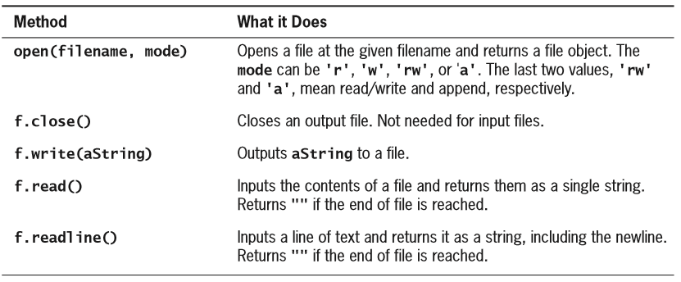
Summary of File Operations

Slide 22
Summary
A text file is a software object that allows a program to transfer data to and from permanent storage on disk, CDs, or flash memory
A file object is used to open a connection to a text file for input or output
The file method write is used to output a string to a text file
The file method read inputs the entire contents of a text file as a single string
The file method readline inputs a line of text from a text file as a string
The for loop treats an input file as a sequence of lines
On each pass through the loop, the loop’s variable is bound to a line of text read from the file

