Slide 1
Trees
18ESC108A Elements of Computer Science and Engineering
B. Tech. 2018
Ami Rai E.
Roopa G
Chaitra S
Department of Computer Science and Engineering
Faculty of Engineering and Technology
Ramaiah University of Applied Sciences

Slide 2
Objectives
At the end of this lecture, student will be able to
use the structure and operations of a binary tree data structure

Slide 3
Contents
Trees
Binary Trees

Slide 4
Trees
Trees in Computer Science terminology refer to hierarchical structured data representations
A nonlinear, two-dimensional data structure with special properties
Trees consist of nodes with a parent-child relation

Slide 5
Tree Data Structures
Tree has root at the top and branches grown down ending in leaves
Each link in the root node refers to a child
The left child is the first node in the left subtree
Right child is the first node in the right subtree

Slide 6
Tree Terminology
Root: A node without a parent
Internal Node: A node with at least one child
Leaf (or External Node): A node without a child
Ancestor of a node: Parent, grand-parent, grand-grand-parent, etc.
Descendent of a node: Child, grand-child, great-grand-child, etc.
Depth of a node: Number of ancestors of the node
Height of the Tree: Maximum depth of any node in the Tree

Slide 7
Example of a Tree
root is node A
Internal (branch) nodes are nodes A, B, C, F
External nodes (leaves) are nodes E, I, J, K, G, H, D
Depth of node F is 2
Height of T is 3
Ancestors of node H are C and A
Children of node A are B, C and D
Nodes B, C and D are siblings
Descendants of node B are E, F, I, J and K
A
B
C
D
E
F
G
H
I
J
K

Slide 8
Binary Trees
Each node has at most two children
Left child and right child
Alternative recursive definition
A Binary Tree is either a Tree with a single node
Or, a Tree whose root has an ordered pair of children, each of which is a Binary Tree
Applications
Binary (e.g., arithmetic) expression evaluation
Binary search algorithms
Decision logic implementation

Slide 9
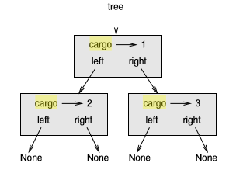
Trees in Python
Trees are recursive data structures because they are deﬁned recursively
A tree is either
the empty tree, represented by None, or
a node that contains an object reference and two tree references
A state diagram for a tree
(cargo means data part)

Slide 10
Building Trees
Each constructor invocation builds a single node
class Tree:
def __init__(self, data, left=None, right=None):
self.data = data
self.left = left
self.right = right
def __str__(self):
return str(self.data)
The data can be any type, but the arguments for left and right should be tree nodes
left and right are optional
the default value is None

Slide 11
Building Trees contd.
To print a node, just print the data
One way to build a tree is from the bottom up
Allocate the child nodes ﬁrst:
left = Tree(2)
right = Tree(3)
Then create the parent node and link it to the children
tree = Tree(1, left, right);
This code can be written more concisely by nesting constructor invocations
>>> tree = Tree(1, Tree(2), Tree(3))

Slide 12
Traversing Trees
The most natural way to traverse a tree is recursively
For example, if the tree contains integers as data, this function returns their sum:
def total(tree):
if tree == None: return 0
return total(tree.left) + total(tree.right) + tree.data
The base case is the empty tree, which contains no data, so the sum is 0
The recursive step makes two recursive calls to ﬁnd the sum of the child trees
When the recursive calls complete, we add the data of the parent and return the total

Slide 13
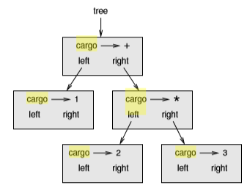
Expression Trees
A tree is a natural way to represent the structure of an expression
Consider the inﬁx expression 1 + 2 * 3
This expression tree represents the same computation:
We can build this tree like this
>>> tree = Tree(’+’, Tree(1), Tree(’*’, Tree(2), Tree(3)))

Slide 14
Tree Traversals
The fundamental algorithm on Trees is Traversal
Visit each node of the Tree
Optionally perform some operation during each visit
Types of Tree traversals
Preorder traversal
Postorder traversal
Inorder traversal
Tree traversal is recursive in nature; the traversal algorithms are expressed recursively

Slide 15
Preorder Traversal
Each node is visited before all of its descendents
The steps for a preOrder traversal
Process the value in the node
Traverse the left subtree preorder
Traverse the right subtree preorder
The value in each node is processed as the node is visited

Slide 16
Preorder Traversal – Python Code
We can traverse an expression tree and print the contents like this:
def printTree(tree):
if tree == None: return
print(tree.data)
printTree(tree.left)
printTree(tree.right)
The output is:
>>> tree = Tree(’+’, Tree(1), Tree(’*’, Tree(2), Tree(3)))
>>> printTree(tree)
+ 1 * 2 3

Slide 17
Postorder Traversal
Each node is visited after its descendents
The steps for a postOrder traversal
Traverse the left subtree postOrder
Traverse the right subtree postOrder
Process the value in the node
The value in each node is not printed until the values of its children are printed

Slide 18
Inorder Traversal
The steps for an inOrder traversal
Traverse the left subtree inOrder
Process the value in the node
Traverse the right subtree inOrder
The value in a node is not processed until the values in its left subtree are processed
The inOrder traversal of a binary search tree prints the node values in ascending order

Slide 19
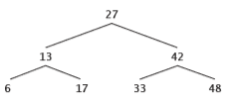
Traversal - Example
Preorder
27 13 6 17 42 33 48
Postorder
6 17 13 33 48 42 27
Inorder
6 13 17 27 33 42 48

Slide 20
Summary
Trees are two dimensional data structures incorporating parent-child relationship
Binary Trees are among the most used data structures
Arithmetic expressions (and polynomials) are best represented and evaluated using Binary Trees
The height of a Tree is crucial for efficient implementation of algorithms using it

