Slide 1
DonHub
UNIVERSITY MARKETPLACE

Slide 2
contents
Introduction
Project Overview
Functional Requirements
Non-Functional Requirements
System Models
System Architecture

Slide 3
donHub
Project Overview
DonHub serves as a tailored university digital marketplace, streamlining transactions for textbooks, electronics, and essentials.
By fostering connections within the community, it promotes affordability, sustainability, and secure local trade, enhancing the overall university experience.

Slide 4
WHAT IS DONHUB?
Exclusive University Marketplace: Tailored for our university’s unique needs.
Easy buying and selling – all in one place.
User-Centric Design: Intuitive, easy-to-use, and made for everyone.
Safe & Secure: Advanced encryption and authentication for peace of mind.
Sustainability Advocate: Promoting reuse and reducing waste on campus.
Community Building: Connect, collaborate, and strengthen university ties.
Cost-Efficient Solutions: Save money and get what you need.
Localized Experience: No hassles. Buy and sell within the university.
Educational Integration: Share, trade, or sell academic resources.

Slide 5
Purpose of DonHub
Waste Generation Statistics | Benefits of using DonHub
Textbooks: - $1,200 spent annually on new textbooks by U.S. students. - Contributes to paper waste. | - Reusing textbooks, reduces waste and saves money.
Electronics: - 53.6 million metric tons of e-waste generated globally in 2019. | - List and buy used electronics, extend device life, and reduce e-waste.
Clothing: - Millions of tons of clothing discarded yearly. - £140 million worth of clothing discarded by UK consumers annually. | - Promote sustainable fashion by buying and selling used clothing.
Furniture & Items: - 9.8 million tons of furniture waste in 2018. | - List items for sale, minimize waste, and save money for all.

Slide 6
Functional Requirements
Admin functionalities
User removal by admin
Notifications
Users should be able to get notifications on price changes.
Item search using keywords.
Item availability
Users should be able update the status of the item whether it is available or sold.
Categories
Users should be able fetch products based on predefined categories.
Sorting
Users should be able to sort items on price, date and condition.

Slide 7

Non-functional requirements

Slide 8
Nice to haves
Built-in Messenger
Facilitates communication between sellers and buyers, making it easy to negotiate price.
Payment Gateways
Facilitates online transactions ensuring security and reliability of electronic payments.

Slide 9
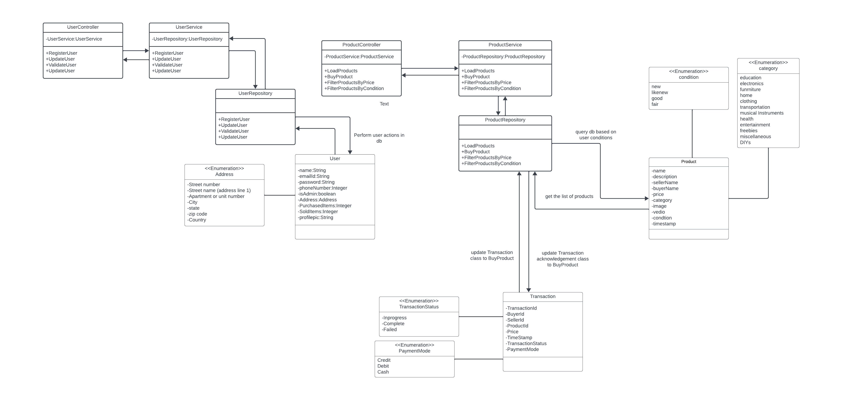
SYSTEM MODELS
Class Diagram

Slide 10
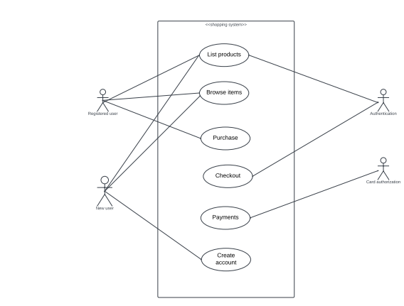
Use Case Diagram

Slide 11
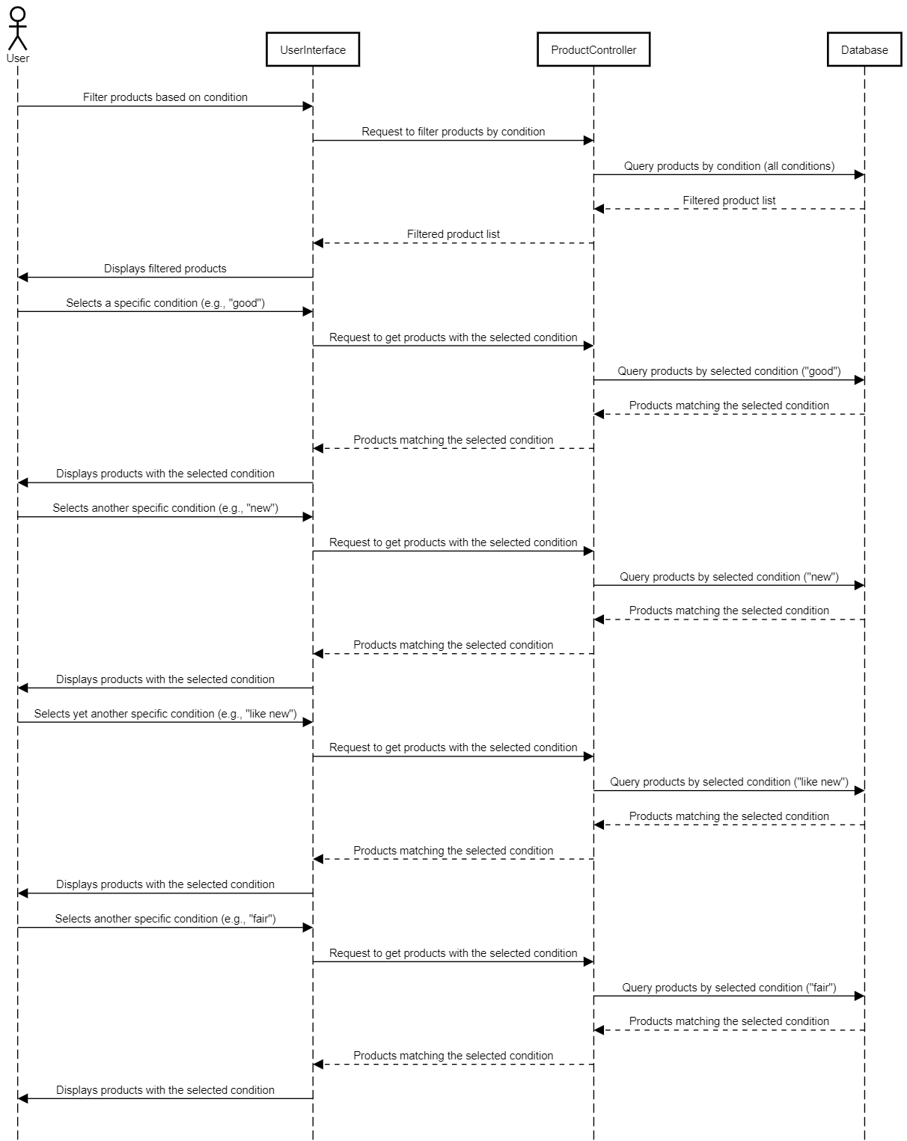
Sequence Diagram

Slide 12
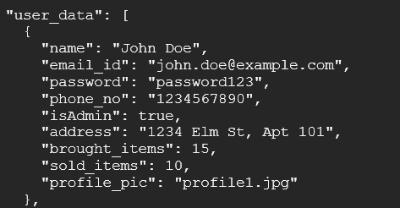
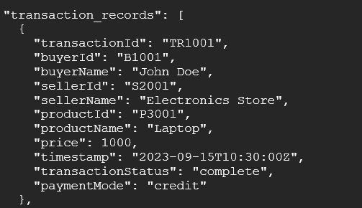
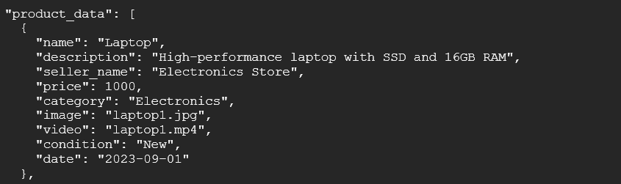
Sample Data

Slide 13
System architecture
Client server architecture
Client: Students and staff
Server: User/product management, notifications, chats.
Communication between client and server: HTTP requests, real-time updates using WebSockets.
Database: MongoDB
Security: Data encryption, authentication

Slide 14
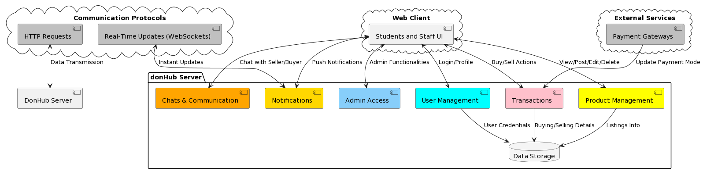
Client – server architecture

Slide 15
Event-driven architecture
Key events: Listing, making an offer, messaging.
Event producers: User posts a new listing
Event consumers: Perform actions based on events
Event broker: Central hub for managing, routing events.
Asynchronous processing: Allows components to operate independently.
Microservices: Both event producers and consumers.
Data Synchronization: Maintain data consistency.

Slide 16
THANK YOU!

