Slide 1
Solving the ARC Challenge with Large Language Models as Multiple Expert Agents

Slide 2
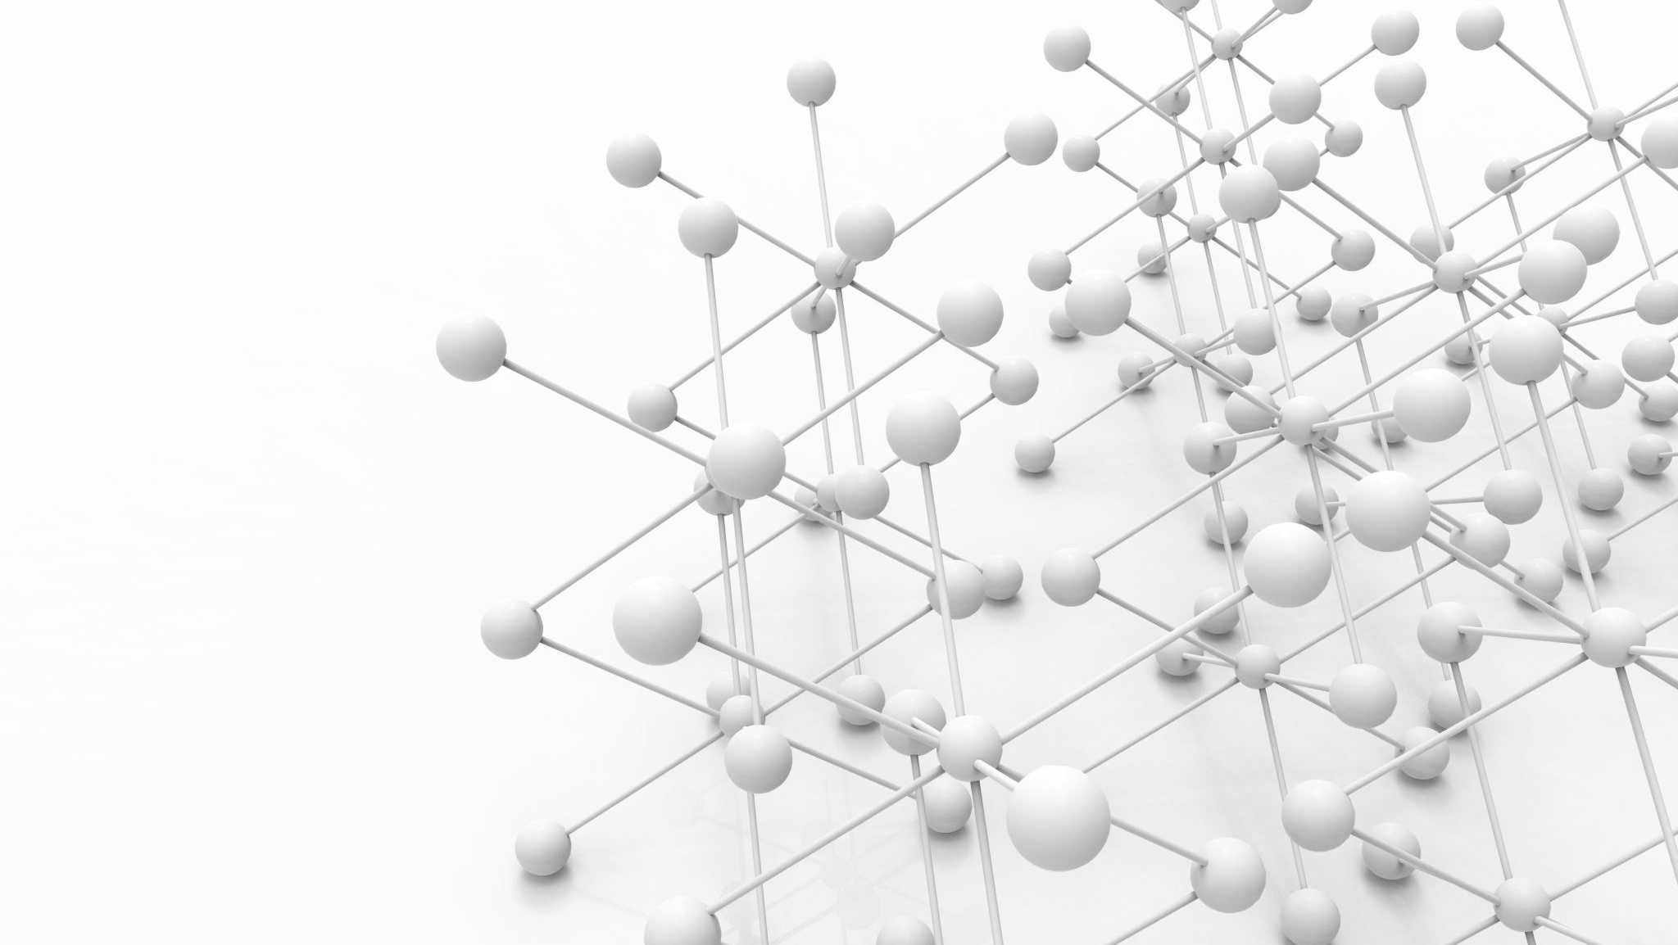
The Abstraction and Reasoning Corpus (ARC) is a benchmark designed to evaluate the ability of artificial intelligence (AI) systems to perform abstract reasoning. It consists of visual puzzles where the goal is to figure out how to transform an input grid into an output grid based on a few examples.
Challenges in Solving ARC
ARC is difficult because: Traditional AI models like deep learning require vast amounts of data.
ARC problems are designed to require abstract reasoning, the type of thinking that humans use when identifying patterns, relationships, in visual puzzles..

Slide 3
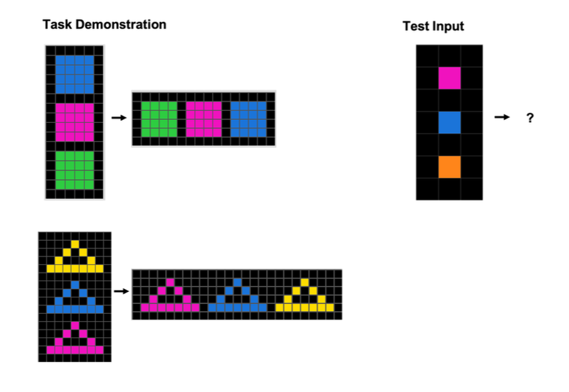
It’s an important step towards Artificial General Intelligence (AGI), which requires learning without extensive data.

Slide 4
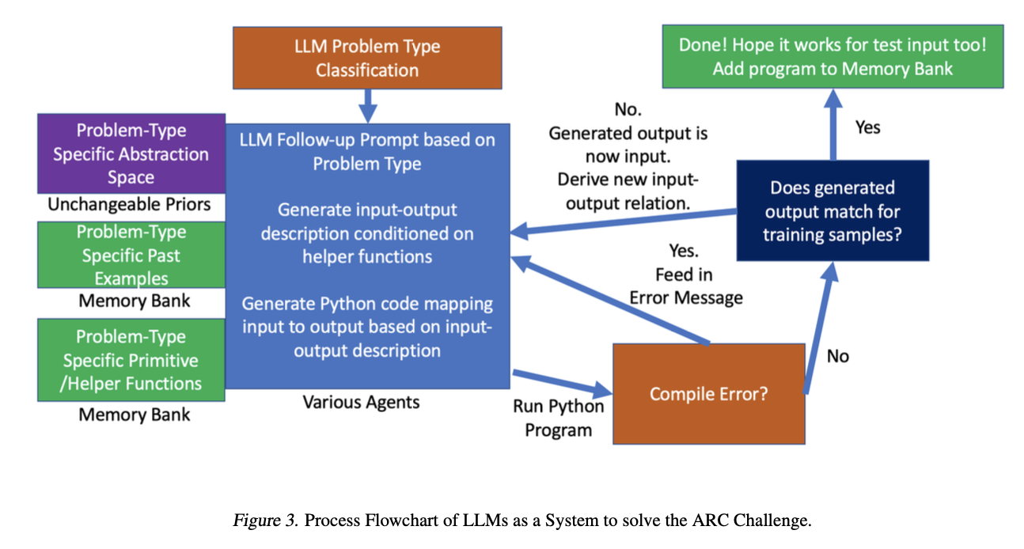
The authors propose using Large Language Models (LLMs) as a system of multiple expert agents to solve ARC tasks
LLMs use different abstraction spaces (Grid, Object, Pixel) and iterative feedback to learn and improve.GPT-4 is the primary model used, solving 45% of ARC training tasks.

Slide 5
Three key abstraction spaces are used to solve ARC tasks:
Grid View: The grid as a whole, using characters to represent pixels.
Object View: Identifies objects based on contiguous pixels.
Pixel View: Tracks individual pixel coordinates and values.
By breaking down the input into multiple views, the LLM can process and analyze the grid in more than one way, increasing the chances of identifying the correct transformation rules.

Slide 6
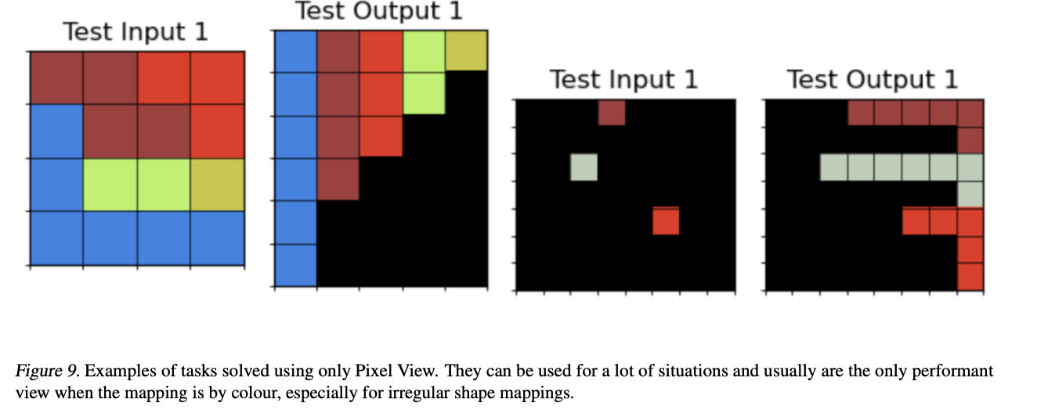
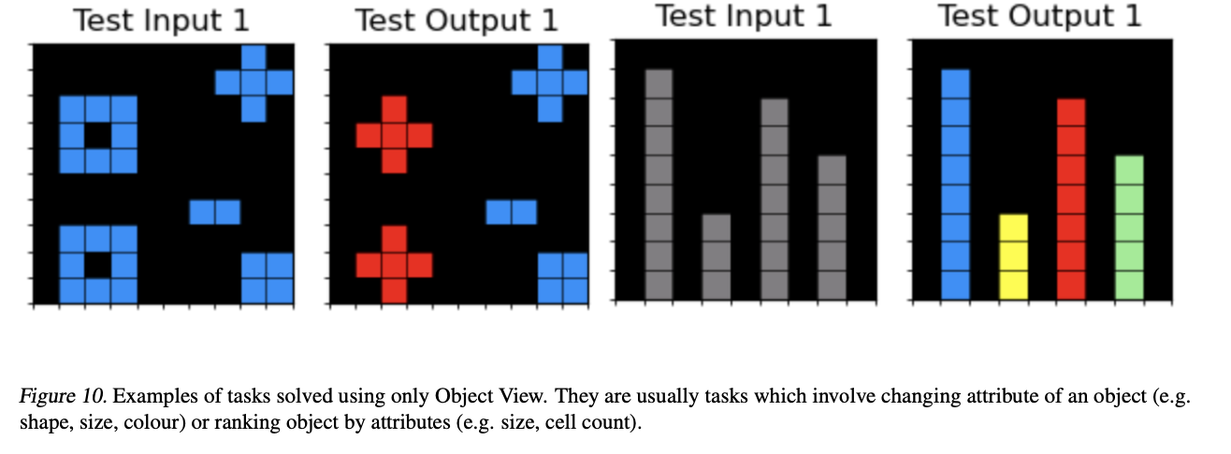
Results
The approach achieved a 45% solve rate on ARC tasks. Combining different abstraction spaces and using feedback improved performance..
examples

Slide 7
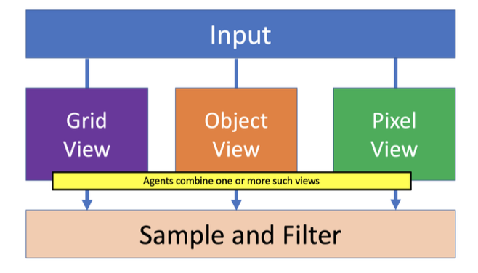
ACCORDING TO THE PAPER
Overall, LLMs as a system of multiple expert agents with
environmental feedback is a promising approach towards
solving the ARC Challenge
Future
Uses brute force method because the system does not yet have the problem type classification step implemented in the paper . Instead of selecting specific expert agents or abstraction spaces based on the nature of the task, the system runs multiple expert agents (such as Grid View, Object View, and Pixel View) for each task and then filters the results to find a solution.

Slide 8


