Slide 1
Efficacy of Consumer Choice on House Rent

Slide 2
Agenda
OBJECTIVE
BACKGROUND
KEY FINDINGS
RECOMMENDATIONS
APPENDIX: DATA ATTRIBUTES DATA METHODOLOGY DATA ASSUMPTIONS

Slide 3

Objective
Develop a shared understanding of market conditions
Deepening shared understanding of customers
Make recommendations for different departments to prepare for post-pandemic change

Slide 4
Background
Major decline in revenues due to the pandemic in the last few months
Restrictions are lifted
People are traveling more

Slide 5
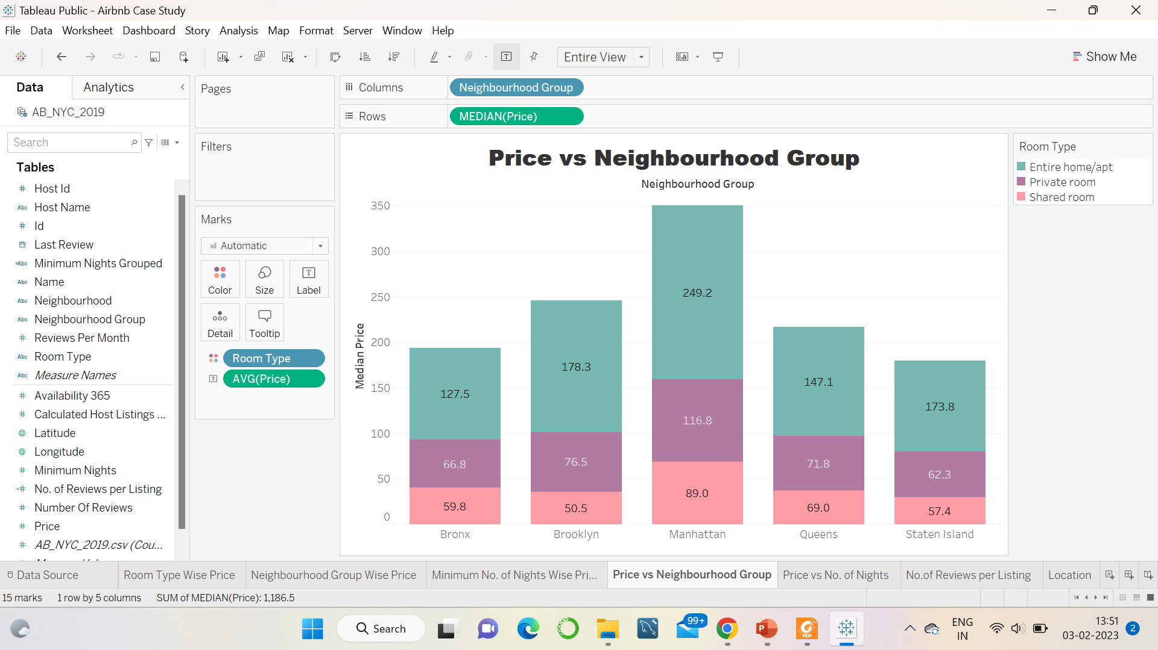
Pricing of the desired Locations
With the ~150% exception of Brooklyn and Staten Island, the entire house/apartment is ~100% more expensive than a private room.
Private rooms are ~10% more expensive than shared rooms, but ~40% more in Brooklyn and Manhattan.
Manhattan is the most expensive overall and the cheapest are:
Entire apt: Bronx
Private room: Staten Islands
Shared room: Brooklyn

Slide 6
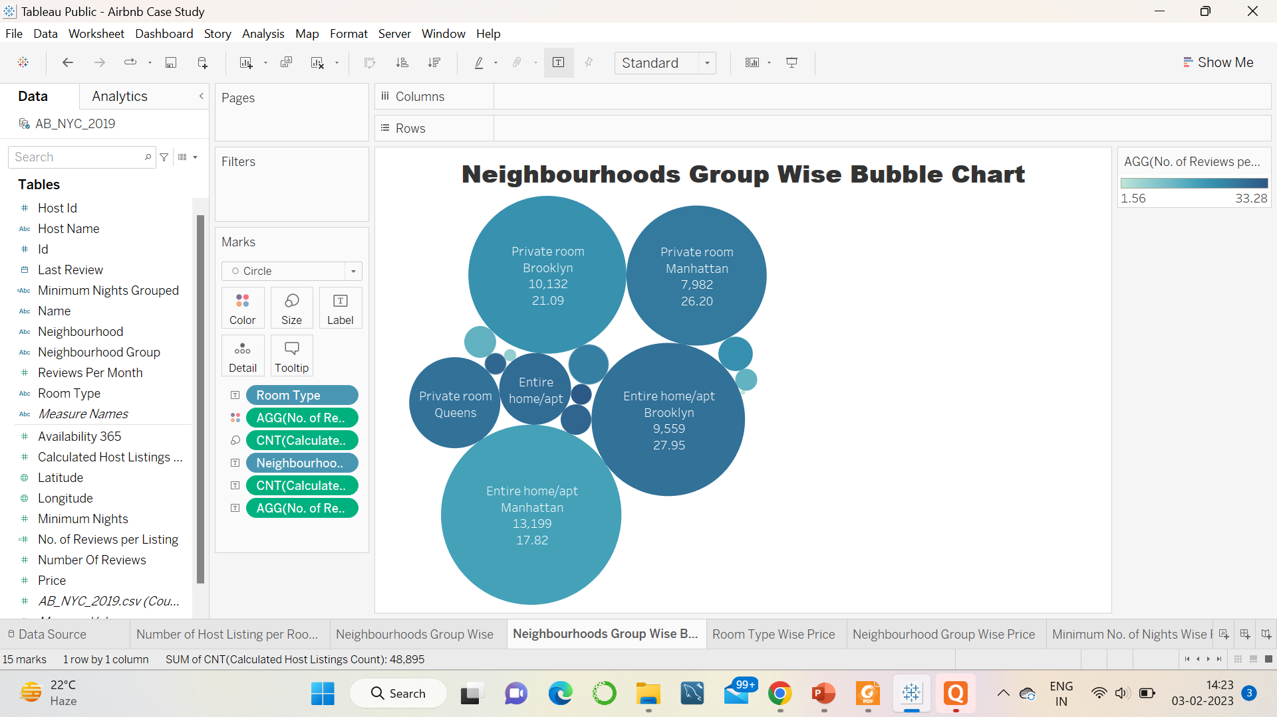
Neighbourhood Group Wise Distribution
Private rooms are the most popular across New York with 25+ reviews per listing
Overall Manhattan homes have a 35% lower rating per listing than the average of 27.7.
With the exception of Manhattan, all shared dormitory areas performed poorly, with an average rating of 7.3 per entry.

Slide 7
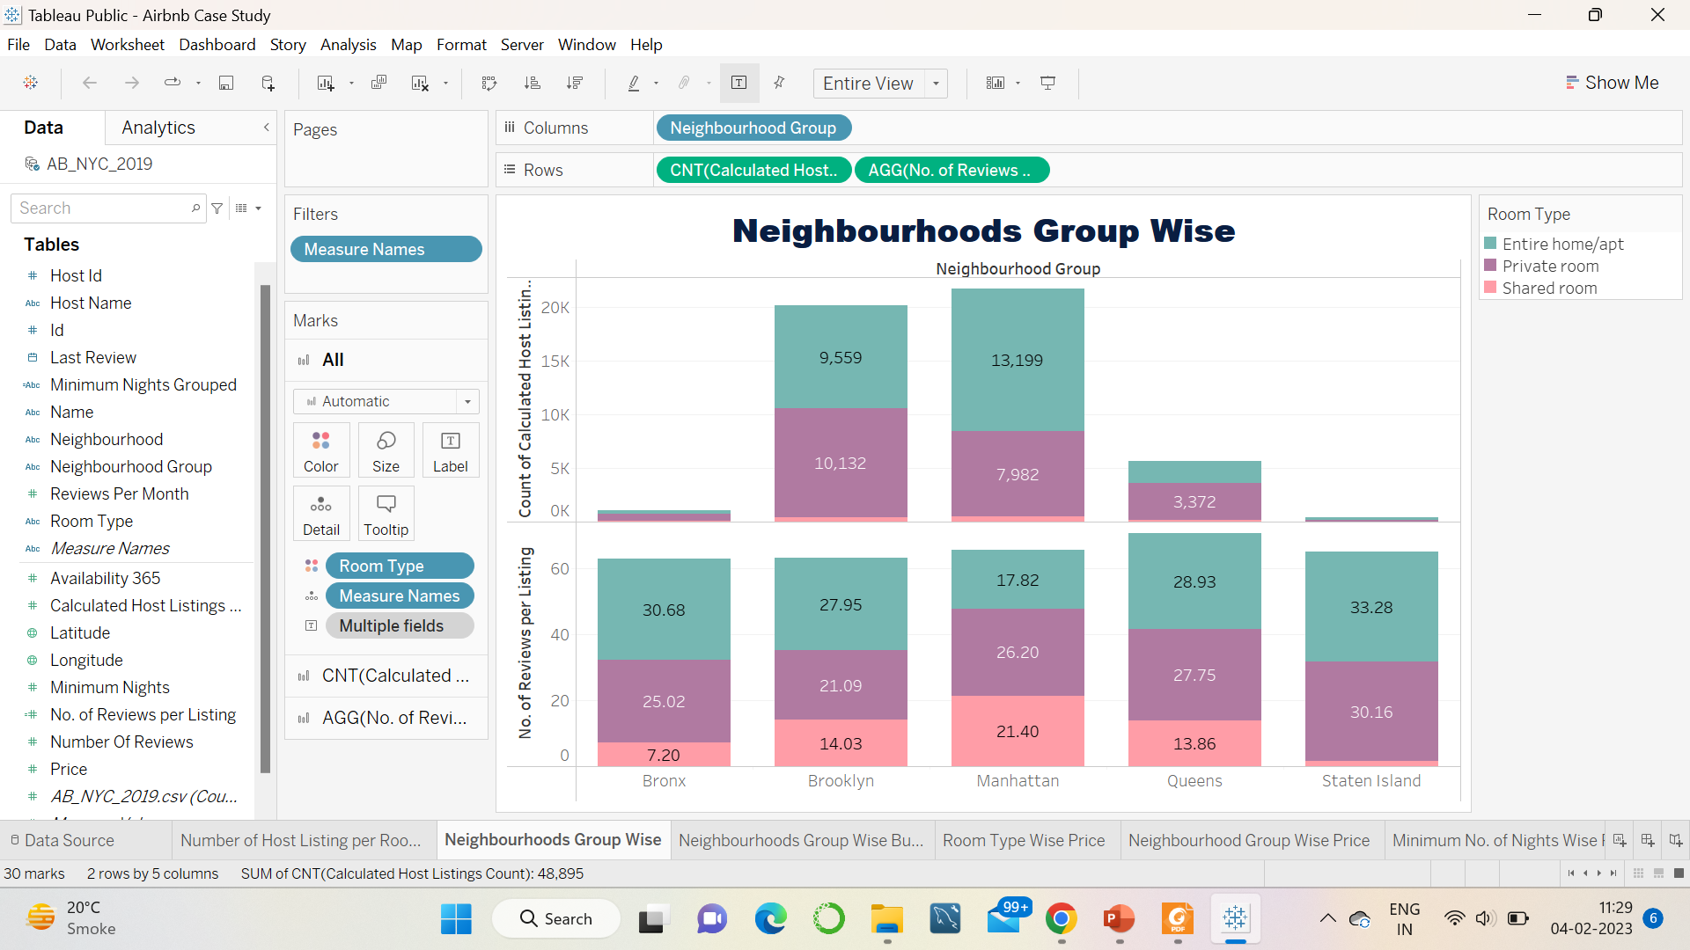
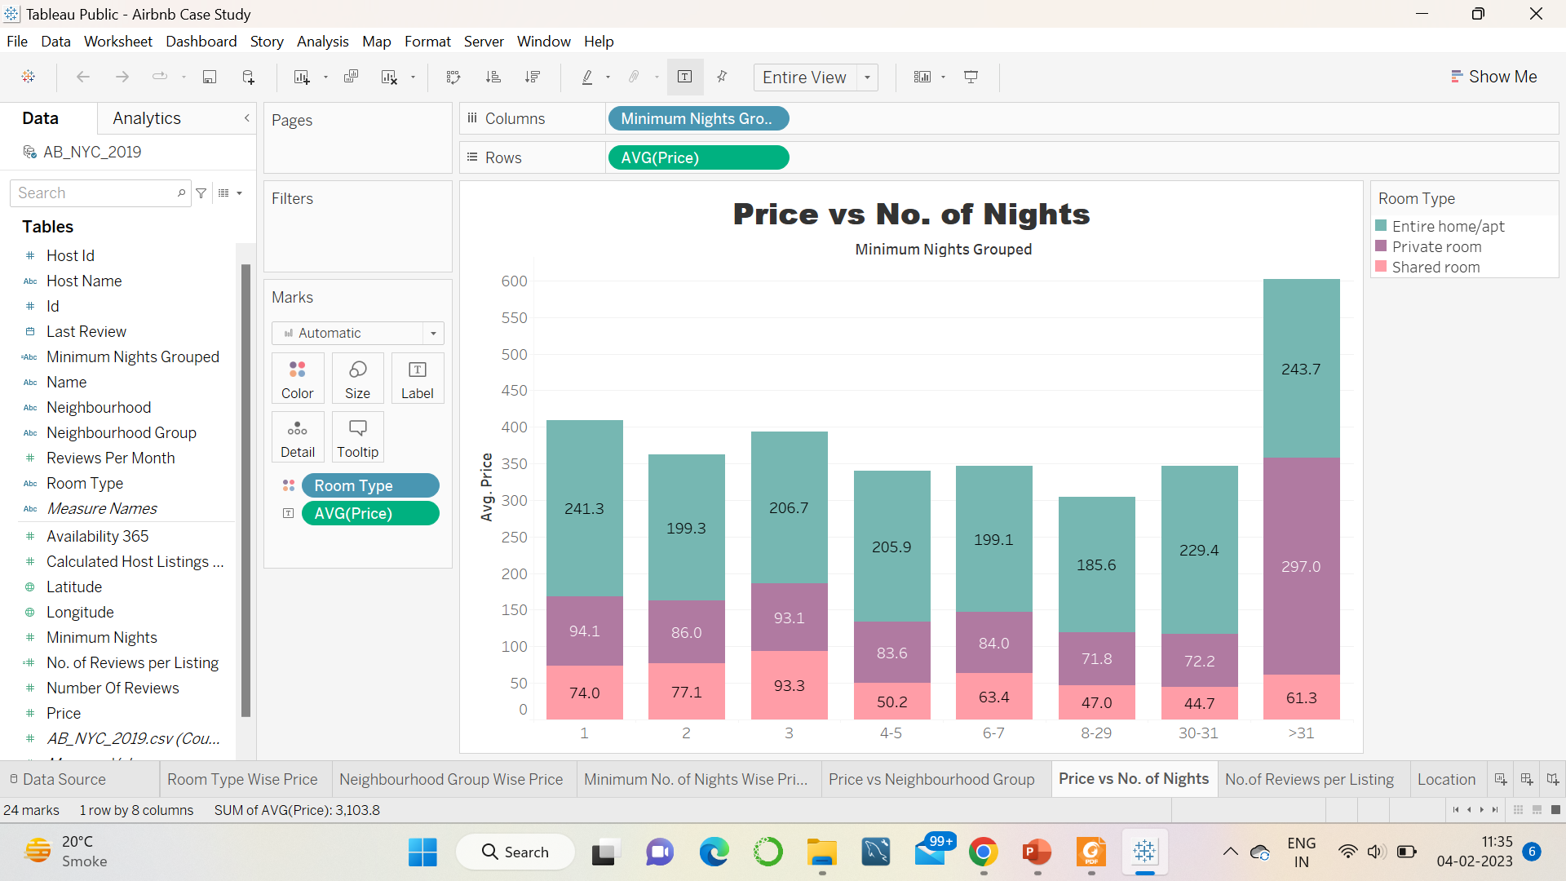
Recommendations
Especially popular in the Staten Islands, so obtain a private room or an entire apartment
Lower the price of all Manhattan apartments by at least 15% and raise the price of private rooms in Queens by at least 10%
The most popular listings have a minimum night stay of 1-5 days and 30 days and are most often displayed by sorting by properties with low availability on most days

Slide 8
Appendix: Data Attributes
Here is an overview of the data:
Host list information such as host name, neighbor, latitude and longitude
Information about customer preferences such as number of reviews and number of monthly reviews

Slide 9
Appendix: Data Methodology
Visualized properly for insights with Tableau
The analysis used the median instead of the mean due to outliers in the price field
Detailed methodological documentation can be found under “Methodological Documentation”.

Slide 10
Appendix: Data Assumptions
Collected information about customer preferences using reviews for each ad as an indicator of popularity
The number of reviews is considered to be the standard measure for judging customer preferences
Null values ​​are considered to have no significant impact on the analysis

Slide 11

thank you

