Slide 1
CINEMATCH
Movie Recommender System
Recommender Systems Course | Prof. Marc Torrens | ESADE 2025
Jan Philipp Gnau

Slide 2
AGENDA
1. Problem & Dataset
2. Non-Personalized Baselines
3. Content-Based Filtering (TF-IDF)
4. Collaborative Filtering (User-User & Item-Item)
5. Matrix Factorization (Biased SGD)
6. Evaluation: Accuracy, Beyond Accuracy, Trade-offs
7. Technical Challenges & Limitations
8. Ethical & Social Implications
9. UX & Prototype Demo
10. Conclusions, Future Work & Final Remarks

Slide 3
PROBLEM & DATASET
Goal: recommend movies a user will enjoy, from a catalog of 9,742 titles
Dataset: MovieLens Latest Small -- GroupLens Research (University of Minnesota)
License: research & educational use permitted (see dataset README)
100,836 ratings | 610 users | 9,742 movies | 0.5--5.0 scale
Data representation: User-Item matrix (610 x 9742), 98.3% sparse
No filtering or sampling applied -- all raw data used as-is
Train/Test split: 80/20 random, stratified by user (random_state=42)
Same dataset, 8 algorithms: enables direct, fair method comparison
Agile approach: basic evaluation running from week 1, extended iteratively

Slide 4
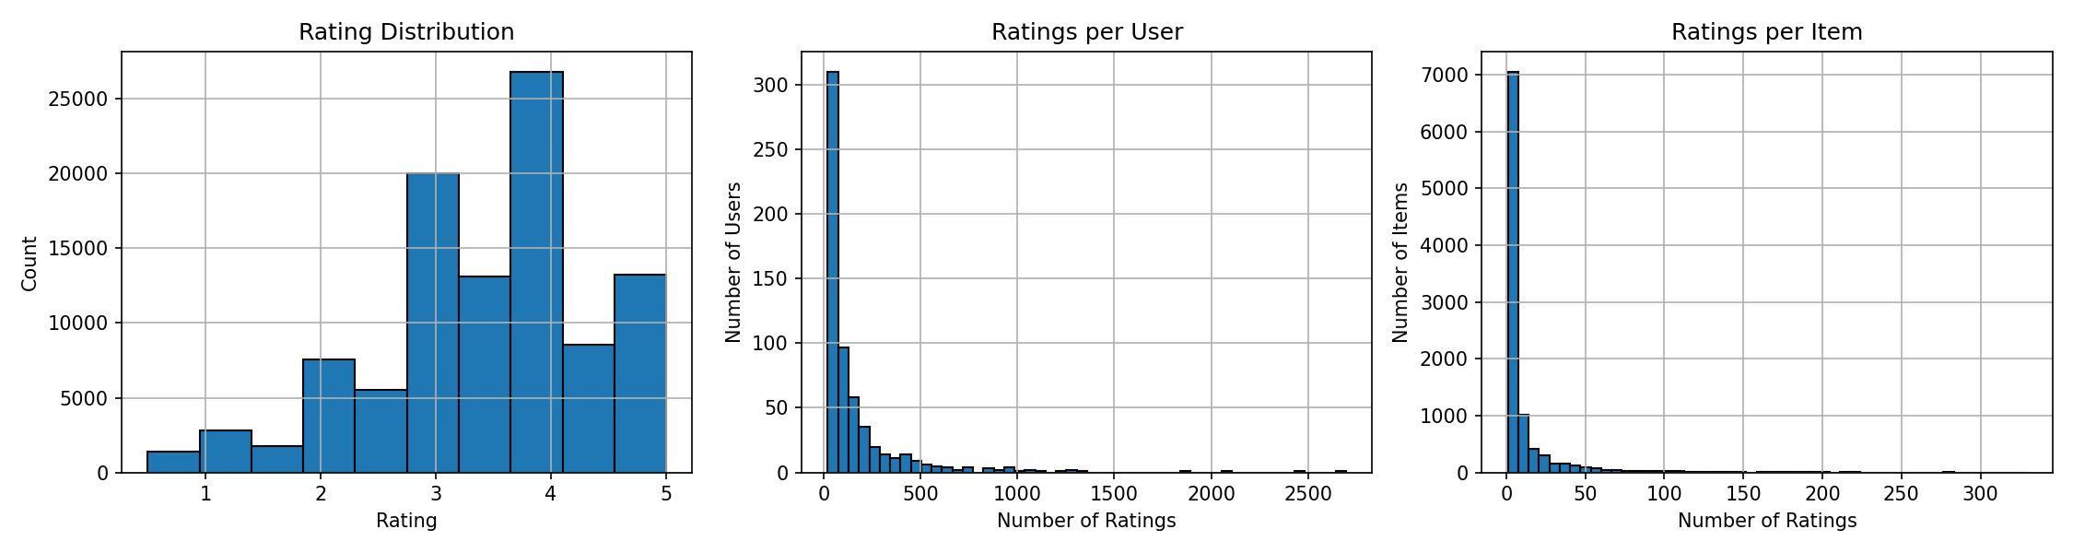
EXPLORATORY DATA ANALYSIS
Rating distribution, user activity, and item popularity from MovieLens Latest Small.

Slide 5
NON-PERSONALIZED BASELINES
Most Popular: rank by interaction count (# ratings)
Highest Average: S(u,i) = mean of all ratings for item i
-- Minimum 20 ratings filter to avoid noise (CollaborativeFiltering.pdf, Folie 12)
Random: control baseline (EvaluationRecommenderSystems.pdf, Folie 28)
Results: Most Popular achieves Precision@10 = 0.122 (best overall!)
Strength: crowd favorites are a strong signal in sparse data
Weakness: 100% popularity bias, 0% serendipity, coverage < 1%
Use case: cold-start fallback when no user history is available

Slide 6
CONTENT-BASED FILTERING
Item representation: TF-IDF on genres (ContentBasedFiltering.pdf, Folie 37)
-- Optionally enriched with user-generated tags (Folie 17)
User profile: profile(u) = Sigma_i (r_ui - r_u) * vector(i), normalized
-- (ContentBasedFiltering.pdf, Folien 27-28)
Prediction: score(u,i) = cos(profile_u, vector_i) (Folie 33)
Results: P@10 = 0.009 | Coverage = 20.6% | Diversity = 0.09
Strength: best coverage (20.6%) and lowest pop bias (18.6%) -- good for discovery
Weakness: low accuracy, limited by genre granularity (only 20 genres)
Use case: niche discovery, cold-start items (no ratings needed for items)

Slide 7
COLLABORATIVE FILTERING
User-User CF (CollaborativeFiltering.pdf, Folie 15):
S(u,i) = r_u + Sigma_v (r_vi - r_v) * w_uv / Sigma |w_uv|
Similarity: Pearson Correlation (Folie 18), top-k=20 neighbours
Item-Item CF (CollaborativeFiltering.pdf, Folie 29):
S(u,i) = r_i + Sigma_j (r_uj - r_j) * w_ij / Sigma |w_ij|
Similarity: Adjusted Cosine (Folie 26), top-k=20 neighbours
Strength: RMSE = 0.893 (User-User), highest novelty = 9.2, 0% pop bias
Weakness: near-zero P@10 -- 98.3% sparsity means too few co-rated items
Use case: rating prediction (not top-N) on denser datasets

Slide 8
MATRIX FACTORIZATION (Biased SGD)
MatrixFactorization.pdf, Folien 6-7 + Koren et al. (2009):
r_hat = mu + b_u + b_i + p_u * q_i
50 latent factors, 20 epochs, lr=0.005, reg=0.02
SGD: b_u += alpha*(e - lambda*b_u), p_u += alpha*(e*q_i - lambda*p_u)
Correct p_u_old for q_i update (simultaneous gradient)
Results: P@10 = 0.053 | RMSE = 0.881 | Hit Rate = 32.4%
Strength: best personalized method (P@10 4x higher than Content-Based)
Weakness: only 32.4% of users receive at least one relevant hit
Use case: personalized ranking at scale (O(n_ratings * k) per epoch)

Slide 9
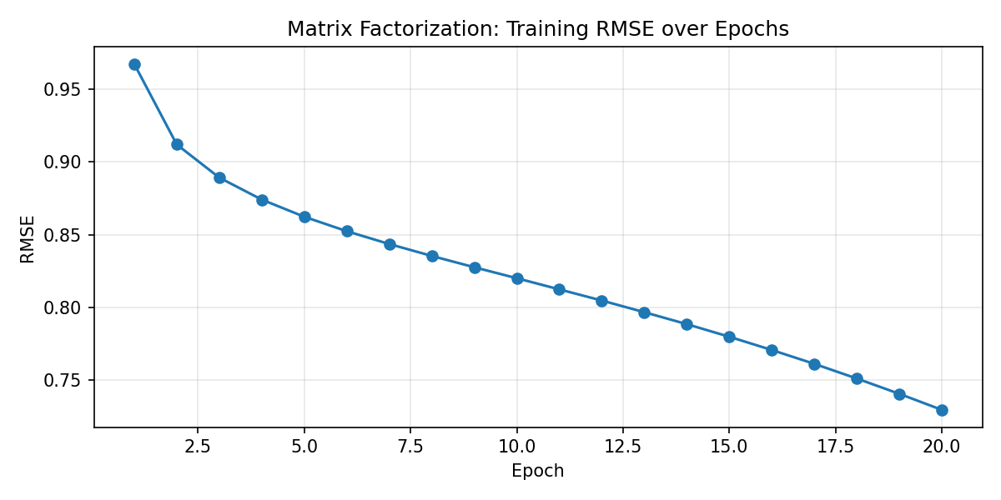
MF TRAINING CONVERGENCE
Training RMSE decreases steadily over 20 epochs, confirming proper SGD convergence.

Slide 10
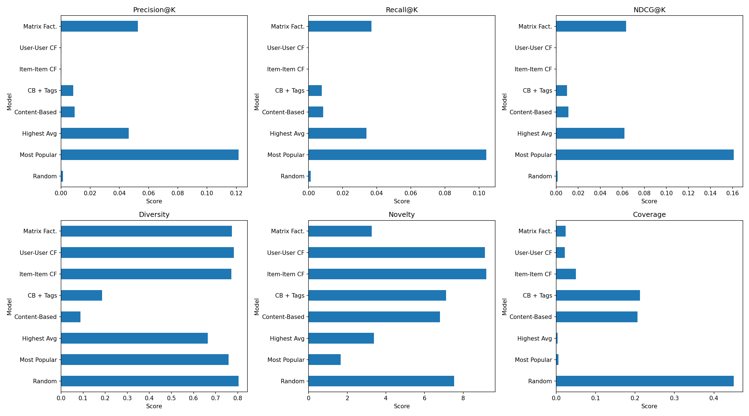
EVALUATION: ACCURACY METRICS
Prediction metrics (MAE, RMSE) and ranking metrics (Precision@10, Recall@10, NDCG@10, MRR, Hit Rate@10) across all 8 models.

Slide 11
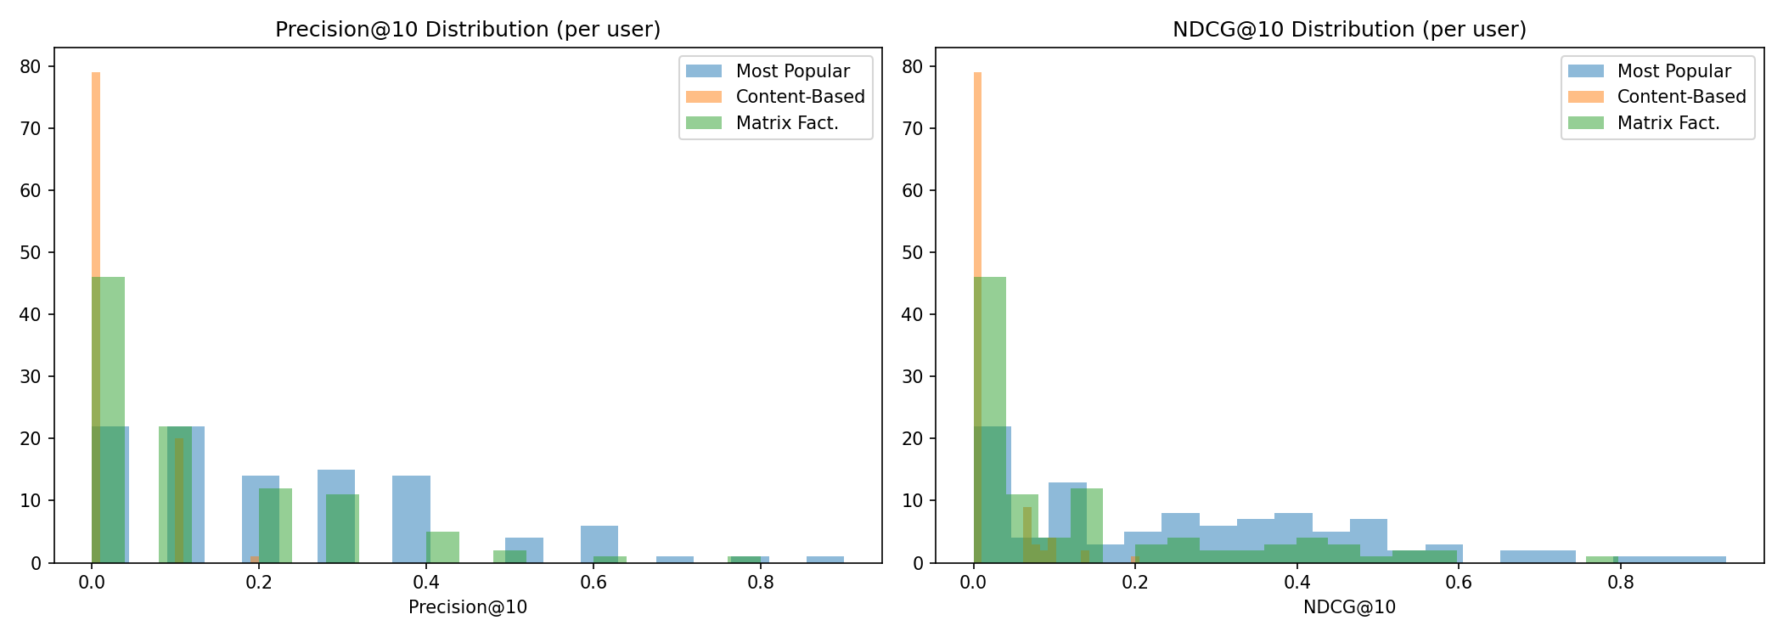
EVALUATION: BEYOND ACCURACY
Beyond-accuracy measures: Coverage, Diversity, Novelty, Popularity Bias, Serendipity, Fairness. Per-user distributions reveal high variance -- mean alone does not tell the full story.

Slide 12
METHOD COMPARISON: ALL MODELS, SAME DATA
P@10 RMSE Coverage Novelty Pop Bias Time
Most Popular 0.122 -- 0.6% 1.7 100% 0.003s
Highest Average 0.046 -- 0.3% 3.4 88% 0.005s
Content-Based 0.009 -- 20.6% 6.8 19% 0.034s
CB + Tags 0.008 -- 21.2% 7.1 16% 0.322s
User-User CF 0.000 0.893 2.1% 9.1 0% 12.35s
Item-Item CF 0.000 0.935 5.0% 9.2 0% 3.84s
Matrix Factorization 0.053 0.881 2.4% 3.3 86% 19.87s
Ranking metrics | Prediction metrics | Beyond-accuracy measures -- all three categories shown.
No single model dominates all dimensions: this IS the core lecture insight.

Slide 13
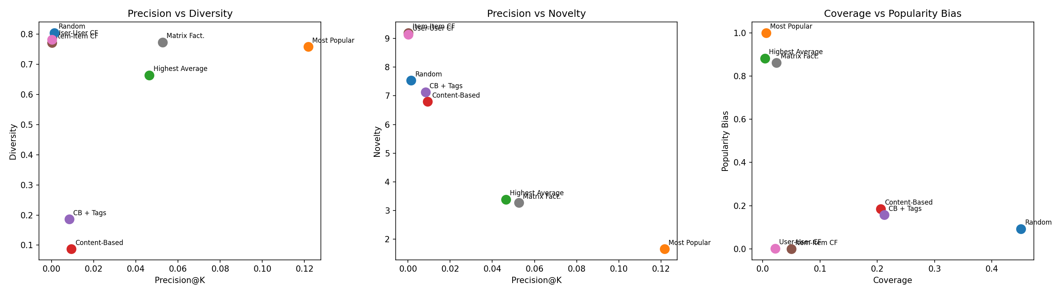
TRADE-OFF: PRECISION vs DIVERSITY vs NOVELTY
Example: Most Popular has 13x higher Precision than Content-Based (0.122 vs 0.009) but 34x lower Coverage (0.6% vs 20.6%) and 4x higher Popularity Bias (100% vs 19%). As the lectures emphasise: accuracy is not enough.

Slide 14
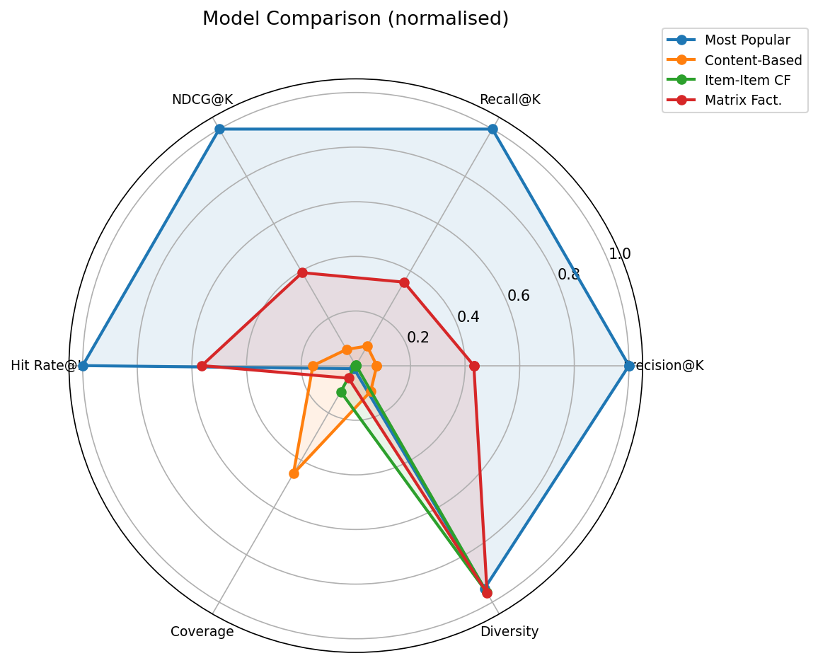
MULTI-DIMENSIONAL MODEL COMPARISON
Normalized radar chart: each model excels in different dimensions. Diversity, novelty, bias, and scalability vary as much as accuracy.

Slide 15
FAIRNESS & POPULARITY BIAS
Fairness: NDCG@K gap between heavy raters (>50th percentile) and light raters
Largest gap: Most Popular (0.156) -- heavy raters benefit disproportionately
Matrix Factorization gap: 0.143 -- also biased toward active users
CB+Tags gap: 0.005 -- most equitable across user groups
Random gap: 0.003 -- naturally fair (no personalization)
Popularity bias: Most Popular = 100% from top 10% items
CF methods = 0% popularity bias (but also near-zero precision)
Production systems need explicit debiasing strategies

Slide 16
TECHNICAL CHALLENGES & LIMITATIONS
Sparsity (98.3%): the dominant challenge -- User-User CF finds too few
co-rated items for reliable Pearson correlations, P@10 drops to ~0
Cold-start: new users without history receive non-personalized fallback;
new items without ratings are invisible to CF/MF (content-based can help)
Scalability: User-User CF = O(n_users^2 * n_items), 12.3s to train;
Most Popular = O(n_ratings), 0.003s -- 4000x faster for higher accuracy
Popularity bias: Most Popular recommends only the top 0.6% of items,
creating a rich-get-richer feedback loop in production systems

Slide 17
ETHICAL & SOCIAL IMPLICATIONS
Filter bubbles: Content-Based diversity = 0.09 -- users see increasingly
narrow genre profiles, limiting cultural exploration
Popularity bias: Most Popular (100%) surfaces the same 60 movies to all
users, marginalizing 99.4% of the catalog (rich-get-richer loop)
Fairness: heavy raters get 2x better NDCG than light raters (Most Pop gap=0.156)
Privacy: CF requires storing individual rating histories
Transparency: MF latent factors are not interpretable to end users
User autonomy: no control over recommendation logic in this prototype

Slide 18
UX & PROTOTYPE
Netflix-inspired Streamlit UI with 6 pages
Design: dark theme (#141414), consistent with CineMatch brand identity
Poster lazy loading via TMDb API with JSON cache
Pages: Home (hero + trending), Discover (search + filter + similar),
Recommendations (7 algorithms), User Profile (stats + genre radar),
Compare (side-by-side with overlap heatmap), Evaluation (full metrics)
Poster cards with hover overlay showing title, year, genres, and 'why'
Horizontal scroll rows mimicking Netflix filmstrip UX

Slide 19
FUTURE WORK
Hybrid model (CF + Content-Based): combine MF's personalized ranking
with CB's item features to address both cold-start and sparsity
Online learning: update latent factors incrementally as new ratings
arrive, instead of full retraining (critical for production deployment)
A/B testing framework: measure real user engagement (clicks, watch time),
not just offline metrics -- offline P@10 does not predict user satisfaction
Explicit debiasing: re-rank to enforce minimum diversity/coverage constraints
All four target the identified weaknesses: cold-start, sparsity, pop bias, offline gap

Slide 20
FINAL REMARKS
All formulas implemented exactly as in Prof. Torrens' lecture slides (verified audit)
Most Popular is surprisingly strong in sparse data (P@10 = 0.122) -- but only 32.4%
of users get a relevant hit even from the best personalized method (MF)
'Accuracy is not enough': diversity, novelty, bias, and scalability matter equally
No single model dominates; ensembles are the path forward (Netflix Prize, Folie 22)
When is MF worth 20s training over 0.003s Most Popular? Only when platform scale
makes a 5% precision lift translate to significant engagement gains
Honest limitation: at 98.3% sparsity all methods struggle with top-N;
academically rigorous, but production deployment requires hybrid extensions

