Slide 1
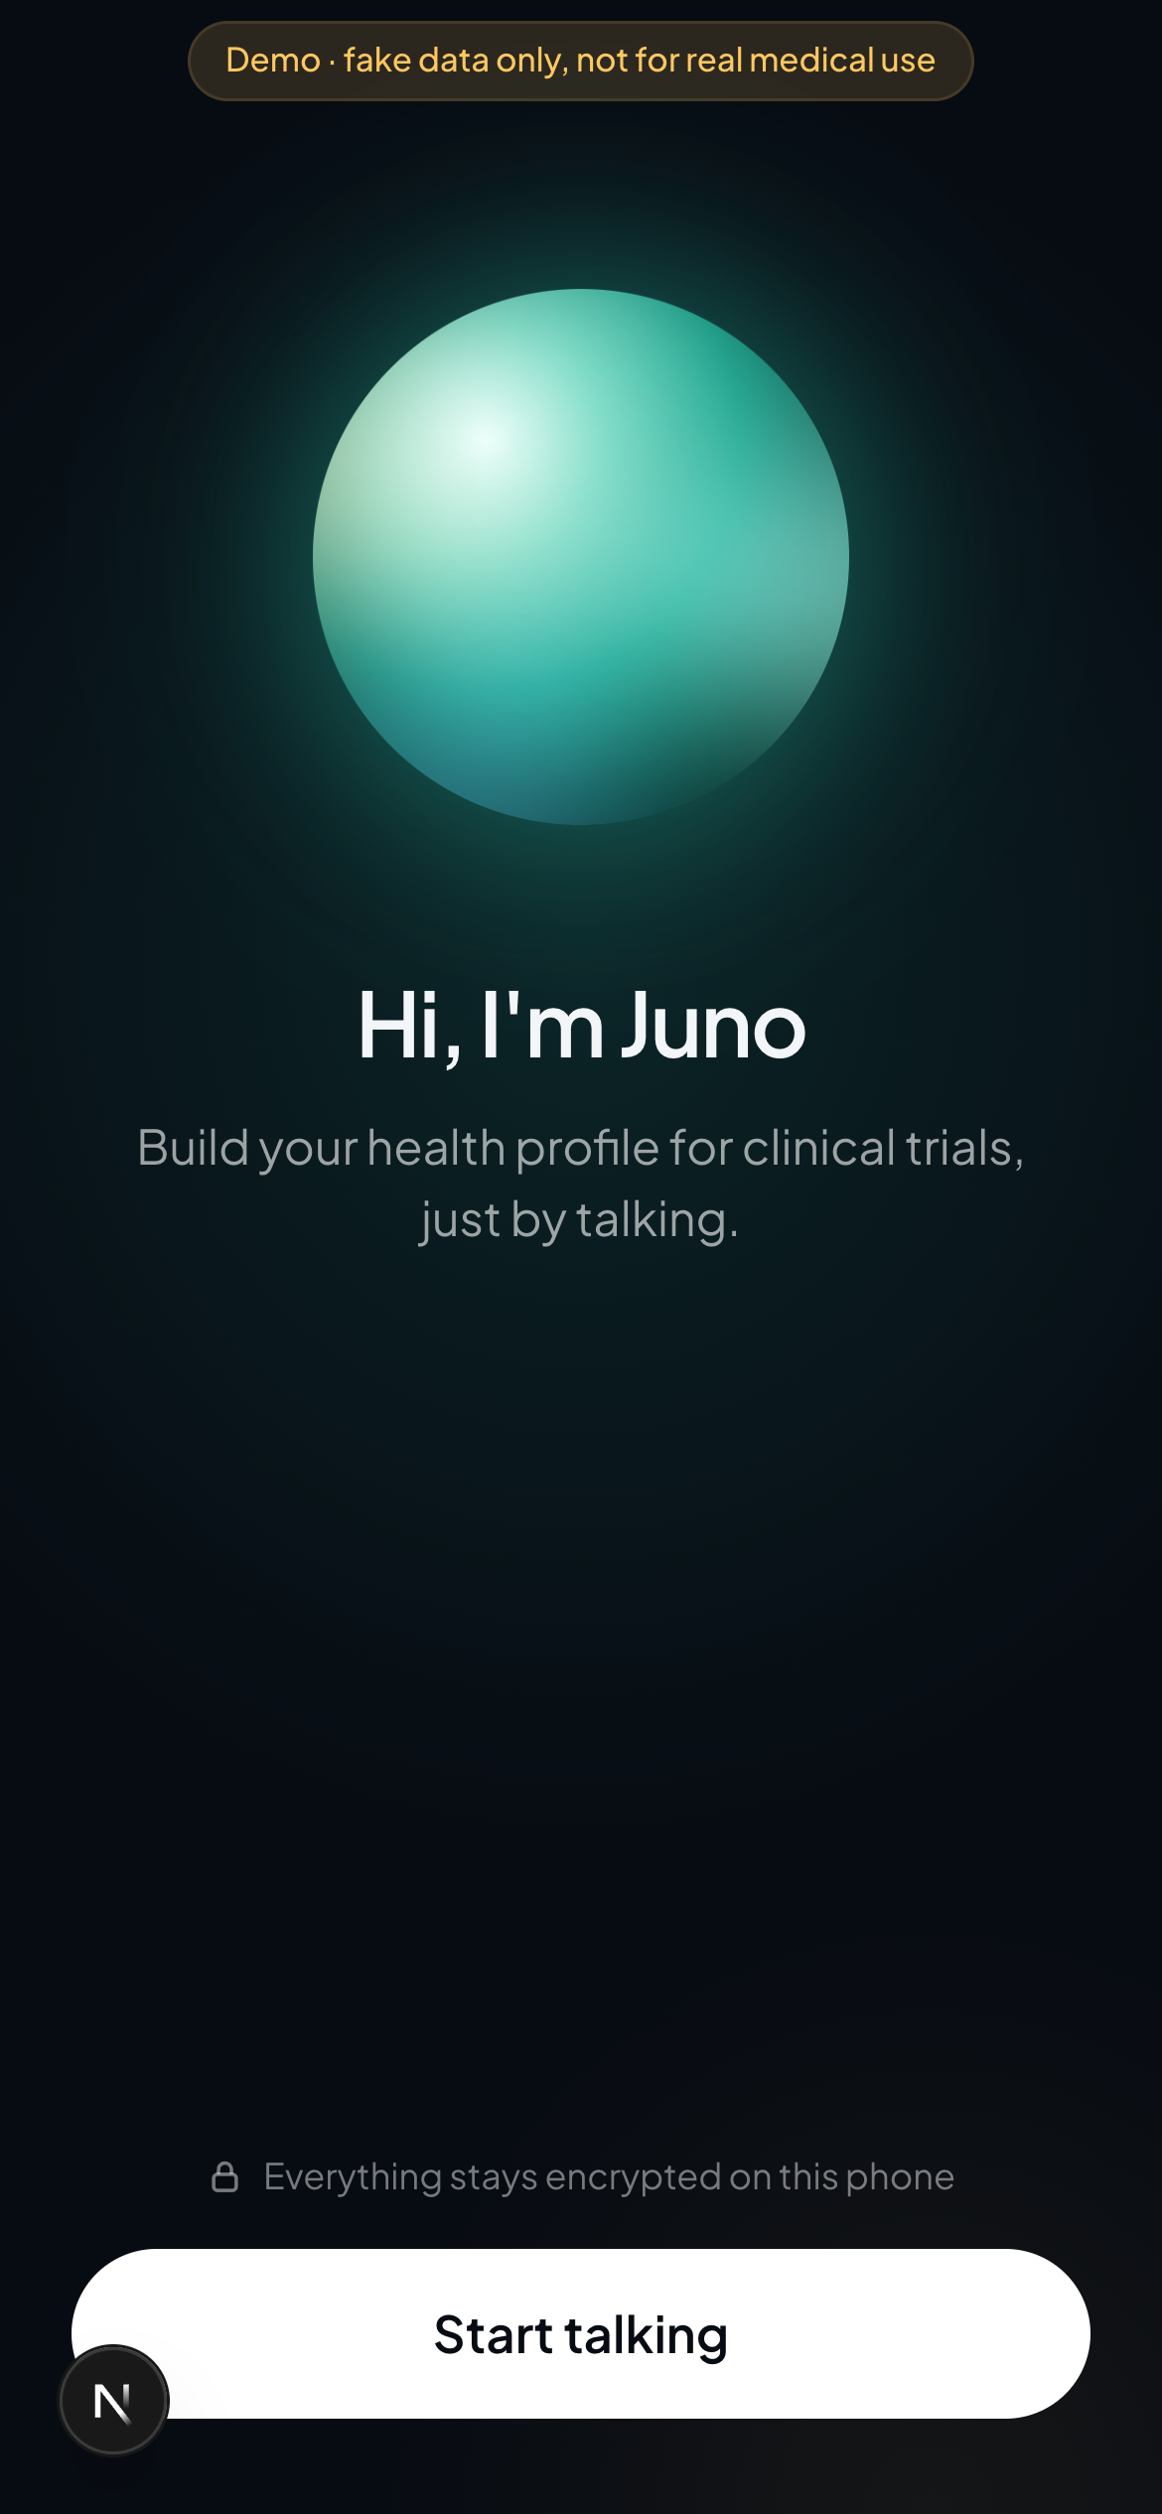

Juno
Your medical profile, built in one friendly conversation, ready for drug trials
Hackathon theme: speeding up the new drug trial process

Slide 2
Trials are slowed down by screening
Every trial needs to know a patient's medical history before they can join
Repeated forms
Slow screening
Privacy worries
Patients fill in the same history again for every trial and every site.
Staff spend phone calls and appointments just collecting the basics before checking eligibility.
Patients are rightly nervous about handing health data to yet another website.

Slide 3
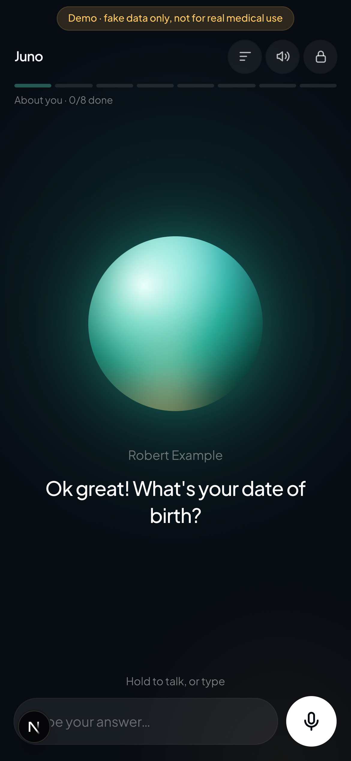
Meet Juno
A voice assistant that interviews the patient and keeps the result on their phone
Talk or type
Hold the mic and speak, or type. Juno replies out loud and in captions, one short question at a time.
Private by design
The profile is encrypted with the patient's PIN and stored only on their device.
Trial-ready
Structured answers across 8 sections, ready to share with a trial team in one tap.

Slide 4
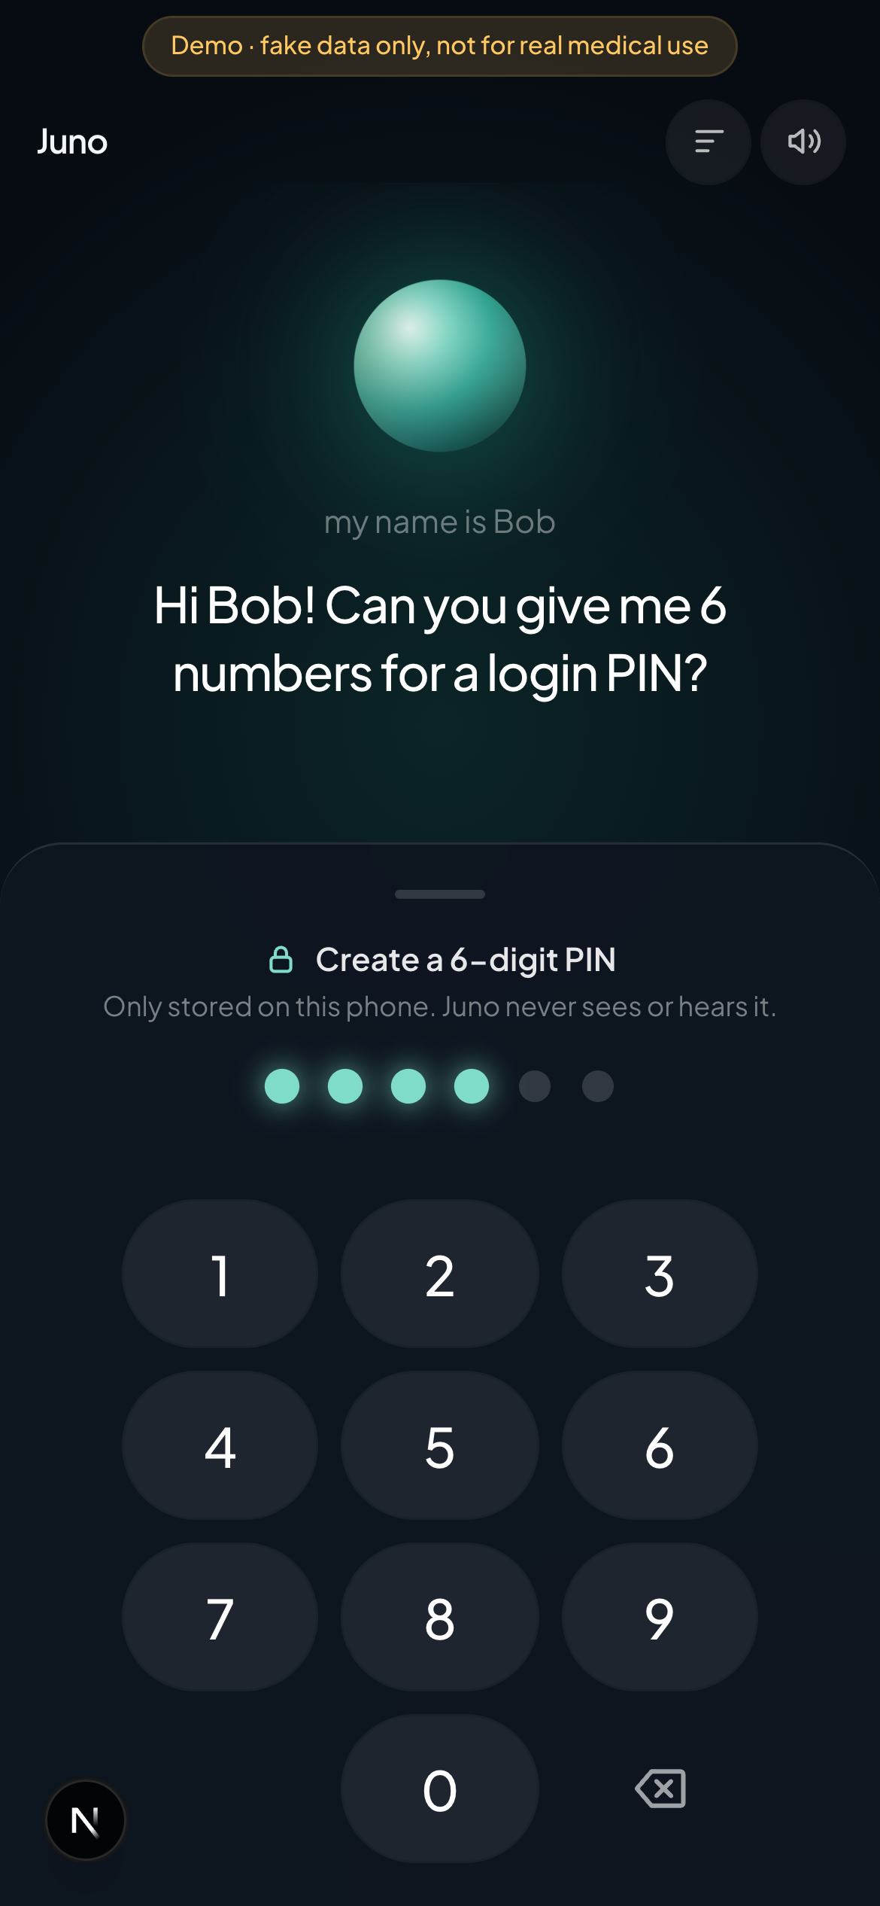
A short, human conversation
Hi! I'm Juno. What's your name?
Bob
Hi Bob! Can you give me 6 numbers for a login PIN?
(secure keypad, never sent to the AI)
Ok great! What's your blood type?
I don't know
That's fine, Bob. Do you have any medical conditions?
I have arthritis

Slide 5
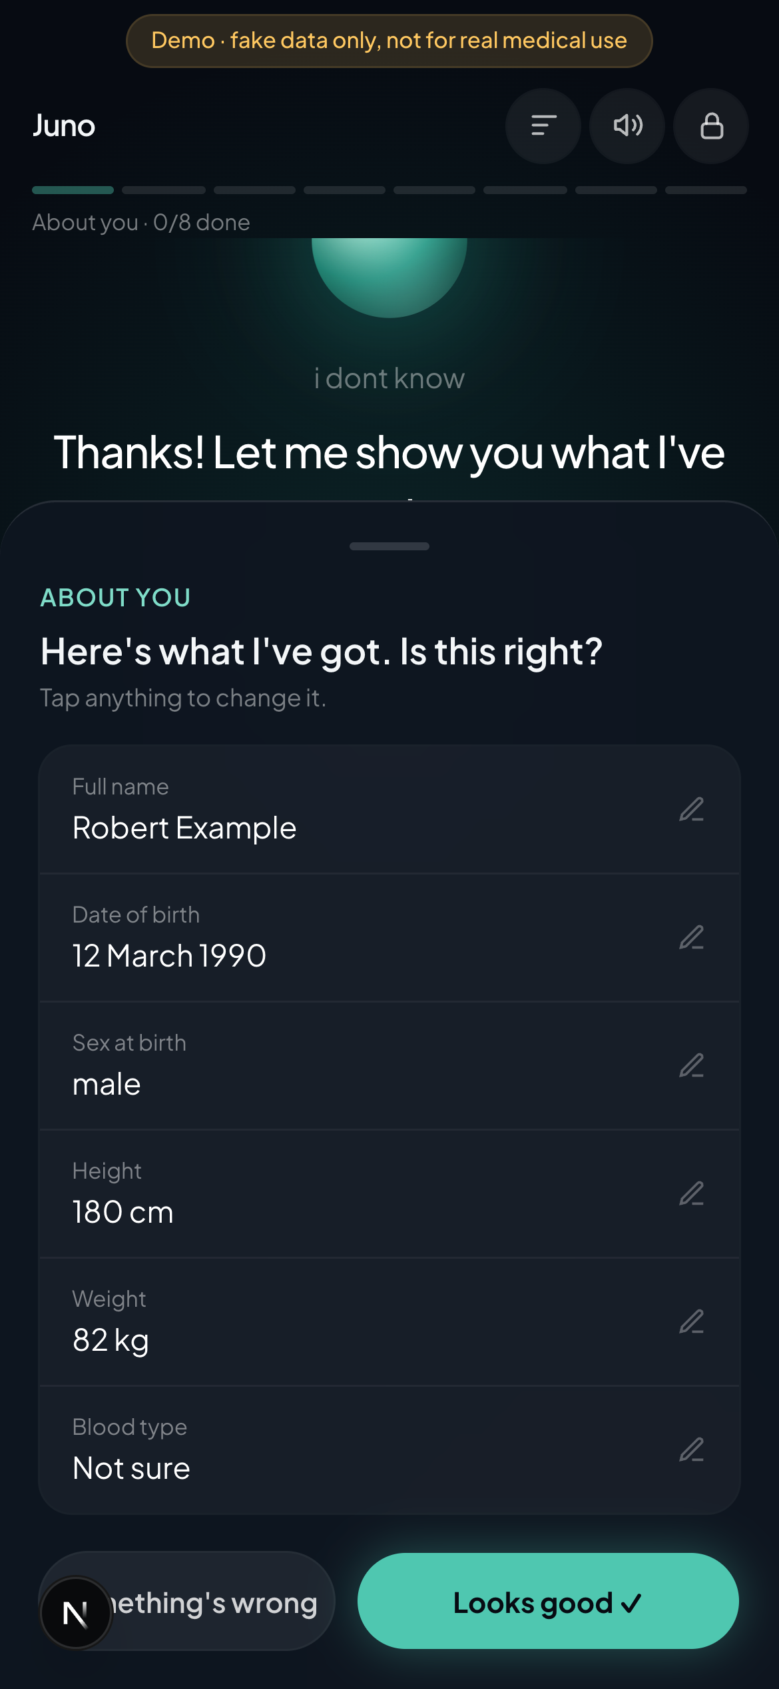
8 sections, checked by the patient
After each section Juno shows a review card the patient can edit before saving
About you
Contact details
1
2
Health conditions
Medicines
3
4
Allergies
Operations & stays
5
6
Family health
Lifestyle
7
8

Slide 6
Privacy and safety built in
On the device
Stateless server
Claude
PIN → PBKDF2 (600k rounds) → AES-GCM key. Encrypted profile saved in IndexedDB. The PIN and key never leave the phone.
One API route forwards only the current section's recent turns to Claude. It stores and logs nothing.
claude-sonnet-5-5 returns structured JSON (reply + extracted fields), validated with Zod.
Safety first
Emergency phrases are caught on the device before anything is sent. Juno stops and shows 999, A&E and NHS 111 (plus Samaritans 116 123 for self-harm). Juno never gives medical advice. Hackathon build uses fake data only.

Slide 7
Built with, and what's next
Stack
Roadmap
Next.js 15 (App Router) + React 19 + TypeScript
Tailwind CSS 4, installable PWA
Anthropic Claude API, structured outputs
Web Speech API (hold-to-talk + spoken replies)
Web Crypto + IndexedDB (idb)
Done: encrypted account by chat, voice interview, review cards, resume, lock screen
Next: My Health Card page to view and edit
Next: share with a trial by QR + trial-staff scanner
Next: demo mode with a fake patient

Slide 8
Talk once. Join trials faster.
npm install · npm run dev · open localhost:3000 in Chrome
Demo with fake data only. Not for real medical use.

