Slide 1







An Autonomous Institution
Department of Computer Science And Engineering
21EE05P - PROJECT REVIEW
TINY TRAIL: A DIGITAL MARKETPLACE - FROM HOME TO YOUR HANDS
Biotech,
Chemical,ECE &IT
VH12436 THISO VALLABADASS - 113022104160 - VII Sem
VH12437 THIRU MURUGAN R - 113022104161 - VII Sem
VH12404 SABARINATHAN S - 113022104127 - VII Sem
SUPERVISOR
MS.HINDUMATHY
ASSISTANTPROFESSOR / CSE
Date: 13/11/2025

Slide 2
PROJECT STRUCTURE
The proposed project work consisting of the Chapters as follows.
Chapter 1: Introduction
Chapter 2: Objective
Chapter 3: Literature survey
Chapter 4: Proposed methodology
Chapter 4: Proposed model
Chapter 5: Experiments and Results
Chapter 5: Discussion and Conclusion

Slide 3
INTRODUCTION
Tiny Trail is a web-based marketplace that helps home entrepreneurs connect with local customers. It offers multilingual (Tamil + English) product listing, secure UPI payments with JWT authentication, and pincode-based discovery, all in a simple, user-friendly design. Future scope includes logistics and delivery.

Slide 4
OBJECTIVE
The main objective of Tiny Trail is to build a secure, web-based platform that empowers local entrepreneurs to digitize their businesses with ease.
It aims to:
Simplify product listing through multilingual support (Tamil + English).
Ensure trust and security using JWT-based authentication and UPI payments.
Enable local product discovery through pincode and proximity-based search.

Slide 5
LITERATURE SURVEY
RESEARCH ARTICLE :01
TITLE OF THE RESEARCH ARTICLE | E-Commerce Adoption by Women Entrepreneurs in India: An Application of the UTAUT Model
PROBLEM ADDRESSED / IDENTIFIED | Women entrepreneurs face challenges in adopting e-commerce due to language, complexity, and digital skills.
AIM / OBJECTIVES | To study factors influencing women’s adoption of e-commerce using UTAUT model.
NOVELTY / SIGNIFICANCE | Focuses on women-owned small businesses and their behavioral intention towards e-commerce.
LIMITATION / WEAKNESS | Limited to small geographic area and sample size.
FINDINGS / CONCLUSION | Effort expectancy, performance, and social influence drive adoption.
AREAS OF IMPROVEMENT / FUTURE ENHANCEMENT | Expand study across regions and include digital literacy factors.

Slide 6
LITERATURE SURVEY
RESEARCH ARTICLE :02
TITLE OF THE RESEARCH ARTICLE | Social Commerce and Women Entrepreneurs in Rural India
PROBLEM ADDRESSED / IDENTIFIED | Rural women lack visibility on big platforms like Amazon/Flipkart.
AIM / OBJECTIVES | To study how social commerce helps women-led microbusinesses.
NOVELTY / SIGNIFICANCE | Focuses on small-scale sellers using WhatsApp/Instagram shops.
LIMITATION / WEAKNESS | Trust issues and lack of integrated payment systems.
FINDINGS / CONCLUSION | Social commerce boosts sales but needs structured platforms.
AREAS OF IMPROVEMENT / FUTURE ENHANCEMENT | Build localized, secure, and easy-to-use platforms.

Slide 7
LITERATURE SURVEY
RESEARCH ARTICLE :03
TITLE OF THE RESEARCH ARTICLE | Digital Empowerment of Small Businesses through Local E-Marketplaces
PROBLEM ADDRESSED / IDENTIFIED | Small entrepreneurs face barriers in joining global e-commerce platforms.
AIM / OBJECTIVES | To show how local web platforms empower microbusinesses.
NOVELTY / SIGNIFICANCE | Emphasizes pincode/local discovery and UPI integration.
LIMITATION / WEAKNESS | Delivery/logistics often missing in early stages.
FINDINGS / CONCLUSION | Localized platforms improve reach and trust.
AREAS OF IMPROVEMENT / FUTURE ENHANCEMENT | Add delivery tie-ups, expand to more regional languages.

Slide 8

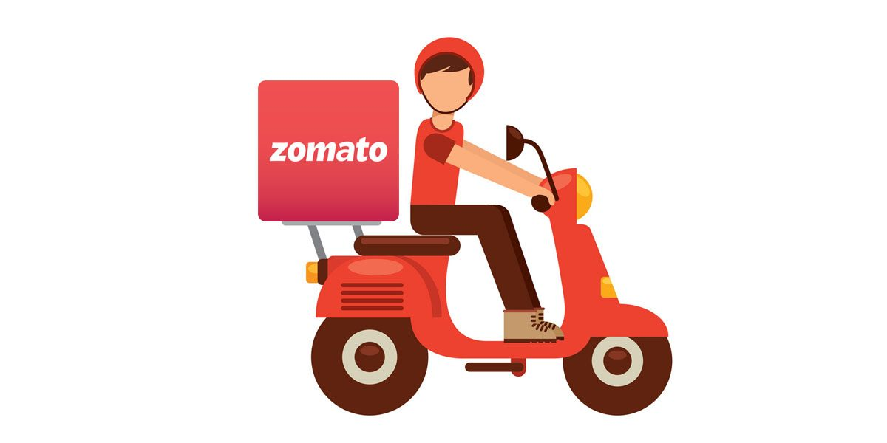



EXISTING SYSTEM
Current digital platforms like Amazon, Flipkart, OLX, and Facebook Marketplace are either too complex, highly commercialized, or cluttered with irrelevant products. They require advanced tech skills, typing in English, and lack simple UPI-based payments or structured order management. Local businesses mainly depend on word-of-mouth sales, which limits reach, trust, and growth.

Slide 9
PROPOSED SYSTEM
Existing platforms such as Amazon, Flipkart, OLX, and Facebook Marketplace are primarily tailored for large-scale or digitally proficient sellers. Their interfaces are complex, heavily English-dependent, and often require typing skills, product catalog management, and advanced digital literacy. These platforms also lack local discovery features, forcing small home entrepreneurs to rely on word-of-mouth marketing. Payment options are often complicated or require multiple verification steps, making UPI usage difficult for new sellers.
TinyTrails, by contrast, is designed as a simple and inclusive web and mobile marketplace built specifically for home businesses and small vendors. The system supports bilingual Tamil/English product uploads through both text and voice input, enabling effortless listing for non-technical users. Buyers can discover local sellers through pincode search, map views, and category filtering, ensuring visibility for nearby home entrepreneurs. Payments are handled through secure UPI integration, making transactions straightforward and trustworthy.
TinyTrails emphasizes accessibility, low-cost adoption, and regional language support, offering a digital platform where small sellers can reach customers without navigating the complexities of mainstream e-commerce. Future enhancements include logistics partnership integration, automated delivery tracking, and AI-driven recommendations that personalize the buyer journey and further strengthen the hyperlocal marketplace ecosystem.

Slide 10
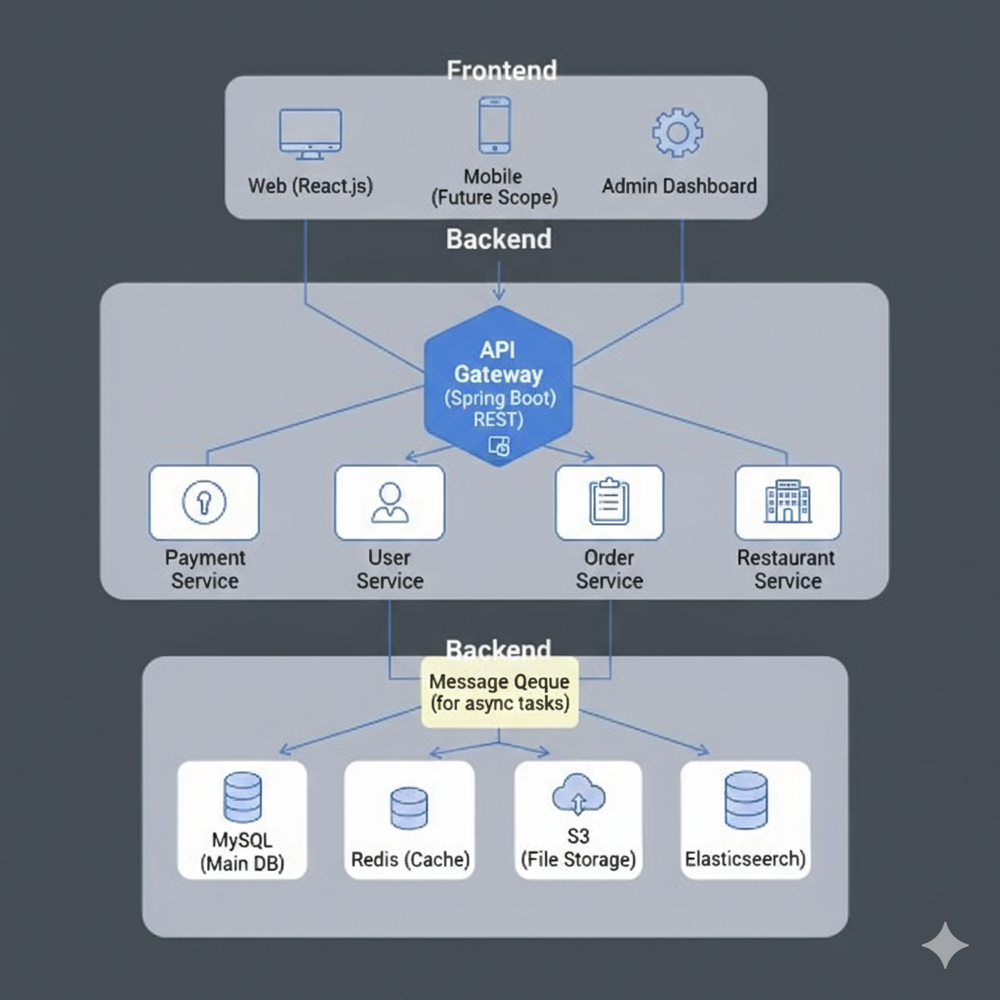
ARCHITECTURE DIAGRAM

Slide 11
FLOW DIAGRAM
Tiny Trail Order Processing Flow
Seller Confirms Order
Order Status Updated to Delivered
User Browses Products
Frontend Sends API Request
Backend Stores Order Details
User Adds Product to Cart
Backend Validates User
Backend Notifies Seller
Tiny Trail Generates Delivery Task

Slide 12
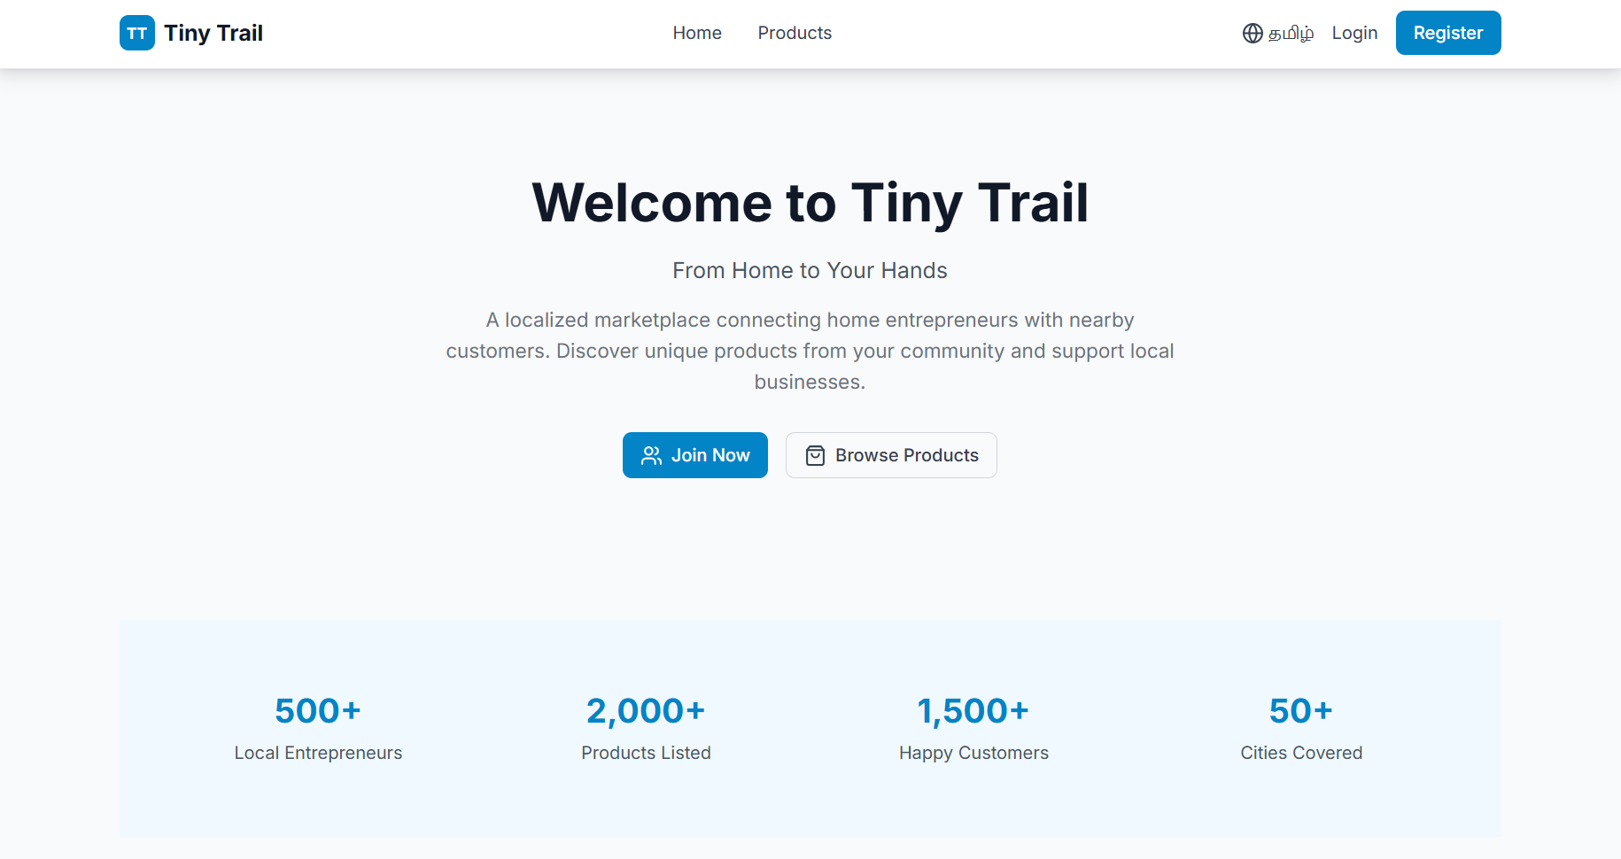
FRONTEND OUTPUT

Slide 13
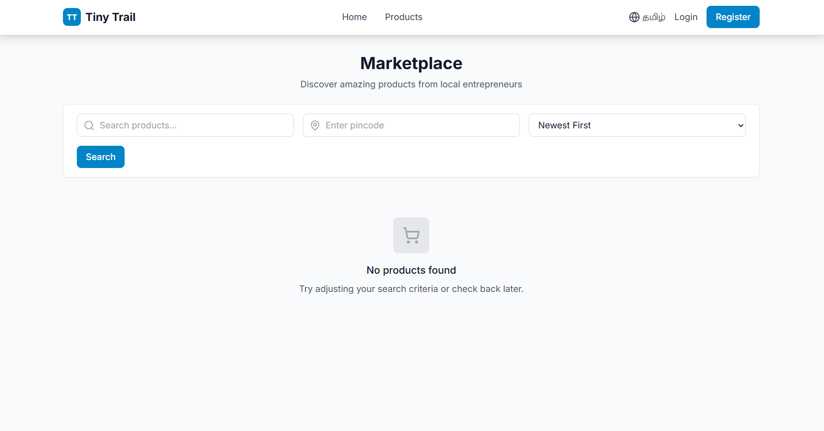
FRONTEND OUTPUT

Slide 14
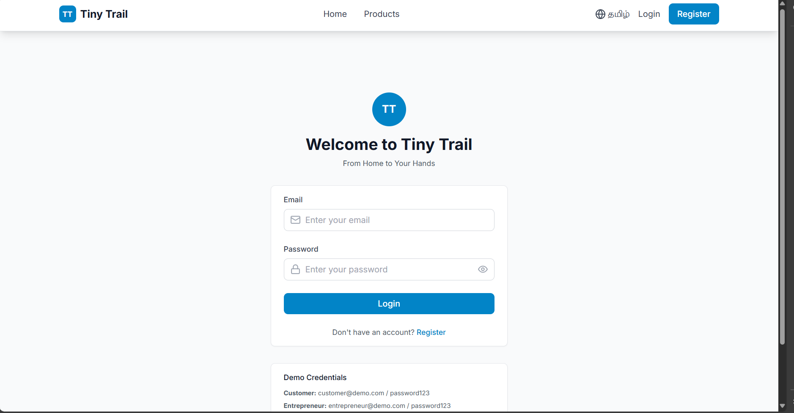
FRONTEND OUTPUT

Slide 15
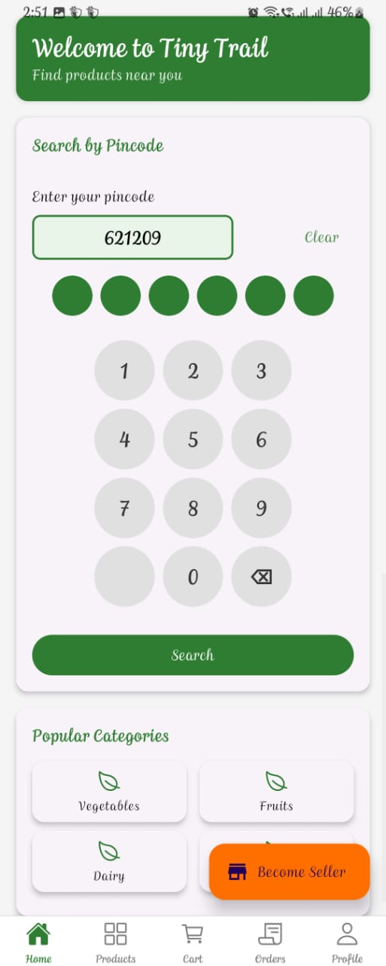
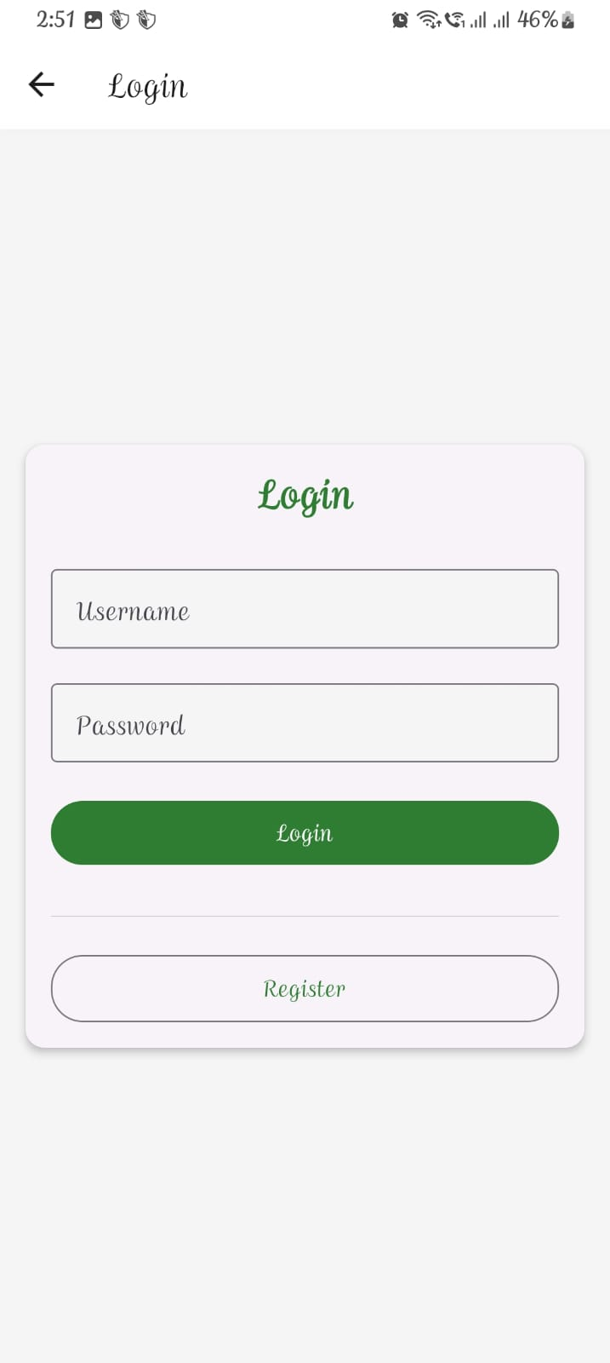
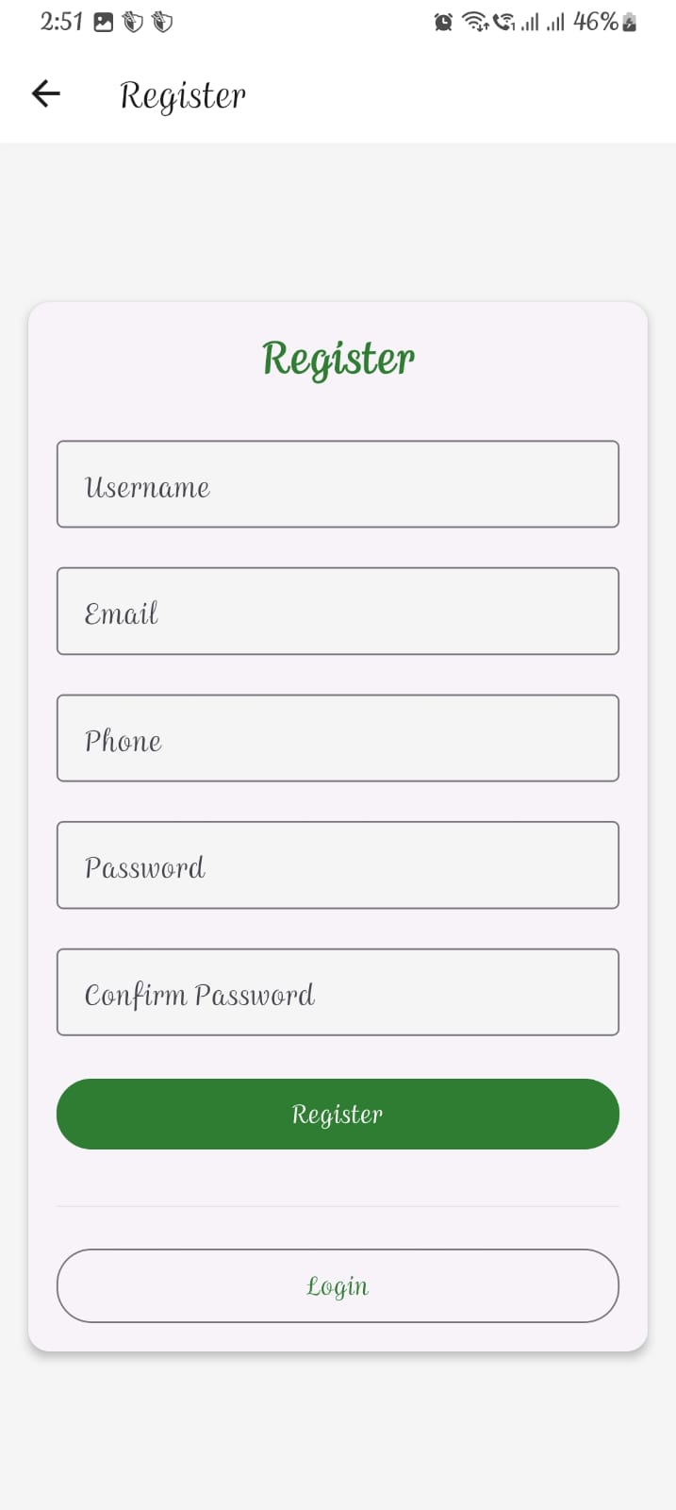
FRONTEND OUTPUT

Slide 16




TECH STACKS
Frontend (Web & Mobile)
React.js (Web application UI)
React Native (Cross-platform mobile application for Android/iOS)
TailwindCSS / Material UI for responsive, modern UI components
Backend
Spring Boot (Java) — RESTful microservices architecture
Node.js (Optional microservices) — for real-time features like live order tracking (future)
Database & Storage
MySQL — main relational database for users, sellers, products, orders
Firebase Firestore — optional for real-time order updates & vendor online status
Cloud Storage (AWS S3 / Firebase Storage) for user & product images

Slide 17
TECH STACKS
Authentication & Security
JWT (JSON Web Tokens) — secure login for both web & mobile
OAuth / Firebase Authentication — Google login for vendor onboarding
Encrypted UPI token handling — for secure payment initiation
Payments
UPI Integration (Razorpay / PhonePe APIs)
UPI QR auto-generation for each seller
Secure client-side payment handoff
Hosting & Deployment
AWS EC2 / Elastic Beanstalk — backend hosting
AWS RDS — MySQL hosted database
Vercel / Netlify — hosting for web front-end
Firebase App Distribution — internal testing for the mobile app

Slide 18
DISCUSSION AND CONCLUSION
Tiny Trail’s strengths lie in its localized design, multilingual support for Tamil and English through text or voice input, seamless UPI payments, and the advantage of being easily accessible via the web without requiring a dedicated mobile app. However, its current limitations include the lack of integrated delivery services and the need for stable internet access along with basic digital literacy among users. Looking ahead, the future work involves partnering with logistics providers for delivery support, implementing an AI-powered recommendation engine, expanding the platform to more regional languages, and conducting training workshops to help home entrepreneurs adapt to the digital marketplace.

Slide 19
REFERENCES
Rani, S. & Meenakshi, “Women Empowerment via Mobile Commerce”, IJCTT, 2022.
S. Subha, “Mobile Applications for Cottage Industries”, IJRTE, 2021.
G. Karthick, “Regional Voice-Based Interfaces for e-Commerce in India”, IJML, 2020.
Sneha Sharma, “Digital Empowerment of Housewives through Tech Platforms”, IJEIT, 2023.
C. Priya, “React Native Applications for Small-Scale Retailers”, IEEE Access, 2022.

Slide 20


Thank you
*

