Slide 1
KOYO
SatNOGS Audio to Operational Telemetry
BEACON DECODER
GNU Radio | G3RUH AX.25 | CRC-valid 263-byte frames
5 / 5
22
20
observations passed
valid local frames
byte-exact control matches
Morning handoff | 31 Aug 2026
01

Slide 2
KOYO BEACON DECODER
End-to-End Architecture
SatNOGS OGG
PCM WAV
GNU Radio
AX.25
KOYO Decoder
Influx + Grafana
>
>
>
>
>
downloaded observation
mono / 48 kHz
FSK / 9600 baud
G3RUH + HDLC + CRC
263-byte frames
channel / value feedback
Decoder input
The OGG recording is the source. SatNOGS demodulated frames are used only as an independent validation control.
Store-and-forward: newest available upload, not continuous live RF.
02

Slide 3
KOYO BEACON DECODER
Mission Data Coverage
55
1,055
17,155
UTC days with frames
SatNOGS observations / 114 stations
decoded frames
2026-07-07 to 2026-08-30 UTC
Daily decoded frame coverage
JUL 07
AUG 01
AUG 30
The 5-row audio table is a controlled end-to-end sample, not the full history.
03

Slide 4
KOYO BEACON DECODER
GNU Radio Receive Flowgraph
WAV File Source
FSK Demodulator
AX.25 Deframer
KISS File Sink
>
>
>
48 kHz mono
9600 baud / clk_bw 0.15
NRZI + G3RUH + HDLC + CRC
validated frame output
Editable flowgraph
gnuradio/koyo_audio_rx.grc
Observed malformed or short PDUs stay diagnostic. Only CRC-valid 263-byte KOYO frames reach telemetry decoding.
04

Slide 5
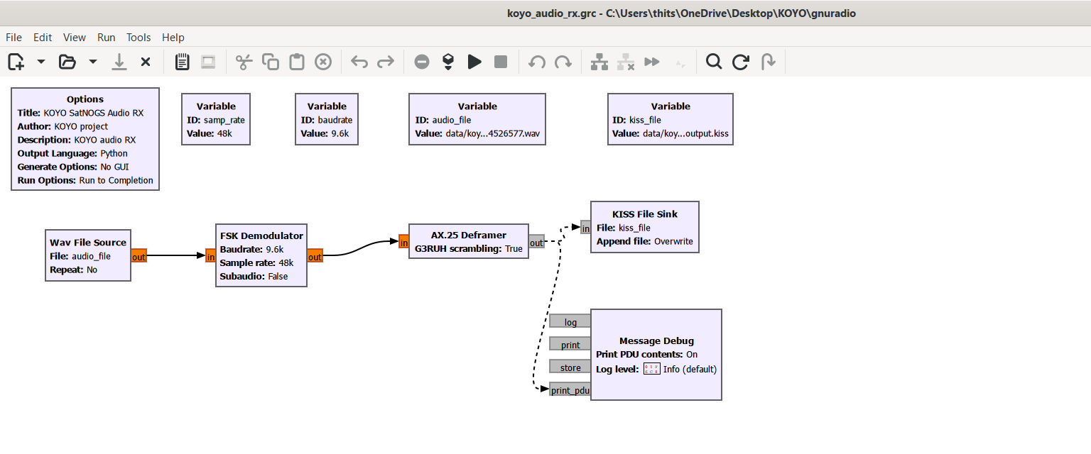
KOYO BEACON DECODER
GNU Radio Companion - Actual Flowgraph
Captured from the installed radioconda GNU Radio Companion; the same .grc compiled and produced a byte-exact control match.
05

Slide 6
KOYO BEACON DECODER
Audio Validation Across Stations
OBSERVATION
STATION
OFFICIAL
LOCAL
EXACT
RECOVERY
RESULT
14526577
MAUSyagi
35
1
1
2.9%
PASS
14637273
EA3AGB
3
1
1
33.3%
PASS
14909294
MAUSyagi
31
14
14
45.2%
PASS
14909617
W6MSU UHF
4
4
3
75.0%
PASS
14909703
MAUSyagi-AK
1
2
1
100.0%
PASS
Overall exact recovery: 20 / 74 = 27%
Not decoded = not recovered from OGG by current settings, or rejected diagnostic PDU; it does not automatically mean an invalid spacecraft frame.
06

Slide 7
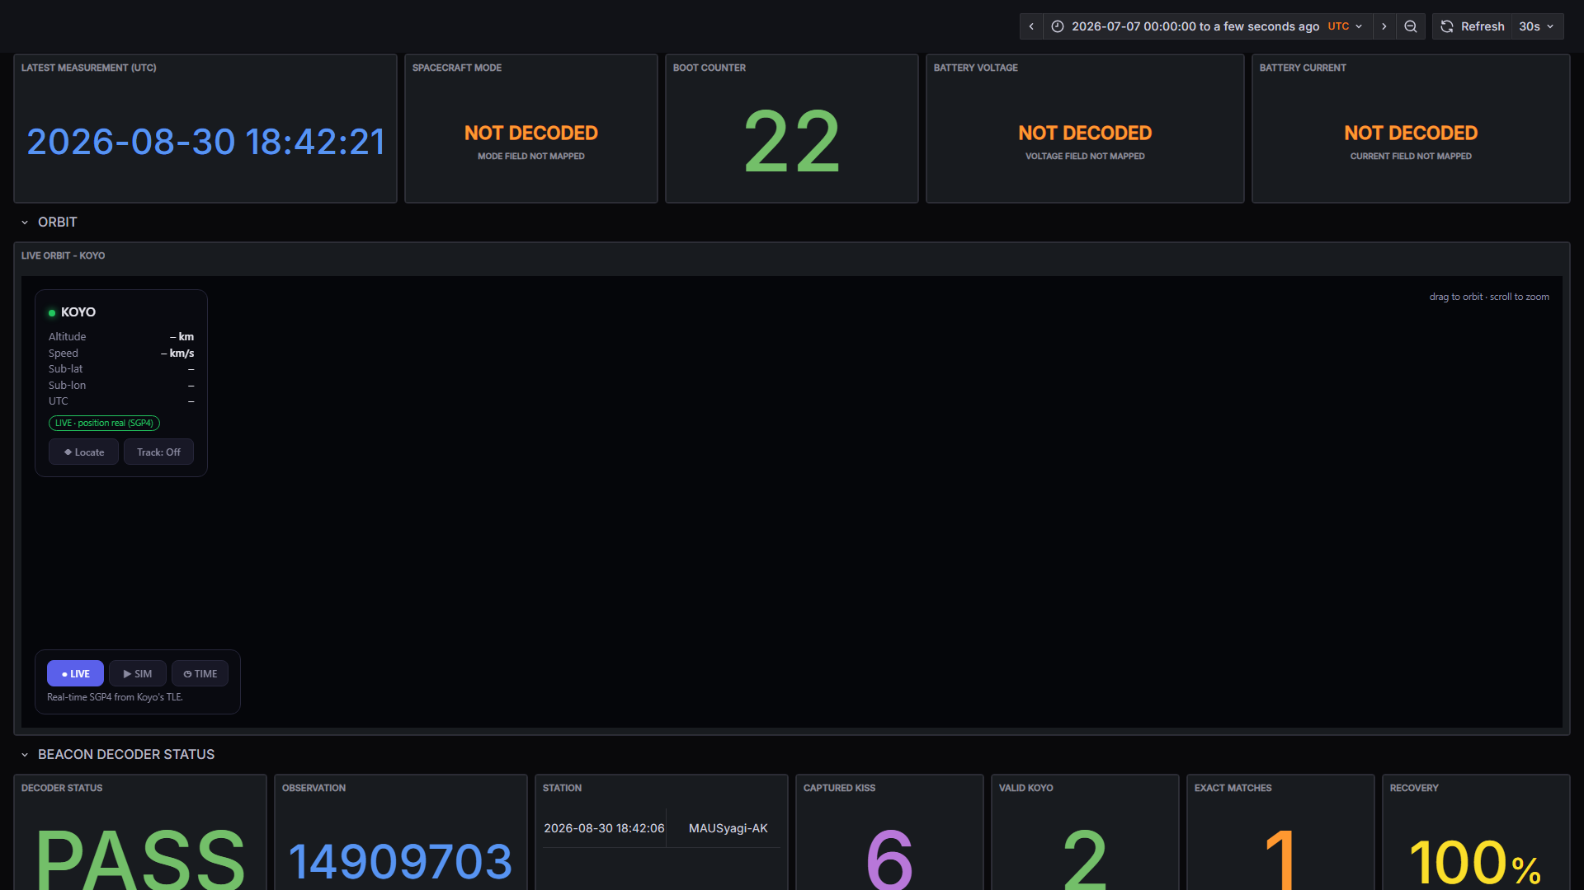
KOYO BEACON DECODER
Operational Dashboard
43 panels | decoder status + raw HEX | confirmed, candidate, and NOT DECODED states remain explicit
07

Slide 8
KOYO BEACON DECODER
Morning Demo and Next Step
ONE-COMMAND DEMO
powershell -ExecutionPolicy Bypass -File .\\local-stack\\live_refresh.ps1
What it demonstrates
Current boundary
1. Fetch newest uploaded SatNOGS OGG 2. Decode locally with GNU Radio 3. Keep CRC-valid 263-byte frames 4. Push telemetry to InfluxDB and Grafana
SatNOGS is store-and-forward. Unconfirmed engineering mappings stay candidate. Next: validate remaining fields against an authorized reference.
Result: reproducible audio-to-dashboard chain with traceable validation evidence.
08

