Slide 1

AI Chatbot for College Enquiry
CSA1711 – Artificial Intelligence
Presented by: Guided by:
Thanigaivel S (192565006) Dr.Krishnakumar
Ranjith M (192511179)

Slide 2


Abstract
The project develops an AI-powered chatbot for automated college enquiry services.
It collects information from authorized college websites and supporting documents.
The collected information is processed, divided into chunks, and converted into embeddings.
RAG retrieves relevant information before the AI generates a response.
The system provides fast, accessible, and conversational college information to users.

Slide 3
Introduction
College information is distributed across websites, documents, and different departments.
Students often spend considerable time searching for information manually.
Common enquiries include admissions, courses, faculty, fees, placements, and facilities.
An AI chatbot can provide college information through a simple conversational interface.
The proposed system uses AI, NLP, web crawling, and RAG to provide relevant answers.

Slide 4
Problem Statement
Students must search through multiple webpages to find required college information.
Important information may be difficult to locate within lengthy webpages or documents.
Repeated enquiries increase the workload of college administrative staff.
Traditional enquiry methods may not provide immediate responses outside working hours.
A centralized AI-based system is required to provide quick and relevant information.

Slide 5
Objectives
To develop an AI chatbot capable of answering common college-related questions.
To collect and organize information from provided college websites and documents.
To implement Retrieval-Augmented Generation (RAG) for context-based responses.
To provide a simple and user-friendly conversational interface.
To reduce enquiry response time and repetitive workload for college staff.

Slide 6
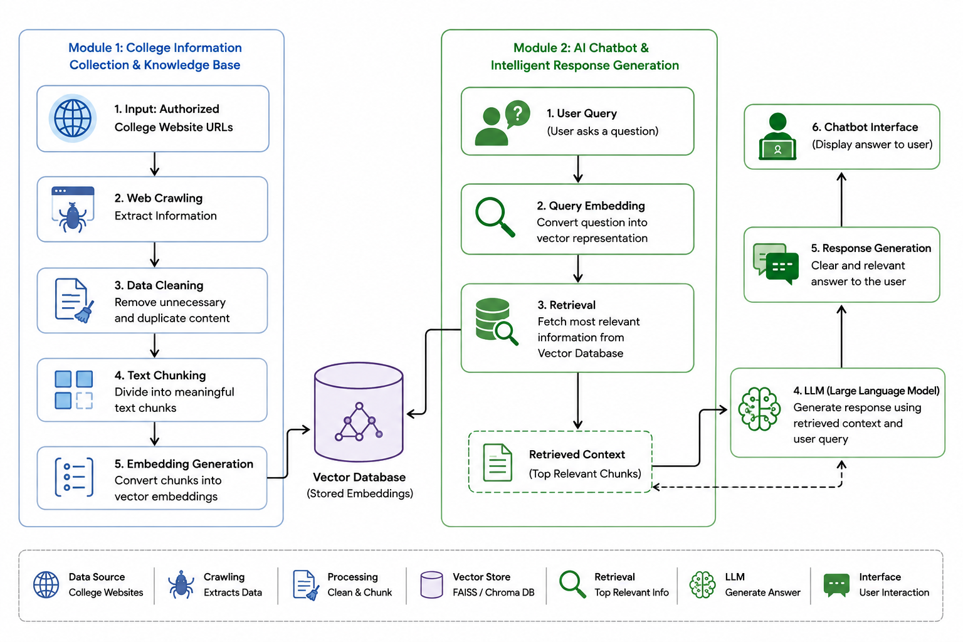
System Architecture

Slide 7
Module 1: College Information Collection & Knowledge Base
Accept one or more authorized college website URLs as input.
Crawl webpages and extract relevant college information.
Clean unnecessary HTML elements and duplicate content.
Divide extracted information into meaningful text chunks.
Generate embeddings and store them in a vector database.

Slide 8
Module 2: AI Chatbot & Intelligent Response Generation
Accept questions from users through the chatbot interface.
Convert the user's question into a searchable representation.
Retrieve the most relevant information from the vector database.
Provide retrieved context to the Large Language Model for response generation.
Display a clear and relevant answer to the user.

Slide 9
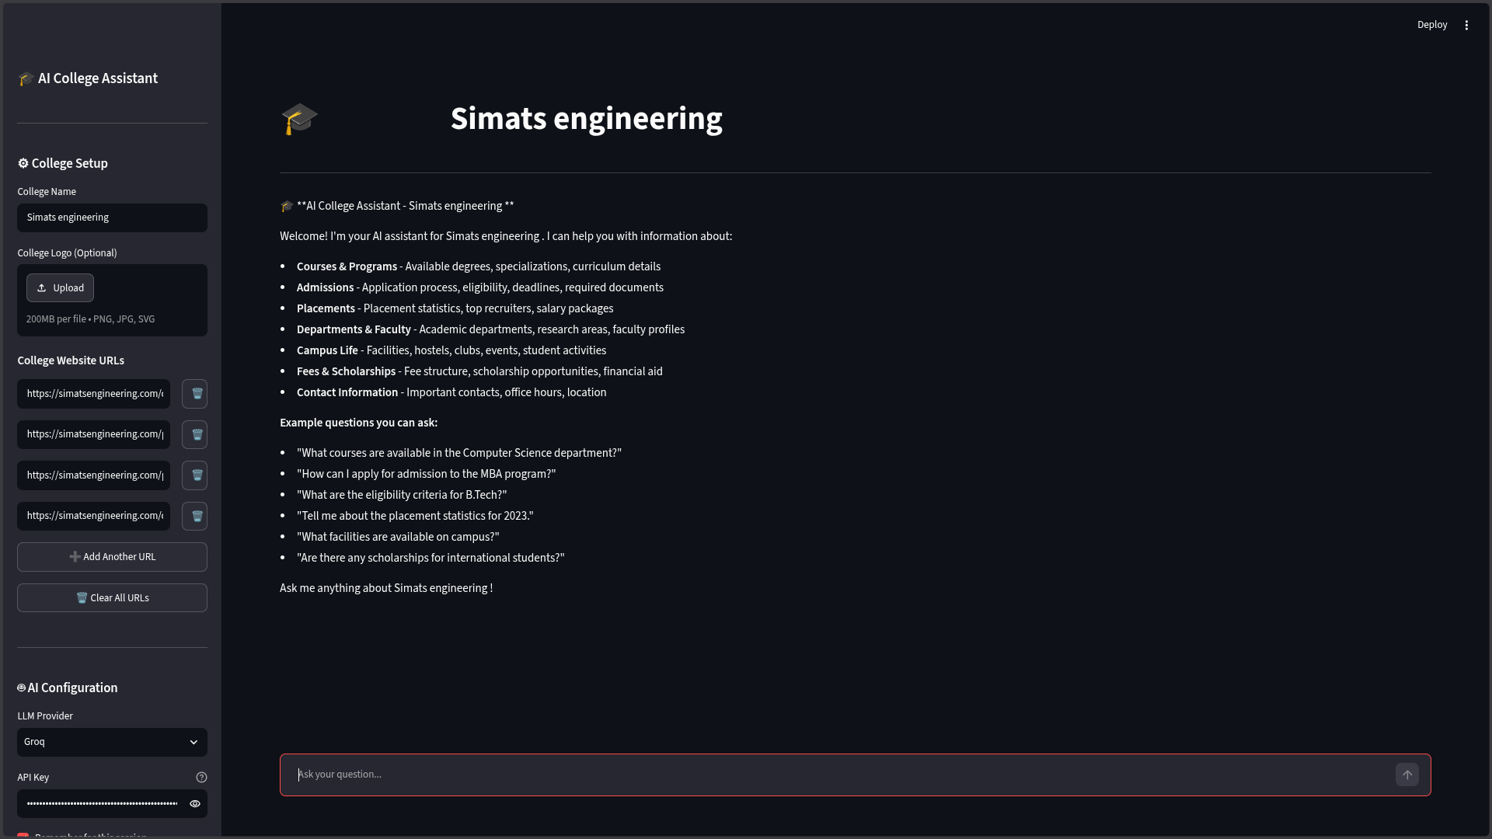
Output:

Slide 10
Conclusion
The proposed system provides an AI-powered solution for college enquiries.
RAG helps retrieve relevant college information before generating responses.
The chatbot reduces the time required to search for information manually.
It can reduce repetitive enquiry workload for college administrative staff.
The system provides a foundation for a fast, accessible, and scalable college information service.

Slide 11
Future Scope
Add voice-based interaction for hands-free college enquiries.
Support Tamil and other regional languages for wider accessibility.
Integrate the chatbot with mobile applications and messaging platforms.
Implement automatic website monitoring to keep information updated.
Add personalized responses and advanced analytics for students and administrators.

Slide 12
References
Lewis et al., “Retrieval-Augmented Generation for Knowledge-Intensive NLP Tasks,” NeurIPS, 2020.
Python Documentation – Official documentation for Python development.
LangChain Documentation – Framework for developing LLM and RAG applications.
Streamlit Documentation – Framework for building interactive Python web applications.
FAISS and Sentence Transformers Documentation – Resources for vector search and text embeddings.

Slide 13
Thank you

