Slide 1
An Introduction to Finite Automata

Slide 2
Finite Automata
A finite automaton is, a machine that has a finite number of states and a finite number of transitions between these.
A transition between states is usually labelled by a character from the input alphabet, but we will also use transitions marked with ε, the so-called epsilon transitions.
epsilon transitions or ε-moves
ε
A
B
Machine can move from state A to state B without reading input

Slide 3
Finite Automata
A finite automaton consists of
An input alphabet Σ
A set of states S
A start state n
A set of accepting states F ⊆ S
A set of transitions state →input state

Slide 4
A Finite Automaton…
Has some number of states
Has a start state and at least one end state
Accepts input that advances it through its states
Can be Deterministic (DFA) or Non-Deterministic (NFA)

Slide 5
Finite Automata
Transition
s₁ →ª s₂
Is read
In state s₁ on input “a” go to state s₂
If end of input
If in accepting state => accept, othewise => reject
If no transition possible => reject

Slide 6
Finite Automata State Graphs
A state
The start state
An accepting state
a
A transition

Slide 7
A Simple Example
A finite automaton that accepts only “1”
A finite automaton accepts a string if we can follow transitions labeled with the characters in the string from the start to some accepting state
1

Slide 8
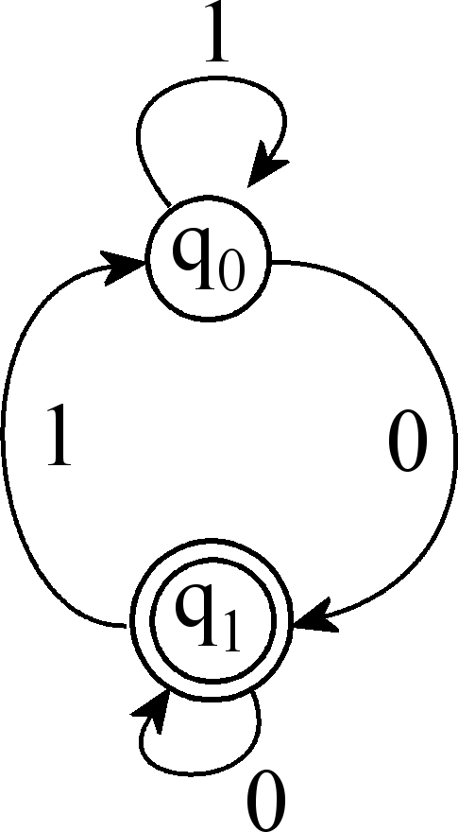
Representing Finite Automata
Finite Automata can be represented visually by state diagrams
M:
Q = q₀, q₁
E = {0, 1}
F = q₁
d(q₀, 0) = q₁
d(q₀, 1) = q₀
d(q₁, 0) = q₀
d(q₁, 1) = q₁

Slide 9
Simple Example
A finite automaton accepting any number of 1’s followed by a single 0
Alphabet: {0,1}
Check that “1110” is accepted but “110…” is not
1
0

Slide 10
Example
a c c c b accepted
q₀ q₀ q₁ q₂ q₂ q₂
a a c rejected
q₀ q₀ q₀ q₁
Accepts those strings that contain at least two c’s
a
a
a/b/c
q₀
c
c
q₂
q₁
b
b

Slide 11
Another Example
Alphabet {0,1}
What language does this recognize?
1
0
0
0
1
1

Slide 12
Deterministic and Nondeterministic Automata
Deterministic Finite Automata (DFA)
One transition per input per state
No ε-moves
Nondeterministic Finite Automata (NFA)
Can have multiple transitions for one input in a given state
Can have ε-moves
Finite automata have finite memory
Need only to encode the current state

Slide 13
Execution of Finite Automata
A DFA can take only one path through the state graph
Completely determined by input
NFAs can choose
Whether to make ε-moves
Which of multiple transitions for a single input to take

Slide 14
A non-deterministic finite automaton (NFA) is a 5-tuple N = (Q, Σ, δ, Q₀, F)
Q is the set of states
Σ is the alphabet
δ : Q × Σ_{ε} → 2^{Q} is the transition function
Q₀ ⊆ Q is the set of start states
F ⊆ Q is the set of accept states
2^{Q} is the set of subsets of Q and Σ_{ε} = Σ ∪ {ε}

Slide 15
Acceptance of NFAs
An NFA can get into multiple states
1
0
1
0
Input:
1
0
1
Rule: NFA accepts if it can get in a final state

Slide 16
Algorithm: The McNaughton-Yamada-Thompson algorithm to convert a regular expression to a NFA.
Algorithm: The McNaughton-Yamada-Thompson algorithm to convert a regular expression to a NFA.
INPUT: A regular expression r over alphabet Σ.
OUTPUT: An NFA N accepting L(r).
Method: Begin by parsing r into its constituent sub-expressions. The rules for constructing an NFA consist of basis rules for handling sub-expressions with no operators, and inductive rules for constructing larger NFA's from the NFA's for the immediate sub-expressions of a given expression.
For expression ε construct the NFA
For any sub-expression a in C, construct the NFA

Slide 17
RE to NFA (cont.)
NFA for the union of two regular expressions
Ex: a|b

Slide 18
Regular Expressions to NFA : Examples
For AB
ε
A
B
For A | B
B
ε
ε
ε
ε
A

Slide 19
Regular Expressions to NFA : Examples
For A*
ε
A
ε
ε

Slide 20
NFA for the closure of a regular expression
(a|b)*

Slide 21
RE to NFA
Consider the regular expression
(a|b)*abb
A*
(1 | 0)*1
0 | 1 (0 | 1)*

