Slide 1
Optimization of DFA

Slide 2
Introduction
Minimization/optimization of a deterministic finite automaton (DFA) refers to the detection of those states of a DFA, whose presence or absence in a DFA does not affect the language accepted by the automata.
The states that can be eliminated from automata, without affecting the language accepted by automata, are:
Unreachable or inaccessible states.
Dead states.
Non-distinguishable or indistinguishable state or equivalent states.

Slide 3
Minimizing DFA’s
Lots of methods.
All involve finding equivalent states
States that go to equivalent states under all inputs

Slide 4
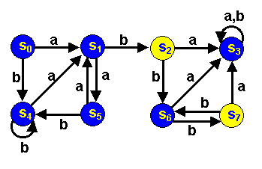
Minimizing DFA’s by Partitioning
Consider the following DFA:
Accepting states are yellow
Non-accepting states are blue

Slide 5
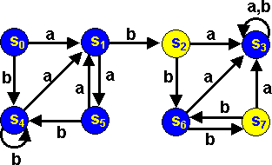
S₂ and S₇ are really the same:
Both Final states
Both go to S6 under input b
Both go to S3 under an a
S0 and S5 really the same.
We can merge equivalent states into 1 state.

Slide 6
Partitioning Algorithm
First, divide the set of states into
▶ Final and
▶ Non-final states
Partition I
 | a | b
S₀ | S₁ | S₄
S₁ | S₅ | S₂
S₃ | S₃ | S₃
S₄ | S₁ | S₄
S₅ | S₁ | S₄
S₆ | S₃ | S₇
*S₂ | S₃ | S₆
*S₇ | S₃ | S₆
Partition II

Slide 7
Partitioning Algorithm
 | a | b
S₀ | S₁ I | S₄ I
S₁ | S₅ I | S₂ II
S₃ | S₃ I | S₃ I
S₄ | S₁ I | S₄ I
S₅ | S₁ I | S₄ I
S₆ | S₃ I | S₇ II
*S2 | S₃ I | S₆ I
*S7 | S₃ I | S₆ I
Now
See if states in each partition each go to the same partition
S₁ & S₆ are different from the rest of the states in Partition I(but like each other)
We will move them to their own partition

Slide 8
Partitioning Algorithm
 | a | b
S₀ | S₁ | S₄
S₅ | S₁ | S₄
S₃ | S₃ | S₃
S₄ | S₁ | S₄
S₁ | S₅ | S2
S₆ | S₃ | S7
*S2 | S₃ | S₆
*S7 | S₃ | S₆

Slide 9
Partitioning Algorithm
Now again
See if states in each partition each go to the same partition
In Partition I, S3 goes to a different partition from S0, S5 and S4
We’ll move S3 to its own partition
 | a | b
S₀ | S₁ III | S₄ I
S₅ | S₁ III | S₄ I
S₃ | S₃ I | S₃ I
S₄ | S₁ III | S₄ I
S₁ | S₅ I | S2 II
S₆ | S₃ I | S7 II
*S2 | S₃ I | S₆ III
*S7 | S₃ I | S₆ III

Slide 10
Partitioning Algorithm
 | a | b
S₀ | S₁ III | S₄ I
S₅ | S₁ III | S₄ I
S₄ | S₁ III | S₄ I
S₃ | S₃ IV | S₃ IV
S₁ | S₅ I | S2 II
S₆ | S3 IV | S7 II
*S2 | S3 IV | S₆ III
*S7 | S3 IV | S₆ III
Note changes in S_{6,} S₂ and S₇

Slide 11
Partitioning Algorithm
 | a | b
S₀ | S₁ III | S₄ I
S₅ | S₁ III | S₄ I
S₄ | S₁ III | S₄ I
S3 | S3 IV | S3 IV
S₁ | S₅ I | S2 II
S₆ | S3 IV | S7 II
*S2 | S3 IV | S₆ V
*S7 | S3 IV | S₆ V
Now S6 goes to a different partition on an a from S1
S₆gets its own partition
We now have 5 partitions
Note changes in S₂ and S₇

Slide 12
Partitioning Algorithm
 | a | b
S₀ | S₁ III | S₄ I
S₅ | S₁ III | S₄ I
S₄ | S₁ III | S₄ I
S3 | S3 IV | S3 IV
S₁ | S₅ I | S2 II
S₆ | S3 IV | S7 II
*S2 | S3 IV | S₆ V
*S7 | S3 IV | S₆ V
▶ All states within each of the 5 partitions are identical.
▶ We might as well call the states I, II III, IV and V.

Slide 13
Partitioning Algorithm
▶ Here we are
 | a | b
I | III | I
*II | IV | V
III | I | II
IV | IV | IV
V | IV | II

Slide 14
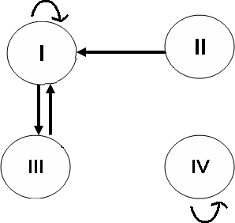
Minimized DFA
Partitioning Algorithm
b
b
b
b
V
a
a
a
a
b
a b

Slide 15
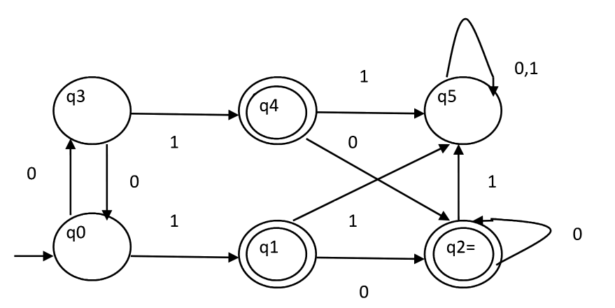

Slide 16
Myhill Nerode Theorem
Or
Table Filling Method

Slide 17
Myphill-Nerode Theorem
Draw a table for all pairs of states (P, Q)
Mark all pairs where Pϵ F and Q∉F.
If there are any Unmarked pairs (P, Q) such that [δ(P, x),δ(Q, x)] is marked, then mark [P, Q] where ‘x’ is an input symbol. Repeat this until no more marking can be made.
Combine all the unmarked pairs and make them a single state in the minimized DFA.

Slide 18
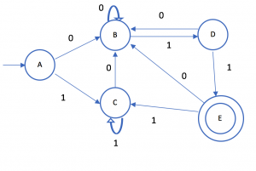
Example:
Minimize the following DFA using Table Filling Method.

Slide 19
Example: Minimize the following DFA using Table Filling Method.
Step 1:Draw a table for all pairs of states (P, Q)
Step 2:Mark all pairs where

Slide 20
Example: Minimize the following DFA using Table Filling Method.
Step 3:If there are any Unmarked pairs (P, Q) such that [δ(P, x),δ(Q, x)] is marked, then mark [P, Q] where ‘x’ is an input symbol. Repeat this until no more marking can be made.

Slide 21
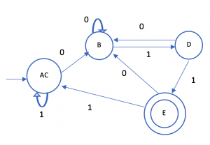
Example: Minimize the following DFA using Table Filling Method.
Combine all the unmarked pairs and make them a single state in the minimized DFA
(A, C), B, D, E

Slide 22
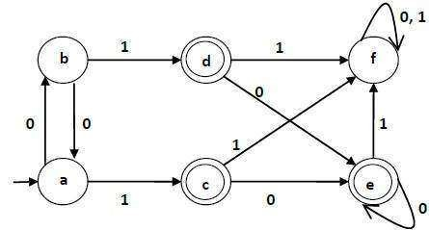
Example
Consider the following DFA. Minimize the following DFA using Table Filling Method

Slide 23
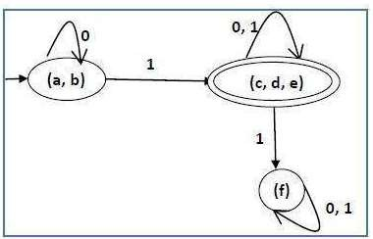
Minimised DFA

Slide 24
Empirical Method

Slide 25
Empirical Method
This method minimized the number of states and transitions according to the following steps:-
We merge two states in DFA into one state if they have the same important states. The important state is the state with no ε-transition
We merge two states if they either both include or both exclude accepting states of the NFA.

Slide 26
Example: Minimize the DFA according to the Empirical method.

