Slide 1
Top-down parsing

Slide 2
Parsing
A parser is a compiler or interpreter component that breaks data into smaller elements for easy translation into another language.
Parsing is a process that constructs a syntactic structure (i.e. parse tree) from the stream of tokens.
Parsing is the process of determining if a string of tokens can be generated by a grammar.
A parser takes input in the form of a sequence of tokens or program instructions and usually builds a data structure in the form of a parse tree or an abstract syntax tree.

Slide 3
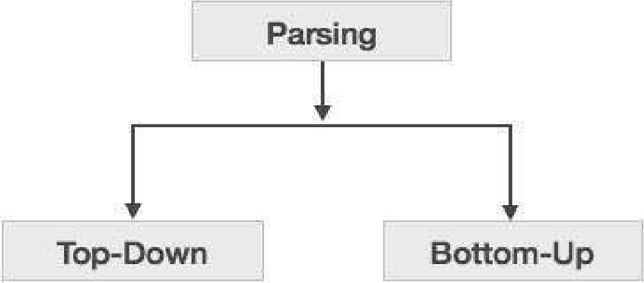
Parsing Techniques
Syntax analyzers follow production rules defined by means of context-free grammar. The way the production rules are implemented (derivation) divides parsing into two types :
Top-down parsing and
Bottom-up parsing.

Slide 4
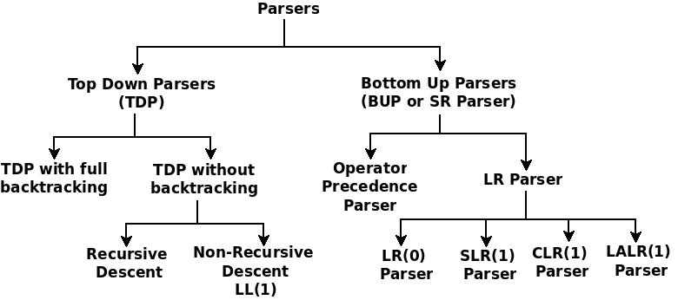
Types of Parser

Slide 5
Types of Parser
There are basically two types of parser:
Top-down parser:
starts at the root of derivation tree and fills in
picks a production and tries to match the input
may require backtracking
some grammars are backtrack-free (predictive)
Bottom-up parser:
starts at the leaves and fills in
starts in a state valid for legal first tokens
uses a stack to store both state and sentential forms

Slide 6
Top Down Parsing
Top-down parsers build parse trees from the top (root) to the bottom (leaves).
A top-down parse corresponds to a preorder traversal of the parse tree
A leftmost derivation is applied at each derivation step
Two top-down parsing are further sub-divided into the following categories:
Predictive Parsing.
Recursive Descent Parsing.

Slide 7
Top Down Parsing
A top-down parser starts with the root of the parse tree, labeled with the start symbol of the grammar.
To build a parse, it repeats the following steps until the fringe of the parse tree matches the input string
STEP1: At a node labeled A, select a production A → α and construct the appropriate child for each symbol of α.
STEP2: When a terminal is added to the fringe that doesn’t match the input string, backtrack.
STEP3: Find the next node to be expanded.

Slide 8
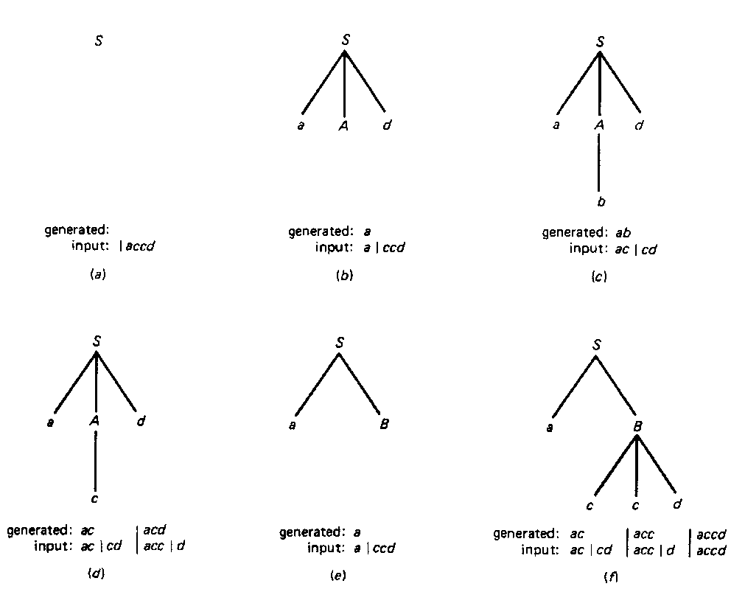
Example for Top Down Parsing
Supppose the given production rules are as follows:
S → aAd|aB
A → b|c
B → ccd

Slide 9
Example for Top Down Parsing
Consider the following Grammar:
<program> → begin <stmts> end $
<stmts> → SimpleStmt ; <stmts>
<stmts> → begin <stmts> end ; <stmts>
<stmts> → €
Input: begin SimpleStmt; SimpleStmt; end $

Slide 10

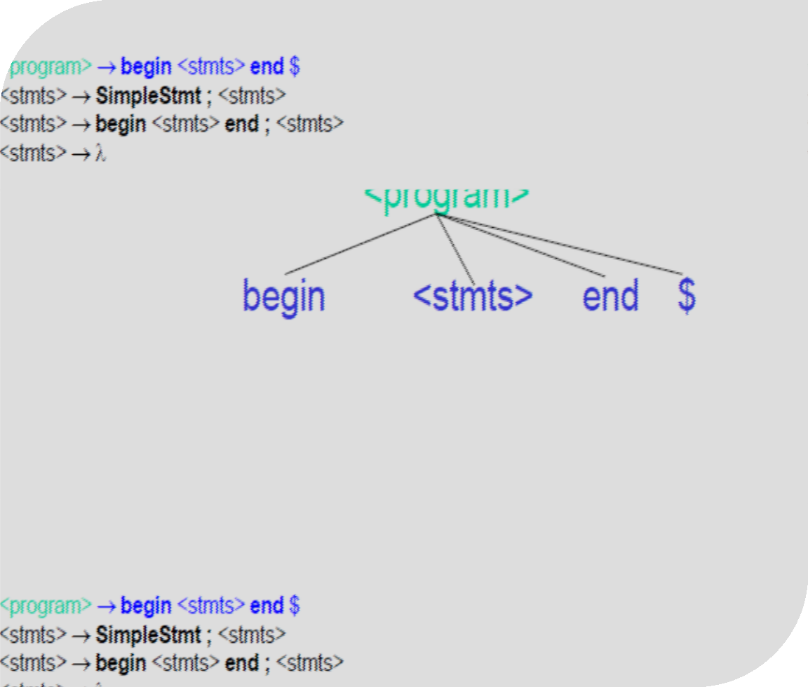

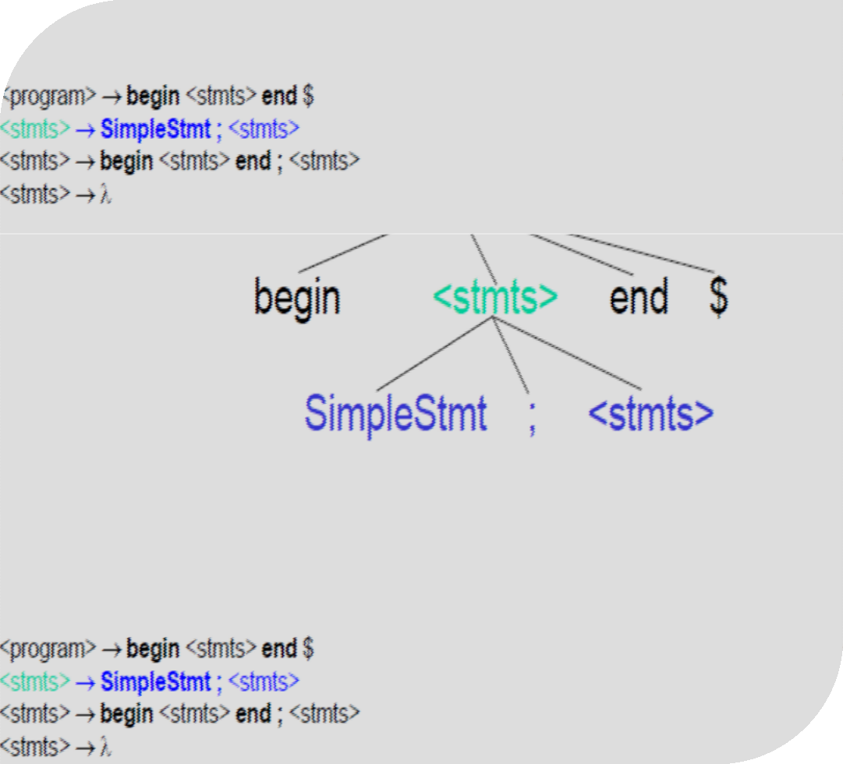

Slide 11

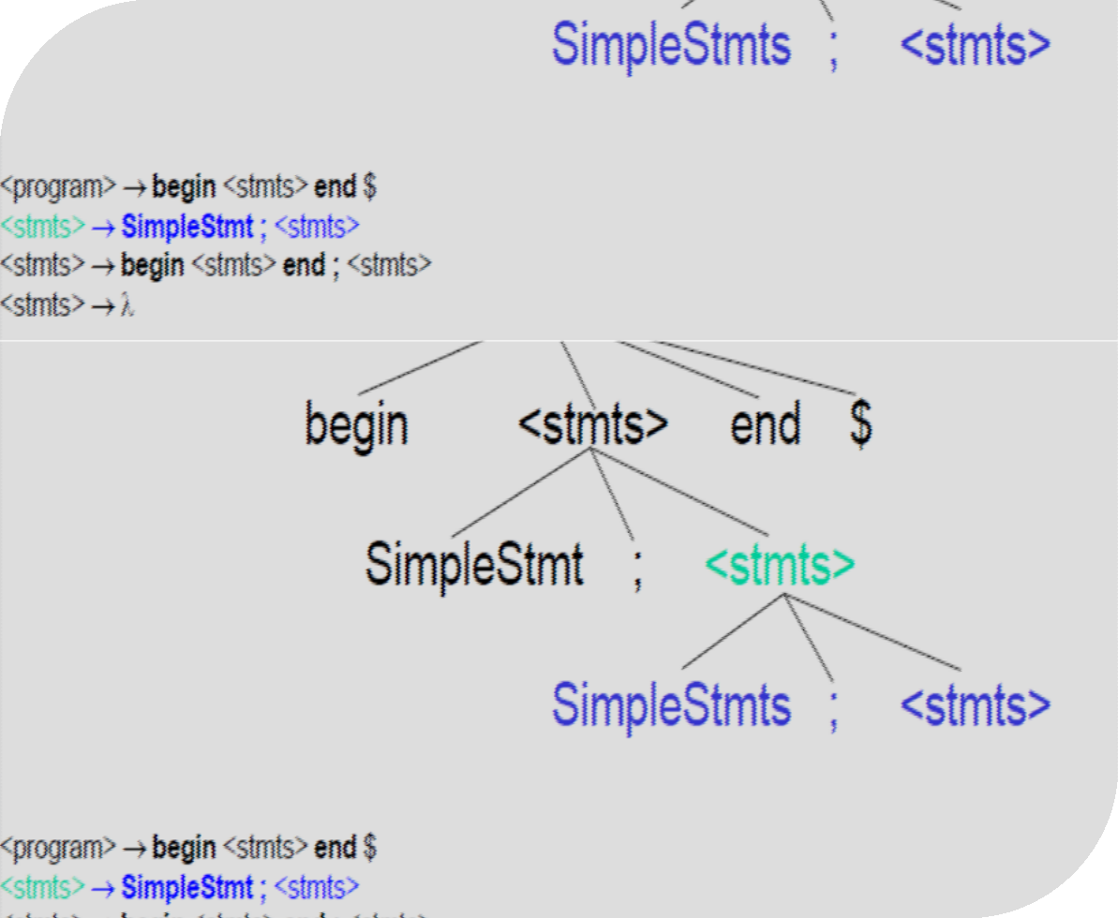

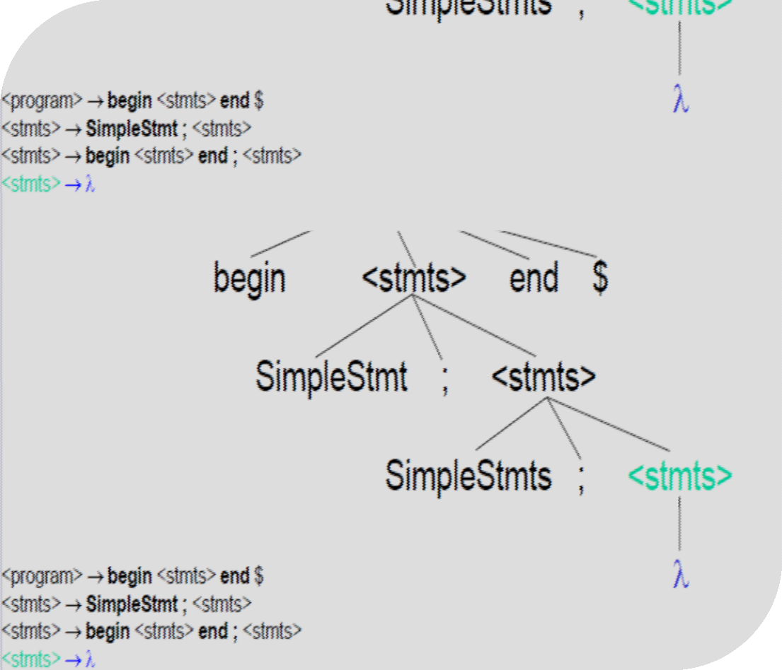

Slide 12
Problems with Top-down Parsing
Backtracking
Backtracing is a technique in which for expansion of non-terminal symbol we choose one alternative and if some mismatch occurs then we try another alternative if any.
If for a non-terminal there are multiple production rules beginning with the same input symbol then to get the correct derivation we need to try all these alternatives.

Slide 13
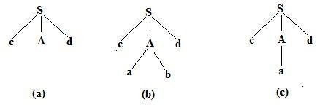
Example of Backtracking
Suppose the given production rules are as follows:
S → cAd
A → a|ab

Slide 14
Problems with Top-down Parsing
2. Left Recursion
Left recursion is a case when the left-most non-terminal in a production of a non-terminal is the non-terminal itself( direct left recursion) or through some other non-terminal definitions, rewrites to the non-terminal again(indirect left recursion). Consider these examples –
A → Aq (direct)
A → Bq
B → Ar (indirect)
Left recursion has to be removed if the parser performs top-down parsing

Slide 15
Problems with Top-down Parsing
3. Left Factoring
Left factoring is removing the common left factor that appears in two productions of the same non-terminal. It is done to avoid back-tracing by the parser. Suppose the parser has a look-ahead, consider this example-
A → qB | qC
where A, B, C are non-terminals and q is a sentence. In this case, the parser will be confused as to which of the two productions to choose and it might have to back-trace. After left factoring, the grammar is converted to-
A → qD
D → B | C

Slide 16
Recursive Descent Parsing
A recursive descent parser is a kind of top-down parser built from a set of mutually recursive procedures (or a non-recursive equivalent) where each such procedure usually implements one of the productions of the grammar.
A recursive-descent parsing program consists of a set of procedures, one for each nonterminal. Execution begins with the procedure for the start symbol, which halts and announces success if its procedure body scans the entire input string.
This parsing technique recursively parses the input to make a parse tree

Slide 17
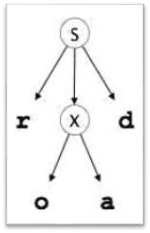
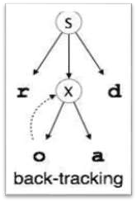
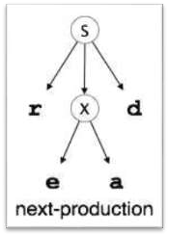
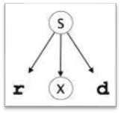
Recursive Descent Parsing - Example
A recursive-descent parser consists of several small functions, one for each nonterminal in the grammar.
A procedure is associated with each nonterminal of a grammar.
Recursive descent parsing involves backtracking.
For an input string: read
S → rXd
X → oa
X → ea

Slide 18
Recursive Descent Parsing - Example
Consider the grammar with input string “cad”:
S →c A d
A → a b | a
S
S S
c A d
c A d c A d
b a
a
cad

Slide 19
Predictive Parsing
Predictive parser, has the capability to predict which production is to be used to replace the input string.
The predictive parser does not suffer from backtracking.
The predictive parser uses a look-ahead pointer, which points to the next input symbols.
To make the parser back-tracking free, the predictive parser puts some constraints on the grammar.
It accepts only a class of grammar known as LL(k) grammar.
Hence, Predictive Parser is also known as LL(1) Parser.

Slide 20
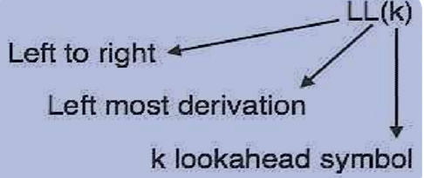
Predictive LL(1) Parsing
The first “L” in LL(1) refers to the fact that the input is processed from left to right.
The second “L” refers to the fact that LL(1) parsing determines a leftmost derivation for the input string.
The “1” in parentheses implies that LL(1) parsing uses only one symbol of input to predict the next grammar rule that should be used.
The data structures used by LL(1) are:
Input buffer
Stack
Parsing table

Slide 21
Non-Recursive Predictive Parsing
INPUT
 | a | + | b | $
Predictive Parsing
Program
X
Y
Z
$
OUTPUT
STACK
Parsing Table M

Slide 22
Constructing Predictive Parser
Following are the steps for constructing predictive parser:
Removing unreachable productions.
Removing ambiguity from the Grammar.
Eliminating left recursion.
Left Factoring of a grammar.
First and Follow.
Constructing a parse table

Slide 23
Predictive LL(1) Parsing
The construction of predictive LL(1) parser is based on two very important functions and those are FIRST and FOLLOW.
For construction of predictive LL(1) parser we have to follow the following steps:
STEP1: computate FIRST and FOLLOW function.
STEP2: construct predictive parsing table using first and follow function.
STEP3: parse the input string with the help of predictive parsing table

Slide 24
Removing Unreachable Productions
An unreachable production is one that cannot possibly appear in the parse tree rooted at the start symbol.
For example, in the following grammar :
S→ A | (1)
A→ a | (2)
B→ b | (3)
Production (3) is unreachable because the non-terminal B does not appear on the right side of any production.

Slide 25
Algorithm to remove unreachable production
Data Structures:
A stack
A List for Reachable Non-Terminals
Method:
Initially both the stack and list are Empty.
Step 1: Start symbol to the list of reachable non-Terminal also push onto the stack.
Step 2: While (The stack is not Empty)
{P= POP one Item of the stack
for (Each non-terminal X on right hand side are P) {
If (X is not in the list of reachable non - terminals) {
Push X;
Add X to the list of Reachable non-terminal; }}}
Step 3: Remove all the productions from the grammar where L-H-S is not in the list of reachable non-terminals.

Slide 26
Algorithm to remove unreachable production
Grammer:
S→aB | bA
A → a | bAA | aS
B → b | aBB | bS
C → aD | bS | €
D → bD | €
After Removing Unreachable Productions we have :
S → aB | bA
A → a | bAA | aS
B → b | aBB | bS

Slide 27
Eliminating Ambiguity
A grammar that produces more than one parse tree for some sentence (input string) is said to be ambiguous.
Ambiguity can be remove only by constructing a new grammar. Note:
For left associative, replace right non-terminal.
For right associative, replace left non-terminal.
If a grammar contains more than one operators, ambiguity will be removed first from the production involving the operator having the lowest precedence.

Slide 28
Example:
S → S+S | S-S | S*S | S/S | NUM
The operators with lower precedence will deal first:
S → S + S ’| S - S ’ | S ’
S ’ → S | S * S | S / S | N U M
R e p l a c e S b y S ’ f r o m R - H - S
S ’ → S ’ | S ’ * S ’ | S ’ / S ’ | N U M
After Eliminating the redundant productions ie, S’ → S’ , We will get :
S ’ → S ’ * S ’ | S ’ / S ’ | N U M
S ’ → S ’ * S ’’ | S ’ / S ’ ’| S ’ ’
S ’ ’ → S ’ | N U M
Replace again S’ by S’’ from R-H-S
S ’ ’ → S ’’ | N U M
After Eliminating the redundant productions i-e S’’ → S’’ , We will get :
S’’ → N U M

Slide 29
Unambiguous Grammar:
S → S + S ’ | S - S ’ | S ’
S ’ → S ’ * S ’ ’ | S ’ / S ’ ’ | S ’ ’
S ’’ → N U M

Slide 30
FIRST and FOLLOW
First and Follow aids the construction of a predictive parser. They allow us to fill in the entries of a predictive parsing table.
a is any string of terminals, then First(a) is the set of terminals that begin the strings derived from a. If a is an empty string(ɛ), then ɛ is also in First(a).
Follow (A), for a nonterminal A, to be the set of terminals a that can appear immediately to the right of A in a sentential form.

Slide 31
FIRST
If X is a terminal then FIRST(X) is just X!
If there is a Production X → ε then add ε to FIRST(X)
If there is a Production X → Y1Y2..Yk then add FIRST(Y1Y2..Yk) to FIRST(X)
FIRST(Y1Y2..Yk) is either
FIRST(Y1) (if First(Y1) doesn't contain ε)
OR (if FIRST(Y1) does contain ε) then FIRST (Y1Y2..YK) is everything in FIRST(Y1) <except for ε > as well as everything in FIRST(Y2..YK)
If FIRST(Y1) FIRST(Y2)..FIRST(YK) all contain ε then add ε to FIRST(Y1Y2..YK) as well.

Slide 32
FIRST
Rules in computing FIRST (X) where X can be a terminal or nonterminal, or even ε(empty string).
If X is a terminal, then FIRST(X)= X.
If X is ε, then FIRST (X) = ε.
If X is a nonterminal and Y and Z are nonterminals, with a production of
X →Y
Y → Za
Z → b;
then FIRST(X) = b; where
FIRST(nonterminal1) → FIRST(nonterminal2) or until you reach the first terminal of the production.
If X is a nonterminal and contains two productions. ex: X → a | b; then FIRST (X) = {a , b}

Slide 33
Consider again grammar G:
1) E → T E”
E” → +T E’’ | ε
T → F T”
T” → *F T” | ε
F → ( E ) | id
2) S → iEtSS" | a
S" → eS | ε
E → b

Slide 34
Consider again grammar G:
1) E → T E”
E” → +T E’’ | ε
T → F T”
T” → *F T” | ε
F → ( E ) | id
2) S → iEtSS" | a
S" → eS | ε
E → b
FIRST(E) = FIRST(T) = FIRST(F) = { ( , id }
FIRST (E") = { + , ε }
FIRST (T‘’) = { *, ε }
FIRST(S)= { i , a }
FIRST(S")= { e, ε}
FIRST(E) = { b }

Slide 35
FOLLOW
Computing FOLLOW
To compute FOLLOW(A) for all nonterminals A, apply the following rules until nothing can be added to any FOLLOW set:
Place $ in FOLLOW(S)
If there is a production A → αBβ, then everything in FIRST(β) (except for ε) is in FOLLOW(B)
If there is a production A → αB, or a production A → αBβ where FIRST(β) contains ε, then everything in FOLLOW(A) is also in FOLLOW(B)

Slide 36
FOLLOW
Rules in computing FOLLOW ( X) where X is a nonterminal
If X is a part of a production and is succeeded by a terminal, for example: A → Xa; then Follow(X) = { a }
If X is the start symbol for a grammar, for ex:
X → AB
A → a
B → b; then add $ to FOLLOW (X); FOLLOW(X)= { $ }
If X is a part of a production and followed by another non terminal, get the FIRST of that succeeding nonterminal.
A → XD
D → aB; then FOLLOW(X)= FIRST(D) = { a }; and if FIRST(D) contains ε (ex: D → aB | ε), then everything in FOLLOW(D) is in FOLLOW(X).
If X is the last symbol of a production, ex: S → abX, then FOLLOW(X)= FOLLOW(S)

Slide 37
EXAMPLE OF FIRST AND FOLLOW
The Grammar
E → TE'
E' → +TE'
E' → ε
T → FT'
T' → *FT'
T' → ε
F → (E)
F → id

Slide 38
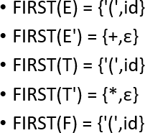
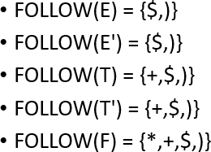
EXAMPLE OF FIRST AND FOLLOW
The Grammar
E → TE'
E' → +TE'
E' → ε
T → FT'
T' → *FT'
T' → ε
F → (E)
F → id

Slide 39
FIRST set
FIRST(S) = {a}
FIRST(B) = {c}
FIRST(C) = {b , ε}
FIRST(D) = FIRST(E) U FIRST(F) = {g, f, ε}
FIRST(E) = {g , ε}
FIRST(F) = {f , ε}
FOLLOW Set
FOLLOW(S) = {$}
FOLLOW(B) = {FIRST(D) – ε} U FIRST(h) = {g , f , h}
FOLLOW(C) = FOLLOW(B) = {g , f , h}
FOLLOW(D) = FIRST(h) = {h}
FOLLOW(E) = {FIRST(F) – ε } U FOLLOW(D) = {f , h}
FOLLOW(F) = FOLLOW(D) = {h}
S →aBDh
B → cC
C → bC
D → EF
E → g |ε
F → f | ε

Slide 40
S → ACB|Cbb|Ba
A → da|BC
B → g|ε
C → h|ε

Slide 41
FIRST set
FIRST(S) = FIRST(A) U FIRST(B) U FIRST(C) = { d, g, h, ε, b, a}
FIRST(A) = { d } U {FIRST(B)-Є} U FIRST(C) = { d, g, h, ε}
FIRST(B) = { g, ε}
FIRST(C) = { h, ε}
FOLLOW Set
FOLLOW(S) = { $ }
FOLLOW(A) = { h, g, $ }
FOLLOW(B) = { a, $, h, g }
FOLLOW(C) = { b, g, $, h }
S → ACB|Cbb|Ba
A → da|BC
B → g|ε
C → h|ε

Slide 42
Construction of Predictive Parsing Tables
Grammar:
first and follow sets:
E → TE'
E' → + T E' |𝜀 T → FT'
T' → * FT' |𝜀
F → ( E )| x|y
Non-Terminal | first | follow
E | ‘(‘, ‘x’, ‘y’ | $, ‘)’
E’ | ‘+’, 𝜀 | $, ‘)’
T | ‘(‘, ‘x’, ‘y’ | ‘+’, $, ‘)’
T’ | ‘*’, 𝜀 | ‘+’, $, ‘)’
F | ‘(‘, ‘x’, ‘y’ | ‘*’, ‘+’, ‘)’, $

Slide 43
Start with an empty parsing table; the rows are non-terminals and the columns are terminals.
Construction of Predictive Parsing Tables
Non- Terminal | Input Symbol
 | x | y | + | * | ( | ) | $
E
E'
T
T'
F

Slide 44
Current production:
Construction of Predictive Parsing Tables
for each production n → 𝛼
for each a ∊ first(𝛼)
add n → 𝛼 to T[n , a]
if 𝜀 ∊ first(𝛼) then
for each b ∊ follow(n) add
n → 𝛼 to T[n , a]
E → T E'
first(T E') = ‘(‘, | ‘x’ | , ‘y’
Non- Terminal | Input Symbol
 | x | y | + | * | ( | ) | $
E | E→ T E' |  |  |  | E→ T E'
E'
T
T'
F

Slide 45
Current production:
Construction of Predictive Parsing Tables
for each production n → 𝛼
for each a ∊ first(𝛼)
add n → 𝛼 to T[n , a]
if 𝜀 ∊ first(𝛼) then
for each b ∊ follow(n) add
n → 𝛼 to T[n , a]
E → T E'
first( T E' ) = ‘(‘, ‘x’, ‘ | y’
Non- Terminal | Input Symbol
 | x | y | + | * | ( | ) | $
E | E→ T E' | E→ T E' |  |  | E→ T E'
E'
T
T'
F

Slide 46
Current production:
for each production n → 𝛼
for each a ∊ first(𝛼)
add n → 𝛼 to T[n , a]
if 𝜀 ∊ first(𝛼) then
for each b ∊ follow(n) add
n → 𝛼 to T[n , a]
E' → + T E'
first( + T E' ) = ‘ | +’
Non- Terminal | Input Symbol
 | x | y | + | * | ( | ) | $
E | E→ T E' | E→ T E' |  |  | E→ T E'
E' |  |  | E'→ + T E'
T
T'
F

Slide 47
Current production:
for each production n → 𝛼
for each a ∊ first(𝛼)
add n → 𝛼 to T[n , a]
if 𝜀 ∊ first(𝛼) then
for each b ∊ follow(n) add
n → 𝛼 to T[n , a]
E‘ → 𝜀
follow( E' ) = | $, | ‘)’
Non- Terminal | Input Symbol
 | x | y | + | * | ( | ) | $
E | E→ T E' | E→ T E' |  |  | E→ T E'
E' |  |  | E'→ + T E' |  |  |  | E' → 𝜀
T
T'
F

Slide 48
Current production:
for each production n → 𝛼
for each a ∊ first(𝛼)
add n → 𝛼 to T[n , a]
if 𝜀 ∊ first(𝛼) then
for each b ∊ follow(n) add
n → 𝛼 to T[n , a]
E‘ → 𝜀
follow( E' ) = $, | ‘)’
Non- Terminal | Input Symbol
 | x | y | + | * | ( | ) | $
E | E→ T E' | E→ T E' |  |  | E→ T E'
E' |  |  | E'→ + T E' |  |  | E' → 𝜀 | E' → 𝜀
T
T'
F

Slide 49
Current production:
for each production n → 𝛼
for each a ∊ first(𝛼)
add n → 𝛼 to T[n , a]
if 𝜀 ∊ first(𝛼) then
for each b ∊ follow(n) add
n → 𝛼 to T[n , a]
T → F T'
first( F T' ) = ‘ | (‘, | ‘x’, ‘y’
Non- Terminal | Input Symbol
 | x | y | + | * | ( | ) | $
E | E→ T E' | E→ T E' |  |  | E→ T E'
E' |  |  | E'→ + T E' |  |  | E' → 𝜀 | E' → 𝜀
T |  |  |  |  | T→ F T'
T'
F

Slide 50
Current production:
for each production n → 𝛼
for each a ∊ first(𝛼)
add n → 𝛼 to T[n , a]
if 𝜀 ∊ first(𝛼) then
for each b ∊ follow(n) add
n → 𝛼 to T[n , a]
T → F T'
first( F T' ) = ‘(‘, ‘ | x’, | ‘y’
Non- Terminal | Input Symbol
 | x | y | + | * | ( | ) | $
E | E→ T E' | E→ T E' |  |  | E→ T E'
E' |  |  | E'→ + T E' |  |  | E' → 𝜀 | E' → 𝜀
T | T→ F T' |  |  |  | T→ F T'
T'
F

Slide 51
Current production:
for each production n → 𝛼
for each a ∊ first(𝛼)
add n → 𝛼 to T[n , a]
if 𝜀 ∊ first(𝛼) then
for each b ∊ follow(n) add
n → 𝛼 to T[n , a]
T → F T'
first( F T' ) = ‘(‘, ‘x’, | ‘y’
Non- Terminal | Input Symbol
 | x | y | + | * | ( | ) | $
E | E→ T E' | E→ T E' |  |  | E→ T E'
E' |  |  | E’→ + T E' |  |  | E' → 𝜀 | E' → 𝜀
T | T→ F T' | T→ F T' |  |  | T→ F T'
T'
F

Slide 52
Current production:
for each production n → 𝛼
for each a ∊ first(𝛼)
add n → 𝛼 to T[n , a]
if 𝜀 ∊ first(𝛼) then
for each b ∊ follow(n) add
n → 𝛼 to T[n , a]
T‘ → *FT’
Non- Terminal | Input Symbol
 | x | y | + | * | ( | ) | $
E | E→ T E' | E→ T E' |  |  | E→ T E'
E' |  |  | E’→ + T E' |  |  | E' → 𝜀 | E' → 𝜀
T | T→ F T' | T→ F T' |  |  | T→ F T'
T' |  |  |  | T'→ * F T'
F

Slide 53
Current production:
for each production n → 𝛼
for each a ∊ first(𝛼)
add n → 𝛼 to T[n , a]
if 𝜀 ∊ first(𝛼) then
for each b ∊ follow(n) add
n → 𝛼 to T[n , a]
T‘ → ∊
follow( T' ) = | ‘+’ | , $, ‘)’
Non- Terminal | Input Symbol
 | x | y | + | * | ( | ) | $
E | E→ T E' | E→ T E' |  |  | E→ T E'
E' |  |  | E’→ + T E' |  |  | E' → 𝜀 | E' → 𝜀
T | T→ F T' | T→ F T' |  |  | T→ F T'
T' |  |  | T' → 𝜀 | T'→ * F T'
F

Slide 54
Current production:
for each production n → 𝛼
for each a ∊ first(𝛼)
add n → 𝛼 to T[n , a]
if 𝜀 ∊ first(𝛼) then
for each b ∊ follow(n) add
n → 𝛼 to T[n , a]
T‘ → ∊
follow( T' ) = ‘+’, | $, | ‘)’
Non- Terminal | Input Symbol
 | x | y | + | * | ( | ) | $
E | E→ T E' | E→ T E' |  |  | E→ T E'
E' |  |  | E'→ + T E' |  |  | E' → 𝜀 | E' → 𝜀
T | T→ F T' | T→ F T' |  |  | T→ F T'
T' |  |  | T' → 𝜀 | T'→ * F T' |  |  | T' → 𝜀
F

Slide 55
Current production:
for each production n → 𝛼
for each a ∊ first(𝛼)
add n → 𝛼 to T[n , a]
if 𝜀 ∊ first(𝛼) then
for each b ∊ follow(n) add
n → 𝛼 to T[n , a]
T‘ → ∊
follow( T' ) = ‘+’, $, | ‘)’
Non- Terminal | Input Symbol
 | x | y | + | * | ( | ) | $
E | E→ T E' | E→ T E' |  |  | E→ T E'
E' |  |  | E'→ + T E' |  |  | E' → 𝜀 | E' → 𝜀
T | T→ F T' | T→ F T' |  |  | T→ F T'
T' |  |  | T' → 𝜀 | T'→ * F T' |  | T' → 𝜀 | T' → 𝜀
F

Slide 56
Current production:
for each production n → 𝛼
for each a ∊ first(𝛼)
add n → 𝛼 to T[n , a]
if 𝜀 ∊ first(𝛼) then
for each b ∊ follow(n) add
n → 𝛼 to T[n , a]
F → (E)
first((E)) = | ‘(’
Non- Terminal | Input Symbol
 | x | y | + | * | ( | ) | $
E | E→ T E' | E→ T E' |  |  | E→ T E'
E' |  |  | E'→ + T E' |  |  | E' → 𝜀 | E' → 𝜀
T | T→ F T' | T→ F T' |  |  | T→ F T'
T' |  |  | T' → 𝜀 | T'→ * F T' |  | T' → 𝜀 | T' → 𝜀
F |  |  |  |  | F → (E)

Slide 57
Current production:
for each production n → 𝛼
for each a ∊ first(𝛼)
add n → 𝛼 to T[n , a]
if 𝜀 ∊ first(𝛼) then
for each b ∊ follow(n) add
n → 𝛼 to T[n , a]
F → x
first( x ) = | ‘x’
Non- Terminal | Input Symbol
 | x | y | + | * | ( | ) | $
E | E→ T E' | E→ T E' |  |  | E→ T E'
E' |  |  | E'→ + T E' |  |  | E' → 𝜀 | E' → 𝜀
T | T→ F T' | T→ F T' |  |  | T→ F T'
T' |  |  | T' → 𝜀 | T'→ * F T' |  | T' → 𝜀 | T' → 𝜀
F | F → x |  |  |  | F → ( E )

Slide 58
Current production:
for each production n → 𝛼
for each a ∊ first(𝛼)
add n → 𝛼 to T[n , a]
if 𝜀 ∊ first(𝛼) then
for each b ∊ follow(n) add
n → 𝛼 to T[n , a]
F → y
first( y ) = | ‘y’
Non- Terminal | Input Symbol
 | x | y | + | * | ( | ) | $
E | E→ T E' | E→ T E' |  |  | E→ T E'
E' |  |  | E'→ + T E' |  |  | E' → 𝜀 | E' → 𝜀
T | T→ F T' | T→ F T' |  |  | T→ F T'
T' |  |  | T' → 𝜀 | T'→ * F T' |  | T' → 𝜀 | T' → 𝜀
F | F → x | F → y |  |  | F → ( E )

Slide 59
56
GRAMMAR:
S → iEtSS’ | a
S’ → eS |ε
E → b

Slide 60
56
GRAMMAR:
S → iEtSS’ | a
S’ → eS |ε
E → b
TABLE: FIRST & FOLLOW
SYMBOL FIRST FOLLOW
S a , i $ , e
S’ e , ε $ , e
E b t

Slide 61



TABLE: FIRST & FOLLOW
for each production n → 𝛼
for each a ∊ first(𝛼)
add n → 𝛼 to T[n , a]
if 𝜀 ∊ first(𝛼) then
for each b ∊ follow(n) add
n → 𝛼 to T[n , a]
S → iEtSS’ | a | a , i | $ , e
S’ → eS |ε | e, ε | $ , e
E→b | b | t
57
Non Terminal | INPUT SYMBOLS
 | a | b | e | i | t | $
S
S’
E
TABLE: PARSING TABLE

Slide 62
TABLE: FIRST & FOLLOW
58
SYMBOL | FIRST | FOLLOW
S → iEtSS’ | a | a , i | $ , e
S’ → eS |ε | e, ε | $ , e
E → b | b | t
Non Terminal | INPUT SYMBOLS
 | a | b | e | i | t | $
S | S → a
S’
E
TABLE: PARSING TABLE

Slide 63
TABLE: FIRST & FOLLOW
59
SYMBOL | FIRST | FOLLOW
S → iEtSS’ | a | a , i | $ , e
S’ → eS |ε | e, ε | $ , e
E → b | b | t
Non Terminal | INPUT SYMBOLS
 | a | b | e | i | t | $
S | S → a |  |  | S → iEtSS’
S’
E
TABLE: PARSING TABLE

Slide 64
TABLE: FIRST & FOLLOW
60
SYMBOL | FIRST | FOLLOW
S → iEtSS’ | a | a , i | $ , e
S’ → eS |ε | e, ε | $ , e
E → b | b | t
Non Terminal | INPUT SYMBOLS
 | a | b | e | i | t | $
S | S → a |  |  | S → iEtSS’
S’ |  |  | S’ → eS
E
TABLE: PARSING TABLE

Slide 65

61
SYMBOL | FIRST | FOLLOW
S → iEtSS’ | a | a , i | $ , e
S’ → eS |ε | e, ε | $ , e
E → b | b | t
TABLE: FIRST & FOLLOW
Non Terminal | INPUT SYMBOLS
 | a | b | e | i | t | $
S | S → a |  |  | S → iEtSS’
S’ |  |  | S’ → eS S’ → ε |  |  | S’ → ε
E
TABLE: PARSING TABLE

Slide 66
TABLE: FIRST & FOLLOW
62
SYMBOL | FIRST | FOLLOW
S → iEtSS’ | a | a , i | $ , e
S’ → eS |ε | e, ε | $ , e
E → b | b | t
Non Terminal | INPUT SYMBOLS
 | a | b | e | i | t | $
S | S → a |  |  | S → iEtSS’
S’ |  |  | S’ → eS S’ → ε |  |  | S’ → ε
E |  | E → b
TABLE: PARSING TABLE

Slide 67
TABLE: FIRST & FOLLOW
62
SYMBOL | FIRST | FOLLOW
S → iEtSS’ | a | a , i | $ , e
S’ → eS |ε | e, ε | $ , e
E → b | b | t
Non Terminal | INPUT SYMBOLS
 | a | b | e | i | t | $
S | S → a |  |  | S → iEtSS’
S’ |  |  | S’ → eS S’ → ε |  |  | S’ → ε
E |  | E → b
TABLE: PARSING TABLE
Ambiguity

Slide 68
A Grammar which is not LL(1)
S → i C t S E | a
FOLLOW(S) = { $,e }
FOLLOW(E) = { $,e }
FOLLOW(C) = { t }
E → e S | ε
C → b FIRST(iCtSE) = {i} FIRST(a) = {a}
FIRST(eS) = {e}
FIRST(ε) = {ε}
FIRST(b) = {b}
FIRST(S) = {i , a}
FIRST(E) = {e , ε}
FIRST(C) = {b}
 | a | b | e | i | t | $
S | S → a |  |  | S → iCtSE
E |  |  | E → e S E → ε |  |  | E → ε
C |  | C → b
two production rules for M[E,e]
Problem ➔ ambiguity

Slide 69
Properties of LL(1) Grammars
No left-recursive grammar is LL(1)
No ambiguous grammar is LL(1)
Some languages have no LL(1) grammar
A ε–free grammar where each alternative expansion for A begins with a distinct terminal is a simple LL(1) grammar.
Example:
S → aS | a
is not LL(1) because FIRST(aS) = FIRST(a) = { a } S → aS´
S´ → aS | ε
accepts the same language and is LL(1)

Slide 70
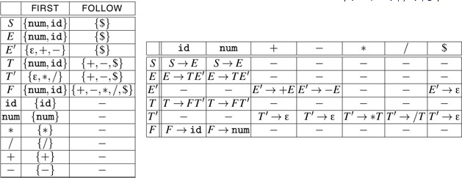
Example of Predictive Parsing LL(1) Table
The given grammar is as follows
S → E
E → TE´
E´ → +E | —E | ε
T → FT´
T´ → * T | / T | ε
F → num | id

Slide 71
LL(1) Parser – Parser Actions
The symbol at the top of the stack (say X) and the current symbol in the input string (say a) determine the parser action.
There are FOUR possible PARSER ACTIONS:
If X = a = $ ➔ parser halts and announces successful completion of the parsing
If X = a # $ ➔ parser pops X from the stack, and advances the input pointer to the next input symbol
If X is a non-terminal ➔ parser looks at the parsing table entry M[X,a]. If M[X,a] holds a production rule X→Y₁Y₂...Y_{k}, it pops X from the stack and pushes Y_{k},Y_{k-1},...,Y₁ into the stack. The parser also outputs the production rule X→Y₁Y₂...Y_{k} to represent a step of the derivation.
none of the above ➔ error
all empty entries in the parsing table are errors.
If X is a terminal symbol different from a, this is also an error case

Slide 72
STACK Implementation
66
The predictive parser uses an explicit stack to keep track of pending non-terminals. It can thus be implemented without recursion.
The input buffer contains the string to be parsed; $ is the end- of-input marker.
The stack contains a sequence of grammar symbols
Initially, the stack contains the start symbol of the grammar on the top of $.

Slide 73
LL(1) Stack
The parser is controlled by a program that behaves as follows:
The program considers X, the symbol on top of the stack, and a, the current input symbol.
These two symbols, X and a determine the action of the parser. There are three possibilities.
X = a = $, the parser halts and announces successful completion.
X =a ≠ $ the parser pops X off the stack and advances input pointer to next input symbol
If X is a nonterminal, the program consults entry M[X,a] of parsing table M. If the entry is a production M[X,a] = {X → uvw } then the parser replaces X on top of the stack by wvu (with u on top).
68

Slide 74
LL(1) Stack
70
Grammar:
E → TE'
E' → +TE'|ε
T → FT'
T' → *FT'|ε
F → (E)|id
Example:
Let’s parse the input string id+id*id
Using the non-recursive LL(1) parser

Slide 75
id + id ∗ id $
71
E
$
 | id | + | * | ( | ) | $
E | E →TE' |  |  | E →TE'
E' |  | E' →+TE' |  |  | E' →ε | E' →ε
T | T →FT' |  |  | T →FT'
T' |  | T' → ε | T →*FT' |  | T' →ε | T' →ε
F | F → id |  |  | F →(E )
stack
Parsing Table

Slide 76
id + id ∗ id $
73
E
$
E →TE'
 | id | + | * | ( | ) | $
E | E →TE' |  |  | E →TE'
E' |  | E' →+TE' |  |  | E' →ε | E' →ε
T | T →FT' |  |  | T →FT'
T' |  | T' → ε | T →*FT' |  | T' →ε | T' →ε
F | F → id |  |  | F →(E )
stack
Table
Parsing Table

Slide 77
id + id ∗ id $
74
T
E'
$
 | id | + | * | ( | ) | $
E | E →TE' |  |  | E →TE'
E' |  | E' →+TE' |  |  | E' →ε | E' →ε
T | T →FT' |  |  | T →FT'
T' |  | T' → ε | T →*FT' |  | T' →ε | T' →ε
F | F → id |  |  | F →(E )
stack
Parsing Table

Slide 78
id + id ∗ id $
75
F
T'
E'
$
 | id | + | * | ( | ) | $
E | E →TE' |  |  | E →TE'
E' |  | E' →+TE' |  |  | E' →ε | E' →ε
T | T →FT' |  |  | T →FT'
T' |  | T' → ε | T →*FT' |  | T' →ε | T' →ε
F | F → id |  |  | F →(E )
stack
Parsing Table

Slide 79
id + id ∗ id $
76
id
T'
E'
$
 | id | + | * | ( | ) | $
E | E →TE' |  |  | E →TE'
E' |  | E' →+TE' |  |  | E' →ε | E' →ε
T | T →FT' |  |  | T →FT'
T' |  | T' → ε | T →*FT' |  | T' →ε | T' →ε
F | F → id |  |  | F →(E )
stack
Parsing Table

Slide 80
+ id ∗ id $
77
T'
E'
$
 | id | + | * | ( | ) | $
E | E →TE' |  |  | E →TE'
E' |  | E' →+TE' |  |  | E' →ε | E' →ε
T | T →FT' |  |  | T →FT'
T' |  | T' → ε | T →*FT' |  | T' →ε | T' →ε
F | F → id |  |  | F →(E )
stack
Parsing Table

Slide 81
+ id ∗ id $
78
E'
$
 | id | + | * | ( | ) | $
E | E →TE' |  |  | E →TE'
E' |  | E' →+TE' |  |  | E' →ε | E' →ε
T | T →FT' |  |  | T →FT'
T' |  | T' → ε | T →*FT' |  | T' →ε | T' →ε
F | F → id |  |  | F →(E )
stack
Parsing Table

Slide 82
+ id ∗ id $
79
+
T
E'
$
 | id | + | * | ( | ) | $
E | E →TE' |  |  | E →TE'
E' |  | E' →+TE' |  |  | E' →ε | E' →ε
T | T →FT' |  |  | T →FT'
T' |  | T' → ε | T →*FT' |  | T' →ε | T' →ε
F | F → id |  |  | F →(E )
stack
Parsing Table

Slide 83
MATCHED | STACK | INPUT | ACTION
 | E$ | id+id * id$
 | TE’$ | id+id * id$ | E->TE’
 | FT’E’$ | id+id * id$ | T->FT’
 | id T’E’$ | id+id * id$ | F->id
id | T’E’$ | +id * id$ | Match id
id | E’$ | +id * id$ | T’->Є
id | +TE’$ | +id * id$ | E’-> +TE’
id+ | TE’$ | id * id$ | Match +
id+ | FT’E’$ | id * id$ | T-> FT’
id+ | idT’E’$ | id * id$ | F-> id
id+id | T’E’$ | * id$ | Match id
id+id | * FT’E’$ | * id$ | T’-> *FT’
id+id * | FT’E’$ | id$ | Match *
id+id * | idT’E’$ | id$ | F-> id
id+id * id | T’E’$ | $ | Match id
id+id * id | E’$ | $ | T’-> Є
id+id * id | $ | $ | E’-> Є
80
 | id | + | * | ( | ) | $
E | E →TE' |  |  | E →TE'
E' |  | E' →+TE' |  |  | E' →ε | E' →ε
T | T →FT' |  |  | T →FT'
T' |  | T' → ε | T →*FT' |  | T' →ε | T' →ε
F | F → id |  |  | F →(E )

Slide 84

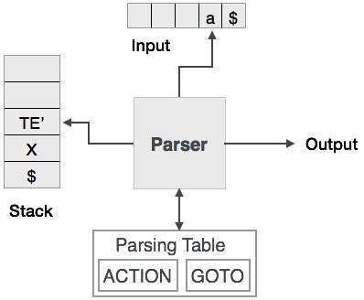
Non-recursive Predictive Parsing
A non-recursive predictive parser is an efficient way of implementing by handling the stack of activation records explicitly.

