Slide 1
PIP4004 - INTERNSHIP Review-3 Presentation
Software Development
Student Details
Name | PL THIYAGARAJAN
Roll No | 20211ISR0017
Section | 8-ISR-01
Under the Supervision of,
Dr. Praveena K N
Assistant Professor
School of Computer Science and Engineering
Presidency University
Name of the Program: B.tech
Name of the HoD: Dr.Zafar Ali Khan
Name of the School Internship/Project Coordinators: Mr. Md Ziaur Rahman

Slide 2
Content
About Company or Organization
Working domain or the technology
About your team and reporting Manager
Challenges Faced in Internship
Objectives of the work
Internship Roadmap
Github Link

Slide 3
About Company or Organization
Company Overview
About Test Yantra: A global IT services company specializing in software testing and quality assurance.
Establishment: Founded with the vision to deliver reliable and efficient QA solutions.
Presence: Offices across various regions, serving clients worldwide.

Slide 4
About Company or Organization
Products & Services
Software Testing & QA: Comprehensive testing solutions including manual, automation, performance, and security testing.
Consulting & Training: Expert guidance on testing methodologies, tools, and best practices.
Customized Solutions: Tailored services to meet specific client needs across diverse domains.

Slide 5
About Company or Organization
Clients & Partnerships
Client Base: Serves startups, mid-sized companies, and large enterprises in sectors like banking, healthcare, and e-commerce.
Key Partnerships: Collaborates with leading technology providers to stay at the forefront of testing innovation.
Reputation: Known for quality-driven approaches and a proven track record of delivering on-time, cost-effective solutions.

Slide 6
Working domain or the technology
Backend: Django (Python Framework)
Features: MTV architecture, ORM for database handling, in-built admin panel, secure session management.
Importance: Streamlines backend development, integrates easily with databases, and accelerates rapid deployment.

Slide 7
Working domain or the technology
Frontend: HTML, CSS, Bootstrap
Features: Semantic page structure (HTML), responsive design (Bootstrap), custom styling (CSS).
Importance: Enhances user interface and experience, ensuring compatibility across devices.

Slide 8
Working domain or the technology
Database: SQLite
Features: Lightweight, serverless, built-in support in Django.
Importance: Ideal for development/testing,
simplifies data storage without complex setup.

Slide 9
About your team and reporting Manager
Project Manager (PM)
Oversees the project timeline, budget, and scope.
Acts as the main point of contact for stakeholders and higher management.
Technical Lead (Tech Lead)
Guides the technical direction of the project.
Mentors developers and ensures coding standards and best practices.

Slide 10
About your team and reporting Manager
Developers
Responsible for writing and maintaining code.
Work in close collaboration with the Tech Lead and QA.
Quality Assurance (QA) / Testers
Verify that the software meets requirements.
Perform functional, integration, and regression testing.

Slide 11
Challenges Faced in Internship
High Competition: With many qualified applicants vying for limited spots, it can be challenging to stand out from the crowd.
Specific Skill Requirements: Test Yantra may be looking for proficiency in particular programming languages or frameworks (e.g., Python, HTML, CSS, JavaScript, Django, React). Gaps in these skills could make the application process more challenging

Slide 12
Challenges Faced in Internship
Networking Opportunities: Sometimes, not having strong industry connections or referrals can make it harder to get noticed during the application process.

Slide 13
Objectives of the work
Enhance User Experience: Develop and integrate features that make web applications more intuitive and responsive for end-users
Improve Code Quality & Efficiency: Write clean, maintainable code using Python, Django, React, etc., ensuring scalability and ease of future enhancements.

Slide 14
Objectives of the work
Operational Platform: The developed features and improvements become part of the live software used by clients, enhancing their daily operations.
Training and Documentation: Your work, including code and documentation, becomes a resource for onboarding new team members and for future troubleshooting and enhancements.

Slide 15
About the Project :
🎬 Project Title: Movie Booking Platform
📌 Objective
To build a web-based platform that allows users to browse movies, check showtimes, book tickets, and manage bookings online in a user-friendly and efficient manner.

Slide 16
About the Project :
🔍 Problem Statement
Traditional movie ticketing involves standing in queues or using outdated websites with limited functionality. There’s a need for a modern, scalable, and user-centric solution that automates and simplifies this process for both users and cinema administrators.

Slide 17
About the Project :
💡 Proposed Solution
A full-stack web application developed using Django (Python) that includes:
Real-time movie listing and seat availability
Secure user login and account management
Admin panel to manage movies, bookings, and user activity
A clean, responsive user interface for easy navigation and booking

Slide 18
About the Project :
⚙️ Technology Stack
Frontend: HTML, CSS, Bootstrap
Backend: Django (Python)
Database: SQLite
Tools: Git, VS Code, Virtual Environment, Postman (optional)

Slide 19
About the Project :
🧱 Project Modules
User Management
Sign-up, login, password management
Movie Management
Admin adds/edits/deletes movies and showtimes
Seat Booking System
Dynamic seat selection with real-time availability

Slide 20
About the Project :
🧱 Project Modules
Booking Confirmation
Generates ticket summary after payment (mock)
Admin Dashboard
Manage all data (users, movies, bookings)

Slide 21
About the Project :
Development Phases
Planning & Requirement Gathering
Designing Database and Wireframes
Developing Backend (Django Models, Views)
Frontend Integration
Testing & Debugging
Documentation & Deployment

Slide 22
About the Project :
🧪 Testing
Manual and functional testing of each module
Ensured that seat booking, login flow, and admin actions worked seamlessly

Slide 23
About the Project :
🧪 Testing
Manual and functional testing of each module
Ensured that seat booking, login flow, and admin actions worked seamlessly

Slide 24
About the Project :
📈 Outcomes
Developed a working, modular web application
Simplified the ticket booking process
Created a foundation that can be scaled and deployed

Slide 25
About the Project :
🌟 Future Scope
Integrate online payment gateways
Add movie trailers, ratings, and reviews
Expand support for multi-theater and location-based searches
Deploy on a cloud platform for real-world use

Slide 26
About the Project :
👨‍ My Role
Led the development as a Full-Stack Developer
Designed database schema, built backend logic, and integrated front-end
Managed project structure and testing process

Slide 27
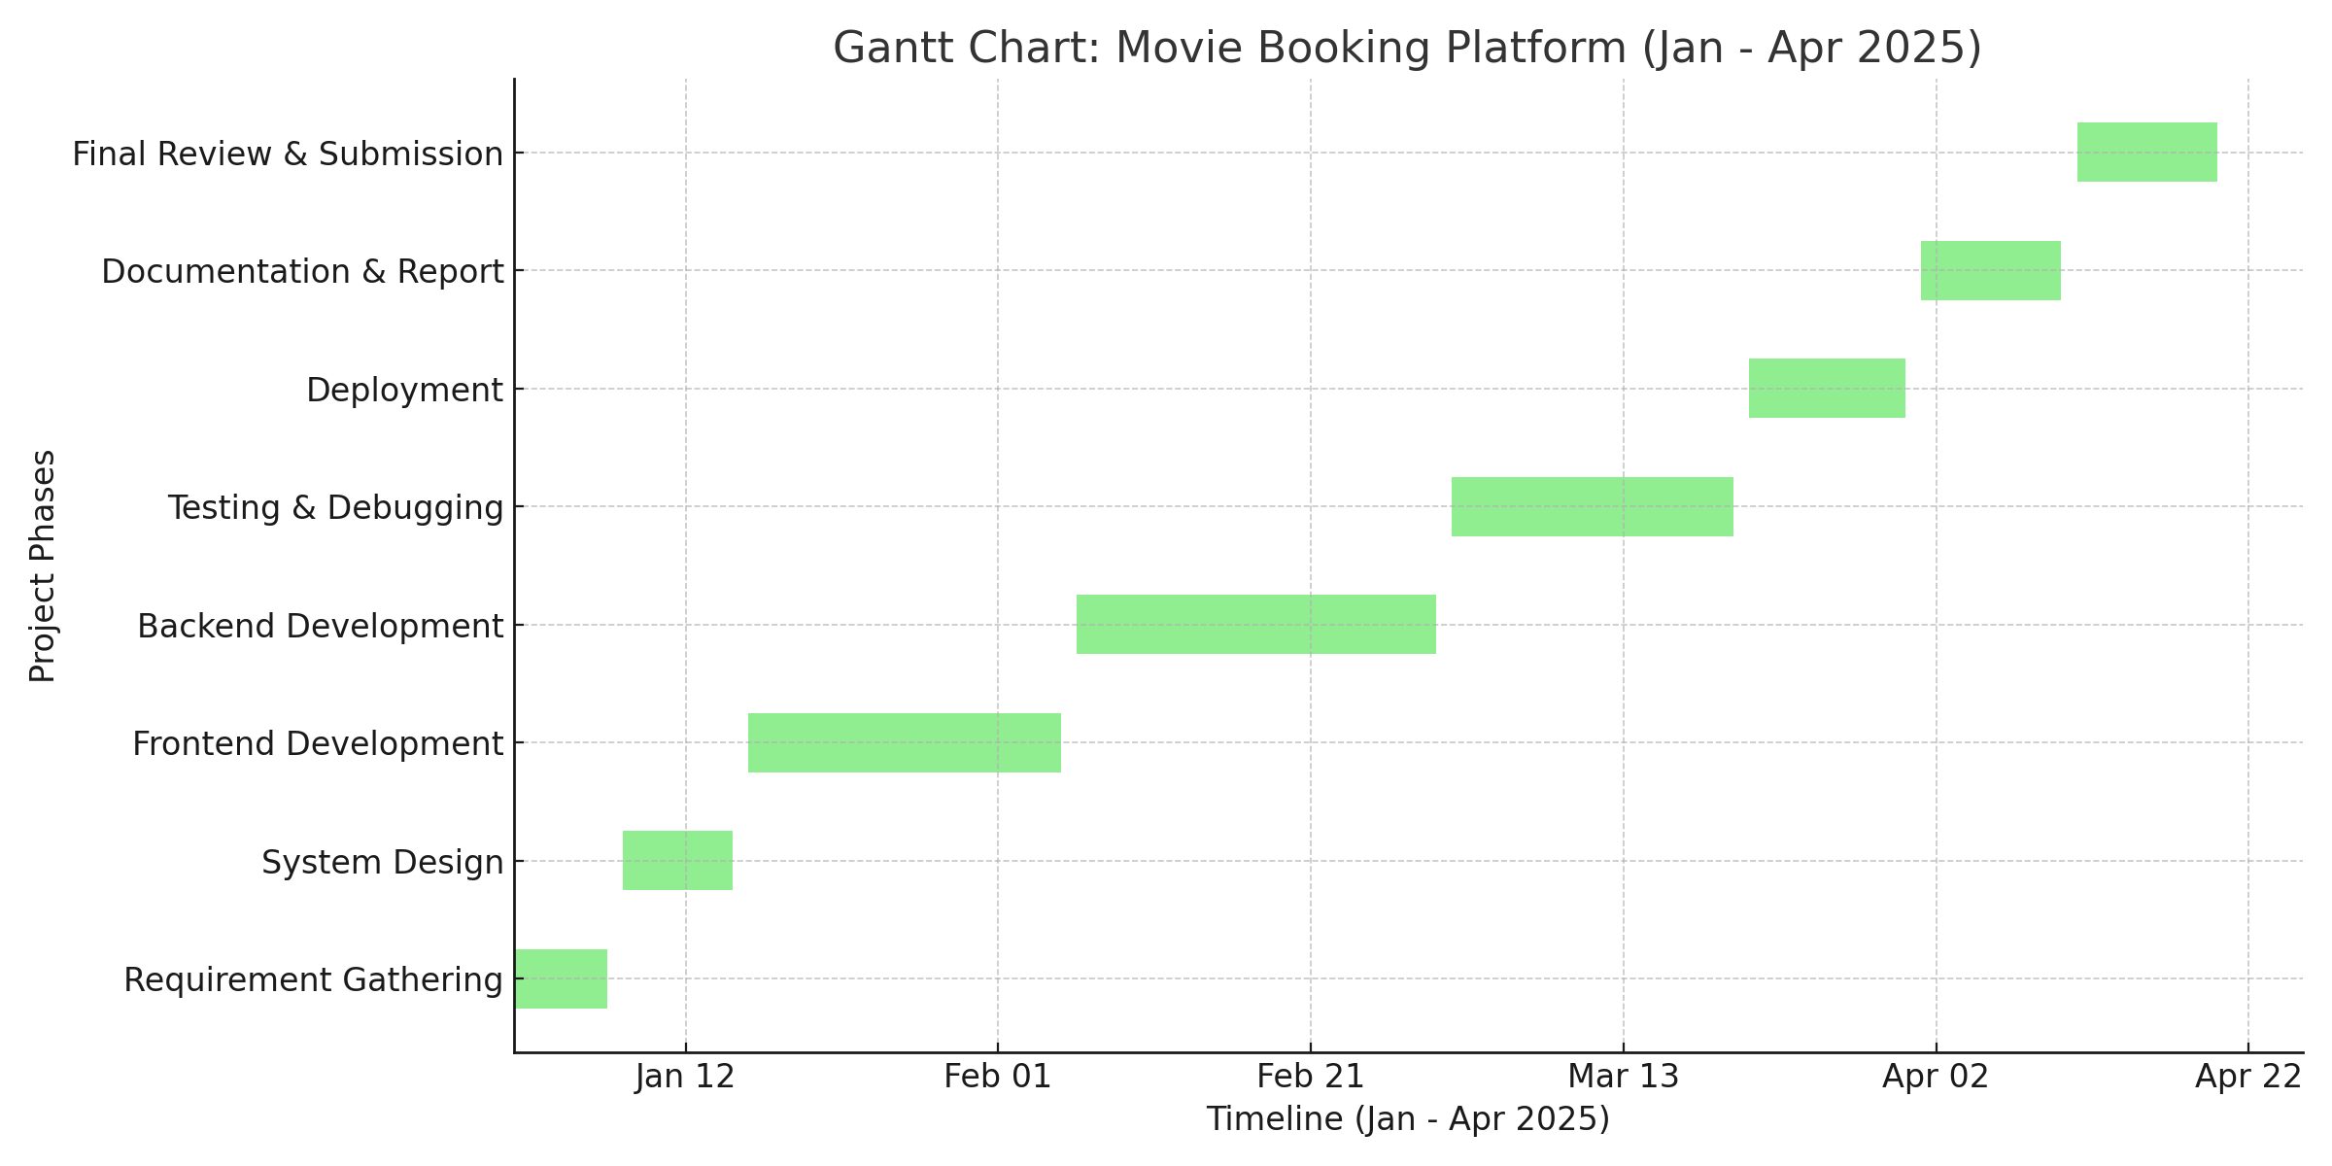
Gantt Chart :

Slide 28
Internship Road Map
Note: Write in the below table what u will be achieving in each review
Review 0
Understand the company processes and project scope.
Review 1
Complete basic coding tasks or documentation to familiarize with codebase.
Review 2
Demonstrate improved coding standards, problem-solving, and understanding of project requirements.
Review 3
Showcase completed work, lessons learned, and plan for next steps or handover.

Slide 29
Literature Review
Why Python & Django for E-Commerce?
Fast & Secure: Built-in authentication, ORM, and security features (CSRF, SQL Injection protection).
Scalability & Modularity: Supports large product catalogs & user traffic with caching and microservices.
Rapid Development: Pre-built admin panel, Django REST Framework (DRF) for APIs, and database integrations.

Slide 30
Literature Review
Key Technologies for Full Stack E-Commerce:
Frontend: React.js, Tailwind CSS for dynamic and responsive UI.
Backend: Django + Django REST Framework (DRF) for handling business logic & APIs.
Payments & Auth: JWT, OAuth, Stripe, Razorpay for secure transactions.

Slide 31
Proposed System / Work
Proposed System:
Django Framework,Python,Web Technologies,SQL
Work Assigned:
To create Website using Django Framework along with linking additional Json file and Bootstrap to it.

Slide 32
Problem Statement
Current movie ticket booking systems are either outdated or lack real-time features, causing inconvenience for users and inefficiency for theater management. There is a need for a centralized, responsive platform that enables users to book tickets with live seat availability while allowing admins to manage movies, shows, and bookings seamlessly.

Slide 33
System Requirements
System with Idle Python version 3.
System with suitable VsCode and latest version.
Latest Django framework installation.
System suitable with activation of virtual environment.
System suitable to handle React Configuration and other API repostories.

Slide 34
Advantages of Proposed System/Work
Proposed System:
Easy readable and understandable.
Friendly user interface.
Huge collection of libraries.
Easy implementation of API keys and Repositories.

Slide 35
Github Link
https://github.com/Thiyag15

Slide 36
Q&A

Slide 37
Thank you !!

