Slide 1
PID No:
00000
10th Edition TECHgium®
Presentation Round
GainShield
Safe AI tuning of PI gains, with a stability certificate and runtime fallback, for bidirectional EV-charger DC links
Author 1
Photo
Author 2
Photo
Author 3
Photo
Author 4
Photo
Name 1
Name 2
Name 3
Name 4
College name, City, State
Notes:
Fill in the PID, the four team photos and names, and the college before submission (placeholders kept from the official template). Rename the file with the last 5 digits of the PID.

Slide 2

Challenge Statement
The DC-link PI loop is tuned once by hand, but the plant it controls changes in every charging session
3-ph grid
415 V, 0.8–1.1 pu
Active front end
inner i_d loop, 1–2 sample delay
DC link 800 V
C = 2 mF ±20 %
Bidirectional DC-DC
constant power, ±30 kW
EV battery
G2V ⇄ V2G
Why it matters
DC-link voltage is the energy buffer between grid and car.
Too slow: voltage dips or swells during power steps and G2V⇄V2G reversal.
Too aggressive: oscillation, trips, stressed semiconductors.
i_d* command
v_dc measured
PI voltage controller, 10 kHz
Kp, Ki fixed, tuned by hand
1 The plant moves
2 Manual PI = one compromise
3 Unrestricted AI is unsafe
4 No evidence trail
C drifts ±20 % with tolerance and ageing; grid sags to 0.8 pu; power reverses from +15 to −15 kW in 15 ms; the DC-DC stage behaves as a constant-power load.
Tuned for nominal conditions, then detuned to survive the worst case. Our baseline keeps only 42° worst-case phase margin and is not re-tuned when conditions change.
Bayesian optimisation or RL that tries any gains on a live 800 V link can apply an unstable pair before it learns it is unstable.
Nobody can show afterwards which gains ran, why, or whether they were proved stable at the time.
Challenge: tune the PI gains online for the current operating point, apply only gains that are proved stable, fall back instantly when something looks wrong, and log every decision.
Notes:
Problem in 20 seconds: the DC-link loop is critical and conventionally hand-tuned once. The plant changes (capacitance, grid, power direction), so a single PI is a compromise. Plain AI tuning cannot be allowed to experiment on an 800 V link. All numbers are engineering assumptions (Assumptions slide).

Slide 3
Concept / Proposed Solution
GainShield: the AI chooses where to explore, while maths and an independent supervisor decide what is allowed
1
Prove
Charger plant
averaged AFE + DC link + DC-DC
① Certificate
Tier 1: stable for ALL plants
Tier 2: margins for this context
③ Candidate gate
exact re-check, GP σ,
envelope, step limit
③ Runtime monitor
V, I, oscillation, sensor
No gain reaches the plant without a stability proof over C ±20 %, 0.8–1.1 pu grid, both power directions.
2
Learn safely
SafeOpt-style BO expands a GP safe set outward from the known-good baseline.
Context
C, Vg, P, G2V/V2G, τ_i, delay
② Safe BO (AI)
contextual GPs: cost, V & I margins
PI controller 10 kHz
anti-windup, bumpless
④ Baseline PI
certified fallback
Supervise
3
An independent gate and monitor that do not trust the optimiser.
rollback
4
Fall back + log
④ Audit log + dashboard: every proposal, acceptance, rejection and rollback with reason
Bumpless rollback to the certified manual PI, with every decision audited.
Core innovation
 | Manual PI | Plain BO / RL | GainShield
Adapts to operating point | ✗ | ✓ | ✓
Stability proved before applying | ✓ (one point) | ✗ | ✓ (whole set)
Runtime fallback + audit | – | ✗ | ✓
A two-tier certificate (a global robust-stability proof plus context-specific margins) is wrapped around contextual safe Bayesian optimisation, so the AI can raise gains when the context allows it, and a sudden grid or capacitance change can never make the active loop unstable.
Notes:
Walk the loop: the plant and its context feed the certificate. The certificate restricts the candidates the GP optimiser may consider. The gate re-checks every proposal independently. The monitor watches real signals and rolls back to the baseline. Everything is logged. This diagram is the code structure (core.py, stability/, optimizer/, safety/, audit/).

Slide 4
Pros and Cons of the solution
Measured strengths, with every limitation stated and a mitigation for each
Strengths (evidence from simulation)
Limitations → mitigation
Adaptive tuning
Model dependency
16 % lower mean peak deviation and 15 % lower IAE than the manual PI (p < 1e-7).
The certificate holds only for the linearised model inside the stated set → context-envelope check, monitor, HIL validation.
Stability-aware optimisation
Computational requirements
Every applied gain is robustly stable for the whole uncertainty set (proof, not sampling).
Uncached context certificate ≈ 1.6 s in Python → off the 10 kHz loop; precomputed lookup table.
Safety supervision
GP uncertainty
0 of 175 online probe episodes left the ±5 % band; an injected unstable gain was rolled back.
A GP is not a guarantee (the RKHS bound is not verified) → GP is one of three layers; σ gate; zero-prior margins.
Traceability
Stability-model assumptions
834 audit records; an automatic check found 0 unexplained gain changes.
Inner-loop lag and delay are gridded, not proved between nodes → margin slack; delay identification in HIL.
Reproducible testing
Simulation-to-hardware gap
Seeded, pre-drawn noise; one command regenerates all results; 36 automated tests.
No hardware yet; a stuck sensor is not detected → power-balance observer, hardware OVP/UVP, PIL→HIL roadmap.
Trade-off made explicit: higher gains amplify sensor noise (current-reference ripple +8.5 % on average), and GainShield stays on the baseline when it has no certified, evidence-backed improvement.
Notes:
Every strength is a measured number from results/. Every limitation is also listed in docs/LIMITATIONS.md.

Slide 5
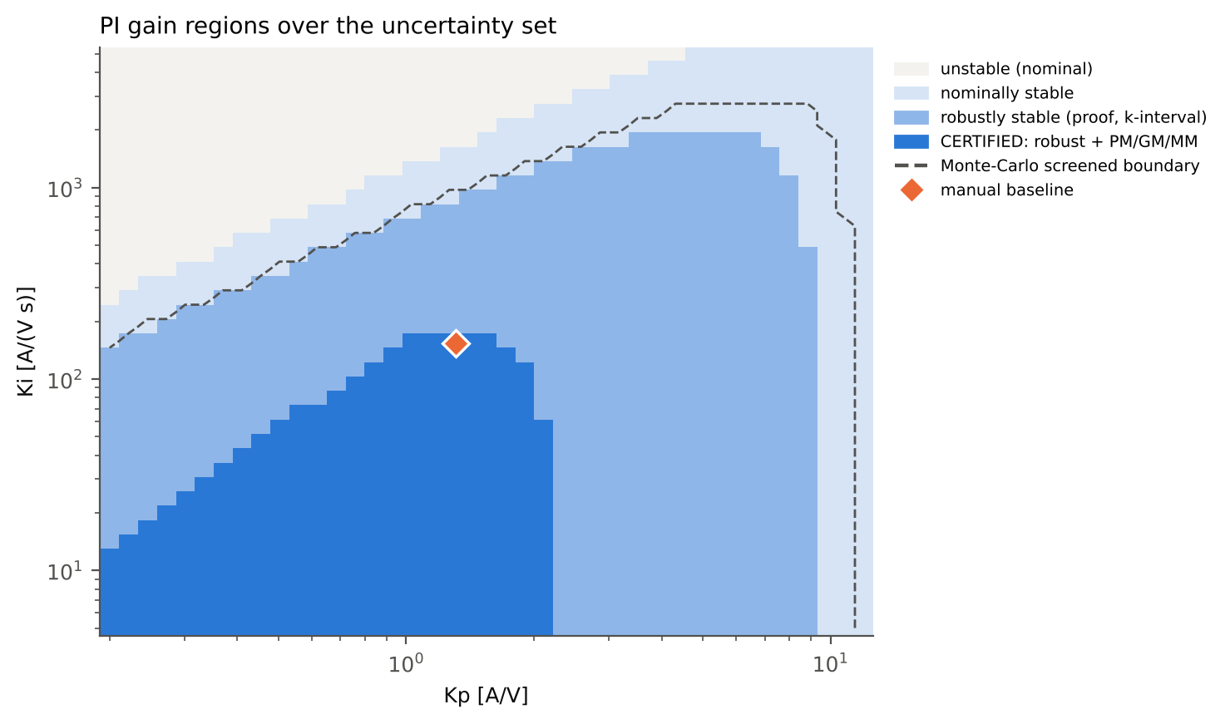
Technical Description
Plant model and controller, and why the stability certificate is an exact test
Averaged plant (energy balance, CPL in G2V)
C·v·dv/dt = P_afe − P_dc − v²/R
P_ac = 1.5·Vg·i_d, P_afe = η·P_ac (G2V) or P_ac/η (V2G)
τ_i·di_d/dt = i_d*(t − T_d) − i_d, τ_dc·dP_dc/dt = P_dem − P_dc
PI controller (sampled at 10 kHz, ±80 A clamp)
u[k] = Kp·e[k] + x_I[k], x_I ← x_I + Ki·Ts·e (clamping anti-windup)
Bumpless gain change: x_I ← u_prev − Kp_new·e_prev
Exact sampled loop (ZOH + fractional delay)
P(z) = k·N̂(z) / ((z−1)(z−λ)z^(d+1)), k = 1.5·Vg·η / (C·Vref)
Closed loop: p(z; k) = D(z) + k·N(z) ← affine in k
C ±20 %, grid 0.8–1.1 pu and power direction enter only through k ∈ [208, 446]. Zero-exclusion principle: stable at k_min and no unit-circle crossing for any k in the interval ⇒ stable for the whole interval. The crossings are the unit-circle roots of D·rev(N) − rev(D)·N.
Checked at 88 inner-lag × delay nodes; margins PM ≥ 40°, GM ≥ 6 dB, |1+L| ≥ 0.5.
22 %
5 / 5
42°
of the gain box is globally certified
nonlinear instability onsets predicted within ±3 %
manual baseline worst-case phase margin
Notes:
Four regions are kept separate in the figure: Monte-Carlo screened, nominal, robust (proof) and certified (robust plus margins). The zero-exclusion test was checked against brute-force eigenvalue sweeps with 100 % agreement. Validity: the linearised (unsaturated) model inside the uncertainty set.

Slide 6
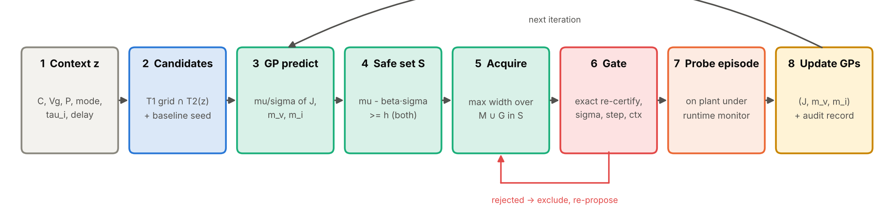
Technical Description
Safe Bayesian optimisation and an independent runtime supervisor
Contextual GPs (scikit-learn)
Candidate gate (does not trust the optimiser)
Runtime monitor + fallback (every 100 µs)
Inputs: Kp, Ki (log), C, Vg, P, τ_i, delay.
Outputs: probe cost J, voltage margin m_v, current margin m_i.
Margin GPs: zero prior ⇒ unexplored = unsafe; safe set grows only from the baseline.
One iteration: 60 ms median on a CPU (no GPU needed).
Exact tier-1 + tier-2 re-certification of the gain pair.
GP σ ≤ 0.25 and LCB(margins) ≥ 0.15.
Context inside the validated envelope; gain step ≤ ×3.
Rejected 35 of 210 proposals while tuning, each with a logged reason.
|Vdc − Vref| > 4 %, current > 97 % for 2 ms, filtered oscillation, implausible dV.
Alarm ⇒ bumpless rollback to the certified baseline, 100 ms lock-out, then re-decide.
Deployed: gains re-scheduled when Vg, P or the mode changes.
Notes:
SafeOpt (Sui et al. 2015) and its contextual version (Berkenkamp et al. 2023), with the gain set restricted to the certified region. We do not claim SafeOpt's theoretical guarantee; the hard guarantees come from the certificate and the monitor.

Slide 7
Implementation Plan
Implementation mapped to the six required deliverables: D1 to D6 are built and tested in simulation; HIL is proposed
D1
D2
D3
D4
D5
D6
Plant, constraints, disturbances, manual PI
Online tuning + stability/safety monitor
Fallback, rollback, audit log
Simulation dashboard
Evaluation vs manual PI
Ablation, failure analysis, HIL roadmap
Averaged RK4 model; 10 seeded disturbance classes; symmetric-optimum baseline
Two-tier certificate; contextual safe BO; candidate gate
Bumpless rollback; lock-out; JSONL audit with trace check
Streamlit: monitoring, AI, safety, experiments, audit, live tuning
11 scenarios × 5 seeds, paired tests, true-plant margins, timing
7 ablation variants; 13 fault cases; HIL plan
Done (sim)
Done (sim)
Done (sim)
Done (sim)
Done (sim)
Done (sim) / HIL proposed
Next phases (proposed, not yet executed)
P1
Software-in-the-loop
P2
Processor-in-the-loop
P3
Controller HIL
P4
Scaled power bench
Port the PI, monitor and fallback to C; precomputed tier-2 lookup table
4 wks
TI C2000 F28379D runs the 10 kHz loop; PC runs the optimiser and gate
4 wks
Real-time plant simulator; tests H1–H8 (timing, faults, communication loss)
6 wks
48 V / 1 kW bidirectional converter, low-voltage only
future
Notes:
Status words are deliberate: 'Done (sim)' means code + tests + generated evidence in simulation. Nothing has run on hardware. Detailed matrix: docs/REQUIREMENTS_TRACEABILITY.md.

Slide 8
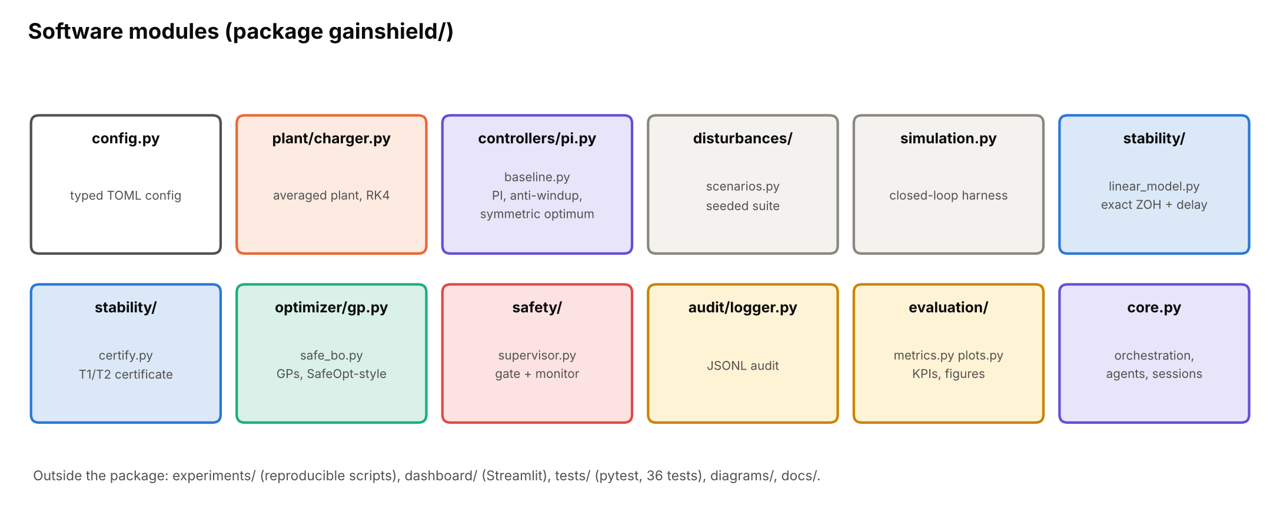
Implementation Plan
A modular, tested, one-command-reproducible Python repository
Layer | Technology | Why
Plant + control | NumPy, RK4, 10 µs step | transparent, no licence
Certificate | NumPy polynomial roots | exact zero-exclusion test
Safe BO | scikit-learn GPs + own SafeOpt logic | auditable, CPU-only
Dashboard | Streamlit + Plotly | free hosting tier
Tests | pytest (36 tests) | unit + integration
Reports | pandas, Matplotlib | numbers generated, not typed
python experiments/run_all.py
regenerates the certificate, tuning, evaluation, failure tests, ablation, reports and diagrams in about 15 min on a laptop CPU
GitHub QR code
(to be added when the repository is published)
Repository: gainshield-safe-ev-charger-control
README with results, install and demo guide; documentation of the model, architecture, assumptions, traceability, HIL roadmap, costs and limitations.
No credentials and no machine-specific paths; fixed seeds; pinned versions in requirements-lock.txt.
Model-in-the-loop simulation completed
SIL on target code proposed
PIL / controller HIL proposed
Power hardware future
Notes:
Replace the QR placeholder after publishing (python -c "import qrcode; qrcode.make(URL).save('qr.png')").

Slide 9
Validation / Testing / Analysis
Test protocol: identical conditions for both controllers, 11 disturbance scenarios × 5 seeds
# | Scenario | What changes | Class
1 | Load increase | battery power 5 → 20 kW | load
2 | Load decrease | 20 → 5 kW | load
3 | G2V → V2G | +15 → −15 kW (slew 2 kW/ms) | reversal
4 | V2G → G2V | −15 → +15 kW | reversal
5 | Grid sag | 1.0 → 0.8 pu at 20 kW, recovery | grid
6 | Sensor noise | 3× noise + load step | noise
7–8 | Capacitance | C −20 % / +20 % + load step | model
9 | Inner-loop lag | τ_i = 1.0 ms (2× nominal) | model
10 | Control delay | 2.0 samples | model
11 | Combined | C −20 %, τ_i 1 ms, delay 2, 0.85 pu, 2× noise, reversal | stress
Metrics (required by the problem statement)
Settling time (±0.5 % band), peak deviation, recovery overshoot, IAE
Voltage violations (±5 %), trips (±10 %), current-limit violations
Stability margin of every gain set used, on the true plant
Computation time per step, per decision, per BO iteration
Robustness: C ±20 %, lag, delay, noise ×2/×3; power reversal
-15.6 %
-14.9 %
-7.9 %
mean peak deviation
mean IAE
mean settling time
0 ms
0
p = 4e-08
Identical for both controllers: initial steady state, plant parameters, event times, pre-drawn noise sequence, context-estimation error, 0.3–0.4 s duration, Ts = 100 µs, constraints. Metrics are computed on the true plant states.
outside ±5 % (both)
trips or current violations
Wilcoxon, 55 pairs
GainShield vs manual PI, 11 scenarios × 5 seeds. Source: results/evaluation_summary.json (experiments/run_evaluation.py)
Notes:
The official heading 'Validation / Testing / Analysis' is kept on all three validation slides. This slide is the protocol and the headline numbers.

Slide 10
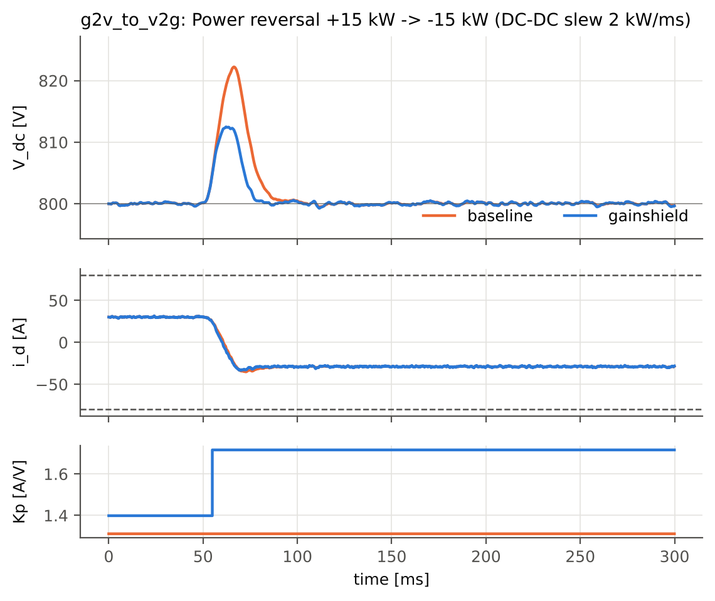
Validation / Testing / Analysis
Results: lower voltage deviation in 8 of 11 scenarios; never worse, because it stays on the baseline when unsure
G2V → V2G reversal: peak 2.79 % → 1.54 %, IAE -44 %. Kp is re-scheduled when the power reverses.
Price paid: current-reference ripple +8.5 %; true-plant PM ≥ 46° (baseline also 46° worst).
Held at baseline: grid sag at 20 kW, slow inner loop and the combined stress (no certified, evidence-backed improvement).
Source: results/evaluation_summary.json, results/figures/eval_g2v_to_v2g.png
Notes:
Every bar is a mean of 5 seeds with identical noise. GainShield never violates a constraint; neither does the baseline. The gain comes with a measured trade-off in noise amplification.

Slide 11
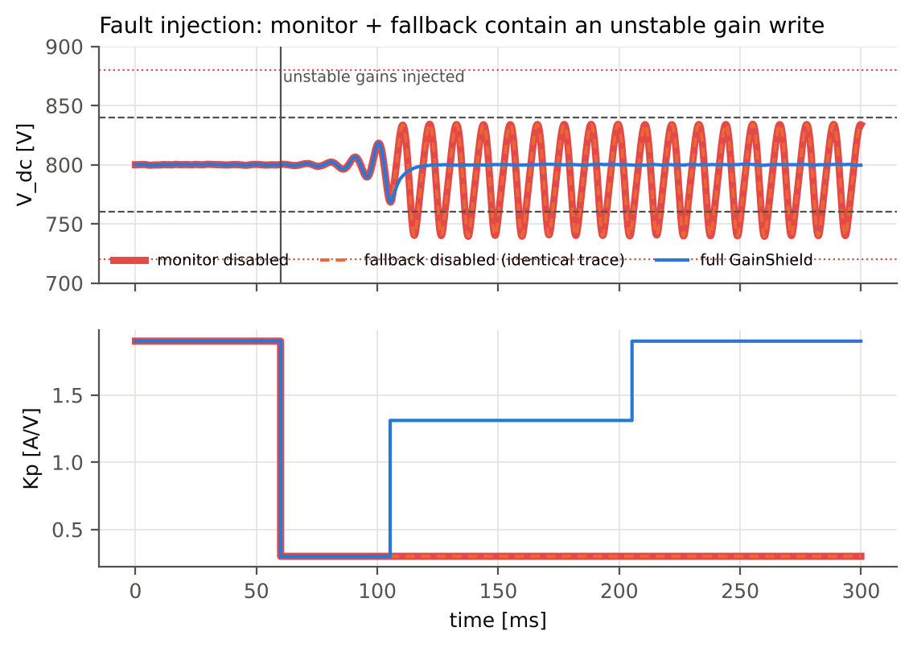
Validation / Testing / Analysis
Ablation and fault injection: each safety layer earns its place, and one gap is still open
Variant | Unsafe tuning episodes | Deployed peak dev. vs PI | Unstable gains injected: peak / outside ±5 %
A full | 0 | 0.82× | 3.9 % / 0 ms
B −cert. | 0 | 0.84× | 4.7 % / 0 ms
C −σ | 0 | 0.64× | 4.4 % / 0 ms
D −monitor | 0 | 0.82× | 7.5 % / 48 ms
E −context | 0 | 0.89× | 4.7 % / 0 ms
F −fallback | 0 | 0.82× | 7.5 % / 48 ms
D and F: without the monitor or the fallback, an unstable gain write turns into a sustained oscillation; the full system rolls it back.
C: trusting GP means gives faster but unverified gains (only 15 measured episodes); the σ check prevents this.
B: no unsafe episode within this budget, so the certificate's value is a guarantee, not an average.
E: without context the improvement shrinks (0.89× vs 0.82×).
5 / 5
unsafe proposals rejected by the gate, each with a logged reason (outside the region, σ, LCB, envelope, step)
Open gap
A stuck voltage sensor is not detected (the baseline is equally blind). Mitigation: power-balance observer and hardware OVP/UVP.
Source: results/ablation.csv, results/failure_injection.csv, docs/FAILURE_ANALYSIS.md. Isolated simulation only.
Notes:
Unsafe ablation configurations are simulation-only and must never be connected to hardware.

Slide 12
Cost Estimate
The prototype cost ₹0 in cash; the next validation step costs about ₹20,000; HIL through lab access first
Tier | Item | Basis / source (12 Nov 2026, 1 USD ≈ ₹94) | INR
A Actual | Software stack | open-source Python (NumPy, SciPy, scikit-learn, Streamlit) | ₹0
A Actual | Computing / cloud / storage | 2-core CPU, no GPU; GitHub free tier | ₹0
A Actual | Dashboard hosting | Streamlit Community Cloud free tier (public app) | ₹0
A Actual | Development effort (in kind) | 480 h at an assumed ₹300/h, not a cash cost | ≈ ₹1.44 lakh
B Estimate | 2 × TI LAUNCHXL-F28379D | $44.16 (Arrow) to ₹5,712 (Indian distributor) | ₹8,300–11,400
B Estimate | Signal conditioning, isolation, cables | engineering estimate | ₹6,000–10,000
C Optional | Real-time HIL via institute lab | usage charges, if any | ₹0–50,000
C Optional | HIL teaching kit (Typhoon HIL101) | US MSRP $9,900; APAC price differs; excl. duties/GST | ≈ ₹9.3 lakh
C Optional | Research-grade HIL (HIL404 class) | published 2025 commercial quote, $44k incl. licences | ≈ ₹41 lakh
C Optional | Scaled 48 V / 1 kW bidirectional bench | engineering estimate, not quoted | ₹1.5–3 lakh
₹0
cash spent on the delivered prototype
≈ ₹20k
next phase: PIL validation
No GPU
full pipeline ≈ 15 min on a laptop CPU
Sources: Arrow, Typhoon HIL product page, Streamlit docs, currencybeacon.com. Budgetary only: no vendor quotation was requested and no partnership exists. Details: docs/COST_ESTIMATE.md
Notes:
Separate actual, estimated and optional costs. Foreign prices exclude import duty and GST.

Slide 13
Assumptions
The problem statement gives no numbers, so every value below is a stated engineering assumption
Group | Assumption (simulation, not a hardware rating)
Plant | 30 kW module, 800 V DC link, C = 2 mF ±20 %, 415 V grid 0.8–1.1 pu
Plant | AFE η = 98 % (direction-dependent); inner loop τ_i 0.3–1.0 ms
Plant | DC-DC power loop τ = 2 ms, slew 2 kW/ms, ±30 kW (constant-power load)
Switching | f_sw = f_s = 10 kHz; delay 1.0–2.0 samples (nominal 1.5)
Electrical limits | ±5 % operating band, ±10 % trip, 4 % supervisor abort; i_d ≤ 80 A
Sensors | noise 1 V and 0.5 A (1σ); scaled ×2 and ×3 in tests
Group | Assumption
Simplifications | averaged model: no switching ripple, AC filter/PLL, unbalance, battery or thermal dynamics
Stability | linearised and unsaturated; k-interval proved; τ_i × delay gridded (88 nodes); worst-case PM ≥ 40°, GM ≥ 6 dB, MM ≥ 0.5
Context | C, τ_i and delay identified within ±5 %, ±20 % and ±0.2 samples (estimator not implemented)
Optimiser | β = 2, h = 0.15, σ ≤ 0.25, step ≤ ×3; fixed margin-GP hyper-parameters; RKHS bound not verified
Probe | +10 V reference step and ±6 kW power step acceptable during a session
Validation | simulation only; no SIL, HIL or hardware tests performed
All values are in config/default.toml (IDs A-1 to A-15, rationale in docs/ASSUMPTIONS.md); changing them and re-running regenerates every result.
Notes:
Ask for approval of these assumptions: they were proposed by us, not supplied.

Slide 14
References
References: each one supports a specific design decision
[1] Y. Sui, A. Gotovos, J. Burdick, A. Krause, “Safe exploration for optimization with Gaussian processes,” ICML, 2015.
[2] F. Berkenkamp, A. Krause, A. P. Schoellig, “Bayesian optimization with safety constraints: safe and automatic parameter tuning in robotics,” Machine Learning 112, 3713–3747, 2023.
[3] C. König, M. Khosravi, M. Maier, R. S. Smith, A. Rupenyan, J. Lygeros, “Safety-aware cascade controller tuning using constrained Bayesian optimization,” IEEE Trans. Ind. Electron., doi:10.1109/TIE.2022.3158007.
[4] C. König, M. Turchetta, J. Lygeros, A. Rupenyan, A. Krause, “Safe and efficient model-free adaptive control via Bayesian optimization,” IEEE ICRA, 2021.
[5] C. E. Rasmussen, C. K. I. Williams, Gaussian Processes for Machine Learning, MIT Press, 2006.
[6] N. Srinivas, A. Krause, S. Kakade, M. Seeger, “Gaussian process optimization in the bandit setting,” ICML, 2010.
[7] B. R. Barmish, New Tools for Robustness of Linear Systems, Macmillan, 1994 (zero-exclusion principle).
[8] K. J. Åström, B. Wittenmark, Computer-Controlled Systems, 3rd ed., Prentice Hall, 1997.
[9] K. J. Åström, T. Hägglund, Advanced PID Control, ISA, 2006 (anti-windup, bumpless transfer).
[10] S. Preitl, R.-E. Precup, “An extension of tuning relations after symmetrical optimum method for PI and PID controllers,” Automatica 35(10), 1999.
[11] A. Emadi, A. Khaligh, C. H. Rivetta, G. A. Williamson, “Constant power loads and negative impedance instability in automotive systems,” IEEE Trans. Veh. Technol. 55(4), 2006.
[12] A. Yazdani, R. Iravani, Voltage-Sourced Converters in Power Systems, Wiley-IEEE Press, 2010.
[13] F. Pedregosa et al., “Scikit-learn: machine learning in Python,” JMLR 12, 2011.
[14] IEC 61851-23 (DC EV supply equipment); ISO 15118-20:2022 (V2G communication); IEEE 1547-2018. Context only, no compliance claim.
[15] Typhoon HIL product pages (HIL101, TyphoonSim); Arrow (LAUNCHXL-F28379D); Streamlit Community Cloud docs; accessed 12 Nov 2026.
Notes:
Each reference was checked to exist; the mapping from reference to claim is in docs/REFERENCES.md.

Slide 15
Thank You
GainShield
Prove. Learn safely. Supervise. Fall back.

