Slide 1

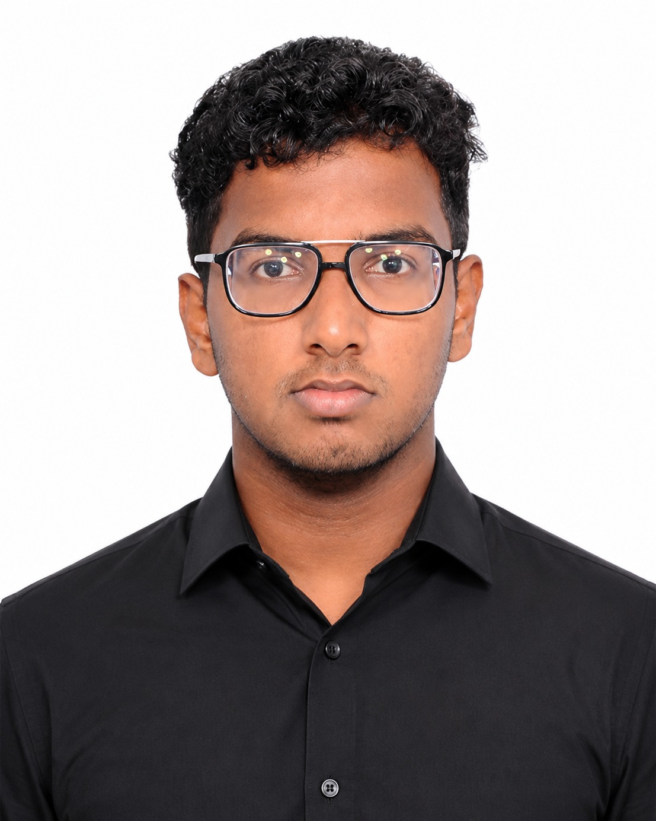
PID No:
TG0929727
10th Edition TECHgium®
Presentation Round
GainShield
AI-Driven Safe Bayesian PI Gain Tuning with Stability Certification
and Runtime Fallback for Bidirectional EV Charger DC-Link Control
Archana RG
Thiyagarajan Gopalakrishnan
SRM Institute of Science and Technology, Kattankulathur
Chennai, Tamil Nadu
Notes:
PID TG0929727. Concept title exactly as registered. Team: Archana RG and Thiyagarajan Gopalakrishnan, SRM Institute of Science and Technology, Kattankulathur, Chennai, Tamil Nadu.

Slide 2

Challenge Statement
The DC-link loop is tuned once by hand, but the plant it controls changes in every charging session
WHERE THE PLANT MOVES · AVERAGED 30 KW / 800 V MODULE
EVIDENCE · ONE FIXED PI, FIVE CONDITIONS
G2V ⇄ V2G power flow
1
2
DC link
v_dc ≈ 800 V
4
3~
AFE
PWM rectifier /
inverter
DC-DC
battery power
loop
EV
battery
3
i_d* command
v_dc measured
PI voltage controller
fixed Kp, Ki · 10 kHz
Peak DC-link deviation (% of 800 V) of the manually tuned PI, mean of 5 seeds. The same gains give almost twice the deviation under reversal and combined stress.
1
Grid sags to 0.80 pu; rises to 1.10 pu
2
Inner loop lag 0.3–1.0 ms, delay 1–2 samples
3
Capacitor C ±20 % with tolerance and ageing
4
Load constant-power DC-DC; ±15 kW reversal
THE CHALLENGE
Adapt
set Kp, Ki for the current grid, load, capacitance and power direction
Prove
apply only gains shown stable beforehand; unrestricted BO or RL could try an unstable pair
Fall back · audit
revert instantly to a known-good controller and log every decision
Tune online, without ever experimenting blindly on 800 V
Notes:
Numbered markers show where the plant varies. The chart is measured: the manually tuned baseline's peak deviation in five of the eleven test scenarios. All parameters are engineering assumptions.

Slide 3
Concept / Proposed Solution
GainShield nests the AI inside a stability proof, which conventional manual or AI tuning cannot offer
THE SAFETY ENVELOPE IN THE KP–KI PLANE
ADVANTAGES OVER CONVENTIONAL TECHNIQUES
Search box
Kp 0.2–12 A/V × Ki 5–5000 A/(V·s) · 41 × 41 log grid
configured bounds
Manual PI
Plain BO / RL
GainShield
Adapts to grid, load, capacitor
✗ no
✓ yes
✓ yes
Tier 1 · robust stability
stable for every plant in the uncertainty set · 66 % of grid
proof, offline
Proven stable before use
~ one point
✗ no
✓ whole set
Tier 2 · context margins
PM ≥ 40°, GM ≥ 6 dB, |1+L| ≥ 0.5 for the current context ± error
proof + sweep, per context
Safe while learning on the live loop
– n/a
✗ no
✓ yes
GP safe set S
lower confidence bound of V and I margins ≥ 0.15
Gaussian processes, online
Falls back automatically
✗ no
✗ no
✓ yes
Every gain change audited
✗ no
✗ no
✓ yes
Peak voltage deviation (simulation)
reference
not tested
up to −48 %
Baseline seed
certified manual PI: always allowed, always the fallback
Deployed gains
argmin over S of pessimistic cost, re-checked by the gate
1
Better regulation up to 48 % smaller voltage swings (G2V → V2G reversal); 23 % on average where it adapts
2
Safer than plain AI tuning none of 482 live learning trials left the ±5 % safe band
3
Accountable every gain change is logged with its reason and can be replayed
Notes:
Read the left diagram from outside in: configured box, tier-1 proof (offline), tier-2 context margins, GP safe set. The deployed gains are always inside all of them; the baseline is the seed and fallback.

Slide 4
Pros and Cons of the solution
Pros and cons in plain terms: what improves, what it costs, and how each risk is handled
PROS
CONS · and how we handle each
✓
Smaller voltage swings
When the load or power direction changes, the DC-link voltage swings up to 48 % less than with the hand-tuned controller (23 % on average where it adapts, 19 % across all 11 tests), and recovers sooner.
!
Slightly more electrical noise
Handled now
Higher gains make the current command about 14 % noisier.
How we handle it: noise is part of what the tuner minimises, within certified limits
✓
Never uses an unproven setting
Every gain setting is checked mathematically for stability before it is applied, for all the capacitor, grid and power-direction conditions we model.
!
Only as good as the model
Handled now
The stability check assumes our model of the charger is accurate.
How we handle it: a live monitor watches the real signals; hardware tests come next
✓
Learns safely while running
In 482 live tuning trials, the voltage never left its ±5 % safe band.
!
AI predictions can be wrong
Handled now
The learning model can be confident in conditions it has not tried yet.
How we handle it: it is never trusted alone; uncertain suggestions are rejected
✓
Built-in safety net
If the monitor sees anything abnormal, control switches straight back to the proven manual controller, without a jump in the output.
!
Safety check is slow in Python
Next step
Checking a new operating condition takes about 1.9 s.
How we handle it: it runs outside the fast control loop; a lookup table will remove it
✓
Every decision is recorded
Each gain change is logged with its reason, so any result can be traced, audited and reproduced.
!
Not yet on real hardware
Next step
Tested in simulation only; sensor checks are tuned on simulated noise.
How we handle it: processor-in-the-loop on a TI board, then lab hardware tests
All figures are from simulation: 11 test conditions × 5 runs, GainShield compared with the hand-tuned controller under identical conditions (results/evaluation_summary.json).
Notes:
Plain-language version. 'Handled now' means the safeguard is already implemented and tested in simulation; 'Next step' means it is planned.

Slide 5
Technical Description
System architecture: four layers separated by time-scale and by trust
OFFLINE
once per configuration
Parameters
config/default.toml
Tier-1 certificate
stability/certify.py · zero-exclusion, 88 nodes
certificate.npz
regions + worst margins
Tier-1 candidates
SUPERVISORY
ms to s · decides gains
Context
C, Vg, P, mode,
τ_i, delay (estimated)
Tier-2 check
local margins for
context ± error
SafeBayesOpt
3 GPs (J, m_v, m_i)
safe set + acquisition
CandidateGate
exact re-certify · σ
envelope · step ≤ ×3
AuditLogger
append-only JSONL
+ trace check
ctx
mask
Kp, Ki
log
accepted gains
events
REAL-TIME
every 100 µs · 10 kHz
Baseline gains
certified manual PI
(symmetric optimum)
PIController
anti-windup clamp
bumpless set_gains()
alarm
RuntimeMonitor
|e| > 4 % · I hold
oscillation · dV/sample
operating point →
context estimate
fallback gains on rollback
i_d* ≤ 80 A
v_dc, i_d (noisy)
PLANT
simulated, averaged
Disturbance suite
disturbances/scenarios.py
10 classes, seeded, pre-drawn noise
ChargerPlant
plant/charger.py · AFE + inner i_d loop + delay · DC link C·v·dv/dt = P_afe − P_dc − v²/R · constant-power DC-DC · RK4, 10 µs
signals / data
gain write
safety path
audit
Implemented: all four layers run in one Python process (simulation). The lane split is the proposed PC / microcontroller deployment for HIL, not yet built.
Notes:
Every box is a real class or module in the repository. The real-time lane is simulated in Python today.

Slide 6
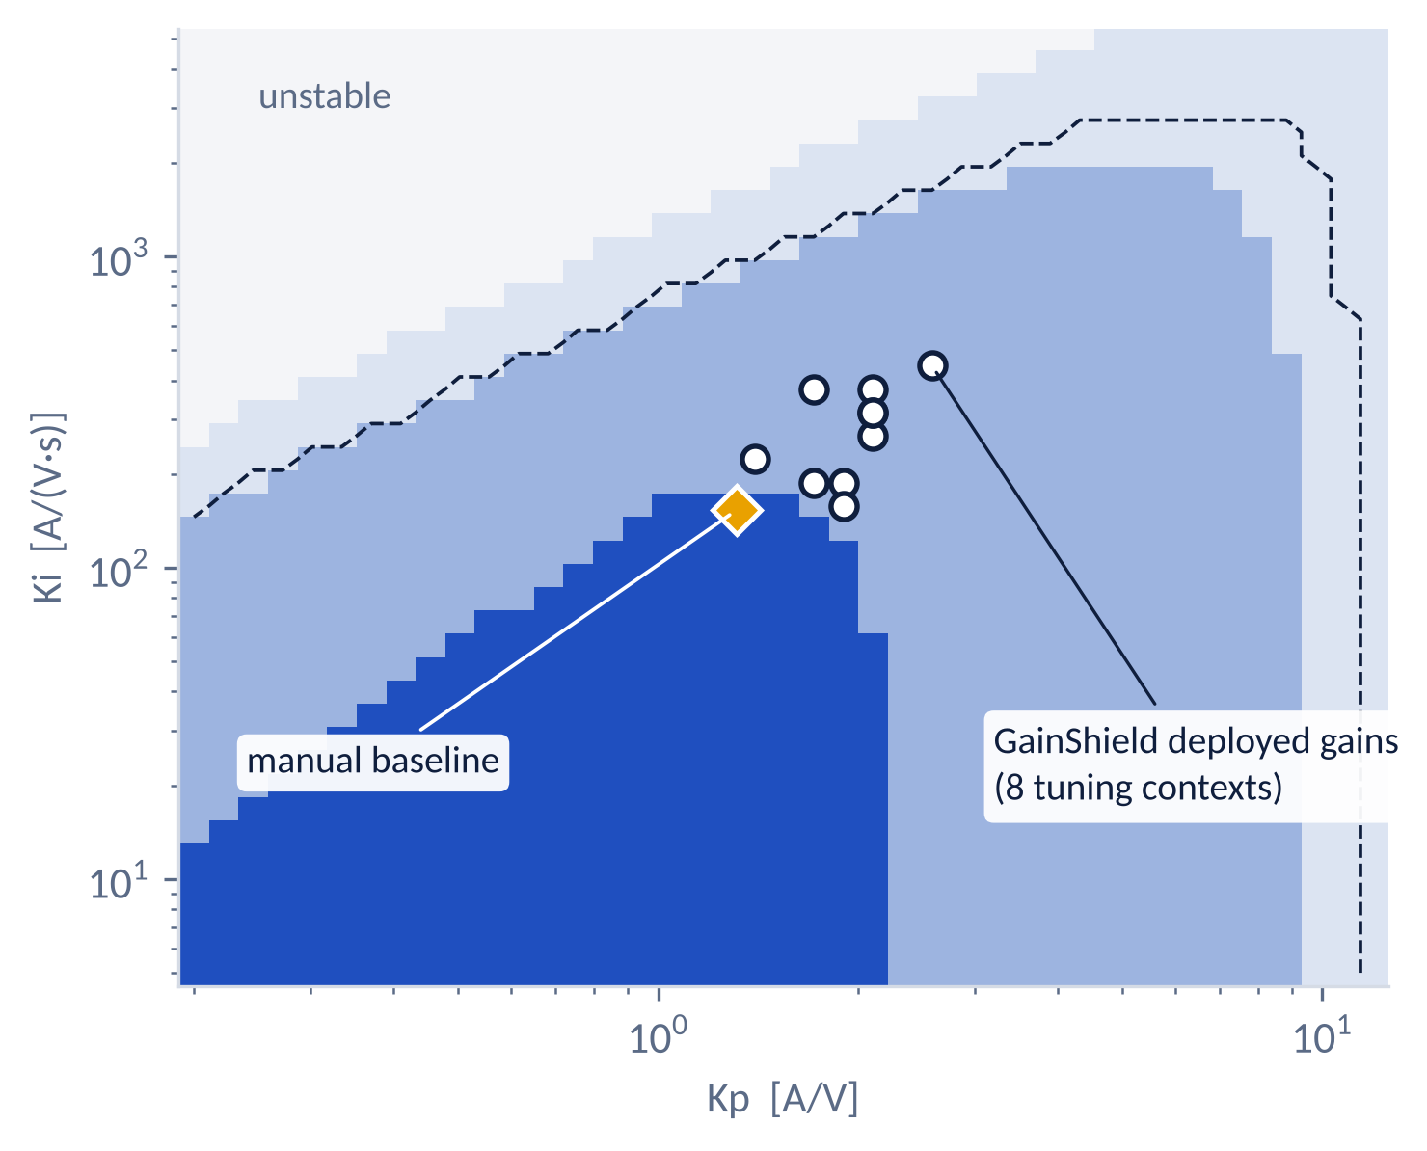
Technical Description
Two algorithms: an exact robust-stability test and a safe contextual Bayesian optimiser
A · CERTIFICATE stability/linear_model.py · certify.py
B · SAFE CONTEXTUAL BO, ONE ITERATION optimizer/safe_bo.py
1
Model the sampled charger loop exactly
includes the 1–2 sample delay and inner-loop lag λ = e^(−Ts/τ_i):
P(z) = k · N̂(z) / ((z − 1)(z − λ) z^(d+1))
1
z ← context estimate (C, Vg, P, τ_i, delay)
2
X ← Tier-1 grid ∩ Tier-2(z) ∪ {baseline}
candidates
2
Collapse all uncertainty into one gain k
C ±20 %, grid 0.8–1.1 pu and power direction enter only via k ∈ [208, 446]:
p(z; k) = D(z) + k · N(z) affine in k
3
μ, σ ← GP_J, GP_v, GP_i at (X, z)
Matern-5/2
4
S ← { x : μ_m − β σ_m ≥ h for m ∈ {v, i} }
safe set
5
M ← { x ∈ S : LCB_J(x) ≤ min_S UCB_J }
maximisers
3
Test every gain pair over the whole k range
if stable at k_min and no k in the range puts a root on |z| = 1, it is stable for all k. Crossings are found as the unit-circle roots of
F(z) = D(z)·rev N(z) − rev D(z)·N(z)
6
G ← { x ∈ S : UCB_m(x) − L‖x − x′‖ ≥ h, x′ ∉ S }
expanders
7
x* ← argmax over M ∪ G of confidence width
8
if Gate(x*) rejects: exclude x*, re-propose
independent
unstable
9
probe episode under RuntimeMonitor → J, m_v, m_i
on plant
nominal only
10
refit the three GPs; write audit record
Tier 1 robust · 66 %
globally certified · 22 %
β = 2
h = 0.15
σ_max = 0.25
step ≤ ×3
41 × 41 grid
zero-prior GPs
Verified: 100 % agreement with brute-force eigenvalue sweeps; predicts nonlinear instability onset within ±3 % (5/5 cases).
Probe cost J = 0.35 IAE + 0.25 peak dev. + 0.10 overshoot + 0.10 settling + 0.20 ripple (each ÷ baseline).
Follows SafeOpt [1] and its contextual form [2]; their theoretical guarantee is not claimed.
Notes:
Left: why the certificate is exact in k. Right: the iteration exactly as implemented in SafeBayesOpt.propose and GainShield.tune_context.

Slide 7
Technical Description
Runtime sequence: every gain change is proposed, re-checked, applied bumplessly and logged
ChargerPlant
RuntimeMonitor
PIController
GainShieldAgent
SafeBayesOpt
CandidateGate
AuditLogger
SAFETY AND INTEGRITY, IN DEPTH
1 Tier-1 proof
a context change can never destabilise the active loop
context change held 5 ms:
ΔVg > 0.05 pu · ΔP > 3 kW · mode
2 Exact re-check
out-of-set proposal rejected (test G1: yes)
recommend(z, Tier-2 mask)
Kp, Ki, σ, LCB
3 GP σ and LCB
extrapolation rejected (G2, G3)
evaluate(proposal, context)
exact re-certify · σ ≤ 0.25
LCB ≥ 0.15 · envelope · ×3
4 Envelope + step
plant outside model, large jumps rejected (G4, G5)
accept / reject + reason
set_gains(bumpless)
5 Monitor + fallback
unstable gains reaching the plant rolled back (R1)
GAIN_APPLIED / GAIN_REJECTED
6 Sensor plausibility
stuck sensor caught; a power-balance estimate takes over (R5)
loop · every 100 µs
i_d*
v_dc, i_d
7 Audit trace check
every gain change explained by a record
alarm → baseline gains
Last line independent hardware over/under-voltage trip behind every software layer (HIL roadmap).
ROLLBACK + reason · adaptation locked out 100 ms
Notes:
Lifelines are the actual classes in core.py, optimizer/safe_bo.py, safety/supervisor.py, controllers/pi.py and audit/logger.py. The security mechanisms here are safety and integrity mechanisms: the system has no network interface, authentication or user data.

Slide 8
Implementation Plan
All six deliverables are implemented and tested in simulation; hardware-in-the-loop is the next phase
IMPLEMENTED AND TESTED IN SIMULATION
PROPOSED · NOT YET EXECUTED
Plant + baseline
Safe online tuning
Fallback + audit
Dashboard
Evaluation
Ablation + faults
SIL
PIL
Controller HIL
Scaled bench
D1
D2
D3
D4
D5
D6
P1
P2
P3
P4
averaged model, 10 disturbance classes, manual PI
two-tier certificate, contextual safe BO, gate
bumpless rollback, lock-out, JSONL with trace check
Streamlit: 6 tabs incl. live tuning
11 scenarios × 5 seeds, paired tests, timing
7 variants, 14 fault cases, HIL plan
port PI + monitor to C; Tier-2 lookup table
TI C2000 F28379D runs the 10 kHz loop
real-time plant, tests H1–H8
48 V / 1 kW, low voltage only
REQUIREMENT TRACEABILITY summary of docs/REQUIREMENTS_TRACEABILITY.md
Deliverable
Module
Test
Evidence
Status
D1 Plant, constraints, disturbances, baseline
plant/, disturbances/, controllers/
test_plant, test_scenarios
energy balance, eval figures
Complete and tested (sim)
D2 Safe online tuning + monitors
stability/, optimizer/, safety/
test_stability, _optimizer, _supervisor
0 of 482 trials unsafe; stuck sensor caught
Complete and tested (sim)
D3 Fallback, rollback, audit
core.py, audit/logger.py
test_integration, test_audit
0 trace problems
Complete and tested (sim)
D4 Dashboard
dashboard/app.py
headless AppTest
6 tabs, no exceptions
Complete and tested (sim)
D5 Evaluation
experiments/run_evaluation.py
55 paired runs
evaluation_summary.json
Complete and tested (sim)
D6 Ablation, failures, HIL roadmap
run_ablation.py, run_failure_injection.py
7 variants, 14 fault cases
HIL_ROADMAP.md: 8 tests, costed
Complete and tested (sim)
Notes:
Status words are deliberate. 'Complete and tested (sim)' never means hardware-validated.

Slide 9

Implementation Plan
Implementation: a tested Python package, a reproducible pipeline and a live dashboard
ONE COMMAND REPRODUCES EVERY NUMBER
TECHNOLOGY STACK (AS IMPLEMENTED)
PROJECT RESOURCES
1
run_certificate.py ≈ 20 s
→ certificate.npz
FRONTEND
Streamlit + Plotly dashboard
dashboard/app.py · monitoring, AI, safety, experiments, audit, live tuning
2
run_tuning.py 13 contexts
→ model.pkl · tuning_audit.jsonl
EXPERIMENTS
pandas · Matplotlib · SciPy stats
experiments/ · reports generated, not typed
3
run_evaluation.py 55 pairs
→ evaluation_summary.json
4
run_failure_injection.py 14 cases
→ failure_injection.csv
CORE PACKAGE
NumPy · scikit-learn
gainshield/ · plant RK4, certificate, 3 GPs, supervisor, audit
5
run_ablation.py 7 variants
→ ablation.csv
Scan: GitHub repository
github.com/Thiyagadurden/GainShield
QUALITY
pytest · Streamlit AppTest
40 unit + integration tests; dashboard tested headless
6
make_reports.py
→ docs/*.md · RESULTS_SNAPSHOT.json
README with results and quick start
Model, architecture, assumptions
Traceability, HIL roadmap, costs, limitations
Generated results, figures, audit logs
build_deck.py
→ this presentation
RUNTIME
Python ≥ 3.11 · CPU only
pinned versions in requirements-lock.txt
7
python experiments/run_all.py
≈ 30 min on a 2-core CPU; fixed seeds; no GPU, MATLAB or network.
Why not PyTorch / BoTorch: the safe-set logic stays auditable line by line and runs on a CPU in seconds, without a ~1 GB dependency.
Notes:
The QR code was supplied by the team and resolves through a qrfy.io short link; the printed URL is the repository itself.

Slide 10
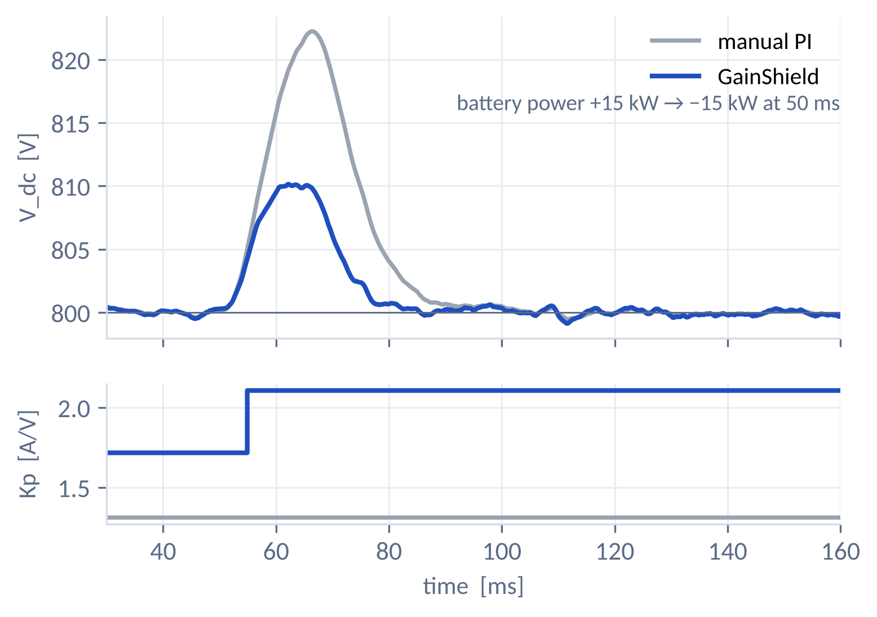
Validation / Testing / Analysis
Up to 48 % smaller voltage swings: better in 9 of 11 scenarios and never worse
PEAK DC-LINK DEVIATION, % OF 800 V · MEAN OF 5 SEEDS
POWER REVERSAL +15 → −15 KW · SEED 0
−48 %
−23 %
−19 %
0
Protocol 11 scenarios × 5 seeds; identical plant, events, pre-drawn noise and context error; Ts = 100 µs; metrics on true plant states. Sag, slow lag and combined: GainShield keeps the baseline.
peak deviation,
G2V → V2G reversal
average where it
adapts (9/11)
average over all
11 scenarios
voltage, current or
trip violations
Source: results/evaluation_summary.json · Wilcoxon p = 7.6e-09 (peak deviation, 55 pairs) · reversal peak 2.79 % → 1.44 %
Notes:
Grey is always the manual PI, blue always GainShield.

Slide 11
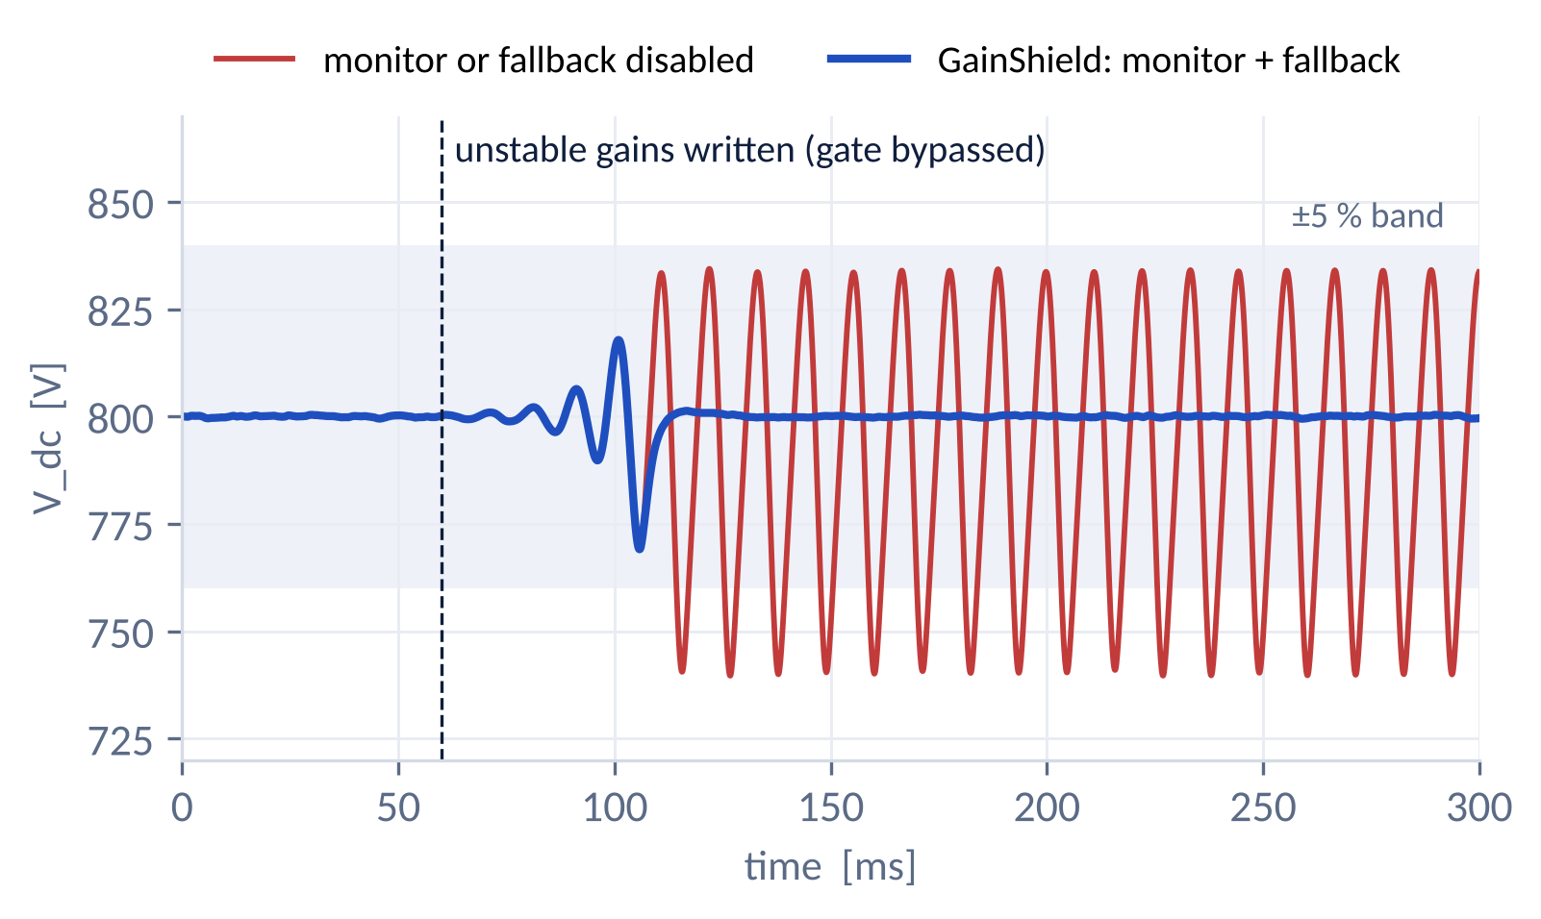
Validation / Testing / Analysis
Ablation and fault injection: removing a safety layer turns a contained fault into a sustained oscillation
REMOVE ONE LAYER AT A TIME · SAME SEEDS, SAME FAULT
FAULT: UNSTABLE GAINS WRITTEN BEHIND THE GATE
Variant
Unsafe tuning
episodes
Deployed peak
vs manual PI
Injected unstable gains:
peak · time outside ±5 %
A Complete GainShield
0
0.80 ×
3.9 % · 0 ms
B − certified region
0
0.86 ×
3.9 % · 0 ms
C − GP uncertainty
0
0.69 ×
4.7 % · 0 ms
D − runtime monitor
0
0.80 ×
7.5 % · 48 ms
E − context
0
0.89 ×
4.7 % · 0 ms
F − fallback
0
0.80 ×
7.5 % · 48 ms
D, F without the monitor or the fallback the fault persists as a limit cycle; with them it is rolled back.
C trusting GP means gives faster but unverified gains (only 35 measured episodes).
5 / 5
46 ms
Stuck sensor (R5): closed
caught in 1.9 ms, voltage held within 1.3 % on the observer estimate. Without the check: 96 % collapse, trip.
B no unsafe episode in this budget: the certificate's value is a guarantee, not an average.
unsafe proposals
rejected by the gate
injection to rollback
(4 % abort band)
E without context the gain shrinks (0.89 × vs 0.80 ×).
Source: results/ablation.csv, results/failure_injection.csv. Isolated simulation; unsafe variants are never for hardware.
Notes:
The 46 ms detection delay is a measured weakness: the oscillation grows until the 4 % abort band is hit.

Slide 12
Cost Estimate
Investment roadmap: about ₹20,000 takes GainShield onto real controller hardware
1
Processor-in-the-loop
2
Controller HIL · institute lab
3
Scaled power bench
4
Own HIL platform · optional
₹14–21k
₹0–50k
₹1.5–3 L
₹9.3–41 L
estimate
usage charges, if any
engineering estimate
only if lab access is unavailable
2 × TI LAUNCHXL-F28379D
₹8.3–11.4k
real-time plant simulator access
₹0–50k
48 V / 1 kW converter bench
₹1.5–3 L
Typhoon HIL101, MSRP $9,900
≈ ₹9.3 L
signal conditioning, isolation
₹6–10k
HIL404 class, quote $44k
≈ ₹41 L
Unlocks
10 kHz PI + monitor on a real MCU; measured delay and timing
Unlocks
fault tests H1–H8, incl. sensor faults and comms loss
Unlocks
real switching, sensors and losses at safe voltage
Unlocks
dedicated, repeatable HIL regression
WHERE THE NEXT IMPROVEMENT COMES FROM
−48 %
≈ −13 %
1.9 s
+14 %
best case today
peak deviation, G2V → V2G reversal; −18.7 % mean over 55 paired runs
further headroom observed
unverified GP-extrapolated gains reached 0.69× vs 0.80× deployed (ablation); more measured episodes per context can recover part of it safely
decision latency to remove
precomputed Tier-2 lookup table instead of the Python check
noise penalty to win back
current-command ripple vs manual PI; ripple-aware cost weighting or a notch filter
Prices researched 12 Nov 2026, 1 USD ≈ ₹94 (Arrow, Typhoon HIL, Indian distributor listings); budgetary, no vendor quotation, no partnership; foreign prices exclude duties/GST. L = lakh. Headroom figures: results/ablation.csv (simulation).
Notes:
Future-focused: staged spending, each stage tied to what it unlocks. Headroom numbers are simulation observations, not promises: the 'no GP uncertainty' variant used gains without measured evidence.

Slide 13
Assumptions
No numbers were supplied, so every value is a stated, configurable engineering assumption
PLANT
STABILITY
A-1/2
30 kW module, 800 V DC link
A-13
worst case PM ≥ 40°, GM ≥ 6 dB, |1+L| ≥ 0.5
A-3
C = 2 mF, ±20 %
model
linearised, unsaturated; lag × delay gridded (88 nodes)
A-4
415 V grid, 0.80–1.10 pu
OPTIMISER
A-6/7
AFE η = 98 %; inner loop τ_i 0.3–1.0 ms
A-15
context known within C ±5 %, τ_i ±20 %, delay ±0.2
A-8
DC-DC τ = 2 ms, 2 kW/ms, ±30 kW
BO
β = 2, h = 0.15, σ ≤ 0.25, step ≤ ×3; RKHS bound unverified
LIMITS
probe
+10 V reference step and ±6 kW power step acceptable
A-9/10
10 kHz switching = sampling; delay 1.0–2.0 samples
BOUNDARY
A-11/12
i_d ≤ 80 A; ±5 % band, ±10 % trip, 4 % abort
scope
averaged model: no switching ripple, AC filter, PLL, battery, thermal
A-14
sensor noise 1 V, 0.5 A (1σ)
tests
simulation only: no SIL, HIL or hardware
All values live in config/default.toml with rationale in docs/ASSUMPTIONS.md; changing them and running run_all.py regenerates every result.
Notes:
These assumptions were proposed by the team, not supplied by the problem statement.

Slide 14
References
References: each supports a specific design decision
SAFE BAYESIAN OPTIMISATION
CONTROL AND ROBUSTNESS
[1] Y. Sui, A. Gotovos, J. Burdick, A. Krause, “Safe exploration for optimization with Gaussian processes,” ICML, 2015.
[7] B. R. Barmish, New Tools for Robustness of Linear Systems, Macmillan, 1994.
[8] K. J. Åström, B. Wittenmark, Computer-Controlled Systems, 3rd ed., 1997.
[2] F. Berkenkamp, A. Krause, A. P. Schoellig, “Bayesian optimization with safety constraints,” Machine Learning 112, 2023.
[9] K. J. Åström, T. Hägglund, Advanced PID Control, ISA, 2006.
[3] C. König, M. Khosravi, M. Maier, R. S. Smith, A. Rupenyan, J. Lygeros, “Safety-aware cascade controller tuning using constrained Bayesian optimization,” IEEE Trans. Ind. Electron., doi:10.1109/TIE.2022.3158007.
[10] S. Preitl, R.-E. Precup, symmetrical optimum extension, Automatica 35(10), 1999.
POWER ELECTRONICS
[4] C. König, M. Turchetta, J. Lygeros, A. Rupenyan, A. Krause, “Safe and efficient model-free adaptive control via Bayesian optimization,” IEEE ICRA, 2021.
[11] A. Emadi et al., “Constant power loads and negative impedance instability,” IEEE Trans. Veh. Technol. 55(4), 2006.
[5] C. E. Rasmussen, C. K. I. Williams, Gaussian Processes for Machine Learning, MIT Press, 2006.
[12] A. Yazdani, R. Iravani, Voltage-Sourced Converters in Power Systems, Wiley-IEEE, 2010.
[6] N. Srinivas, A. Krause, S. Kakade, M. Seeger, “Gaussian process optimization in the bandit setting,” ICML, 2010.
STANDARDS, SOFTWARE, SOURCES
[13] F. Pedregosa et al., “Scikit-learn,” JMLR 12, 2011.
[14] IEC 61851-23; ISO 15118-20:2022; IEEE 1547-2018 (context only, no compliance claim).
[15] Typhoon HIL, Arrow and Streamlit pages, accessed 12 Nov 2026.
Notes:
Mapping from each reference to the claim it supports: docs/REFERENCES.md.

Slide 15
Thank You
GainShield
Archana RG · Thiyagarajan Gopalakrishnan
SRM Institute of Science and Technology, Kattankulathur, Chennai, Tamil Nadu
PID TG0929727
Code, results and documentation
github.com/Thiyagadurden/GainShield

