Slide 1
MACS 30100 Project 2
Thiyaghessan Poongundranar

Slide 2
Task
Terrorist Attacks
Assassination
Hijacking
Kidnapping
Facility/Infrastructure Attack
Barricade Incident
Bombing/Explosion
Armed Assault
Unarmed Assault
In this project, my task is to predict the type of attack a terrorist will engage in.
The task involves classifying data about terrorist attacks into 1 of 8 possible attack types.
The paper replicates the findings of another machine learning paper.
Huamaní, E. L., Alicia, A. M., & Roman-Gonzalez, A. (2020). Machine learning techniques to visualize and predict terrorist attacks worldwide using the global terrorism database. Machine Learning, 11(4).

Slide 3
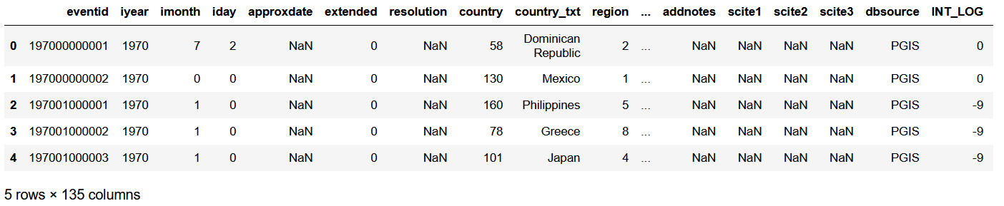
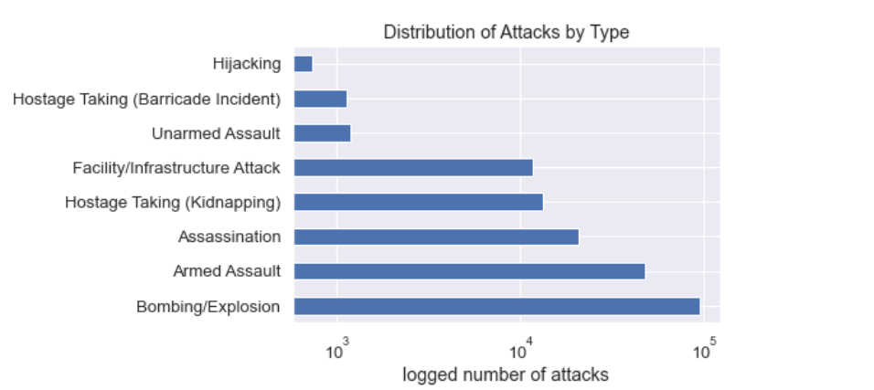
Data
My data has 191,953 instances, 134 features and a multi-class target class.
After eliminating unnecessary features and modifying others, left with 84 features
39 categorical, 26 numeric continuous and 19 numeric categorical
For pre-processing I fill in missing values, perform one hot encoding on categorical variables and use min max scaling with numerical variables
7,137 features in final dataset.
Unbalanced Dataset: Over 95,904 bombings and only 734 hijackings

Slide 4
Model Choice
3 Models
Random Forest Classifier (RF)
Logistic Regression with Stochastic Average Gradient (LR)
Scales well with large datasets
Support Vector Machine with Linear Kernel (SVM)
1 Unified pipeline
Preprocessing + Estimating
Train/Test split before preprocessing
Prevent information leakage
Similar balance of target class in training data

Slide 5
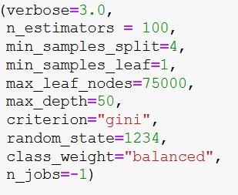
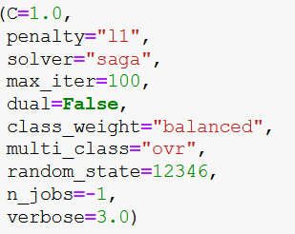
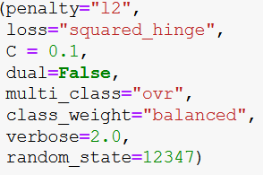
Hyperparameters
Class_weight = “balanced”
Dataset is unbalanced
Decide on remaining hyperparameters with gridsearchcv
Metric for evaluation: weighted f-1 score (dataset is unbalanced)
Randomized Search CV for RF (cut down on computation time)
 | RF | LR | SVM
Best Weighted F1 | 0.93 | 0.86 | 0.91
Final Model

Slide 6
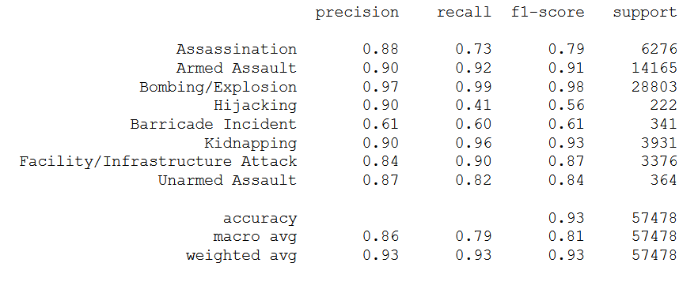
Model Performance: Random Forest
High precision and recall
93% chance of a predicted attack type being correct
93% of all attack types identified
F1 score is maximized with this classifier at 0.93, which is important for an unbalanced dataset
Strongest Performance
Bombings
97% of bombing predictions correct
99% of all bombings identified
Kidnappings
90% of kidnapping predictions correct
96% of kidnappings identified
Armed Assault
90% of predictions correct
92% of assaults identified
Weakest Performance
Barricade incidents
61% of barricade incident predictions correct
60% of all barricade incidents identified
Hijackings
90% of predictions correct
41% of incidents identified
Assassinations
88% of predictions correct
73% of incidents identified
Overall performance
Scales with availability of data
Returning very few results for hijackings but when it does is mostly correct

Slide 7
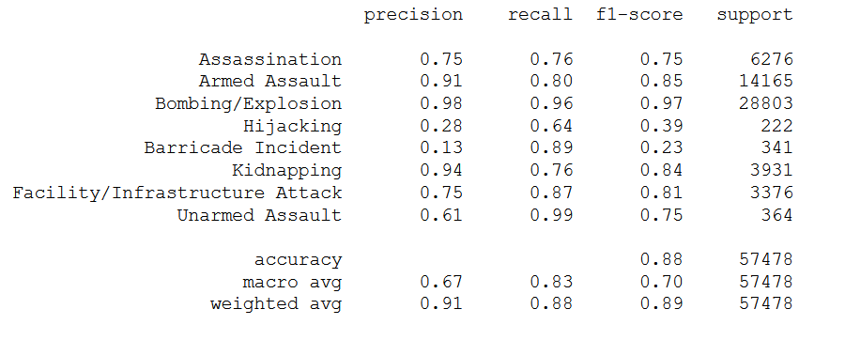
Model Performance: Logistic Regression
High precision and recall
91% chance of a predicted attack type being correct
88% of all attack types correctly identified
Strongest Performance
Bombings
98% of bombing predictions correct
96% of all bombings identified
Unarmed Assault
63% of kidnapping predictions correct
98% of kidnappings identified
Kidnapping
94% of predictions correct
76% of assaults identified
Weakest Performance
Barricade incidents
13% of barricade incident predictions correct
89% of all barricade incidents identified
Hijackings
28% of predictions correct
64% of incidents identified
Unarmed Assault
61% of predictions correct
99% of incidents identified
Overall performance
Scales with availability of data
Opposite for hijackings as RF, identifies most of them but only because it is having many false positives

Slide 8
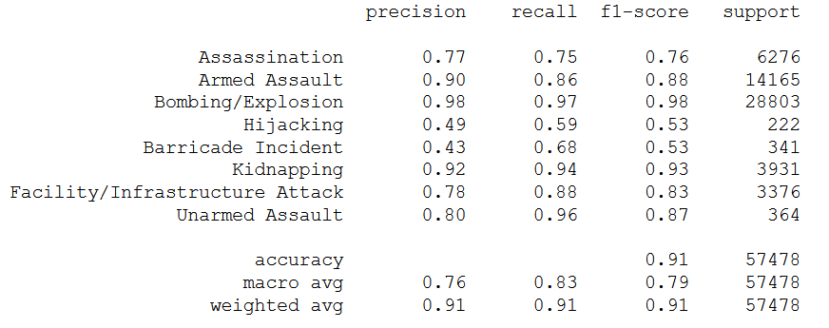
Model Performance: Linear SVM
High f1 score: 0.91
High precision and recall
91% chance of a predicted attack type being correct
91% of all attack types correctly identified
Strongest Performance
Bombings
98% of bombing predictions correct
97% of all bombings identified
Kidnappings
92% of kidnapping predictions correct
94% of kidnappings identified
Armed Assault
90% of predictions correct
86% of assaults identified
Weakest Performance
Barricade incidents
43% of barricade incident predictions correct
68% of all barricade incidents identified
Hijackings
49% of predictions correct
59% of incidents identified
Assassinations
77% of predictions correct
75% of incidents identified
Overall performance
Scales with availability of data
Overall random forest is the best
Ties in with ML Paper

Slide 9
Overall Comparison
Random Forest is the best, followed by SVM and LR
Highest weighted f1 overall and across all classes
Consistently higher precision and recall
With terrorist attacks you need to minimize both FP and FN
High costs with both options

Slide 10
Results Analysis: Sources of Error
Use confusion matrix instead of printing out decision trees
Very big tree and want a basis for comparison between all models
Look at misclassifications > 10%
Attack Type | RF | LR | SVM
Assassination | 15% misclassified as armed assaults | 13% misclassified as armed assaults | 14% misclassified as armed assaults
Armed Assault
Bombing/Explosion
Hijacking | 16% misclassified as armed assaults 32% misclassified as kidnappings | 12% misclassified as barricade incident | 16% misclassified as kidnappings
Barricade Incident | 28% misclassified as kidnappings |  | 23% misclassified as kidnappings
Kidnapping |  | 19% misclassified as barricade incident
Facility Attack
Unarmed Assault

Slide 11
Results Analysis: Sources of Error
Hijackings, assassinations, barricade incidents and kidnappings are attacks that specifically target a small number of people
Similar weapon types
Similar target types
Also have a lack of data

Slide 12
Results Analysis: Most Important Features
Attack Type | RF | LR | SVM
Assassination | Use of melee weapons Use of chemical weapons Use of blunt weapons Use of vehicles Use of hands, feet, fist as weapons Unknown weapons Biological weapons Poisoning | Black September group Kidnapping/Hostage resolved in Nepal NALU group | Black September group South African Suicide Squad Targeting journalists/media
Armed Assault |  | Use of firearms Use of knives Number killed | Use of firearms Use of knives Missing property damage
Bombing/Explosion |  | Use of explosives Meinhof anti-imperialist group | Use of explosives
Hijacking | 16% misclassified as armed assaults 32% misclassified as kidnappings | Targeting vehicles Targeting aircraft/airports | Afghan guerrillas Los Pelusos group FARC guerrillas
Barricade Incident | 28% misclassified as kidnappings | Targeting radio stations Panamanian terrorists Use of hands, feet, fists | Panamanian terrorists Incident resolved in Nigeria Lebanese Man group
Kidnapping |  | Taking captives El Arkam Ku Klux Klan | Taking captives El Arkam group FALN group
Facility Attack |  | Peruvian terrorists Use of sabotage equipment Pro-Kabul groups | Corsican NLF Sabotage Equipment Incendiary weapons
Unarmed Assault |  | Melee weapons Blunt weapons | Take place in Nigeria Chemical and biological weapons

Slide 13
Results Analysis: Future Work
Gathering more data is unrealistic since that would require more terrorist attacks
Find the correct values for missing/unknown features
Detailed secondary research
Include interaction terms since attack types can depend on a combination of factors
Deep contextual knowledge is required to better understand how the model performs

Slide 14
Thank You

Slide 15
Appendix

Slide 16
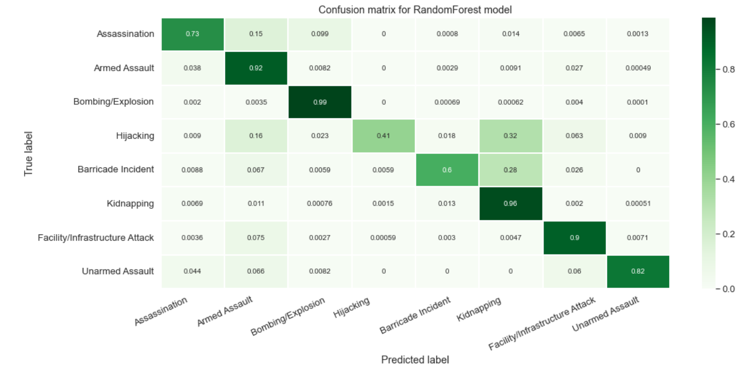
Random Forest Matrix

Slide 17
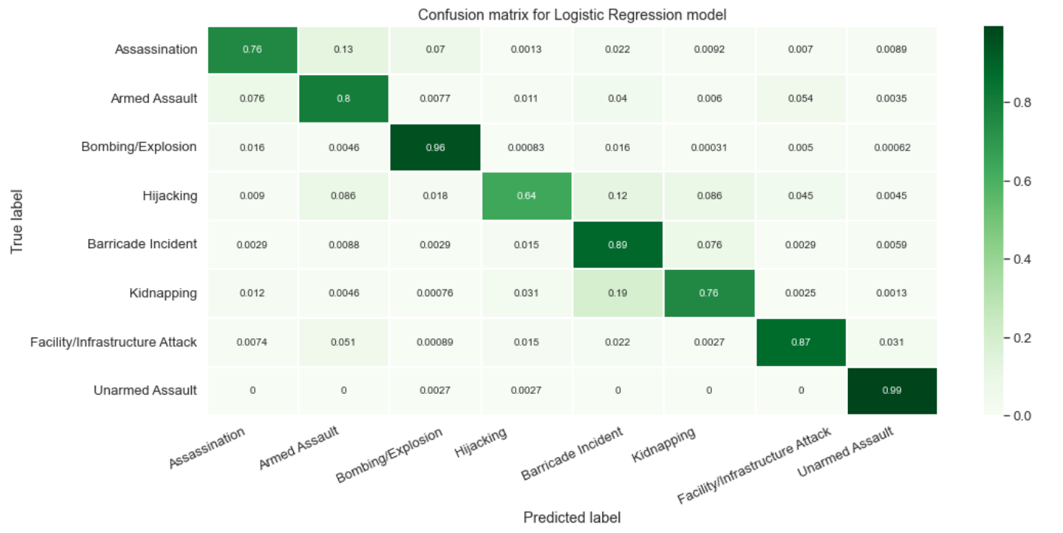
Logistic Regression Matrix

Slide 18
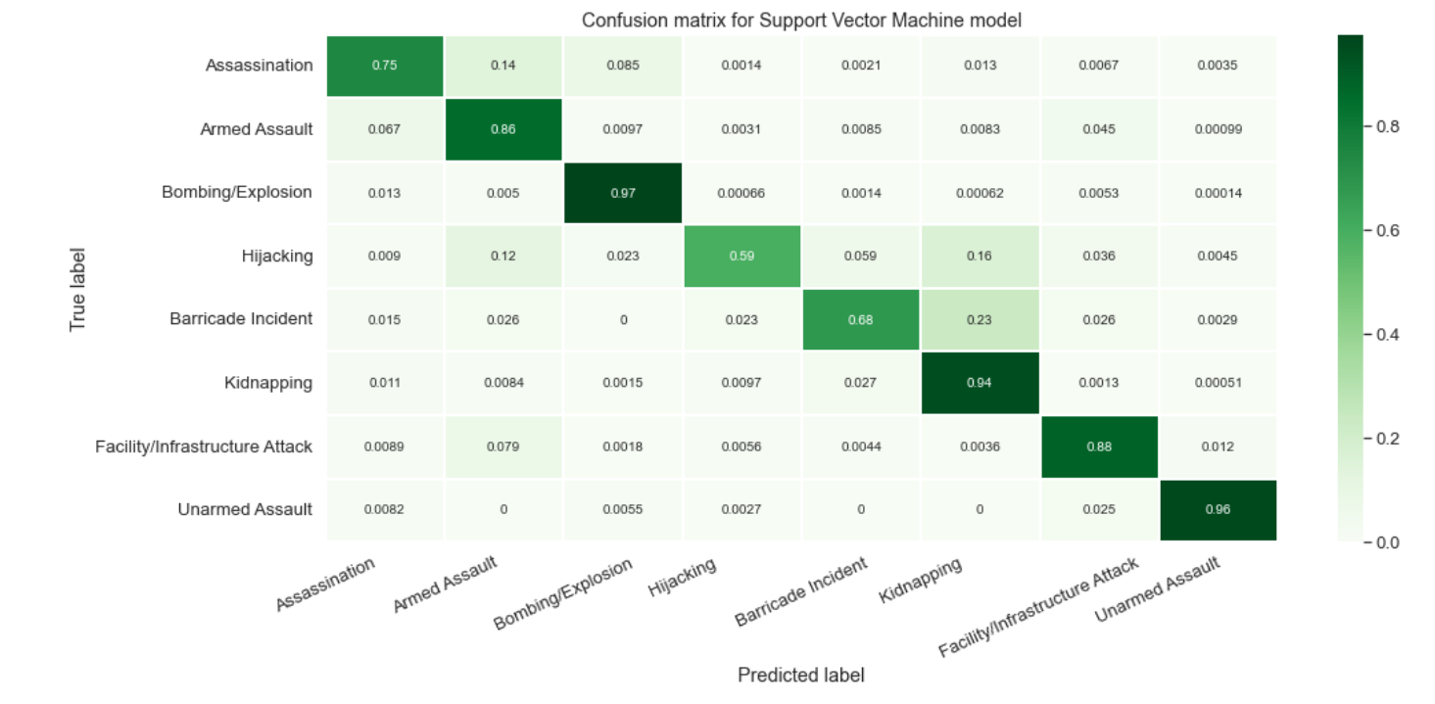
Support Vector Machine Matrix

