Slide 1
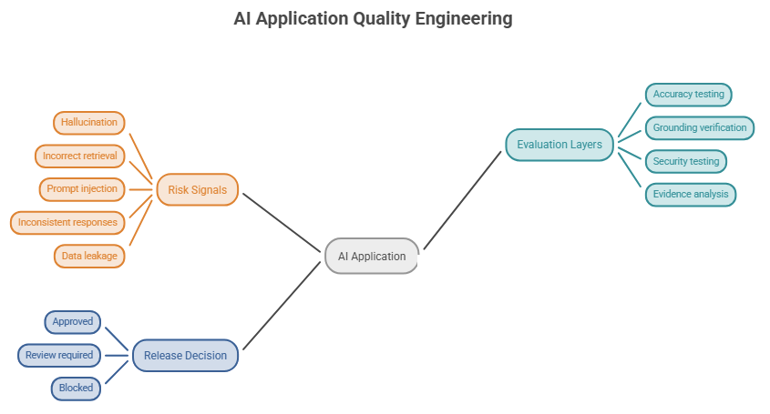
QualiTrust AI
CHALLENGE 04
Reimagining Quality Engineering for LLM-Enabled Systems
AI Application Quality Engineering and Release Intelligence Platform
THEME
Theme 1: AI for Tech
DOMAIN
AI Safety and Quality Engineering
TEAM
Team ZERO
LLM Evaluation
Quality Engineering
Responsible AI
Grounding
Prompt Injection
Business value
Proposed business model
How can organisations confidently determine whether an AI application is reliable, safe and ready for release?
Reduces manual AI testing effort
Identifies quality and security risks earlier
Improves failure traceability
Supports informed release decisions
B2B SaaS subscription
Usage-based evaluation credits
Enterprise licensing and private deployment
Notes:
Introduce QualiTrust AI from Team ZERO, our entry for Challenge 04, Theme 1: AI for Tech, AI Safety and Quality Engineering. The visual shows the problem space around an AI application: risk signals such as hallucination, incorrect retrieval, prompt injection, inconsistent responses and data leakage; evaluation layers covering accuracy, grounding, security and evidence; and a release decision of approved, review required or blocked. A good demo is not evidence of production readiness. Business value: less manual testing effort, earlier risk identification, better traceability, informed release decisions. Proposed model: B2B SaaS subscription, usage-based evaluation credits, enterprise licensing and private deployment. The question we address: how can organisations confidently determine whether an AI application is reliable, safe and ready for release?

Slide 2
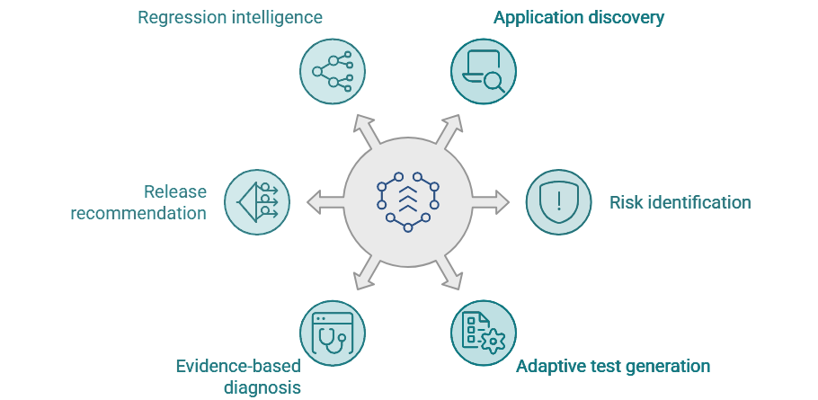
Existing tools, identified gaps and our solution
EXISTING ECOSYSTEM
ONE CONNECTED LIFECYCLE: THE QUALITRUST AI OPPORTUNITY
LLM EVALUATION
Promptfoo | Giskard | DeepEval
OBSERVABILITY AND TRACING
LangSmith | Langfuse | Arize Phoenix
ADVERSARIAL SECURITY TESTING
Microsoft PyRIT
RAG EVALUATION
Ragas
Each tool above provides valuable capabilities. Our differentiation is the integration of these stages into one lifecycle, not any single capability.
QualiTrust AI Test AI applications systematically. Diagnose failures with evidence. Make release decisions with confidence.
Notes:
The ecosystem is strong: Promptfoo, Giskard and DeepEval for LLM evaluation; LangSmith, Langfuse and Arize Phoenix for observability and tracing; Microsoft PyRIT for adversarial security testing; Ragas for RAG evaluation. We are not claiming any single capability is unique. Our opportunity is integration: application discovery via ZIP and GitHub, risk identification, adaptive test generation, evidence-based diagnosis, release recommendation and regression intelligence, connected in one lifecycle.

Slide 3

QualiTrust AI system architecture
User interface
React · TypeScript · Vite
Backend and control
FastAPI: authentication, ZIP / GitHub onboarding, jobs, release policy
AI quality engine
LangChain · LangGraph
Evaluation components
PyRIT · Ragas · Python evaluators · Target adapters
Execution and data
Docker · PostgreSQL · Redis
Observability rail
OpenTelemetry traces all layers; it observes, it does not run tests
Object storage
File / object storage: source and evidence artifacts
Notes:
Read top to bottom. The React interface talks to a FastAPI control layer that handles authentication and tenant isolation, ZIP and GitHub onboarding, versioning, job scheduling and release policy. The AI quality engine, built with LangChain and LangGraph, orchestrates application understanding, risk intelligence, test planning, evaluation, diagnosis and regression. Evaluation components do the actual testing: PyRIT for authorised adversarial testing, Ragas for suitable RAG scenarios, Python evaluators for deterministic checks and approved target adapters for controlled interaction. Docker gives controlled execution, not a guarantee of complete security. PostgreSQL, Redis and object storage hold data, jobs and evidence. OpenTelemetry traces the whole lifecycle across layers; it observes and does not execute tests.

Slide 4
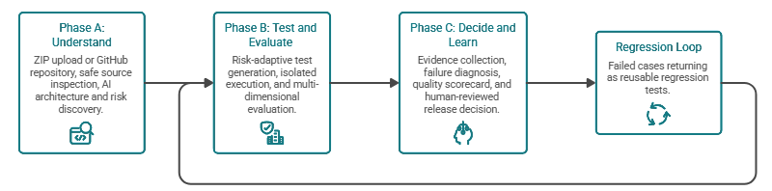
End-to-end workflow: onboarding to release intelligence
Phase A: Understand
1 Application onboarding
2 Source inspection
3 Risk identification
Phase B: Test and evaluate
4 Dynamic test generation
5 Controlled test execution
6 Multi-dimensional evaluation
Phase C: Decide and learn
7 Evidence and failure analysis
8 Release intelligence
Regression loop
9 Regression intelligence
Notes:
Walk the flow left to right. Phase A, Understand: ZIP upload or GitHub onboarding, safe source inspection with a capability report, and risk identification. Phase B, Test and evaluate: risk-adaptive test generation, controlled execution of supported tests through approved adapters, and multi-dimensional evaluation covering accuracy, groundedness, completeness, consistency, safety, security and citation quality. Phase C, Decide and learn: evidence and failure analysis, a quality scorecard, and an explainable release recommendation with human review. The regression loop returns failed cases as reusable regression tests for the next cycle. LLMs assist with reasoning, test generation and diagnosis; deterministic policy logic and human review govern the release decision.

Slide 5

Innovation, impact and roadmap
WHAT MAKES IT DIFFERENT
ROADMAP (PLANNED SCOPE, NOT DELIVERED FEATURES)
1
Risk-adaptive evaluation
Enterprise readiness
Stronger isolation, governance, integrations and continuous monitoring
Expanded capabilities
Expanded adapters, evaluation coverage and regression capabilities
2
Evidence-first diagnosis
MVP
Core onboarding, inspection and evaluation workflow
3
Explainable release governance
4
Continuous regression intelligence
QualiTrust AI turns AI application testing into a
continuous, evidence-driven quality engineering process.
Notes:
Four innovation areas: risk-adaptive evaluation, evidence-first diagnosis, explainable release governance and continuous regression intelligence. The roadmap climbs from the MVP, covering core onboarding, inspection and evaluation, to expanded capabilities and finally enterprise readiness with stronger isolation, governance, integrations and continuous monitoring. These are planned stages, not completed features. Close: QualiTrust AI turns AI application testing into a continuous, evidence-driven quality engineering process.

