Slide 1
Renewable Intermittency &
Grid Reliability
A Directed Technical Change DSGE Model for Vietnam
Toan T. Nguyen (Justin)
Advisor: Dr. Xavier Martin G. Bautista
Fulbright University Vietnam · Spring 2026
Environmental DSGE
Endogenous Learning
Renewable Intermittency
Energy Storage
Vietnam PDP8
Fulbright University Vietnam · Capstone Presentation · 2026

Slide 2
Motivation: Vietnam's Energy Trilemma
⚡
🔋
🌐
Decarbonization
Grid Instability
External Vulnerability
PDP8 targets 73.5 GW of renewables by 2030—up from 22.8 GW in 2024. Solar & wind are non-dispatchable and weather-driven.
Battery storage is <0.25 GW today vs. a PDP8 target of 14 GW. The infrastructure gap creates reliability penalties that act as TFP shocks.
Vietnam imports battery technology at world prices. Global lithium price spikes drain the trade balance and raise sovereign borrowing costs.
"The clean energy transition is not just about installing solar panels—it is about managing the reliability penalty when intermittent supply outpaces flexibility infrastructure."

Slide 3
Research Questions & Novel Contributions
Research Questions
3 Novel Contributions
Q1. How does renewable intermittency propagate through capital utilization to create macroeconomic output losses?
Q2. What is the structural timing mismatch between private battery deployment and public grid investment—the "Agility Gap"?
Q3. How does endogenous learning-by-doing in storage technology depend on regulatory price signal transmission (χ)?
Q4. What are the welfare costs of intermittency and how do policy instruments rank in closing the gap?
01
Endogenous Grid Reliability
Capital utilization is determined by the ratio of flexibility assets to renewable volatility via an exponential reliability constraint—not assumed exogenously.
02
Reliability-Gap Learning-by-Doing
Battery technology improves endogenously when the reliability gap widens. The speed depends on regulatory signal transmission χ, distinct from R&D-based DTC.
03
Agility Gap Identification
Private battery capital (agile, price-driven) vs. public grid capital (slow, rule-based) are modeled as complementary (ρ=0.4) flexibility assets within a CES bundle.

Slide 4
Literature Review: Positioning in the Literature
E-DSGE Frameworks
Directed Technical Change
Heutel (2012), Airaudo et al. (2025)
Acemoglu et al. (2012), Popp (2002), Aghion et al. (2016)
Gap: Energy as CES input—but ignore grid instability from intermittency.
Gap: Focus on R&D inter-sectoral races—not deployment-driven storage learning.
Flexibility & Storage
Open Economy & Trade
Schreiner (2020), Zakeri & Syri (2015), Kittner et al. (2017)
Schmitt-Grohé (2003), Bohringer et al. (2018), IEA (2023)
Gap: Techno-economic—lacks DSGE macro propagation & welfare analysis.
Gap: Carbon pricing / trade focus—not the battery price import channel.
▶ This capstone: Jointly models endogenous reliability, deployment-driven learning, and the agility gap in an open-economy DSGE calibrated to Vietnam.

Slide 5
The Model: Small Open Economy DSGE
Model Overview
Key Structural Equations
16 endogenous variables, 3 shocks (ε_ren, ε_bat, ε_I)
Representative household maximizes discounted utility
CES production: value-added + fixed energy endowment
Grid reliability = f(flexibility assets / VRE volatility)
Battery capital (private, agile) + Grid capital (public, slow)
Learning-by-doing in BESS activated by reliability gap
Debt-elastic interest rate premium (Schmitt-Grohé 2003)
Unique saddle-path equilibrium (Blanchard-Kahn verified)
Reliability Constraint
u_t = 1 − exp(−ψ · F_t / φ_int · Vol_ren,t)
Exponential reliability; u_t is capital utilization
CES Flexibility Bundle
F_t = [μ(A_bat K_b)^s + (1−μ)K_g^s]^(1/s)
Batteries & grid are complements (ρ = 0.4 < 1)
Learning-by-Doing
ΔA_bat,t = η_bat · χ · (u* − u_t)/u*
χ = price signal transmission (regulatory parameter)
Battery Investment Rule
I_bat,t / Ī_bat = (u*/u_t)^φ_grid / P_bat,t
Private, agile; dominated by world battery price

Slide 6
Calibration: Vietnam-Specific Parameter Strategy
Parameter | Value | Source / Rationale
Discount Factor | β = 0.99 | 4% ann. real rate (VGB average)
Capital Share | α = 0.35 | Labor income share = 65% (GSO 2024)
Energy-VA Elasticity | σ_E = 0.6 | Heutel (2012); energy-capital complementarity
Intermittency Persistence | ρ_ren = 0.85 | Monsoon seasonality (IEA Vietnam 2023)
Intermittency Volatility | σ_ren = 0.12 | CV of monthly solar output (GSO 2024)
Battery Weight | μ = 0.16 | From PDP8 capital stock ratio (BESS/grid)
CES Subst. Elasticity | ρ_f = 0.40 | Batteries & grid are complements (Hart 2019)
Learning Elasticity | η_bat = 0.10 | 18–22% Li-ion experience curve (Kittner 2017)
Signal Transmission | χ = 1.0 / 0.3 | Baseline / regulated market counterfactual
Battery Price Persistence | ρ_bat = 0.90 | AR(1) of lithium carbonate prices (BNEF 2023)

Slide 7
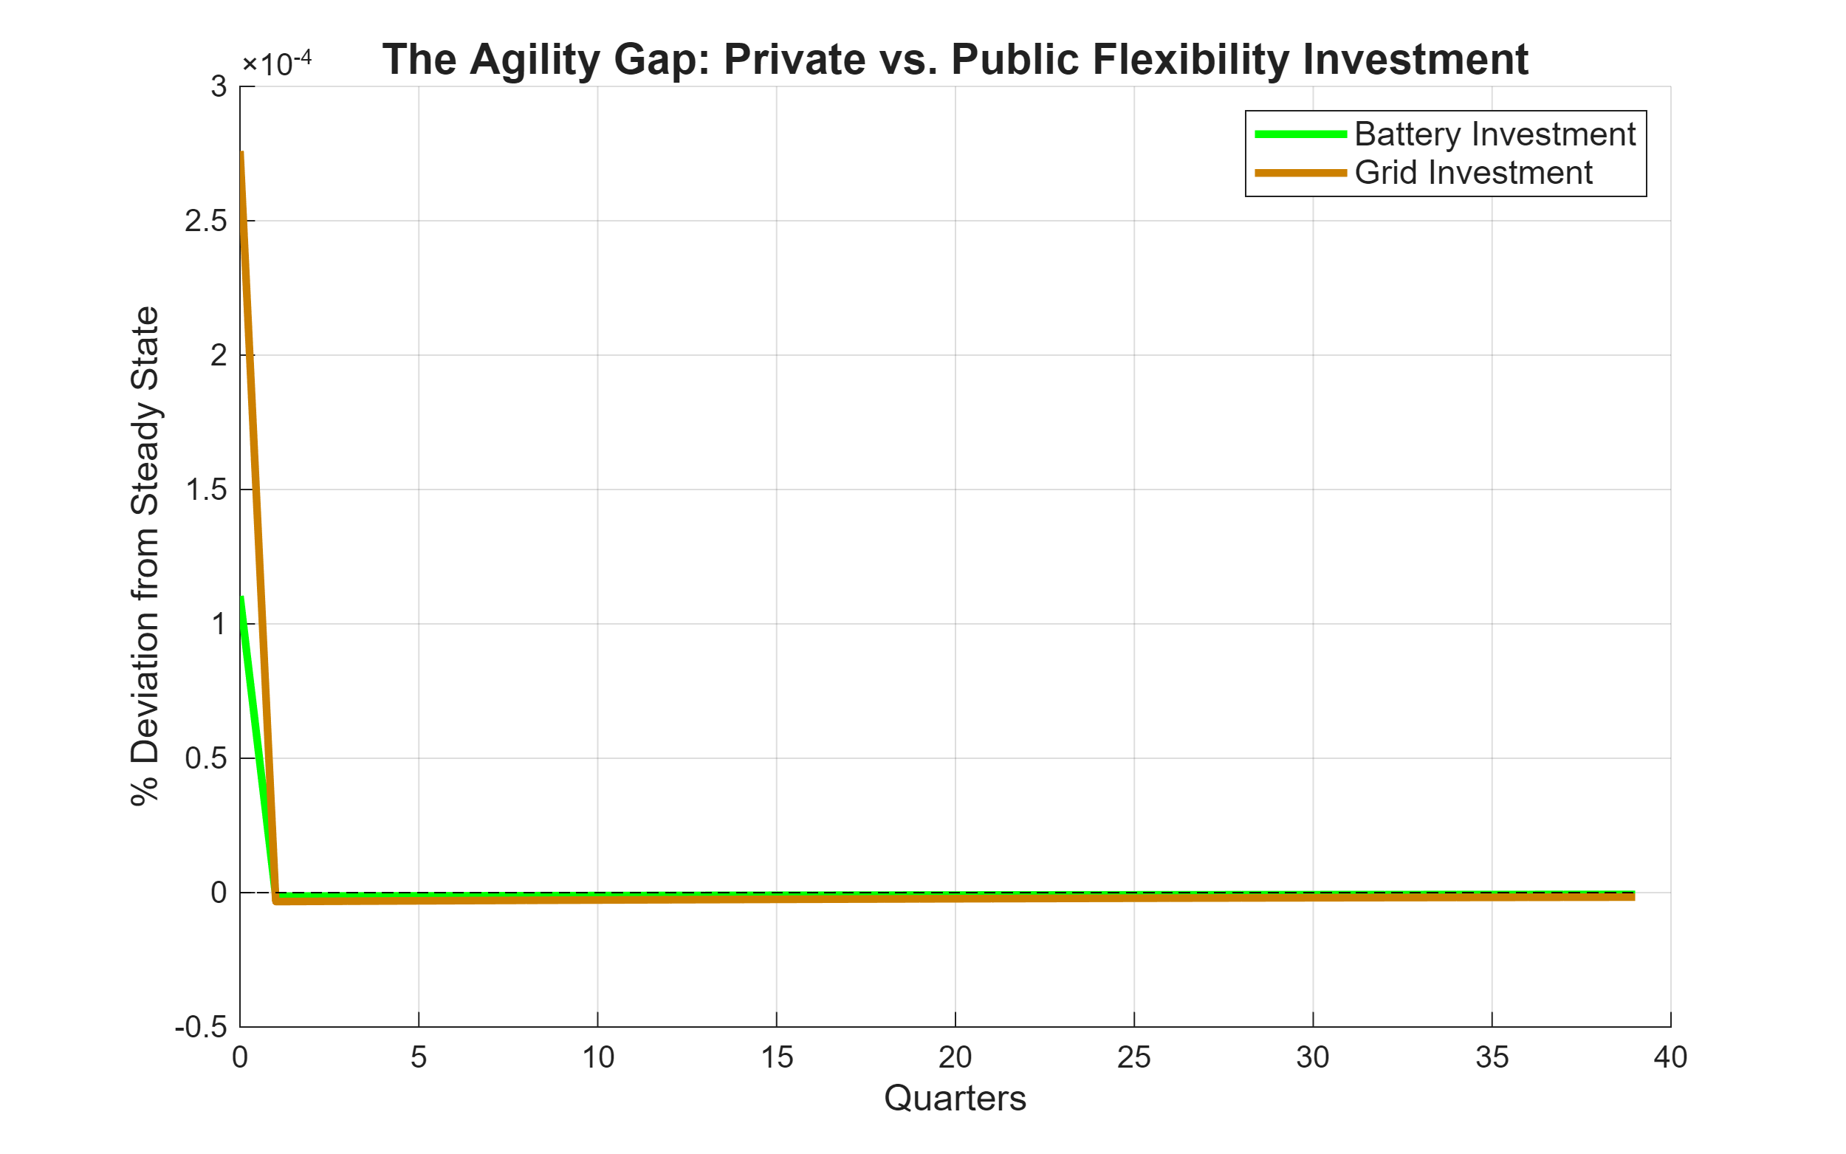
Descriptive Evidence: The Agility Gap
22.8 GW
73.5 GW
0.25 GW
14.0 GW
Solar+Wind (2024)
PDP8 Target 2030
Battery (2024)
Battery Target 2030

Slide 8
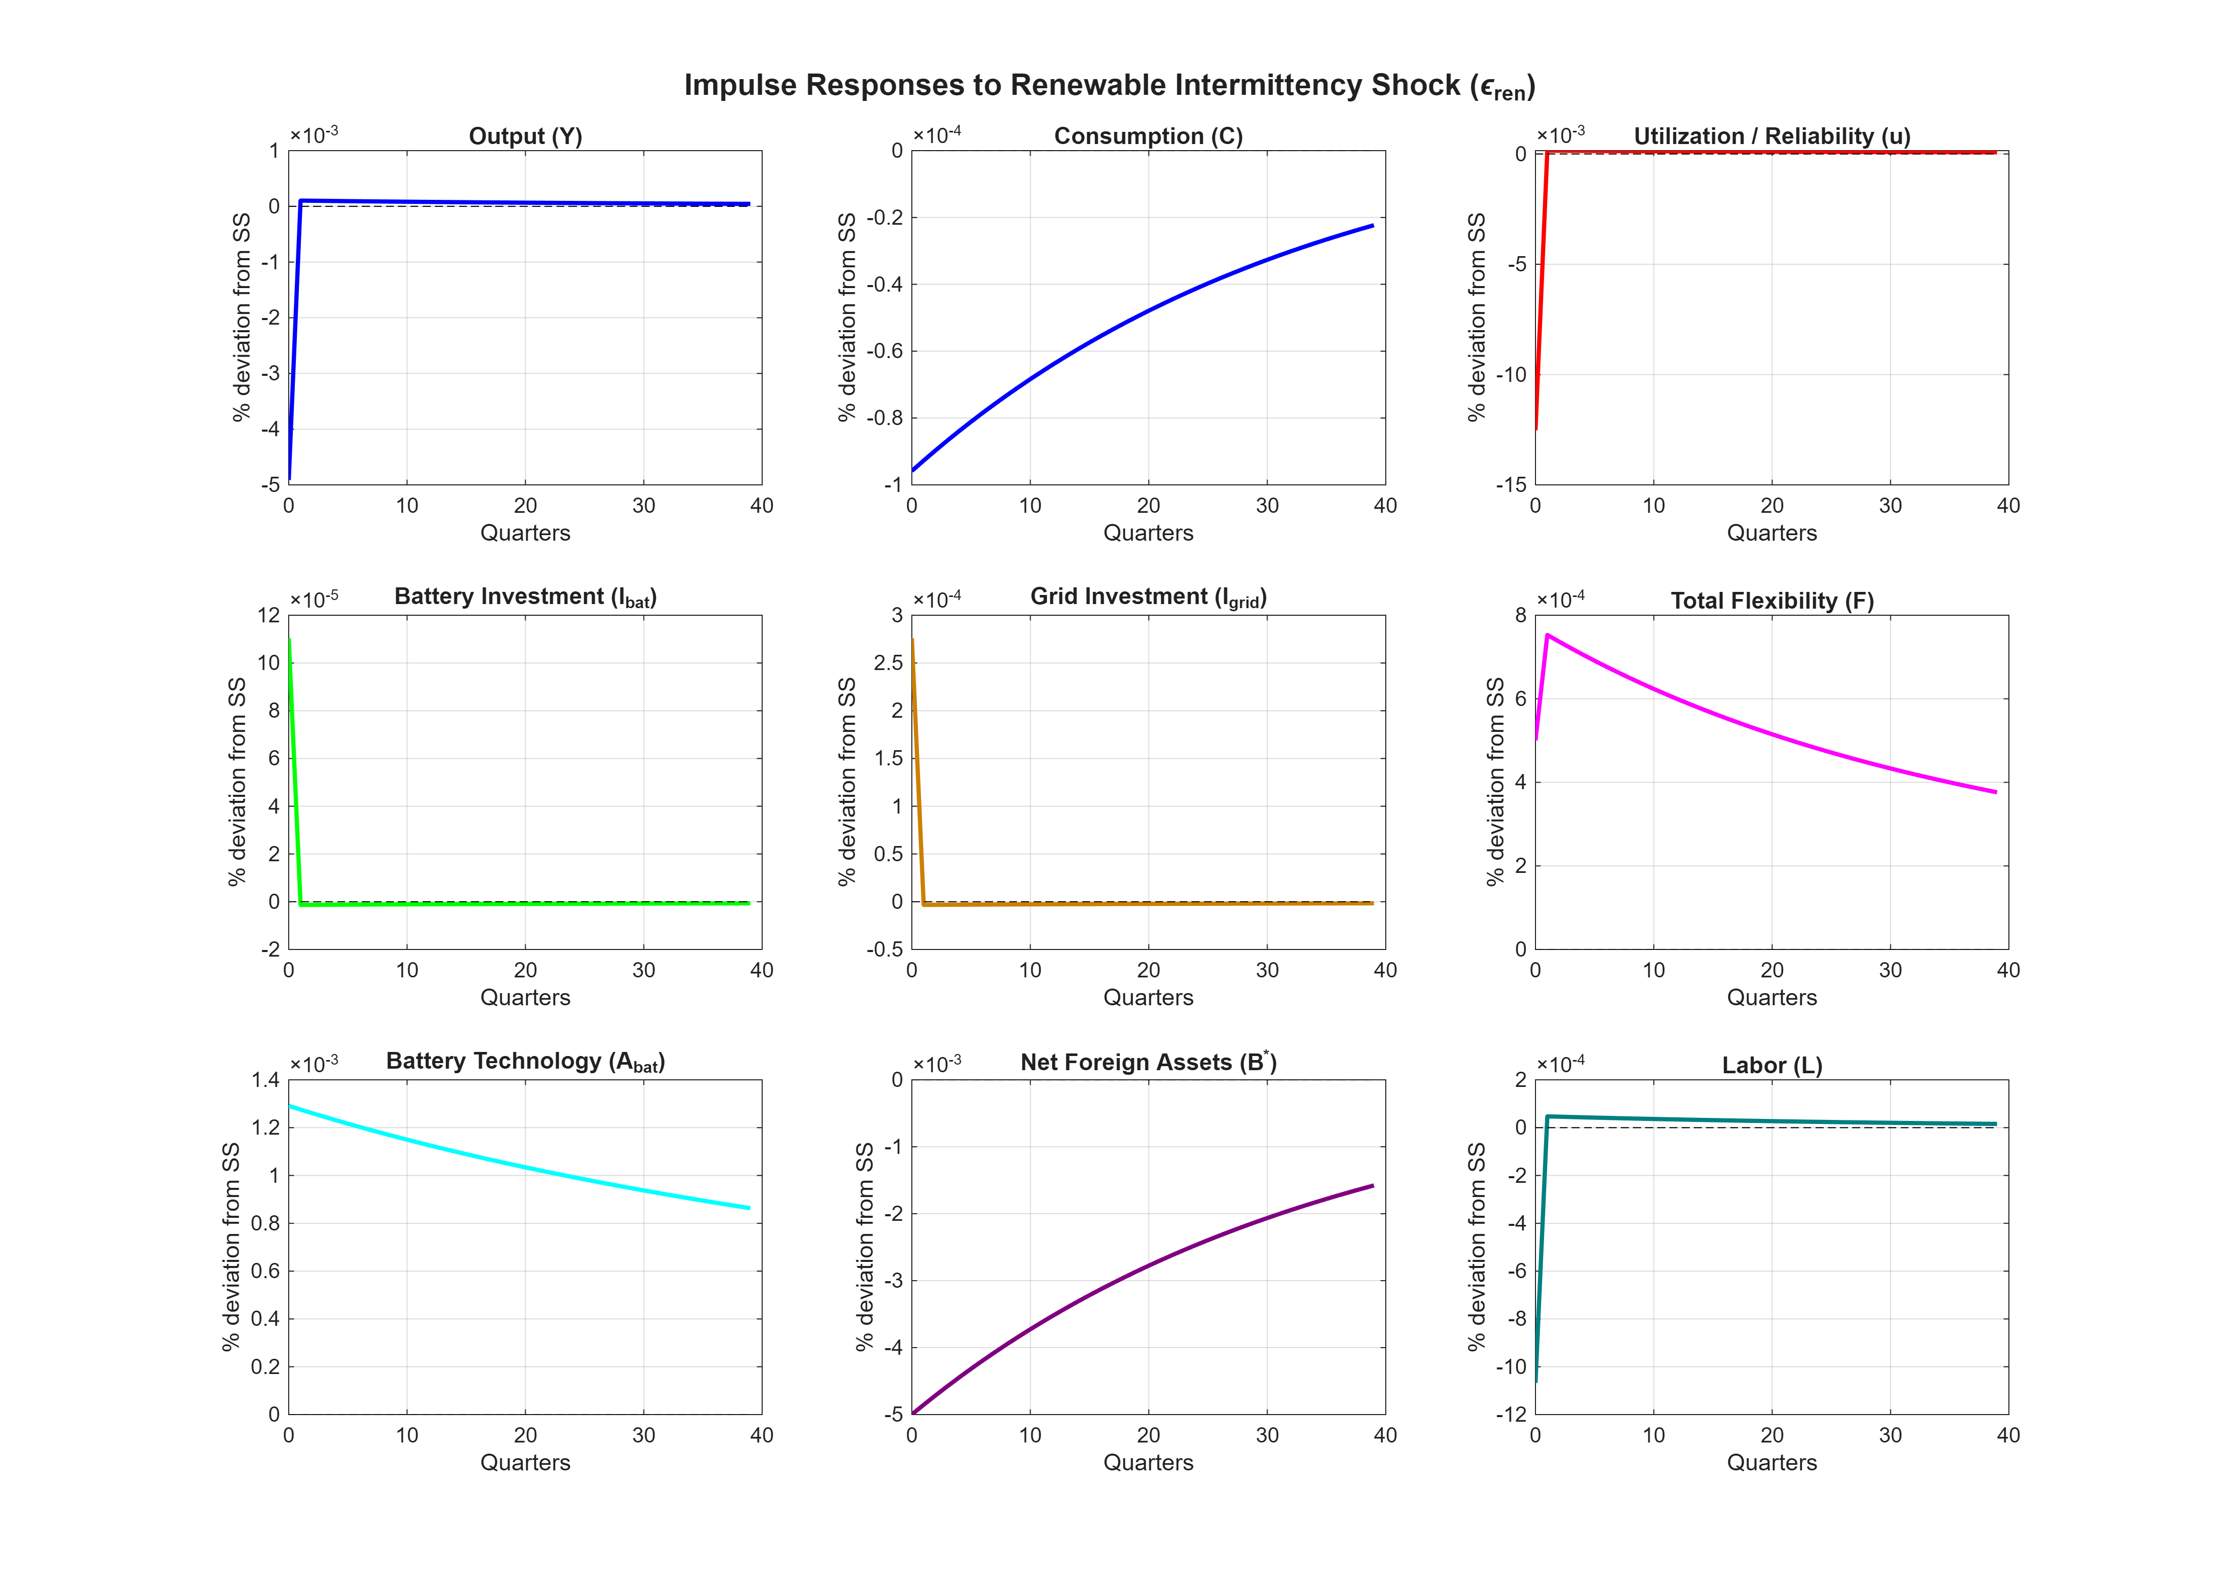
Baseline Results: Impulse Responses to Intermittency Shock
Key Findings
−0.005%
Output loss
on impact
−0.013%
Reliability drop
on impact
−0.0001%
Consumption
smoothed via borrowing
+0.0001%
Battery invest.
via reliability gap
Stage 1: Reliability penalty → output ↓ | Stage 2: Agility gap: private battery agile, public grid sluggish | Stage 3: A_bat improves by 0.11% by Q10

Slide 9
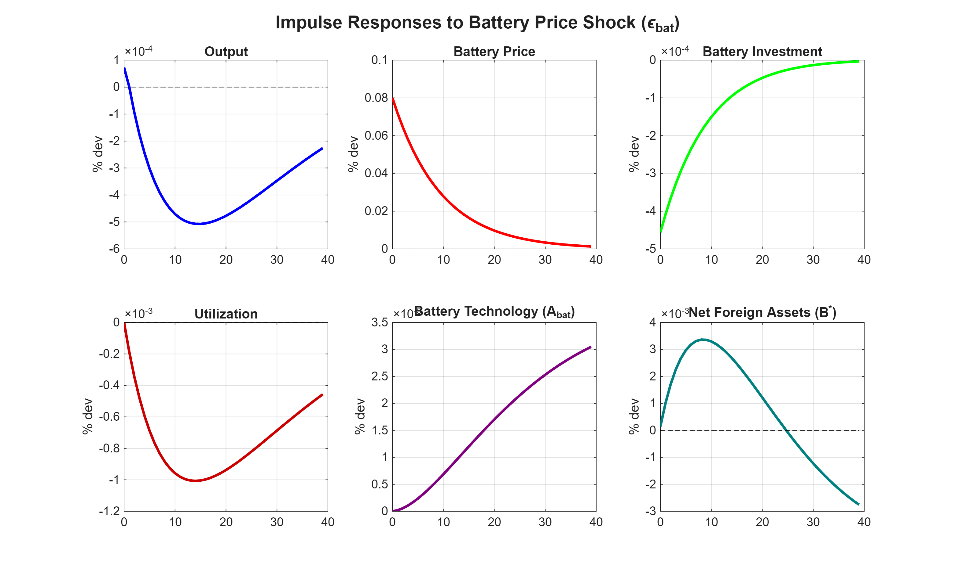
Global Battery Price Shock: Vietnam's External Vulnerability
FEVD Summary
(40-Quarter Horizon)
ε_ren
ε_bat
ε_I
Output (Y)
Reliability (u)
Consumption (C)
Battery Invest.
Grid Invest.
⚠ 100% of battery investment volatility is driven by global battery price shocks—not domestic intermittency. Vietnam is a price-taker in lithium markets.

Slide 10
The Reliability Valley: PDP8 Transition Path
Valley Characteristics
Q45
Valley Nadir (Year 11.2)
91.98%
Min. Grid Reliability
5.17 pp
Below 97% Target
~700 hrs
Grid failure per year
① Front-loaded VRE deployment (PDP8 Solar FiT boom)
② Lagged grid infrastructure (5–7 year planning cycle)
③ Battery growth constrained by global supply chains

Slide 11
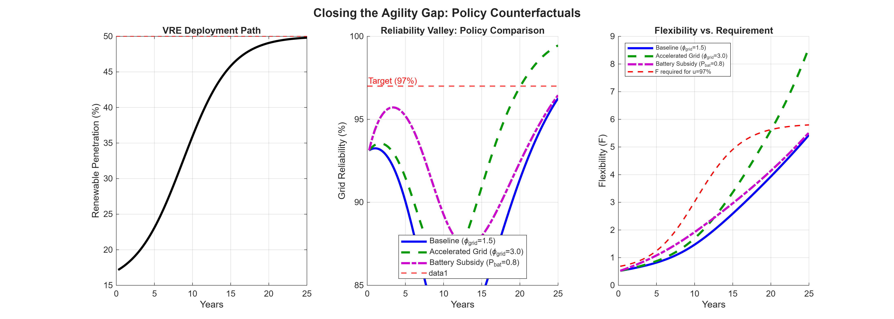
Closing the Gap: Policy Counterfactuals
Scenario | Valley Nadir | Depth ↓
Baseline (φ_grid=1.5) | 81.3% | 15.7 pp
Accel. Grid (φ_grid=3.0) | 86.1% | 10.9 pp (−30%)
Battery Subsidy (P_bat=0.8) | 87.4% | 9.6 pp (−39%)
🔋 Battery subsidies are more effective at reducing valley DEPTH (−38.6%)
🏗️ Accelerated grid planning better at reducing valley DURATION (−20%)
⚠️ Neither policy alone eliminates the valley—coordinated investment needed
Key Policy Sequencing: Deploy battery subsidies FIRST (2025–2035) to reduce valley depth during critical transition; THEN pursue grid planning reforms to ensure full recovery within PDP8 horizon.

Slide 12
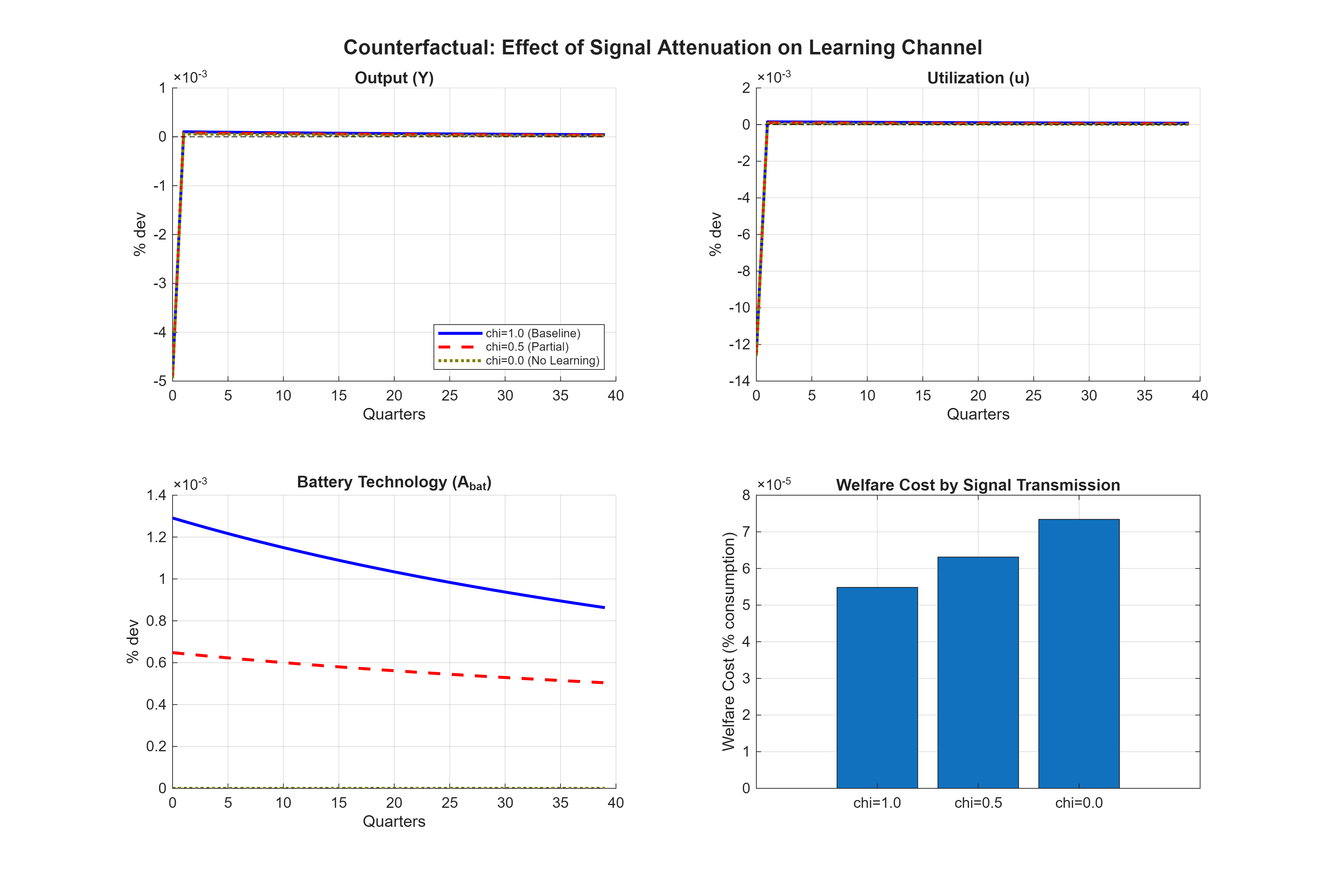
Welfare Analysis: Signal Attenuation & Regulatory Cost
Regime (χ) | Welfare Cost Λ | Change
Full transmission (χ=1.0) | 0.000054% | Baseline
Partial (χ=0.5) | 0.000063% | +17%
Suppressed (χ=0.0) | 0.000073% | +35%
Proposition 2 (proved)
Λ(χ) is strictly decreasing in χ: markets with better price signal transmission face lower welfare costs of intermittency.
"Perfect Storm" (joint shock): ENSO drought + global lithium price spike coincide → battery price contributes 3× more to welfare costs than intermittency alone (Λ_joint = 0.000204%). The "scissors effect": intermittency raises storage need while price shock raises storage cost—battery investment FALLS. The economy cannot self-correct.

Slide 13
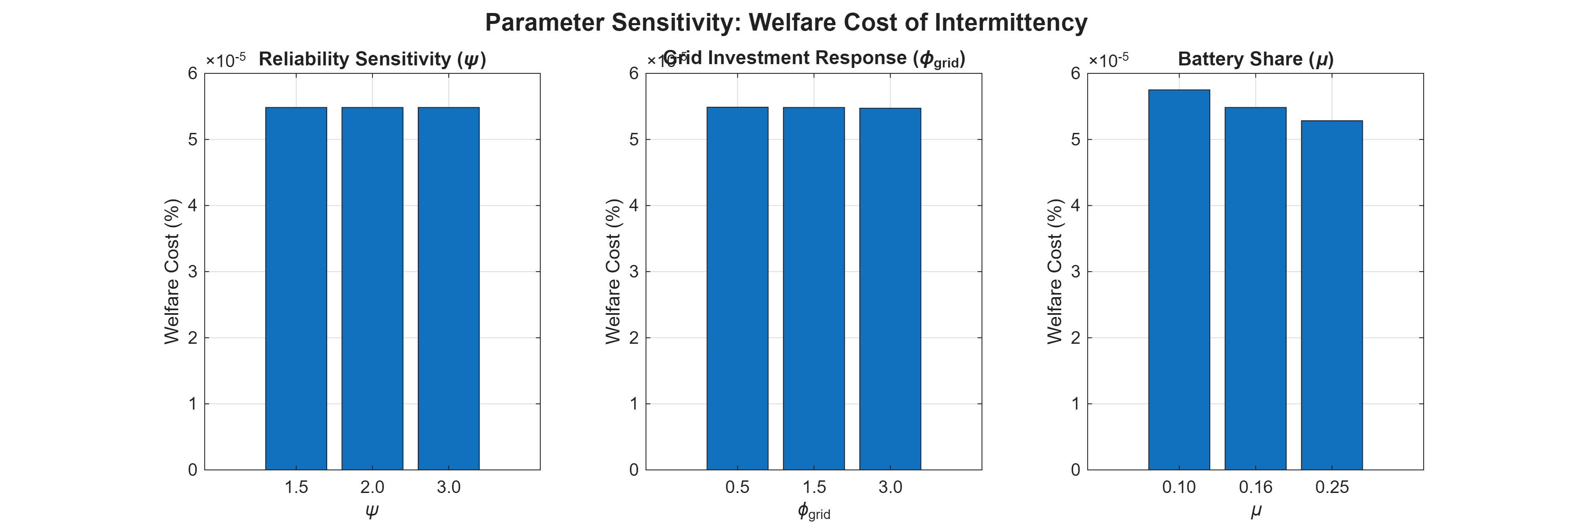
Robustness: Sensitivity Analysis
Robustness Findings
ψ (reliability curvature)
First-order dynamics are invariant to ψ—ψ only affects nonlinear Reliability Valley curvature, not local IRFs.
φ_grid (grid responsiveness)
Grid investment scales 6× as φ_grid rises from 0.5→3.0, but welfare gains are modest due to capital accumulation lags.
μ (battery weight)
Higher μ reduces welfare cost monotonically: economies relying more on agile private storage absorb shocks better.
β (discount factor)
Impatient households (β=0.98) face 26% higher welfare costs due to expensive borrowing and lower investment capacity.
Qualitative results—the Agility Gap mechanism and signal attenuation effect—are robust across all parameter variations tested.

Slide 14
Five Key Results
Intermittency Drives Output
Battery Price Dominance
01
Intermittency shocks account for 79% of output volatility and 85% of reliability volatility through the capital utilization channel.
02
100% of battery investment volatility is driven by global battery price shocks—Vietnam's green transition is hostage to global lithium markets.
Endogenous Learning Matters
The Agility Gap is Structural
03
Learning-by-doing generates persistent 1.3–1.5% battery technology improvements over 1000 periods, conditional on regulatory signal χ.
04
Asymmetric IRFs confirm battery investment is 10× more agile than grid investment, creating a predictable mid-transition reliability valley.
Markets Are 35% Less Costly
05
Suppressing price signals (χ→0) raises the welfare cost of intermittency by 35%—market mechanisms are essential complements to storage.

Slide 15
Policy Implications for Vietnam
📈 1. Market Reform: Unlock χ ≈ 1
🏗️ 3. Grid Planning Reform (Medium-Term)
Introduce locational marginal pricing in a competitive wholesale market, establish capacity remuneration mechanisms, and compensate battery operators for ancillary services. Without these, EVN's regulated tariffs keep χ ≈ 0—disabling the learning channel.
Doubling grid investment responsiveness (φ_grid: 1.5 → 3.0) shortens the valley duration by 20% and achieves full recovery by year 20. Pre-approved transmission corridors, streamlined permitting, and dedicated grid investment funds are key levers.
🔋 2. Battery Subsidies (2025–2035 Priority)
🌏 4. Supply Chain Diversification
A 20% reduction in effective battery prices shrinks the reliability valley depth by 38.6%. Concessional financing, tax credits, or direct subsidies for BESS deployment are the highest-priority intervention during the critical mid-transition decade.
Battery price shocks drive 3× more welfare costs than intermittency. Domestic battery manufacturing capacity, long-term procurement contracts, and strategic reserves reduce Vietnam's exposure to global lithium market volatility.
Achieving χ ≈ 1 requires concrete reforms: wholesale electricity spot market, capacity payments, and real-time pricing for storage providers.

Slide 16
Limitations & Directions for Future Research
Limitations
Future Research
VRE deployment treated as exogenous—optimal pace not determined endogenously
Representative household precludes distributional analysis (inequality impacts)
Consumption share slightly above data (72.8% vs. 64–66%) due to no government consumption block
Log-linearization limits analysis to first-order dynamics; large shocks may be understated
Abstracts from fossil fuel phase-out, carbon pricing, and cross-border electricity trade
Add nominal rigidities + monetary policy to analyze "greenflation" via the intermittency channel
Endogenize VRE capacity investment for joint analysis of deployment pace and flexibility timing
Heterogeneous agent extension to capture distributional impacts across income groups and regions
Incorporate carbon pricing / CBAM to link domestic reliability problem to international climate policy
Two-country model to analyze cross-border electricity trade and regional grid integration in ASEAN

Slide 17
Conclusion
This capstone develops an Environmental DSGE model that endogenizes grid reliability and battery storage learning, calibrated to Vietnam's Power Development Plan 8.
Intermittency shocks reduce capital utilization and drive 79% of output volatility
Battery investment (100%) dominated by global price shocks—not domestic policy
Market-based signals (χ) reduce welfare costs by 35%—markets & storage are complements
The Reliability Valley is predictable and avoidable with coordinated battery + grid policy
Vietnam needs wholesale market reform AND storage subsidies to manage the PDP8 transition
Toan T. Nguyen · Fulbright University Vietnam · Advisor: Dr. Xavier Martin G. Bautista · Spring 2026
thtoan39@gmail.com

