Slide 1
Lecture 2
Instruction Sequencing

Slide 2
Decimal and Binary
Decimal 8547 = 8*10³ + 5*10² + 4*10¹ + 7*10⁰
Common Form D = d_{n-1}d_{n-2} ………d₁d₀
V(D) = d_{n-1}*10^{n-1} + d_{n-2}*10^{n-2}…d₀*10⁰
Binary B = b_{n-1}b_{n-2} ………b₁b₀
V(B) = b_{n-1}*2^{n-1} + b_{n-2}*2^{n-2}…b₀*2⁰

Slide 3
Based Convert
Binary to Decimal
  (1101)₂ = 1*2³ + 1*2²+ 0*2² + 1*2⁰
  = 8 + 4 + 1
  = 13
Decimal to Binary
2 ⎠13
2 ⎠ 6
2 ⎠ 3
2 ⎠ 1
0
13 = 1101₂
1
0
1
1

Slide 4
Octal
Digits range from 0 to 7
A single octal digit can be represented using 3 bits.
A binary number can be converted to an octal number by taking a group of 3 bits, starting from the LSB (least significant bit)
EX. (101011010111)₂ = 101 011 010 111
= (5327)₈

Slide 5
Hexadecimal
Digits range from 0-9, A-F
A single hexadecimal digit can be represented using 4 bits
Ex. (AF25)₁₆ = (1010 1111 0010 0101)₂
Octal and Hexadecimal numbers are used as shorthand notations for binary numbers.

Slide 6
Number Representations
Sign-and-magnitude
  Similar to decimal numbering format.
  An extra bit is used as a sign.
  MSB = 0 : number is positive and MSB = 1 : number is negative
  Ex. 0101 = +5 , 1101 = -5
1’s-complement
  The negative number can be obtained by complementing each bit of the number including the sign bit (MSB)
  Ex. 0101 = +5 , -5 = 1010
2’s-complement
  The negative number can be obtained by adding 1 to a 1’s complement representation.
  Ex. 0101 = +5 , -5 = 1011

Slide 7
Number Representations
B
V
alues represented
Sign and
b
3
b
2
b
1
b
0
magnitude
1'
s complement
2'
s complement
0
1
1
1
+
7
+
7
+
7
0
1
1
0
+
6
+
6
+
6
0
1
0
1
+
5
+
5
+
5
0
1
0
0
+
4
+
4
+
4
0
0
1
1
+
3
+
3
+
3
0
0
1
0
+
2
+
2
+
2
0
0
0
1
+
1
+
1
+
1
0
0
0
0
+
0
+
0
+
0
1
0
0
0
-
0
-
7
-
8
1
0
0
1
-
1
-
6
-
7
1
0
1
0
-
2
-
5
-
6
1
0
1
1
-
3
-
4
-
5
1
1
0
0
-
4
-
3
-
4
1
1
0
1
-
5
-
2
-
3
1
1
1
0
-
6
-
1
-
2
1
1
1
1
-
7
-
0
-
1
Notes:
2 zeros in Sign and magnitude system also in 1’s complement
-8 be able in 2’s complement system
Sign and magnitude, it looks natural

Slide 8
Addition of Sign-and-magnitude
Although the simplest representation, adding two numbers of opposite signs can be complicated. We need to find a smaller number to be subtracted from the larger one
The extra logic circuit will be needed to compare numbers.
This representation is not used in computer systems nowadays

Slide 9
Addition of 1’s-complement
In some cases, a correction is needed, which means an extra addition will have to be performed.
The correction is done by adding the carry bit to the result.
Ex. 5₊ 0101₊
-2 1101
3 10010₊
1
0011
Notes:
Addition of 1’s complement can be done without the number comparing circuit.

Slide 10
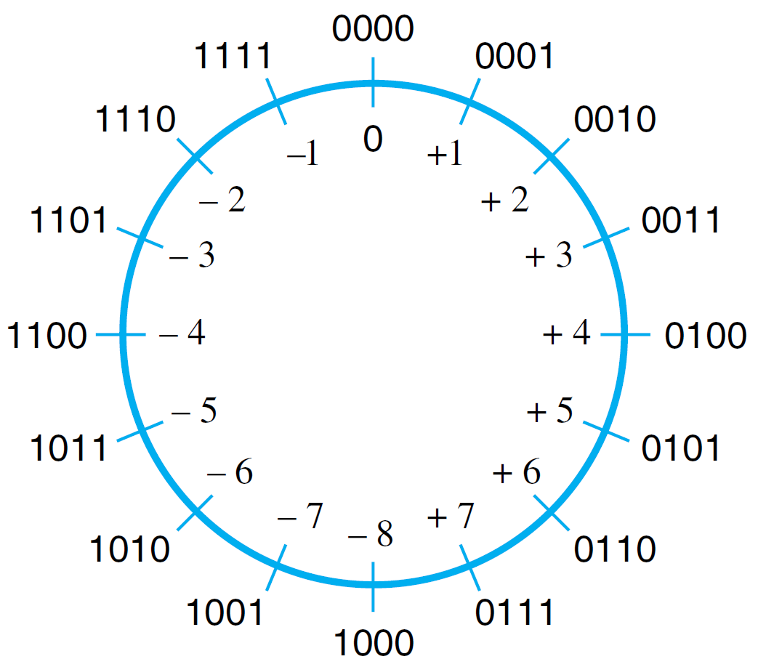
Mod 16 System for 2’s-complement Numbers

Slide 11
Addition of 2’s-complement
Addition of 2’s complement is simple. The carry out can be ignore.
The addition can be done in the same way regardless of the sign.
Ex. 5₊ 0101₊
-2 1110
3 10011
ignore
Notes:
The result is always correct. No comparing or correction is needed.

Slide 12
Arithmetic Overflow
Arithmetic Overflow occurs when addition or subtraction produce a result that doesn’t fit within the significant bit used to represent the number.
Usually happens when 2 numbers have the same sign.
A circuit can be added to detect an overflow
Overflow = C_{n-1} + C_{n}
(C is a carry occurs from bit n)

Slide 13
Arithmetic Overflow Example
Ex. c₄c₃c₂c₁
+7₊ 0111₊
+2 0010 C₃ = 1
+9 1001 C₄ = 0
C₃ + C₄ = 1 overflow occurs

Slide 14
Arithmetic Overflow Example
Ex. c₄c₃c₂c₁
- 7₊ 1001₊
+2 0010 C₃ = 0
- 5 1011 C₄ = 0
C₃ + C₄ = 0 no overflow

Slide 15
Memory Locations and Addresses
Memory consists of a set of storage cells, where each cell stores 1 bit of information. A group of bits form a word, which is a unit use when retrieving the stored information
Accessing a word need a distinct address. Memory address is typically a number from 0 to 2^{k}-1 , for some value k. 2^{k} is the size of the address space.
Ex. 32-bit address creates 2³² (4 gig) address space

Slide 16
Memory Locations
1 byte = 8 bits
1 word = 16 to 64 bits, normal is 32 bits
Most computers have a byte–addressable memory. All bytes in one word usually are stored consecutively in the address space.
If a word has 4 bytes, successive word locations are 0,4,8,12,……
Notes:
Load
Read or fetch data from a memory to a processor.
Store
Write data from a processor back to a memory

Slide 17
Byte Address
Byte
Address
8-bit
0
First byte
1
Second byte
•
•
•
i-th byte
•
•
•
2^{k}-1
last byte
Notes:
k=24 bit: 16MB
k=32 bit; 4GB

Slide 18
Word Address
Byte
Address
32-bit
0
First word
4
Second word
•
•
•
i-th word
•
•
•
2^{k}-4
last word

Slide 19
Encoded Information
32 bits
•
•
•
b
31
b
30
b
b
1
0
Sign bit:
b
31
=
0
for positive numbers
b
31
=
1
for negative numbers
(a) A signed integer
8 bits
8 bits
8 bits
8 bits
ASCII
ASCII
ASCII
ASCII
character
character
character
character
(b) Four characters

Slide 20
Big-endian and Little-endian
8 bits
8 bits
8 bits
8 bits
Most significant byte
Less significant byte
W
ord
address
Byte address
Byte address
0
0
1
2
3
0
3
2
1
0
4
4
5
6
7
4
7
6
5
4
•
•
•
•
•
•
2
k
-
4
2
k
-
4
2
k
-
3
2
k
-
2
2
k
-
1
2
k
-
4
2
k
-
1
2
k
-
2
2
k
-
3
2
k
-
4
Big-endian assignment
Little-endian assignment
Notes:
Big-endian : lower byte addresses are used for more significant bytes (left most of the word)
Little-endian : opposite ordering

Slide 21
Instruction Sequencing

Slide 22
Instructions (1)
A task carried out by a computer consists of a sequence of small steps.
These small steps are called instructions.
Ex
  Adding 2 numbers
  Testing condition (if)
  Reading/writing a word
So .. computer task is a Instructions Sequencing

Slide 23
Instructions (2)
There are four types of instructions, which are
  Data transfers (between the memory and the processor)
  Arithmetic and logic operations
  Program control operations
  I/O transfers
Notations for machine instructions
  Register Transfer Notation (RTN)
  Assembly Notation

Slide 24
Register Transfer Notation (RTN)
Notations often used for data transfer
  Processor’s registers : R0, R1,…., Rn
  Memory locations : VAR, LOCA, A
  I/O : DATAIN, DATAOUT
The content in each location are denoted using a bracket ([R0])
  R1 [LOC] : put the content of the memory location, LOC, into register R1.
  R3 [R1] + [R2] : add the content of registers R1 and R2, and places the result into register R3.

Slide 25
Assembly Notation
Notations in assembly language format can be shown below
  Load R1, LOC Ξ R1 [LOC]
  Add R3, R1, R2 Ξ R3 [R1] + [R2]
Some processors use mnemonics instead Eng.
  Ex. LD for Load from mem or ST for Store to mem
source operands
operation
destination operand
Notes:
Some use mnemonics Move or LD

Slide 26
Instruction Operands (1)
ADD A, B, C (3 Operands)
  A 3-address instruction possibly be too large to fit in a word of a reasonable size. We may need an instruction format that allows multiple words to be used for a single instruction, which make things more complex.
ADD A, C (2 Operands)
  A 2-address instruction can sometime fix the problem.

Slide 27
Instruction Operands (2)
For some machines, 2-address instructions are still too large to fit in one word. We can use a 1-address instruction, assuming that the second operand is stored in a fix location ( processor register call “accumulator”).
Ex ADD A Ξ add the content of A to the accumulator and save the result in the accumulator
LOAD A Ξ copy the content of A to the accumulator
STORE A Ξ copy the content of the accumulator to A

Slide 28
RISC and CISC Instruction Sets
All instructions in the set need to fit in one word to reduce the complexity and the number of different types of instructions, called Reduced Instruction Set Computer (RISC)
More complex instructions may span more than one word of memory per an instruction for specifically complicated task, called Complex Instruction Set Computer (CISC)
Notes:
RISC the same length of all instruction lead to easy to Pipelining and Superscala
CISC 1970s

Slide 29
Instruction execution: C = [A] + [B]
Word Address
Content
Load R0, A
Load R1, B
Add R0, R1
Store C, R0 . .
. . .
. . .
Begin execution here
i
i+4
i+8
i+12
A
B
C
4-instruction
Program
segment
Data for the
Program

Slide 30
Instructions Execution (1)
Each instruction has two phases of execution, which are fetch and execution.
Instruction is placed in the instruction register (IR), which is decoded to determine what operation is performed.
In the mean time of operation PC is pointing to the next instruction

Slide 31
Instructions Execution (2)
A PC or a program counter is a register on a processor that holds the address of the next instruction to be executed.
The address of the first instruction (i) is placed in the PC, the processor fetches and executes the instruction, and the PC is incremented by 4 (assume byte addressable).
After an instruction stored at i+12 is executed, the PC will contain i+16, which should hold the first instruction of the next program.

Slide 32
Branching Concept
The following slides show programs that add n number together.
  First program: No branch instruction is used
  Second program: Uses a loop structure (via branch instruction) to optimize the program

Slide 33
No Branching
Load R0, NUM1
Add R0, NUM2
Add R0, NUM3
. . .
Add R0, NUMn
Store SUM, R0
. . .
. . .
i
i+4
i+8
i+4n-4
i+4n
SUM
NUM1
NUM2
NUMn

Slide 34
Branching
LOOP
SUM
N
NUM1
NUM2
NUMn
Load R1, N
Clear R0
Determine address of “Next” number and add “Next” number to R0
Sub R1, #1
Branch>0 LOOP
Store SUM, R0
. . .
n
. . .
Program
loop

Slide 35
Conditional Branching
The branch instruction loads the new target address to the PC, instead of the next instruction in the sequence.
Conditional branch, only causes a branch when the condition is met.
  The instruction “Branch > 0 LOOP” causes a program to branch to the location, LOOP , when the result of the preceding instruction is > 0.

Slide 36
Condition Codes with Flags
Condition codes are used to determine the condition of the instruction so that a branch can be determined. These codes are grouped together and stored in status register.
  N (negative), 1 if negative
  V (overflow), 1 if arithmetic overflow
  Z (zero), 1 if result is 0
  C (carry), 1 if have carry-out

Slide 37
Addressing Modes (1)
There are different ways in which the location of an operand is specified in an instruction.
Address modes in modern processors are listed in the above table.
Most variables and constants use two addressing modes, which are register and absolute modes.
The absolute mode is also used for global variables.

Slide 38
Addressing Modes (2)
Name | Assembly syntax | Addressing function
Immediate | #Value | Operand = Value
Register | Ri | EA = Ri
Absolute (Direct) | LOC | EA = LOC
Indirect | (Ri) (LOC) | EA = [Ri] EA = [LOC]
Index | X(Ri) | EA = [Ri] + X
Base with index | (Ri,Rj) | EA = [Ri] + [Rj]
Base with index and offset | X(Ri,Rj) | EA = [Ri] + [Rj] + X
Relative | X(PC) | EA = [PC] + X
Autoincrement | (Ri)+ | EA = [Ri]; Increment Ri;
Autodecrement | -(Ri) | Decrement Ri; EA = [Ri;]
EA = effective address
Value = a signed number

Slide 39
Immediate Addressing Mode
Immediate mode : Move R0, #200
  Moves the value, 200, into the register R0
A = B+6 can be translated to
Load R1, B
Add R1, #6
Store A, R1

Slide 40
Indirect Addressing Mode (1)
In the Indirect mode, the effective address is the content of a register or a memory location.
Indirect mode can be used to implement the concept of pointers in a high-level language.

Slide 41
Indirect Addressing Mode (2)
Add R0, (R1)
. . .
Operand
B
Add R0, (A)
. . .
B
. . .
Operand
Main
memory
B
R1
A
B
Register
(a) Through a general-purpose register
(b) Through a memory location

Slide 42
Indirect Addressing Mode (3)
Add n numbers together (Use R2 as a pointer)
Address | Content
 | Load | R1, N
 | Load | R2, #NUM1
 | Clear | R0
LOOP | Add | R0, (R2)
 | Add | R2, #4
 | Decrement | R1
 | Branch>0 | LOOP
 | Store | SUM, R0
Initialization

Slide 43
Index Addressing Mode (1)
In the index mode, the effective address is generated by adding a constant value to the content of the register.
X (Ri) ea = [Ri] + X

Slide 44
Index Addressing Mode (2)
Add R2, 20(R1)
. . .
. . .
Operand
1000
1020
1000
R1
20 = offset
(a) Offset is given as a constant
Add R2, 1000(R1)
. . .
. . .
Operand
1000
1020
20
R1
20 = offset
(b) Offset is in the index register

Slide 45
Index Addressing Mode (3)
A program uses a 2 dimensional array of 4xn. There are n
students in the class and each student takes 3 exams.
The program calculate the accumulative score for each test.
n
Student ID
TEST 1
TEST 2
TEST 3
Student ID
TEST 1
TEST 2
TEST 3
. . .
N
LIST
LIST+4
LIST+8
LIST+12
LIST+16
Student 1
Student 2

Slide 46
Index Addressing Mode (4)
Index addressing mode is used in the program. R0 only changes in the last ‘add’ instruction (move to the next student).
 | Load | R0, #LIST
 | Clear | R1
 | Clear | R2
 | Clear | R3
 | Load | R4, N
LOOP | Add | R1, 4(R0)
 | Add | R2, 8(R0)
 | Add | R3, 12(R0)
 | Add | R0. #16
 | Decrement | R4
 | Branch>0 | LOOP
 | Store | SUM1, R1
 | Store | SUM2, R2
 | Store | SUM3, R3

Slide 47
Relative Addressing Mode
Relative mode: is similar to the index mode, except that a PC is used instead of a general purpose register. This mode can be used to specify target address in branch instructions

Slide 48
Autoincrement/autodecrement Modes
Autoincrement (Ri)+ and Autodecrement -(Ri)
These two modes combine 2 instructions, which are Load and Increment/Decrement.
EA = [Ri]
INC Ri
DEC Ri
EA = [Ri]

