Slide 1
Defne: intro, why VLA is not enough
Arda: World action model Architectures
Oğuz: Low level world model, why reinforcement learning isn't enough in these scenarios, it works with a greedy algorithm and how greedy the greedy algorithms work
Başak: CEM planner
Shayan: High Level world model
Some gifs at the end

Slide 2
INZVA HWM-0.2
Push a T. Don't Grab It.
— The task — Push-T. A pusher must move a T-shaped block into a target pose. It can only push, never grasp.
— Why that's hard — to rotate the T, you often have to back away and travel around it first.
— The usual answer — a policy. See an image, output an action, react.
— Ours — learn a model that predicts what would happen, then search over imagined futures before moving.
Don't react. Imagine, then decide.
That model is a world model — and the intelligence lives in the search at test time, not in the weights.
1 / 4
Notes:
OPEN WITH THE PICTURE, not the method. Show the scene: a small round pusher, a T-shaped block,
and a target outline. The pusher cannot grab anything. It can only make contact and push. That
single constraint is what makes Push-T a standard benchmark -- the robot has to reason about
contact, friction and rotation, not just about where to go.
WHY IT IS HARD. Getting the T to rotate usually means backing away from the goal, travelling
around the block, and pushing from the other side. The move that helps you most in the long run
looks like the wrong move right now. Hold that thought -- Oguz's segment is built on it.
REACTION VERSUS IMAGINATION -- the core contrast of the whole talk. The common approach is a
policy: a network that looks at an image and emits an action. It reacts. It never asks "what
would happen if I did this?" We do the opposite. We train a model of the world's dynamics, and
then, at test time, we imagine many candidate action sequences through that model and pick the
best one. The model makes no decisions; the search does.
WHY THAT MATTERS FOR US SPECIFICALLY: because the search happens at test time rather than being
baked into the weights, the task can change without retraining. That property is what the next
three slides all lean on.
THE TASK SOURCE, if asked: Push-T comes from the Diffusion Policy paper (Chi et al., 2023); we
use the gym-pusht simulator and the lerobot/pusht demonstration dataset.

Slide 3
THE HIERARCHY, AND THE PAPER
Does Hierarchy Survive at 3M Parameters?
THE PAPER Assran et al., Hierarchical Planning with Latent World Models (Meta, 2026)
Built on DINO-WM (Zhou et al., 2024) and PLDM (Sobal et al., 2025).
— Low level — predicts one step at a time. Plans primitive moves over ~10 steps.
— High level — predicts whole chunks of 5–15 steps at once. It places subgoals.
— Both share one 64-dim latent, so a subgoal drops straight into the low-level planner.
HIGH LEVEL
searches macro-actions — chunks of 5–15 steps
subgoal
LOW LEVEL
searches primitive moves — up to 10 steps
action
Like a map app: one part picks the route, the other steers.
THE WORLD
18,500 → ~200
TRAJECTORIES · PAPER → US
1.3B → 3.15M
PARAMETERS · PAPER → US
Cluster → T4
HARDWARE · A100s → ONE T4
2 / 4
Notes:
THIS SLIDE ANSWERS THE TWO QUESTIONS THE AUDIENCE WILL HAVE: which hierarchy, and which paper.
WHAT "HIERARCHY" MEANS HERE -- it is temporal, not spatial. Two world models, at two timescales:
- The LOW-LEVEL model predicts one step at a time, and its planner searches primitive 2D moves
over a short horizon of about ten steps.
- The HIGH-LEVEL model works in macro-actions: a whole chunk of 5 to 15 primitive steps
compressed into a single 4-dimensional code by a GRU autoencoder. Its planner searches only
three or four of those coarse hops.
The high level's output is a SUBGOAL -- an imagined future latent -- which becomes the low
level's target. Crucially both models operate in the SAME 64-dimensional latent space, produced
by one shared frozen encoder, so a subgoal predicted upstairs is directly usable downstairs
without any translation.
THE ANALOGY: a map app plans the route at the level of streets; you still steer the car metre by
metre. Neither level could do the other's job efficiently.
WHY BOTHER. Two reasons, both from the paper's section 1. First, non-greedy tasks: when the cost
surface is not monotone, a short-horizon planner stalls, but a high-level plan can commit to the
detour. Second, long horizons: searching 40 primitive steps directly is an 80-dimensional search
that explodes, whereas a few macro hops is 16 dimensions.
THE PAPER: Assran et al., "Hierarchical Planning with Latent World Models", 2026 -- the Meta
paper we are reproducing. Its lineage: DINO-WM (Zhou et al., 2024), which showed planning on
frozen pretrained visual features, and PLDM (Sobal et al., 2025), on learning from reward-free
offline data. Exact arXiv ids are in our README if anyone asks.
THE SCOPE, AND HOW FAR WE NARROWED IT. They use frozen DINOv2 or V-JEPA 2 backbones, 300M to
1.3B parameters, with 25M and 75M transformer dynamics models on top, 18,500 Push-T
trajectories, multi-node A100/H100 clusters. We use ~200 human teleoperation demos plus
contact-biased synthetic episodes, 3.15M parameters, zero pretrained weights, one free Colab T4.
So our question is not "does hierarchy work" -- they showed it does. Ours is: does it STILL work
when you strip away the scale? We also staged the work: Diverse Maze first to isolate pure
spatial hierarchy, then Push-T with its contact physics.
WHERE WE ARE, HONESTLY: right now the flat planner still beats the hierarchical one. Oguz will
explain why that turned out to say more about how we were MEASURING than about the hierarchy.

Slide 4
RECURRENCE
The Model Needs a Memory
— The predictor's job: given where we are and what we do, what happens next?
— An MLP sees only the current frame. It cannot know “I am touching the block right now.”
— A GRU carries a hidden state and updates it at every step.
— Update gate — how much of the past to keep.
— Reset gate — how much to forget.
— Two gates, not three. Cheaper than an LSTM — which matters at our budget.
WHAT WE ACTUALLY RUN
h(t) = GRU( z(t), a(t), h(t−1) )
z(t+1) = z(t) + readout( h(t) )
It predicts the change, not the state.
So “nothing happens” is the default, and the model only has to learn what a push actually does.
Ours: 2 layers, 384 hidden units, 1.58M parameters.
3 / 4
Notes:
KEEP THIS CONCEPTUAL -- Oguz covers the world model itself right after.
WHY RECURRENCE AT ALL. The predictor has to answer: given the current latent state and an
action, what is the next latent state? Our first version was a single-step Markov MLP:
z(t+1) = z(t) + MLP(z(t), a(t)), about 30K parameters. The problem is that some things are not
visible in a single frame. "Am I currently in contact with the block" is state that only exists
across a short history. An MLP recomputes from scratch every step, so it can never represent it.
WHAT A GRU DOES, plainly. It keeps a hidden state h -- a running memory -- and at every step it
decides how to update it. The update gate controls how much of the old memory to carry forward;
the reset gate controls how much of it to throw away when computing the new candidate memory.
Two gates. An LSTM does something similar with three gates and a separate cell state; the GRU is
cheaper and, at our parameter budget, that is the right trade.
WHY THE RESIDUAL FORM. Notice z(t+1) = z(t) + readout(h(t)). The model outputs a DELTA, not an
absolute state. That makes "nothing changes" the default behaviour, which is correct most of the
time -- the block only moves during contact -- and it means the network spends its capacity
learning what a push does rather than re-deriving the whole scene every step.
The GRU also appears a second time in this project, one level up: the action encoder that
compresses a 5-15 step chunk into a single 4-dim macro-action is a GRU autoencoder. Same reason
-- a chunk is a sequence, and a sequence needs a memory.
If someone asks about size: 2 layers, hidden 384, 1.58M parameters, roughly 50x the old MLP.

Slide 5
WHY VLA IS NOT ENOUGH
A VLA Reacts.
We Need Something That Imagines.
— A VLA maps image + instruction → action. It never simulates the consequence.
— It is behavior cloning at scale — and it inherits the bias toward the average demo.
— Our goal is an image, not a sentence. “This exact pose” has no words.
— To change what a VLA optimizes, you retrain it. We just change the cost function.
~2,000×
smaller. A VLA like OpenVLA is around 7B parameters, trained on roughly a million robot episodes. Our whole system is 3.15M, on ~200 demos.
The question isn't whether scale works.
It's what's left when you don't have it.
So: a small model that imagines, and a search on top of it. Arda will show the architecture.
4 / 4
Notes:
THE CORE DISTINCTION -- say this clearly. A VLA is a POLICY: it maps what it sees plus an
instruction directly to an action. It is reactive. It never asks "what would happen if I did
this?" before doing it. A world model is the opposite: it makes no decisions, it only predicts
consequences -- and the decision comes from searching over those predictions at test time.
Reaction versus deliberation. This is the same contrast as slide 1, now aimed at the strongest
version of the reactive approach.
FOUR REASONS IT IS NOT ENOUGH FOR US:
1. No imagination, no search. There is no place in a VLA to evaluate a candidate plan before
committing to it. Our whole method is that evaluation step.
2. It is behavior cloning at scale. Scale mitigates BC's failure mode but does not remove it:
a policy trained by regression drifts toward the demonstrated average, and the non-greedy
contact maneuvers we care about are exactly the rare tail. We have our own evidence for this
-- Oguz's slide covers our behavior-cloning run, where 12 of 15 seeds never touched the block.
3. The goal is an image. "Push the T to this exact pose" is not well specified in language;
sub-centimetre pose targets do not have words. Our goal enters as a latent vector, and any
goal image works without retraining.
4. Test-time flexibility. Changing what a VLA optimizes means retraining it. We changed our cost
function mid-project -- added a block-pose term -- without touching the model.
SCALE NUMBERS -- these are from memory, worth double-checking before the talk: OpenVLA is about
7B parameters trained on roughly 970k episodes from Open X-Embodiment; RT-2 goes up to ~55B.
Present them as "billions of parameters, about a million real robot episodes" if you'd rather
not commit to exact figures. The contrast is the point, not the decimal places.
BE FAIR: do not claim VLAs don't work. They work, and they generalize in ways we cannot. Our
claim is narrower and more honest -- they answer a different question, and they are not
available to a team with one free GPU. That is the question we picked.
HAND OFF TO ARDA on the closing line.

Slide 6
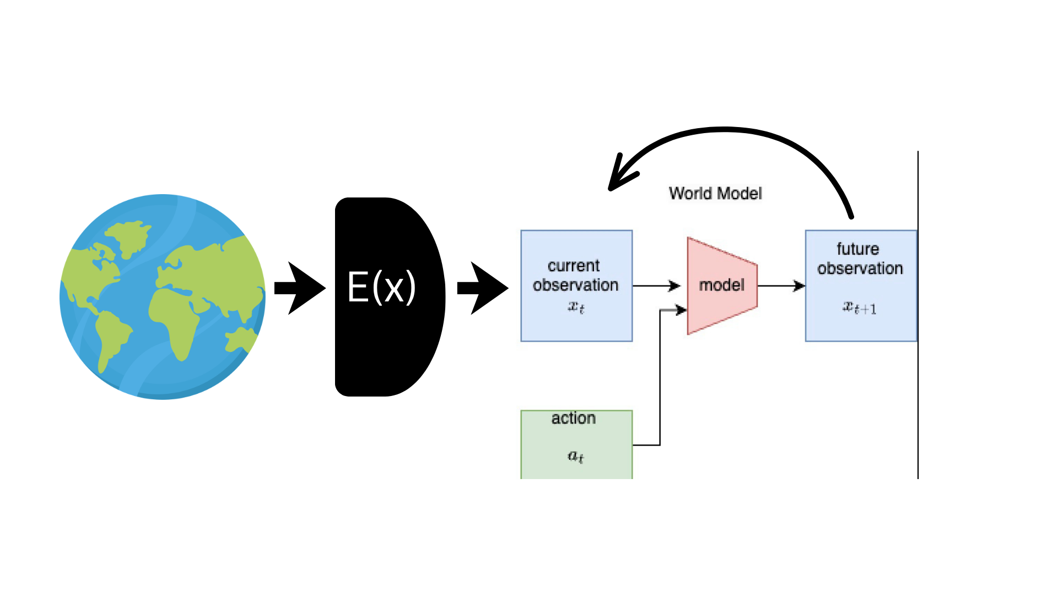

Slide 7
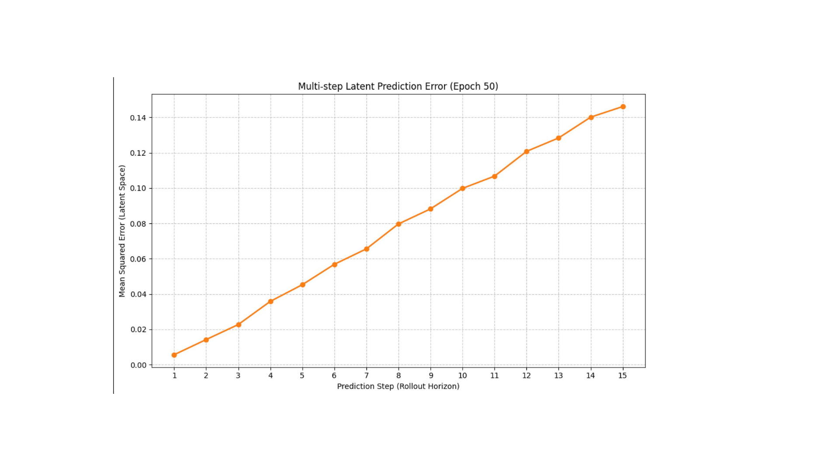

Slide 8
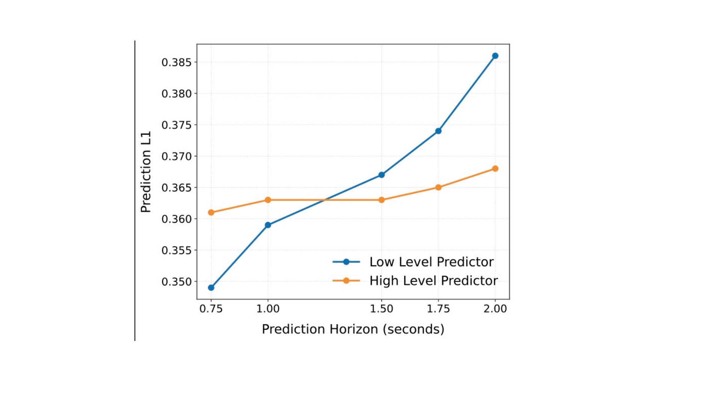

Slide 9
LOW-LEVEL WORLD MODEL
From 27,648 Pixels to 64 Numbers
— Encoder: a CNN, from scratch. 96×96 RGB → 64 numbers.
— Predictor: a 2-layer GRU. It predicts change, not state.
— No decoder. VICReg is what stops the latent collapsing.
— The problem: the data only tracks the pusher. We built a maze solver.
— The fix: contact-biased data, plus a head that must report the block's pose.
3.15M
TOTAL PARAMS
PAPER: ~325M
0.0131
VAL ROLLOUT
LATENT MSE
14.9 px
BLOCK POSE
SEEN
20.5 px
BLOCK POSE
IMAGINED
1 / 3
Notes:
Two decisions worth defending.
WHY A GRU, NOT AN MLP. The original predictor was a single-step Markov MLP, ~30K params.
It had no mechanism to represent "am I currently in contact with the block", because contact
is state that only exists across a short history, not in one frame. The GRU's hidden state
accumulates that context. An architecture problem, not a parameter-count problem.
Full sizes: encoder 1.57M params, predictor 2-layer GRU hidden 384, 1.58M params.
z(t+1) = z(t) + readout(h(t)). Trained on 15-step latent rollout MSE.
WHY VICREG AND NO DECODER. We never reconstruct pixels. Latent-only prediction has a trivial
degenerate solution: map every image to the same vector and prediction error is zero. VICReg's
variance term forces each dimension to keep std near 1; the covariance term decorrelates them.
Measured latent std settles at 1.03 against a target of 1.
THE BLOCK PROBLEM. The real dataset's state is pusher (x, y) only. The block moves only on
contact; the pusher moves every frame. So the encoder had every incentive to ignore the T.
Fix: contact-biased synthetic data (contact frames 38% -> 70%) plus a BlockPoseHead,
z -> (bx, by, sin, cos), supervised BOTH on the still frame and on the imagined rollout.
Epoch 1 -> 50: 51px/45deg -> 14.9px/5.5deg seen, 50px/47deg -> 20.5px/9.7deg imagined.
SAY HONESTLY: this made the MODEL better and did NOT make the PLANNER better. We swept the
matching planner cost weight across 100x and it never beat turning it off on more than 41%
of tasks. Slide 3 explains why.

Slide 10
WHY REINFORCEMENT LEARNING ISN'T ENOUGH
RL Learns a Policy for a Reward.
We Need a Plan for an Image.
— No reward exists. The task is an image, handed over at test time.
— The data is fixed and offline. ~200 demos, one free T4.
— Contact is rare — so credit assignment is brutal.
— We tried a learned policy. It trained beautifully.
12 / 15
seeds where our behavior-cloned policy never touched the block, 60 steps each, real physics
It learned the average action.
The average action is not a push.
We did not run an RL baseline. This is an argument about fit.
2 / 3
Notes:
One-line version is the title. RL bakes the task into the weights: the goal has to exist at
training time. Our setup keeps the task OUTSIDE the model. The world model only learns physics;
the goal enters at test time as a cost function. That is what let us add a block-pose term to
the cost without retraining anything.
THE FOUR REASONS, in full:
1. No reward. A task is a goal IMAGE. Every new goal is a new reward function and a new training
run. Our world model trains once, on reward-free data, and accepts any goal at test time.
2. Fixed offline data. ~200 human demos plus synthetic rollouts, one free Colab T4. RL wants
millions of online interaction steps.
3. Credit assignment across sparse contact. Reward arrives only after a long maneuver in which
most frames never touch the block.
4. Planning separates physics from strategy, so when it fails we can measure which half failed.
A policy network gives one number and no dial.
THE EVIDENCE. We trained a behavior-cloning policy, z -> action, plain MSE on real expert demos.
It trained cleanly: val MSE 0.159 -> 0.035, and 85x better than a shuffled-pairing control, so it
was genuinely state-conditioned. Then, in real physics, 15 seeds, 60 steps each, starting near the
block: 12 of 15 made zero contact for the entire rollout. Contact is a minority of frames, so
uniform MSE is dominated by repositioning behavior. Reverted the same day.
PRE-EMPT THE QUESTION: "did you run an RL baseline?" No. Say so plainly. This is an argument
about fit -- reward-free offline data with test-time image goals -- plus one policy-learning
failure. Not an experimental refutation of RL.

Slide 11
THE PLANNER
Greedy Twice Over
CEM, IN ONE LINE
360,000
imagined GRU steps to produce one executed action (d=40). 59 s per task, the hierarchy needs 6.9 s.
Sample → imagine → score →
keep the best 10% → repeat.
Hill-climbing over a distribution. No backtracking.
0.00 px
scored by a no-model control that just holds the goal position, beating both planners
TWO KINDS OF GREED
— In search: CEM only ever refits to its elites.
— In time: horizon 8–10, on a 40-step task.
Our goals never moved the block. On that task, greedy is optimal.
Push-T is non-greedy: to rotate the T you must back away first — and greedy won't.
3 / 3
Notes:
Land the two-kinds-of-greed point first; people usually notice only one.
CEM IN FULL, if asked:
1. Sample a population of complete action sequences from a Gaussian.
2. Imagine each one forward through the GRU. No simulator is touched.
3. Score by latent distance to the goal.
4. Keep the best 10% -- the elites. Throw the other 90% away.
5. Refit mean and std to the elites alone. Repeat.
Whichever basin the first blob of samples overlaps is the basin you converge into.
And MPC on top: plan H steps, execute only the FIRST action, re-encode the real image, replan.
THE COST. At d=40: 600 population x 15 iterations x 40 horizon = 360,000 imagined GRU steps
for ONE executed action; ~7.4M per episode. 59 s per task vs the hierarchy's 6.9 s -- 8.6x
faster, because it searches 16 dimensions instead of 80. Nice irony: flat planning got 11x
SLOWER over this project precisely because we improved the low-level model. Better physics
makes brute force more expensive -- itself an argument for hierarchy.
THE GREEDY TRAP. Push-T is non-greedy by construction: to rotate the T you must back away and
go around, which INCREASES distance to the goal. The cost surface is not monotone, and a greedy
short-horizon planner will not take the temporarily-worse action.
THE TWIST -- the punchline of the segment. Flat currently beats hierarchical (11/45 wins,
15.0px vs 5.5px). But the task distribution was degenerate: goals were built by replaying an
UNRELATED episode's action snippet, and Push-T actions are absolute PD target positions, so the
goal collapsed to "put the pusher at point X". Median block displacement in the goal: 0.0 px.
A two-line non-planner that commands the goal position and holds it scored 0.00 px at every
horizon (d=20/30/40), against flat CEM's 7.00/5.10/5.10 and hierarchical's 22.60/15.90/14.20.
On a monotone, one-step-deep task there is nothing to decompose -- hierarchy losing was the
CORRECT outcome.
This retro-explains most of our open puzzles: the null cost-weight sweep, block-error curves
identical across all three methods, a random walk scoring 80% "success". The block never had to
move, so nothing reasoning about the block could show an effect.
FIXED SINCE: goals now come from the same trajectory, rejected unless the block actually moved.
Contact 0% -> 100%, median block travel 102.8px. CAVEAT TO SAY OUT LOUD: the full head-to-head
has NOT been re-run under the fixed distribution, so treat every flat-vs-hierarchical number
so far as void, not as a baseline.

Slide 12
MODEL PREDICTIVE CONTROL
Trust The Plan For Eight Steps.
Not Forty.
— The predictor rolls forward in latent space — but every step compounds the last step's error.
205px → 5px
— The fix: search a plan over the full horizon, execute only the first action, then throw the rest away.
agent error at goal, same seed — open-loop vs. closed-loop replanning
— Re-encode the real frame, get the true z, replan. The horizon shrinks every step: 8 → 7 → 6 → ... → 1.
Closed-loop converges on 4 of 5 tasks.
Open-loop is worse on every one it solved.
— This is what makes it “closed-loop.” Planning once and executing blind is the ablation, not the method.
Don't plan the whole trip. Plan one step, take it, look again.
1 / 4

Slide 13
CROSS-ENTROPY METHOD
Don't Solve It.
Sample Your Way There.
— Start from a Gaussian over action sequences, centered on the current position.
1.0·final + 0.2·path
— Sample 256 candidates from it, each an 8-step sequence of raw pixel moves.
the cost: mostly where the imagined rollout lands, a little how it got there
— Imagine every candidate through the predictor, score it by distance to the goal latent.
256 × 6 × 8
— Keep the best 10% — the elites — refit the Gaussian to just them, repeat 6 times.
candidates × elite refits × steps searched, per single replan
No gradient, anywhere. It just keeps what worked and forgets what didn't.
2 / 4

Slide 14
TEMPORAL HIERARCHY
CEM Twice,
At Two Timescales.
— High-level CEM searches macro-actions — 3 hops of 5–15 primitive steps each — to place a subgoal.
18,885ms → 3,173ms
— Low-level CEM is the exact planner from the last slide, unchanged — now aimed at that subgoal, not the far goal.
planning time per task, d=20, same 60% success rate — flat CEM vs. hierarchical
— Same loop, two clocks: “sample → imagine → keep the best 10%” runs once over macro-actions, once over primitives.
Position error grows: block 15.98px → 28.80px,
agent 8.75px → 57.85px.
Two clocks, one search. Shayan is up next with the architecture underneath it.
4 / 4

Slide 15
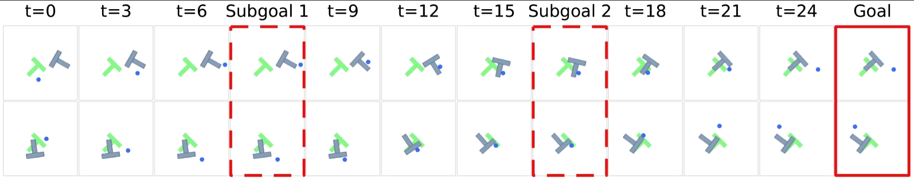
A Subgoal Is an Imagined Future
High level planner
— Same job as low level BUT Predict where chunk of actions lands, not step by step
— Action chunking: 5-15 primitive moves (2D) → 1 macro-action (4-dim) via GRU autoencoder
— Training: sample a trajectory → compress each chunk → predict the latent AFTER the whole chunk
— At test time: CEM searches 3-4 macro-actions (16 dims, not 80). Output is a subgoal latent
— Drop-in: same 64-dim latent as low level, so subgoal is directly the low level's target

Slide 16
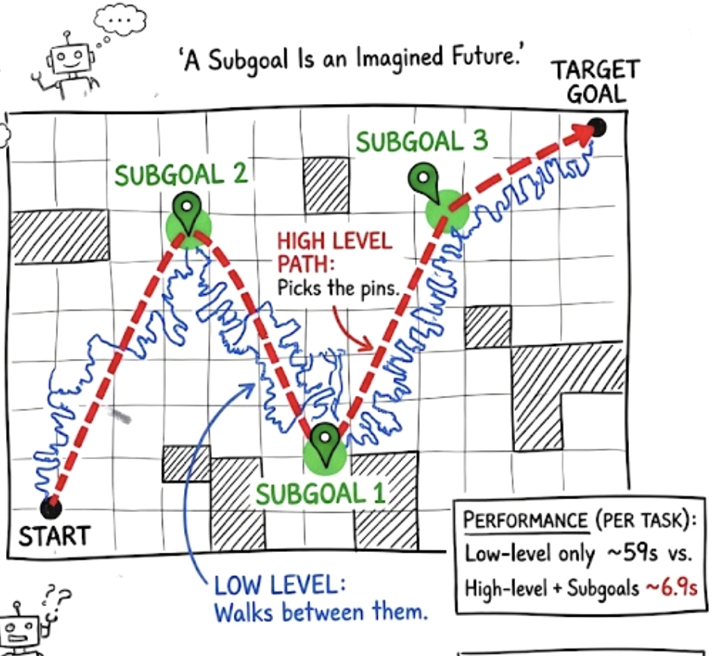
A Subgoal Is an Imagined Future
High level planner
— Same job as low level BUT Predict where chunk of actions lands, not step by step
— Action chunking: 5-15 primitive moves (2D) → 1 macro-action (4-dim) via GRU autoencoder
— Training: sample a trajectory → compress each chunk → predict the latent AFTER the whole chunk
— At test time: CEM searches 3-4 macro-actions (16 dims, not 80). Output is a subgoal latent
— Drop-in: same 64-dim latent as low level, so subgoal is directly the low level's target

Slide 17
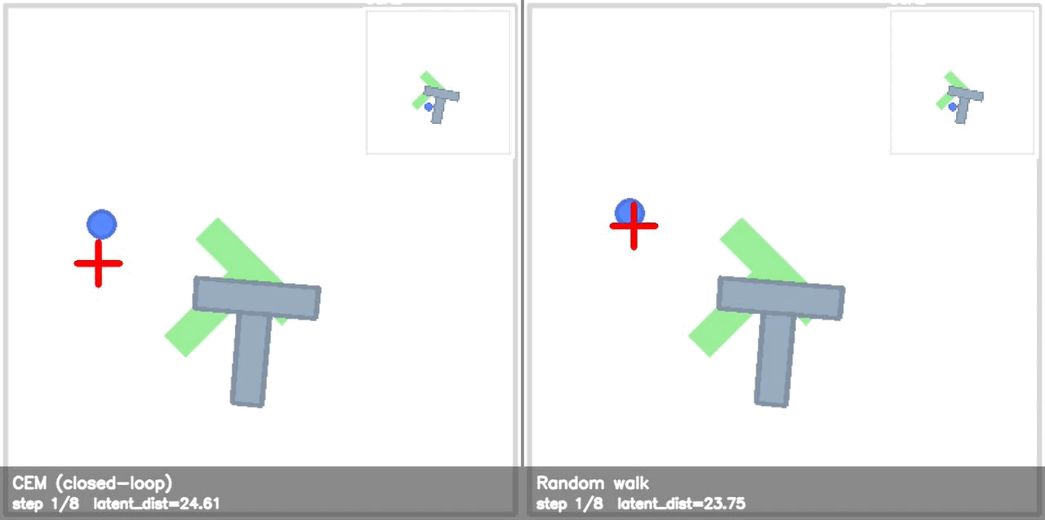

Slide 18
