Slide 1


GROUP 11
CHEAPSHARK API
BABADZHANIAN ARTUR 22224507
ADAM 21229508
THOMAS 21229025
PYTHON FOR DATA SCIENCE AND AI

Slide 2

QUICK INTRODUCTION
API used : VIDEO GAME PRICING DATABASE (CHEAPSHARK)
Hypothesis 1 : "Cheaper games are higher rated compared to more expensive games."
Hypothesis 2 : "The longer a game is on the market, the lower the review percentage."
Hypothesis 3 : "Certain stores consistently offer lower prices for games compared to others."

Slide 3
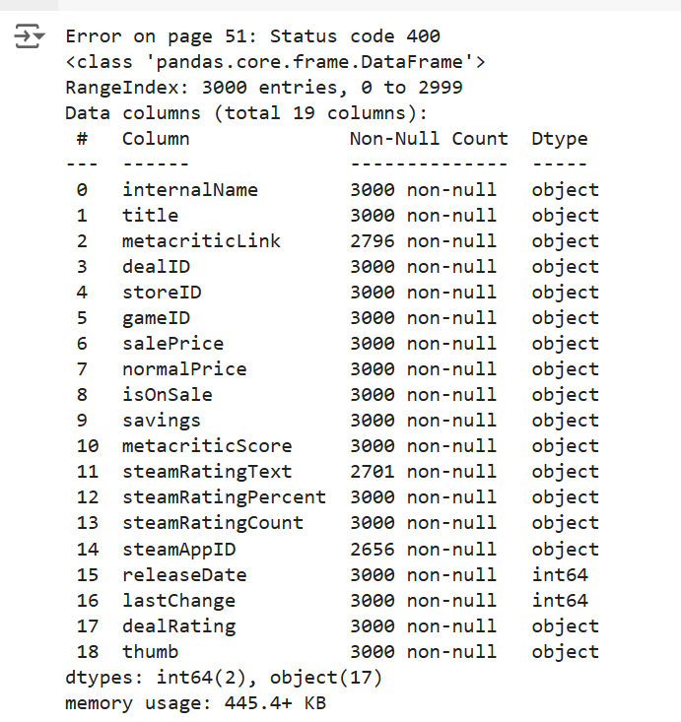
REGARDING THE API,
WHILE WORKING WITH LARGE API AND DATABASES:
REQUESTS NEED TO BE LIMITED AND TIMED
3000 LIMIT OF ROWS PULLED
SOME APIS SUCH AS STEAM, WE NEED PUBLISHER’S RIGHTS
Link to the google colab

Slide 4
HYPOTHESIS 1
Research Q
How does game pricing correlate with user ratings?
"Cheaper games are higher rated compared to more expensive games."
Result
There is virtually no linear relationship between the two variables. The price threshold, set at the median value of $19.99, further contextualizes the data. The t-statistic of -0.298 and a p-value of 0.766 imply that the difference in ratings between games priced below and above the median is not statistically significant. Overall, these results imply that, contrary to the hypothesis, price does not significantly influence game ratings on Steam.

Slide 5
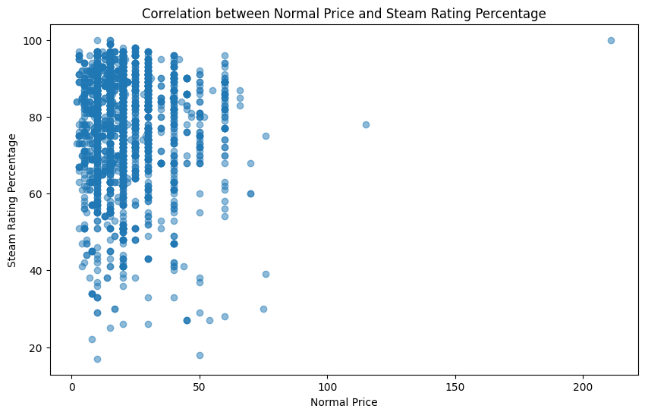

Slide 6
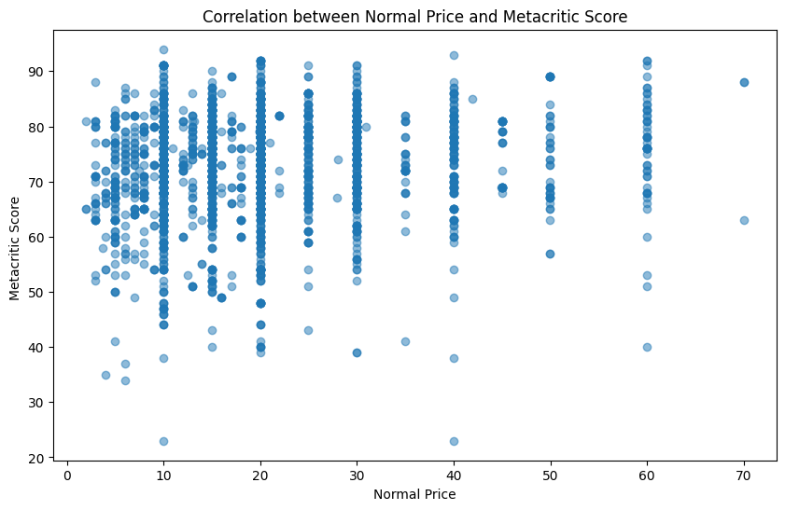

Slide 7
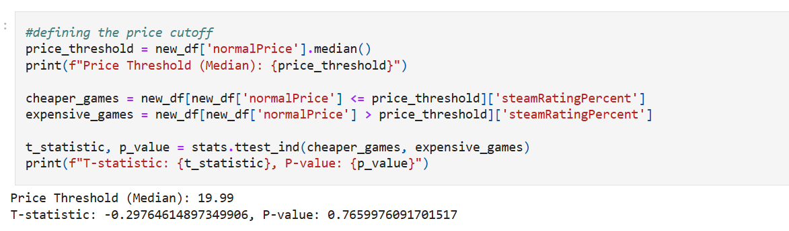
HYPOTHESIS 1
T-TEST
Null Hypothesis:
Game price has no impact on user ratings.
there is not enough evidence to conclude that game price has a significant impact on user ratings.

Slide 8
HYPOTHESIS 2
Research Q
How does the age of a game impact the user reviews?
"The longer a game is on the market, the lower the review percentage."
Result
The examination of the hypothesis that the longer a game is on the market, the lower the review percentage produced a correlation coefficient of approximately -0.048. This indicates a slight negative correlation between the number of days since release and Steam rating percentage. Additionally, the p-value of 0.016 suggests that this correlation is statistically significant, implying that there may be a weak tendency for older games to have lower review percentages. Overall, while the correlation is weak, it supports the notion that games released longer tend to receive slightly lower ratings.

Slide 9
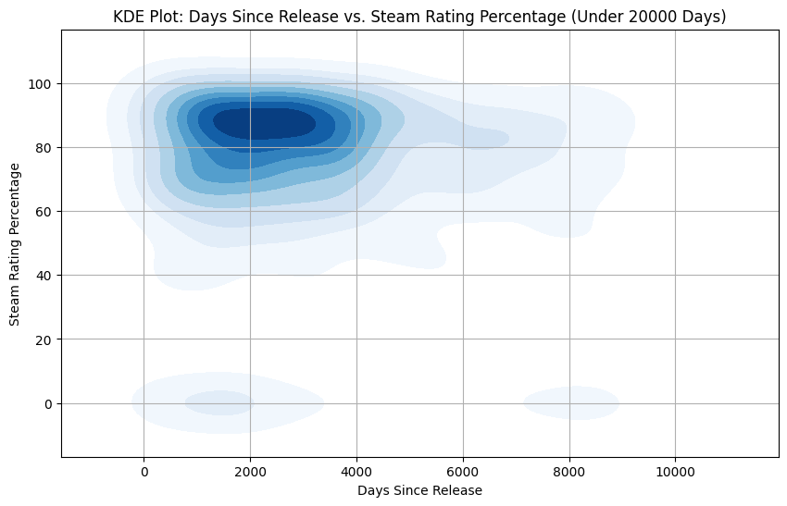

Slide 10
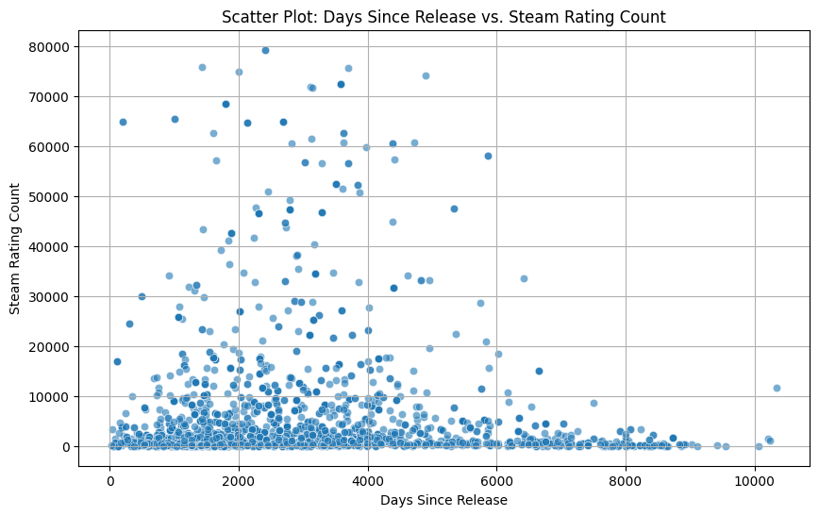

Slide 11
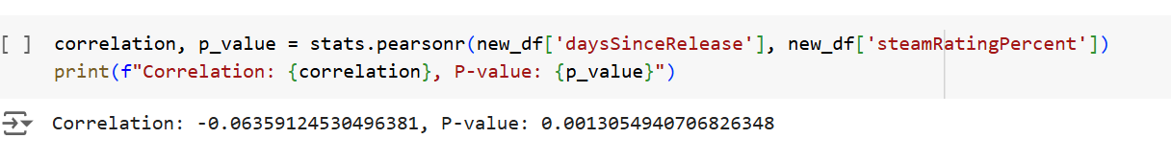
HYPOTHESIS 2
T-TEST
Null Hypothesis:
Game’s release date has no impact on steam ratings.
Since the P-value is lower than 0.05 but not 0, we can reject the null hypothesis.

Slide 12
HYPOTHESIS 3
Research Q
Is there a significant difference between prices at different stores?
"Certain stores consistently offer lower prices for games compared to others."
Result
The bar graph clearly illustrates that certain stores dominate in offering cheaper games, confirming the hypothesis that price variability exists among different retailers. This pattern indicates that consumers may benefit from comparing prices across stores to find the best deals on games. Surprisingly, the stores selling certain games at higher prices than others continues in a similar ranking, meaning that the stores who sell games cheap are also demanding higher prices than other stores for certain games.

Slide 13
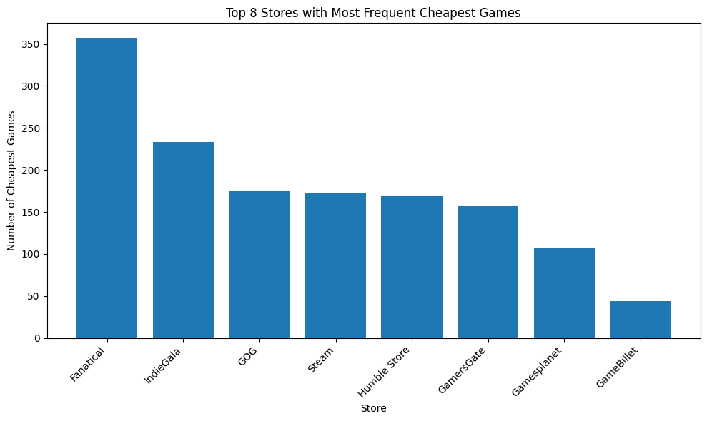

Slide 14
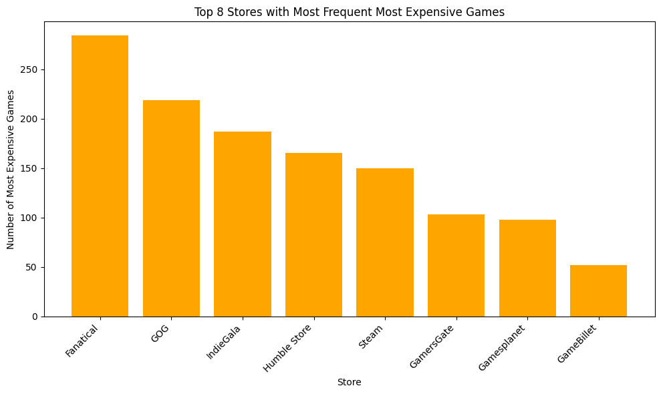

Slide 15

CONCLUSION
There is no significant relationship between the price of a game and its user rating
While there is a negative correlation between a game's age and its rating, the effect is weak.
As for the final hypothesis, it is supported. There is significant variation in game prices across different stores, and some stores consistently offer better deals than others.

Slide 16

THANKS FOR WATCHING

Slide 17

REFERENCES
STEAM API
Valve Corporation. (n.d.). Steamworks API overview. Steamworks Documentation. https://partner.steamgames.com/doc/api
ChatGPT
OpenAI. (2024). ChatGPT (Version 4.0) [Large language model]. https://openai.com/chatgpt
CheapShark
CheapShark. (n.d.). CheapShark API. https://www.cheapshark.com/api

