Slide 1
Coronary Heart Disease Classification and Linear Regression Systems
August 19,2019 Thoa Shook

Slide 2
Problem Statement
Coronary Heart Disease (CHD) involves the reduction of blood flow to the heart muscle due to build -up of plaque in the arteries of the heart.
Risk factors include hypertension, smoking , diabetes, obesity, and high cholesterol.
In 2017, 110 million people were diagnosed with Coronary Heart Disease (CHD) resulting in 8.9 million deaths, making it the most common death globally.
Early prognosis of CHD in high risk patients can aid in making decisions on lifestyle changes. If caught in time, lifestyle changes will reduce complications and thus save lives.
There are two parts in this research:
Linear Regression Model is used to determine if other risk factors have a significant impact on BMI
Logistic Regression Model is used to classify whether or not the patients will have CHD within ten years given having other risk factors.

Slide 3
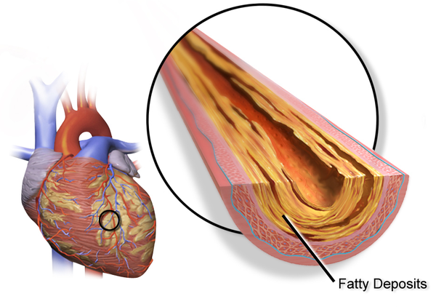
Risk Factors
Demographic: : Sex, age
Behavioral: Current Smoking, number of cigarette per day
Medical (history):
Previous of having stroke
Hypertension
Diabetes
blood pressure medication
Medical (current):
Total cholesterol level
BMI, Glucose
Heart rate
Sys BP, Dia BP
.

Slide 4
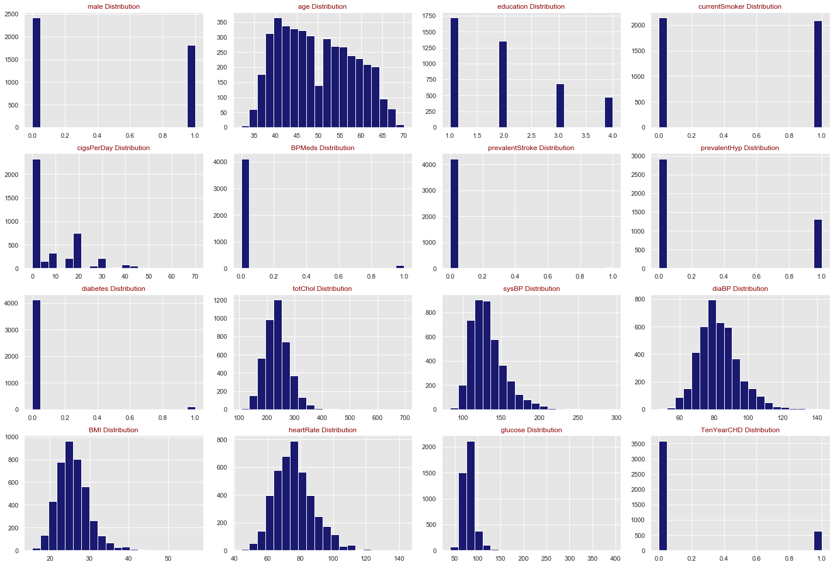
Data Distribution

Slide 5
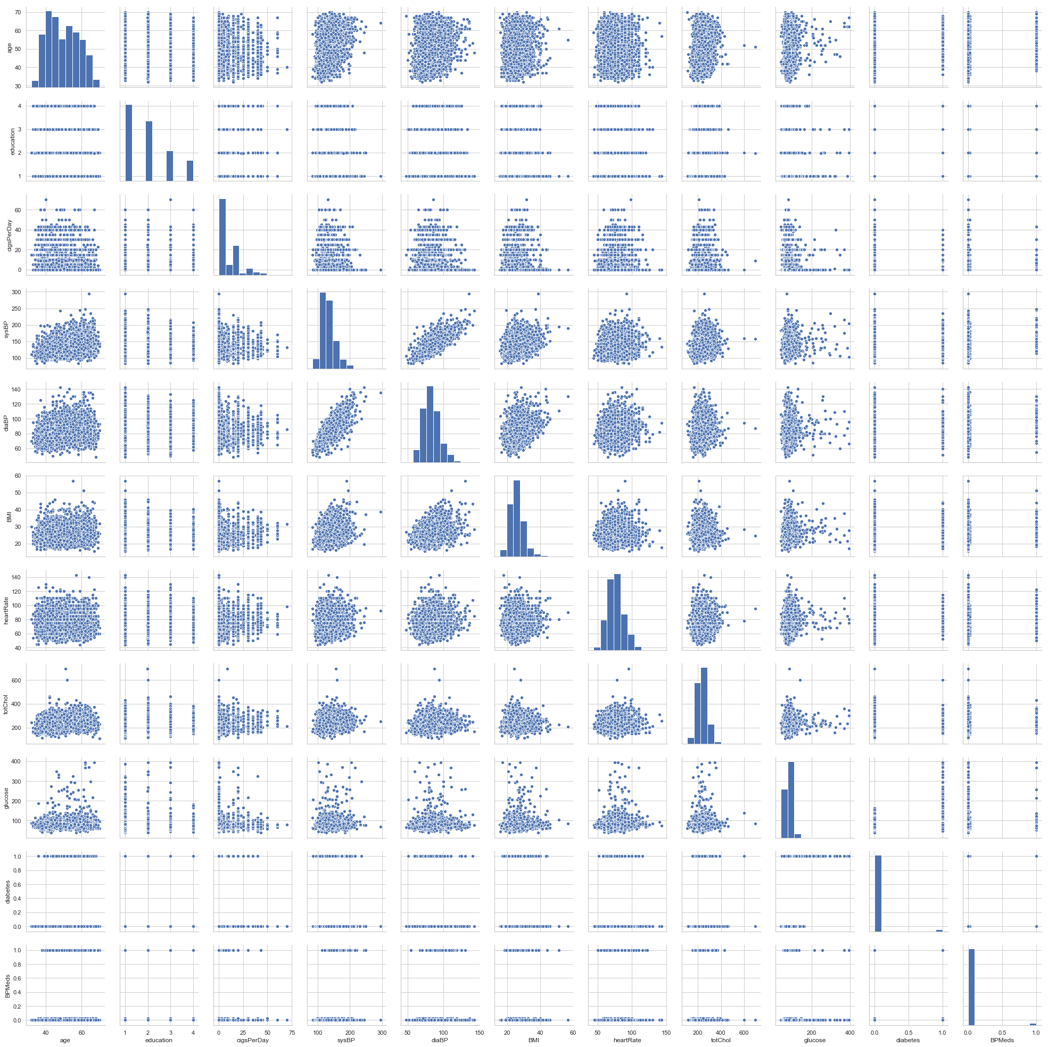

Slide 6
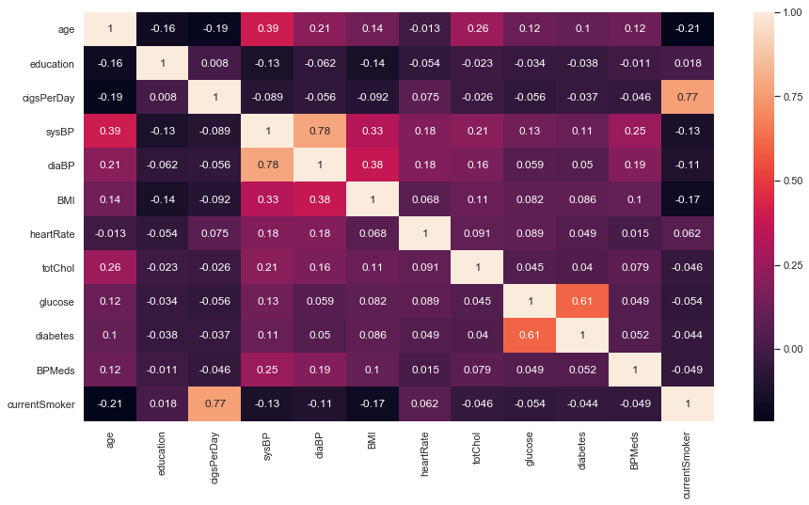
Correlation Heat Map

Slide 7
Multiple Linear Regression
H₀ : β_{age} = β_{male} = β_{education} = β_{cigsPerDay}= β_{BMI}= …. = β_{glucose} = 0
H_{a} : β_{age} ≠ β_{male} ≠ β_{education} ≠ β_{cigsPerDay}≠β_{BMI}= …. ≠ β_{glucose}
At least one of the predictors such as age, male, education, glucose, ... useful in predicting the BMI
Do all the predictors help to explain the correlation with BMI , or is only a subset of the predictors useful?
What methods do we use: Forward, Backward, or Mix Selection?
How well does the model fit the data?
Adjusted R-Squared: Increases or decrease if added features improve model

Slide 8
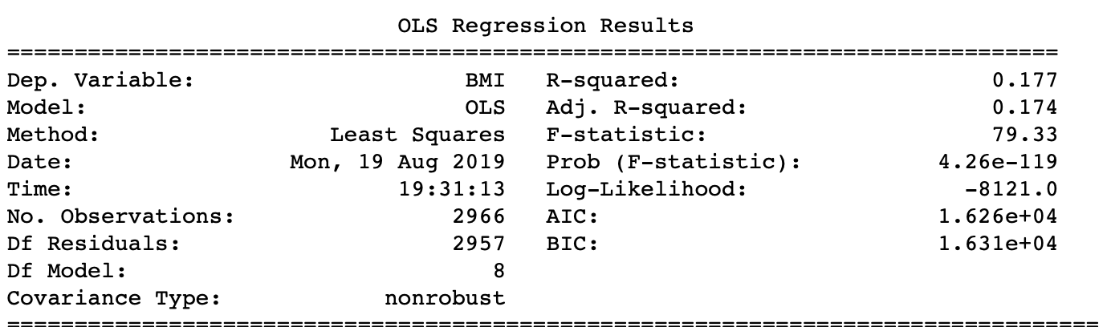
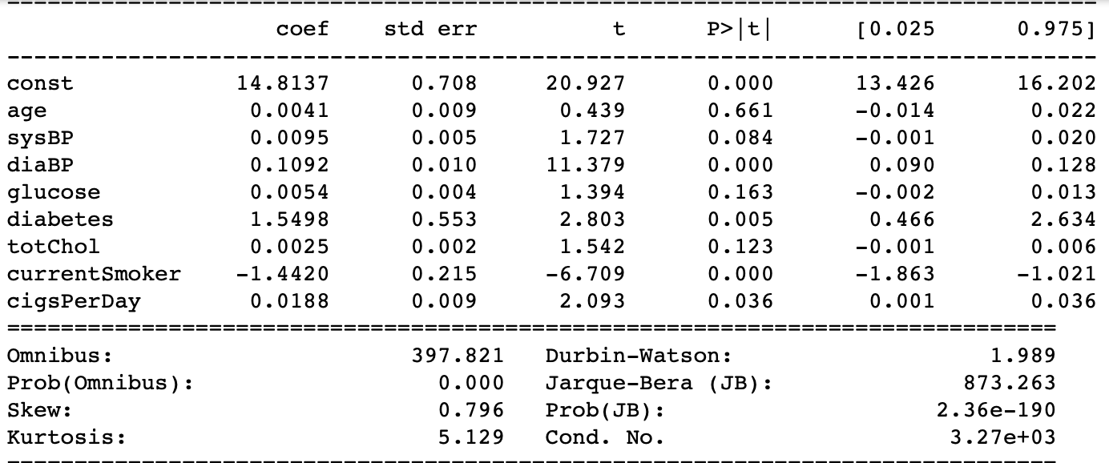
Initial Model

Slide 9
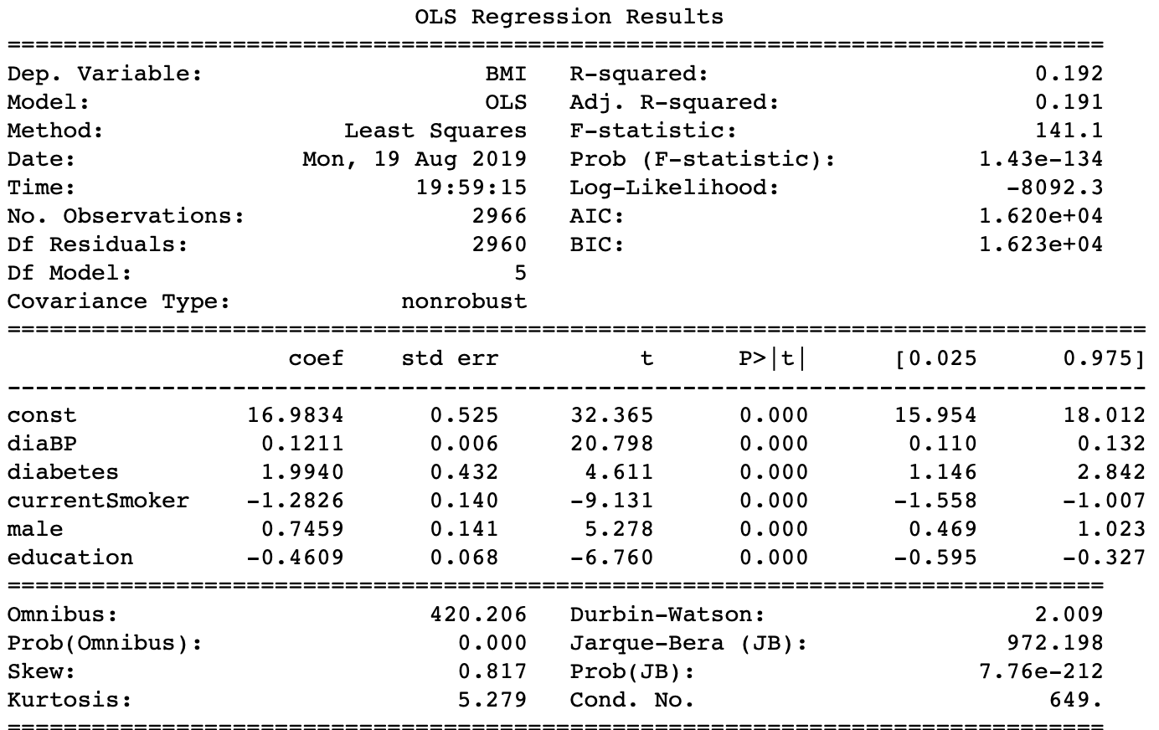
Final Model

Slide 10
Model Evaluation
AIC: = 1.633e+04 and it hasn't change from iteration 1 to iteration 5.
Adjusted R-squared: Value has changed from 0.174 to 0.191, it is slightly increase but not much.
Individual variable's p-value (P>|t|): None of the variables are insignificant; all p- values are less than 0.05.
Individual variable's VIF: All variables are less than five. Hence, we do not need to remove any further variable based on VIF value.

Slide 11
Interpreting the Results:
This fitted model shows that, holding all other features constant, the odds of getting diagnosed with CHD:
With one unit increase in diaBP associates with 0.12 increase in BMI
Increasing diabetes one unit will lead to an increase of 1.99 in BMI
There is a 1.28% decrease in BMI for current smoker person. (Smokers are usually thin!)
Education has an inverse effect on BMI
The odds of getting high BMI for males over that of female is 74%
*** Total cholesterol and glucose level have no effects on BMI.

Slide 12
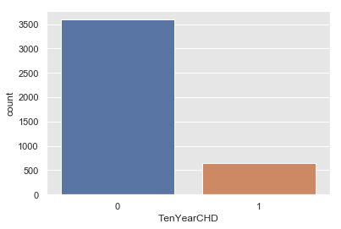
Logistic Regression/Classify Ten Years CHD

Slide 13
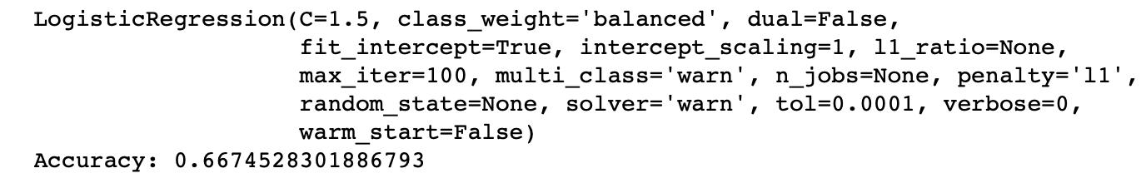
Initial Model

Slide 14
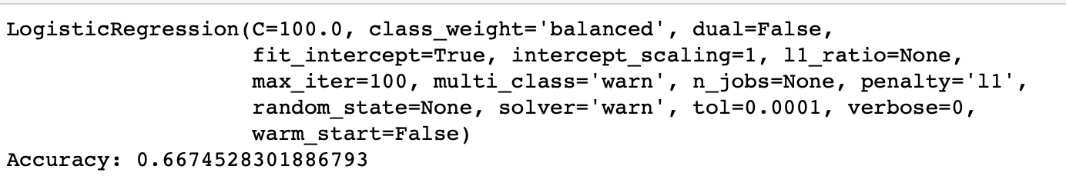
Final Model

Slide 15
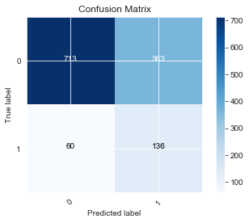
Visualizing Confusion Matrix using Heat Map
TP = 136
TN = 60
FP =363
FN = 713

Slide 16
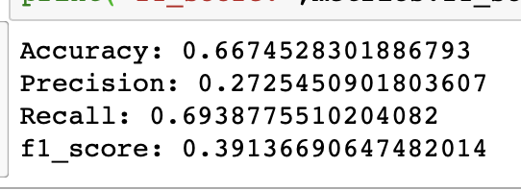
Confusion Matrix Evaluation Matrix

Slide 17
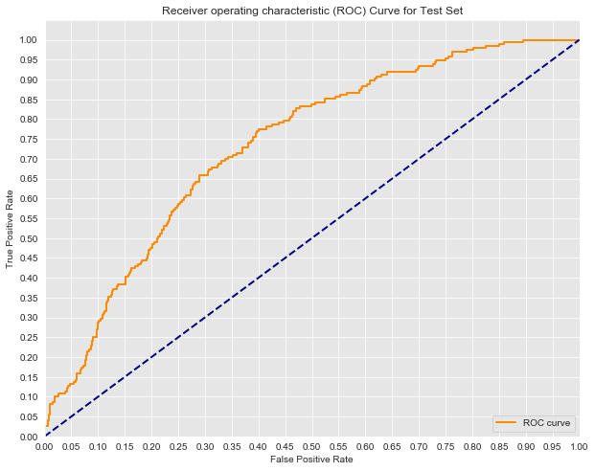
ROC Curve

Slide 18
Conclusion
The true positive rate is more important than the false positive rate because it determines the percentage of patients with CHD who are correctly identified and warned.
When TPR = 0.9, we correctly identify and warn 90 out of 100 patients with CHD.
However, at the same time, FPR = 0.6 meaning that more than half of the time, we incorrectly warn a patient about CHD who is actually healthy!!!
We need another model with enhanced accuracy that predicts better results.
This may be achieved with data sets identifying the critical, specific factors present in patients with CHD.
We can also increase the size of datasets if it is available.
Due to the diversity of the given data, more time is needed to enhance the model fidelity.
The bottom line is these features included in the dataset are not the best predictors for CHD

