Slide 1
Topics
- ROS
- Model visualisation and Simulation
- DH parameters
- Panda robot

Slide 2
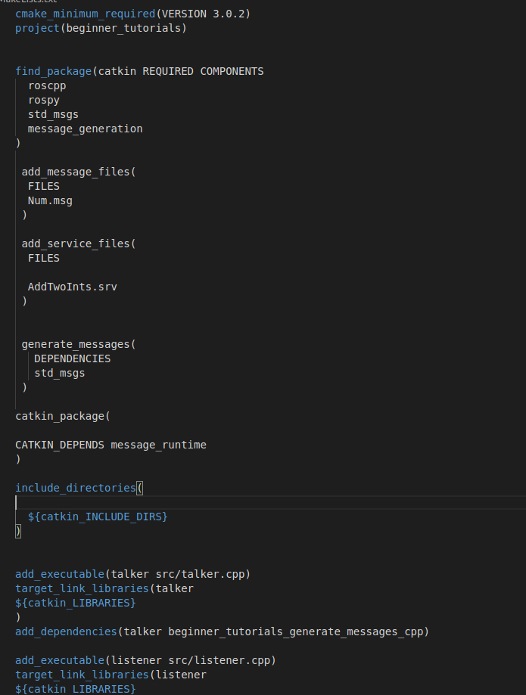
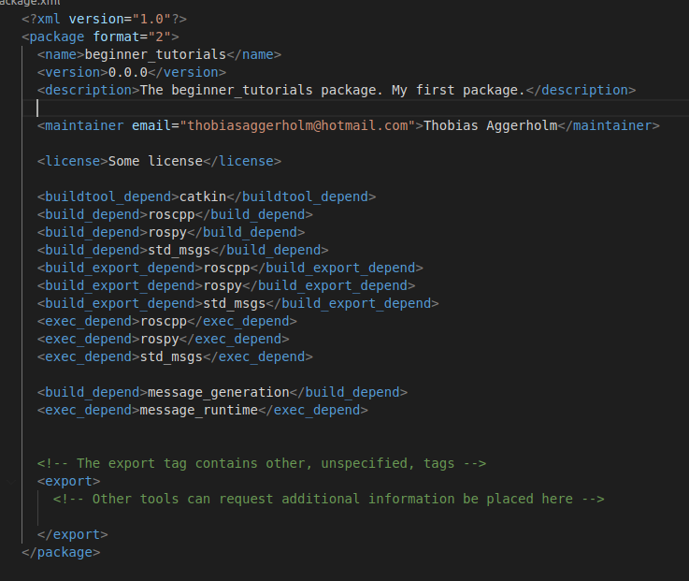
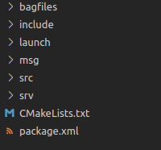
ROS structure
Packages
Organisation
Atomic build in ros

Slide 3
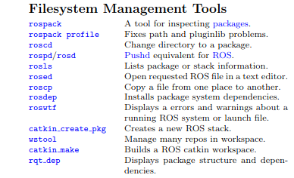

ROS structure
Packages
Navigation

Slide 4
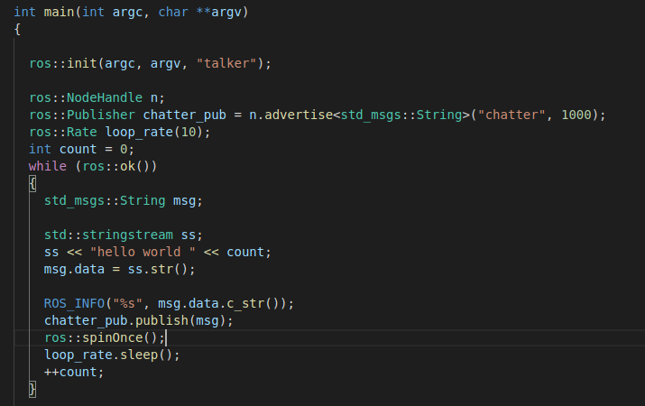
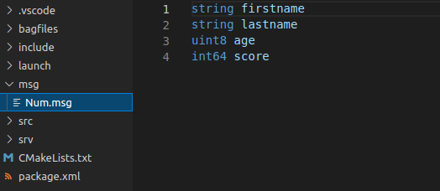
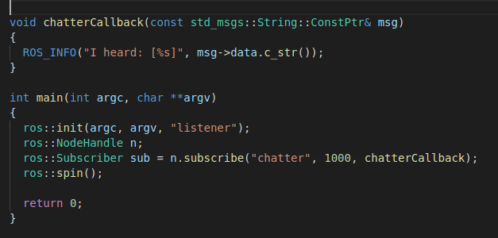
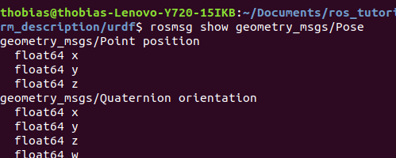
ROS structure
Data structures
Message types

Slide 5
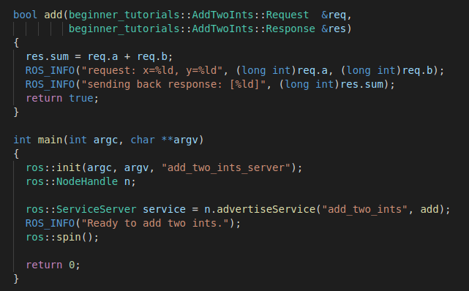
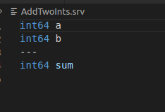

ROS structure
Data structures
Service types

Slide 6

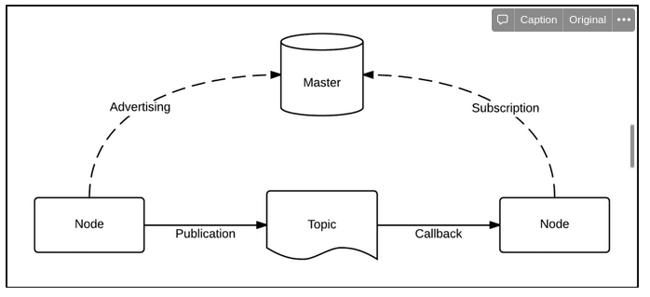
ROS fundamentals
Nodes
Communication

Slide 7
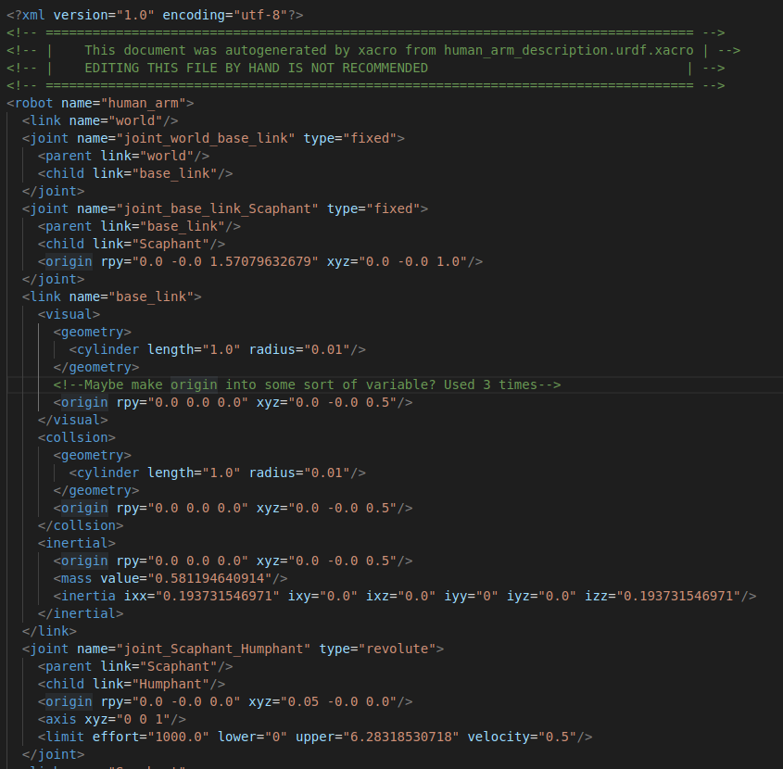


Model visualisation
URDF
Limits affects
rotation of frames

Slide 8
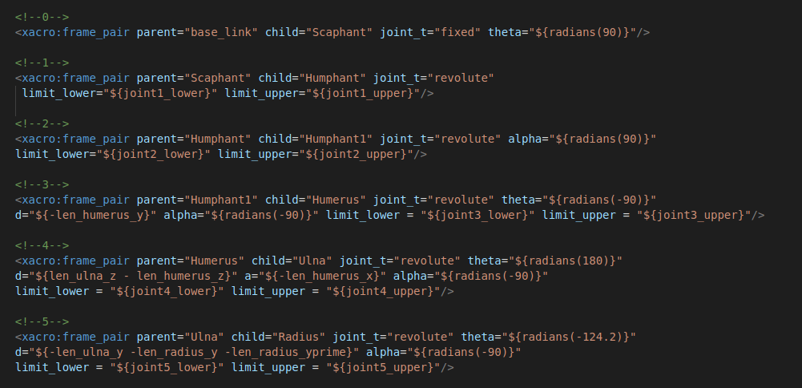
Model visualisation
XACRO

Slide 9
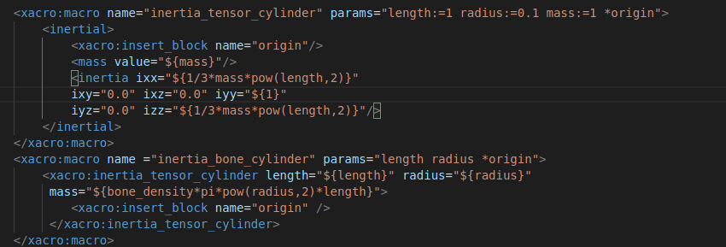


Model visualisation
XACRO

Slide 10

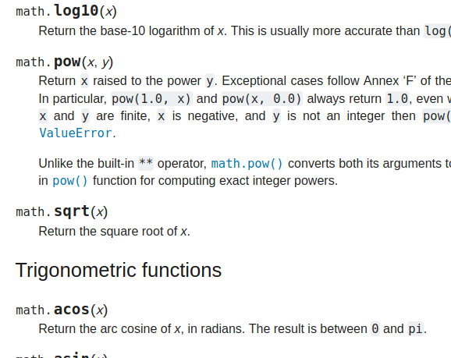
Model visualisation
XACRO
Python math module

Slide 11
Model visualisation
XACRO
rosrun xacro xacro filename.xacro > filename.urdf

Slide 12
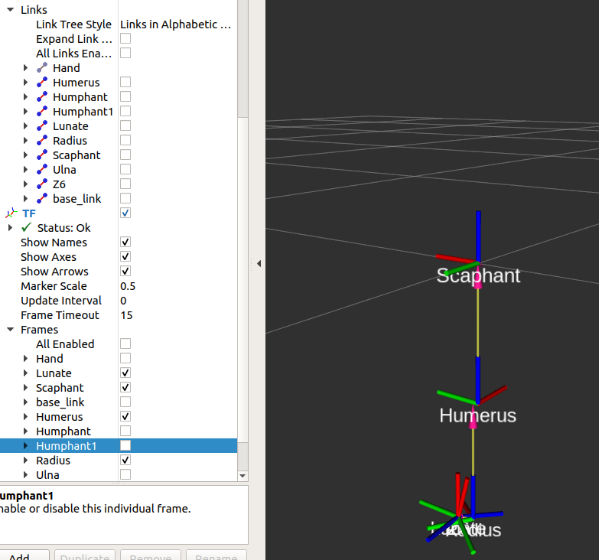
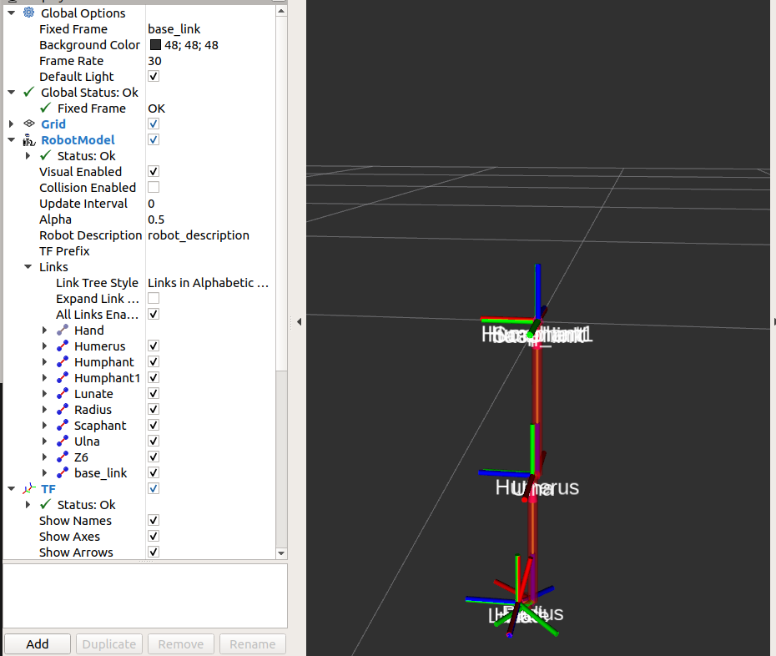
Model visualisation
RVIZ
base_link

Slide 13
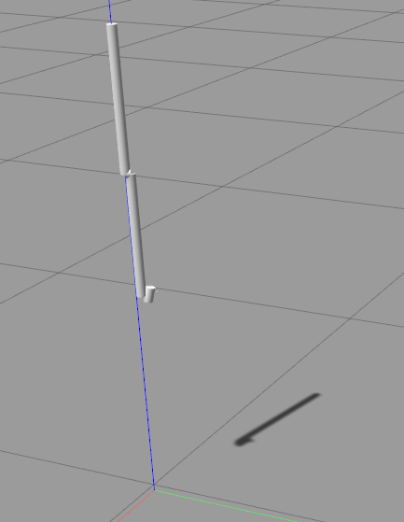
Model Simulisation
Gazebo
World
Inertia

Slide 14





Model Simulisation
Gazebo
Geometry
Inertia!

Slide 15
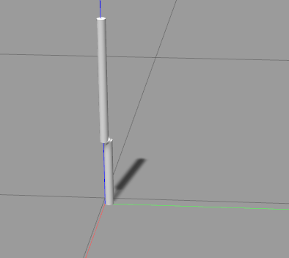
Model Simulisation
Gazebo
More inertia

Slide 16

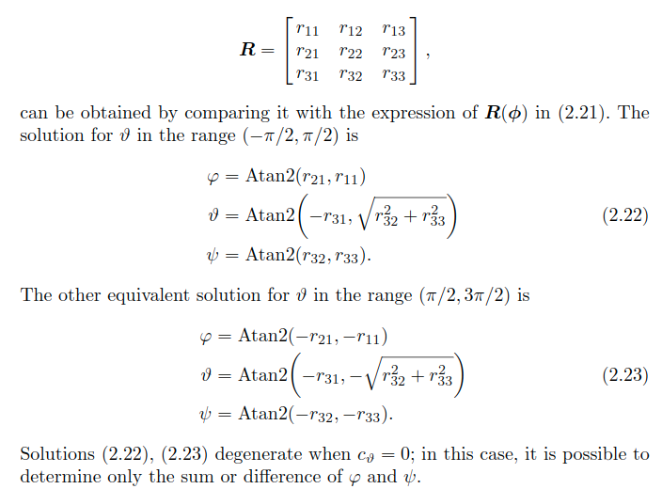


DH parameters
Transformation

Slide 17
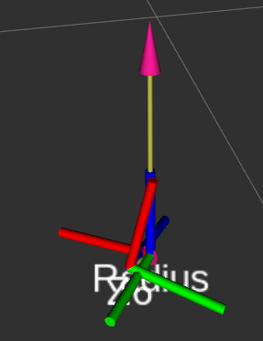
DH parameters
Transformation
  Not a simple rotation about
  principle axis’
  Expression singularities

Slide 18
Panda robot
Security
Control

