Slide 1
Unicorn Project
Sales Performance 2015-2018
Thofa Tazkia, masterschool da 105.4

Slide 2
Unicorn business
E-commerce platforms like Unicorn allow people to buy products via online from different caretogies
Furniture (Bookcases, Chairs,Furnishings, Tables) ,
Office Supplies ( Appliances, Art, Binders, Envelops, Fasteners, Labels, Paper, Storage, Supplies) and
Technology (Accesorries, Copiers, Machines,Phones) in different sates in USA.

Slide 3

Problem statement
Negative profits from certain products
Ineifficient of discount strategy
Higher delivery time in certain region
Lower promoting on high-profit margin products

Slide 4
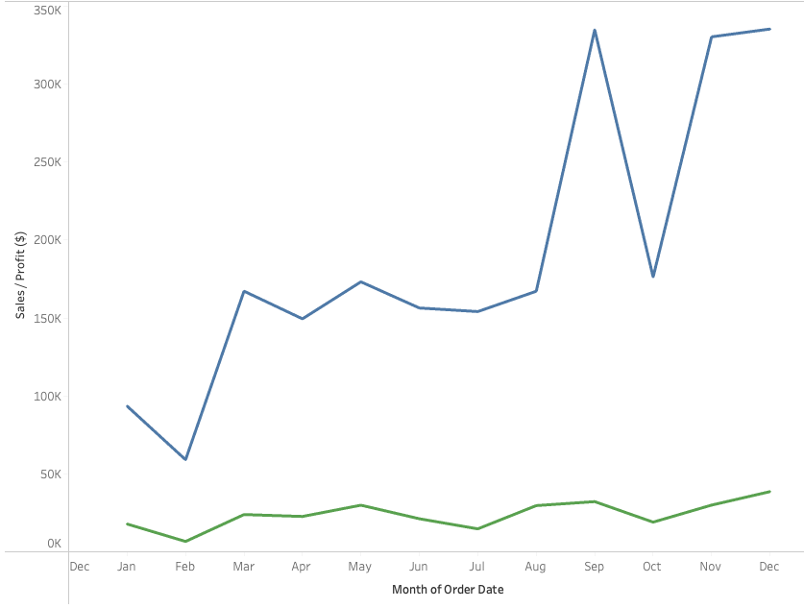

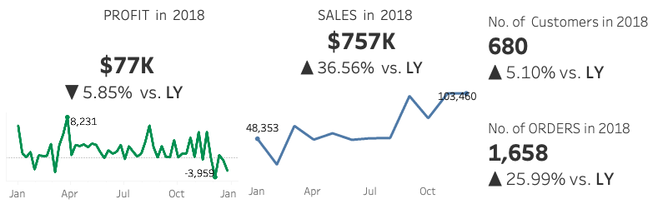
Trend analysis
High sales Aug.-Dec. over 2015-2018
Sales high but Profit low in 2018 from 2017

Slide 5
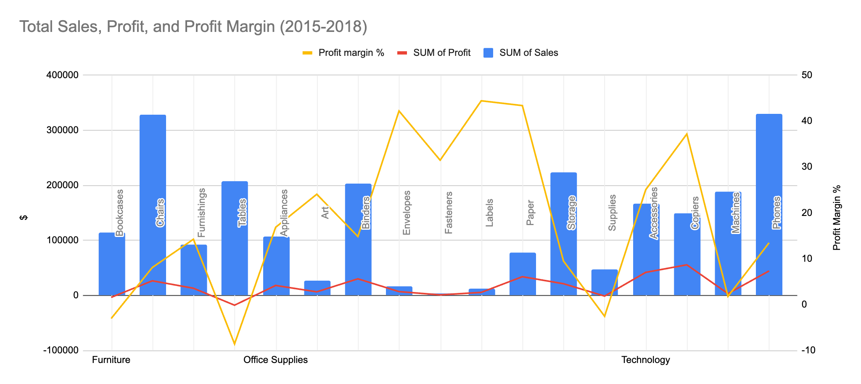
Sales performance by category
% of total profit & mostly profit driven sub-category
Technology (Copiers', Accessories) 50.79%
Office Supplies (Envelop, Fasteners, Labels, Paper) 42.77%
Furniture (Chairs and Furnishings) 6.44%
Negative driven sub-category (Bookcase, Tables and Supplies)

Slide 6
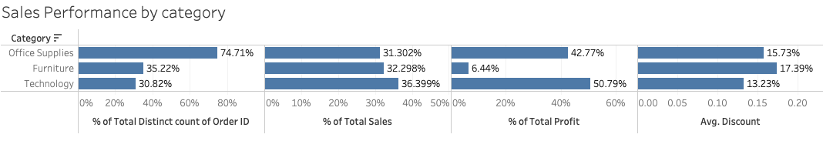
Sales performance by category
Mostly orders are placed in Office Supplies.
Mostly sales revenue and profit generated in Technology category.
Avg. discount is higher in Furniture category compared to others.

Slide 7
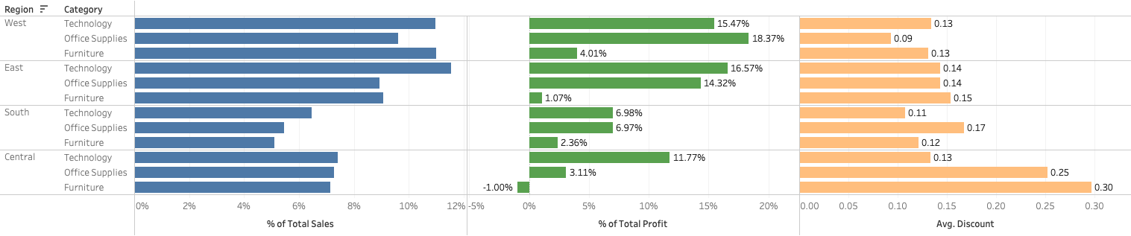
Sales performance by region 2015-2018
% of total profit, and avg. discount by region
West (mostly office supply) 37.85% profit, avg. discount 11%
East (mostly technology) 31.96% profit, avg. discount 15%
South (mostly tech. & ofc. Supply) 16.32% profit, avg. discount 15%
Central (mostly tech.) 13.87% in total profit though it has high sales compare to south but avg. discount ratio 24%
Inefficient discount policy on Furniture category leads to negative profit in Central

Slide 8
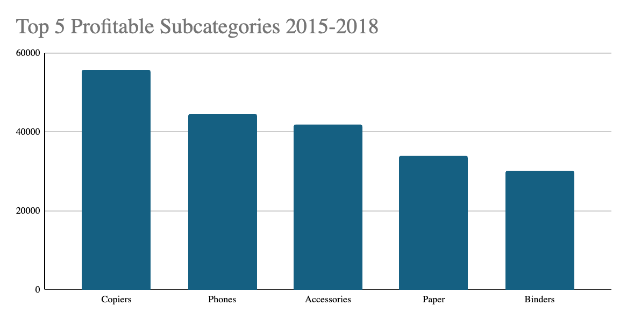
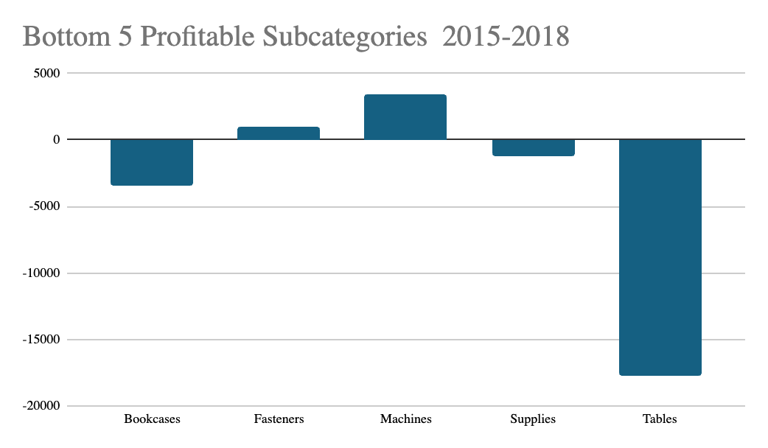
Top 5 & bottom 5 Sub-category

Slide 9
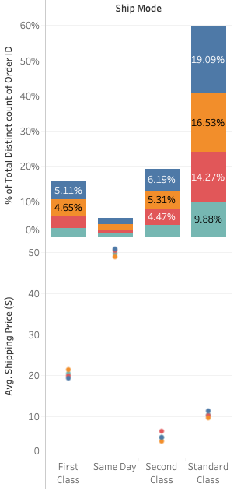

Sales performance by ship mode (2015-2018)
Total number of orders 5009
59.77% orders (highest) shipped via Standard Class and 5.27% (lowest) shipped via Same Day mode
West has max. orders and South has lowest orders in Standard Mode
Avg. shipping price for Standard mode is 10 $, 50$ for Same day, 20$ for First Class and 6$ for Second Class.

Slide 10
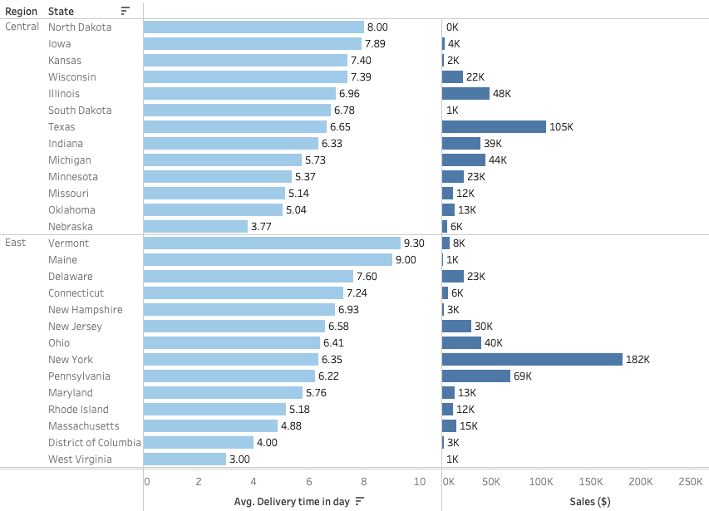
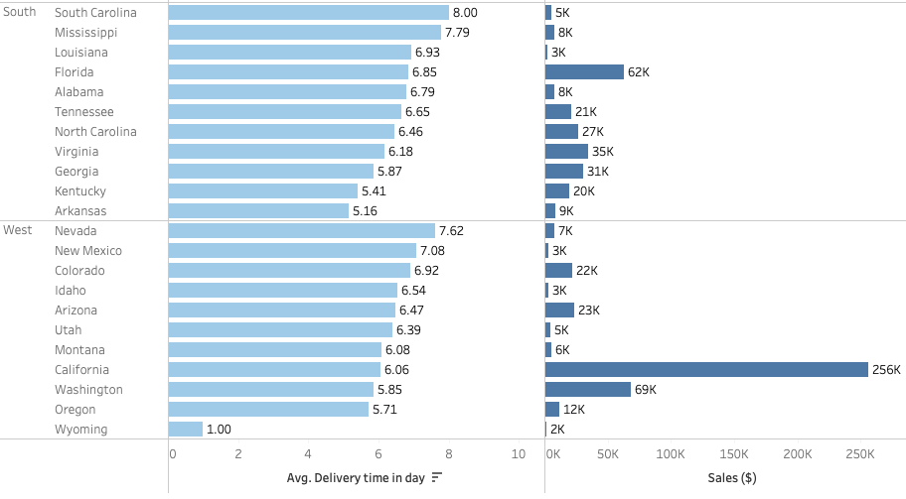
Sales performance by shipping time (standard mode)
Avg. shipping time in day with min and max per state & region
Central- North Dakota (8d), Nebraska (3.77d)
East- Vermont (9d), West Virginia (3d)
South- South Carolina (8d),Arkansas(5d)
West- Nevada (7.6d) , Wyoming (1d)
Lower the avg- shipping time hence higher the sales volume

Slide 11
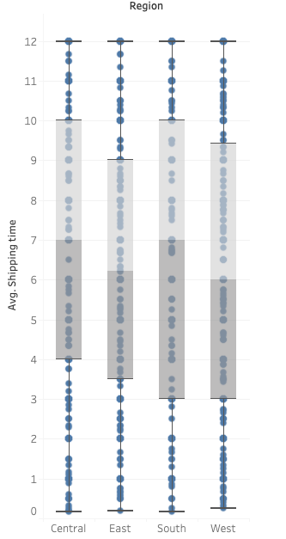
Shipping efficiency by region
Most orders are shipped with in
Central- 2 to 6 days (performs best with the shortest median shipping time and the least variability. )
East- 3 to 8 days
South- 4 to 10 days (has the longest shipping times and the largest variation )
West- 3 to 7 days
East and West regions perform moderately

Slide 12
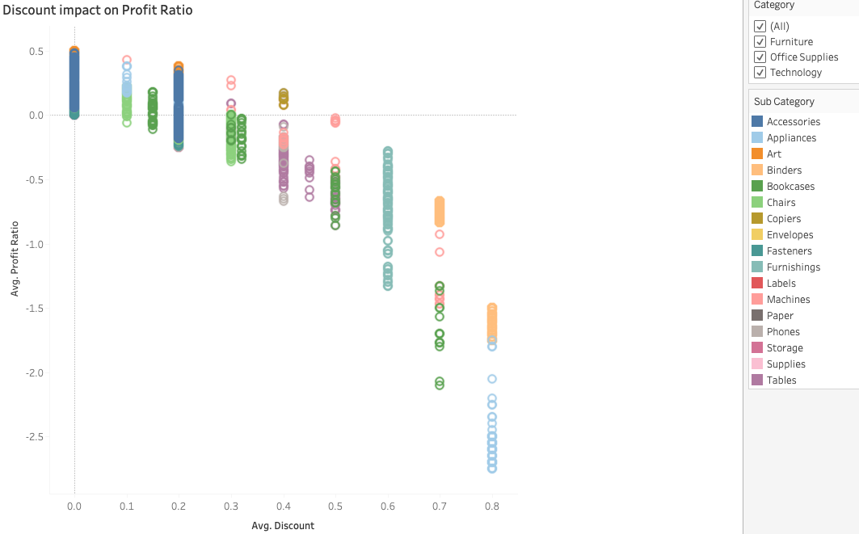
Discount impact on profit ratio
Higher discount leads negative profit ratio

Slide 13
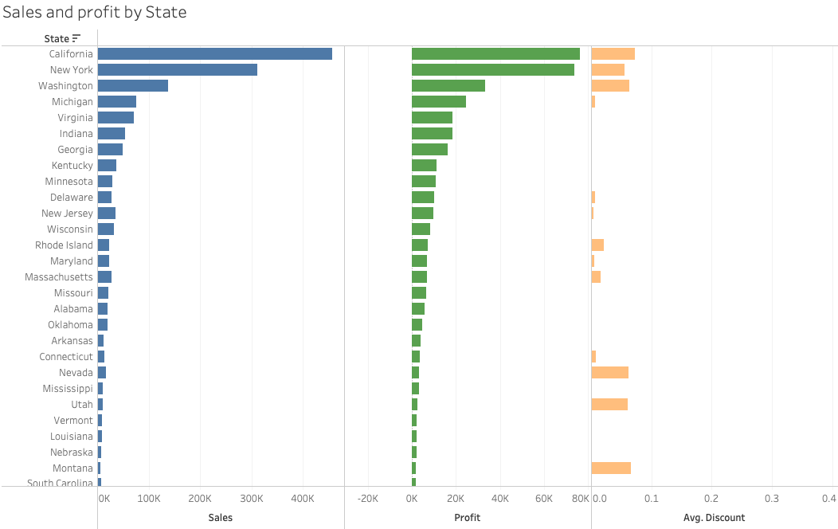
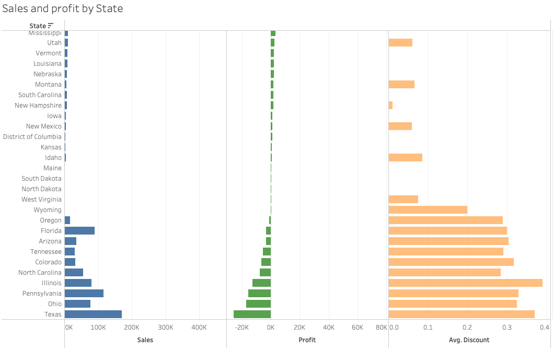
State performance
Higher discount rate leads negative profit in States

Slide 14
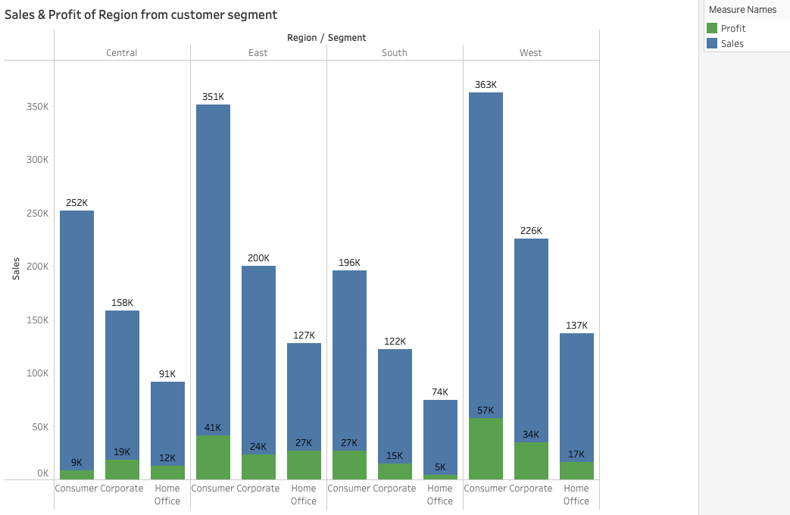
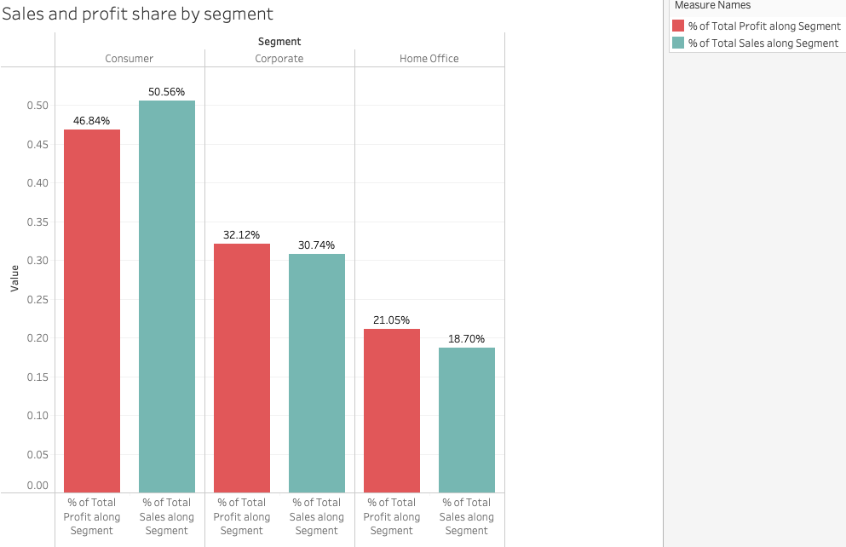
Sales and profit by customer
50% Customers are from Consumer Segment , 30 % and 18% from Corporate and Home Office Segments.
Mostly profit (46%) comes from Consumer segment

Slide 15
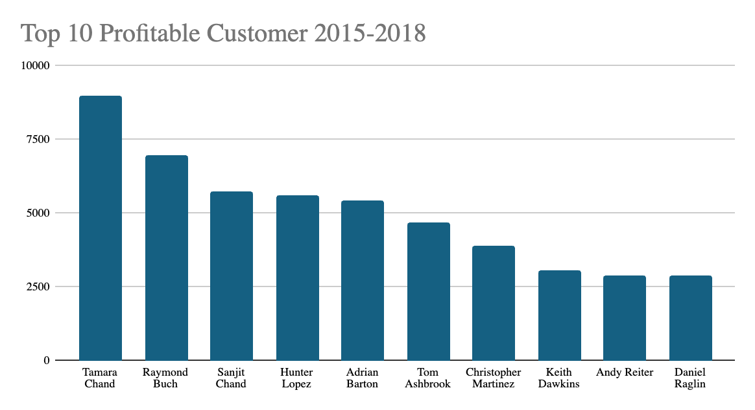
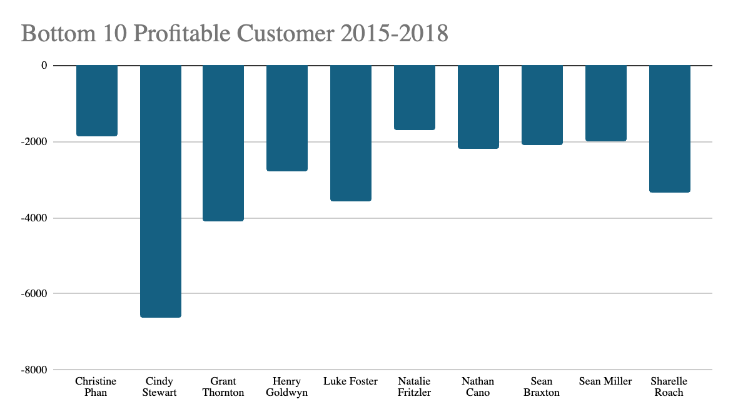
Top and bottom 10 profitable customer

Slide 16
Key insights
Sales are increased in 2018 than 2017 but profit has decreased
Higher purchase rate from August to December.
West and East has higher profit share in office supply and Technology categories than South and Central
Central has most negative profit mostly in Furniture category (tables) due to higher discount
Higher delivery time in south region hence customer retention
Central region has faster and efficient shipping time
Most of the profit came from consumer segment (west region)
Home office segment has lower profit share
Most of the negative profit generates from Tables and Bookcase products.
Technology category shares most of the profit and sales.
Most of orders in office Supplies category (74.7%), then Furniture (35.22%) and Technology (30.82%)
Avg. discount is higher in Furniture category than others.
Higher shipping price for Same day ship mode.

Slide 17

Recommendation for Higher profit
Focus on High-Margin product (Technology and Office supplies in south)
Optimize Discount Policy (set max. discount cap 20% for furniture item to increase sales revenue by 50% and positive profit)
Reassess the logistics in south (e.g., warehouse/transportation to lower the shipping time, optimize the routes)
Develop loyalty programs for corporate and home office customers segment to enhance the profit level
Refine the shipping price strategy

