Slide 1

Emotion Recognition for Everyday life Using physiological signals for wearables
T. Hemanth
Under Guidance:
Dr Shaik Abdul Nabi

Slide 2
Abstract
we explore using smart wearable devices with sensors to detect emotions in everyday situations. We reviewed existing research and found a common process involving participant recruitment, stimulus preparation, data collection, self-assessment, and machine learning. We identified seven emotion recognition scenarios and looked at the shift from psychological models to machine learning. While most research was done in labs, we believe field studies are possible. They would need: (1) new ways to assess and trigger emotions in real-life settings, (2) better attention to the machine learning process, including using suitable deep learning methods, addressing imbalanced data, and processing data for individual subjects, (3) reliable validation methods, (4) thinking about whether the model should work for everyone or be personalized, (5) comfortable devices that can give accurate readings even during movement. We suggest more large-scale studies to improve the credibility of results. We also emphasize the importance of making research replicable and comparable.

Slide 3
Introduction
Emotions are pivotal in decision-making and impact various aspects of daily life.
Previous studies predominantly focused on controlled lab settings, posing a challenge for accurate real-world emotion identification.
Wearable technology, like smartwatches, utilizing physiological signals, holds promise for revolutionizing healthcare, human-computer interaction, automotive systems, gaming, and e-learning.
Identifying conditions such as depression could significantly enhance mental health care, while those with Autism Spectrum Disorder could benefit from tailored emotional support.
This review emphasizes monitoring physiological signals through embedded wearables' sensors for natural setting emotion recognition.
It covers crucial components: emotional models, participant recruitment, signal processing, and machine learning model development.
The review also compares lab and field studies, explores the shift from psychological models to machine learning, and scrutinizes ground truth acquisition methods.
It serves as a comprehensive resource for researchers conducting emotion recognition studies in real-world scenarios.
Further information and resources can be found at the Emognition portal .

Slide 4
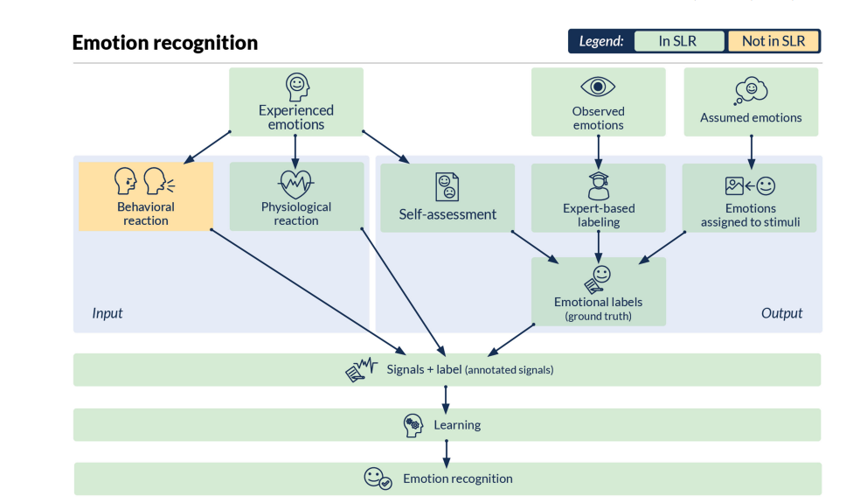
Model/architecture

Slide 5
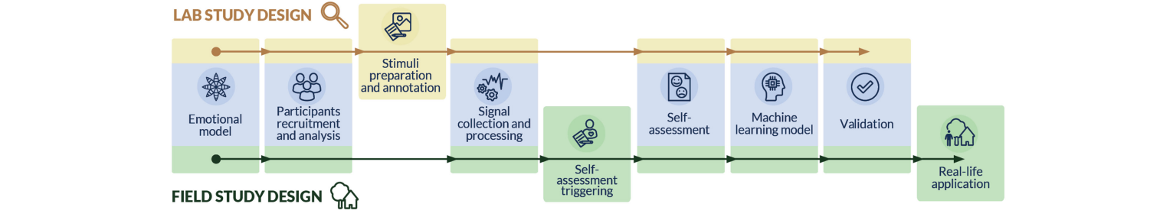
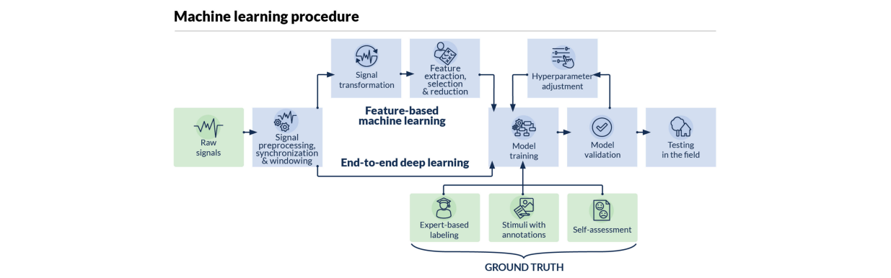
Technical concept

Slide 6
Performance analysis
Emotion Recognition For Everyday Life Using Physiological Signals For Wearables
Feasibility of Wearable-Based Emotion Recognition:
The systematic literature review indicates that recognizing emotions in everyday life using physiological signals from wearables is indeed feasible.
Availability of Off-the-Shelf Wearable Devices:
Encouragingly, there are a growing number of off-the-shelf wearable devices equipped for field investigations, facilitating real-world emotion recognition.
Advancements in Inter-Subject Validation:
More studies are now applying inter-subject validation techniques, such as leave-one-subject-out, indicating a trend towards robust and reliable emotion recognition models.
Potential of Deep Learning Architectures:
Deep learning architectures have emerged as a promising approach for solving complex tasks in field studies, showing potential for further advancements in emotion recognition.

Slide 7
Conclusion
In our systematic review of over 3,000 articles, we have explored the potential of wearables in recognizing emotions in everyday life. While we found promising evidence from 34 relevant papers, further research is needed to refine this solution. We've identified seven scenarios for emotion recognition through physiological signals, signaling a shift towards field studies from controlled lab environments. This shift requires comfortable, motion-compatible devices and user-friendly self-assessment triggers. Positive takeaways include the feasibility of emotion recognition using wearable technology, availability of suitable off-the-shelf devices, increased use of inter-subject validation, and the promise of deep learning for complex tasks in field studies. However, challenges remain, including a predominance of lab-based studies, simplification of classification problems, neglect of the machine learning stage, and difficulties in research reproducibility. Our Emognition portal will continue to provide updated resources for the emotion recognition task.

Slide 8
reference
Emotion Recognition for Everyday Life Using Physiological Signals for Wearables
S. Li and W. Deng, “Deep facial expression recognition: A survey,” IEEE Trans. Affective Computer, to be published.
E. P. Torres, E. A. Torres, M. Hernandez-Alvarez, and S. G. Yoo, “EEG-based BCI emotion recognition: A survey,” Sensors, vol. 20, no. 18, 2020, Art. no. 5083.
M. Dziezyc et al., “How to catch them all? Enhanced data collection for emotion recognition in the field,” in Proc. IEEE Int. Conf. Pervasive Computer. Communication. Workshops, 2021, pp. 348–351.
S. Saganowski, M. Behnke, J. Komoszynska, D. Kunc, B. Perz, and P. Kazienko, “A system for collecting emotionally annotated physiological signals in daily life using wearables,” in Proc. IEEE Int. Conf. Affect. Computer. Intel. Interact. Workshops Demos, 2021, pp. 1–3.
L. Romeo, A. Cavallo, L. Pepa, N. Berthouze, and M. Pontil, “Multiple instance learning for emotion recognition using physiological signals,” IEEE Trans. Affective Computer, vol. 13, no. 1, pp. 389–407, Jan.–Mar. 2022

Slide 9

THANK YOU.
Name: - T. HEMANTH
Group: - CSE-C
Roll No: - 205U1A05D2

