Slide 1




A Comparative Study of Machine Learning Algorithms for Early Disease Prediction Using Healthcare Data
Submitted By
Thokar Manish Raj 2417137
Shrestha Suman 2417119
Tamang Parasol 2417133
KC Rabin 2417127
Thapa Bishal 2417136
Supervisor Name: Ghulam Sarwar
Bachelor of Science in Software

Slide 2


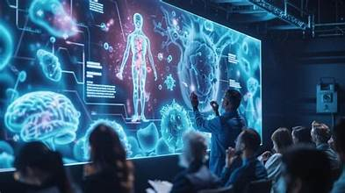
Introduction
This project focuses on using machine learning to predict diseases at an early stage.
The system analyzes patient symptoms and basic health data.
It provides possible disease predictions quickly and efficiently.
The main goal is to support early diagnosis and improve healthcare decisions.

Slide 3
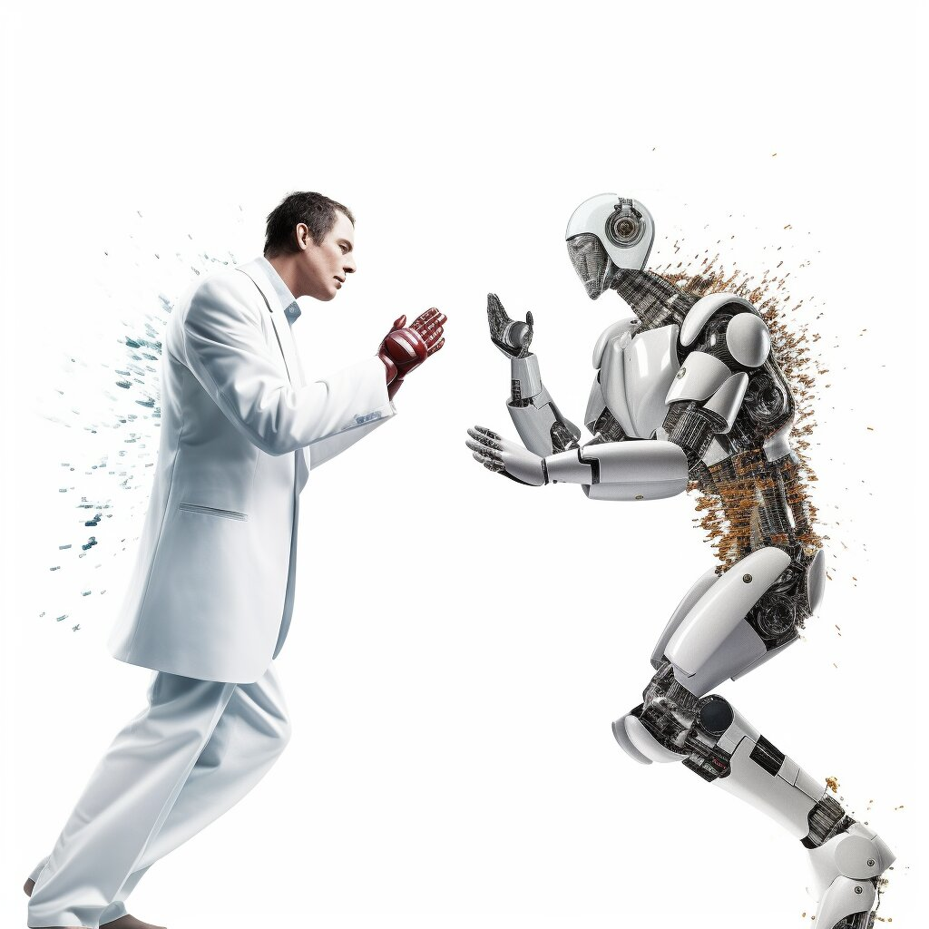

Background
Early disease detection is very important for effective treatment.
In many regions, patients do not have quick access to medical experts.
Machine learning can analyze large amounts of data and assist in diagnosis.
This project uses ML to help solve this problem.

Slide 4

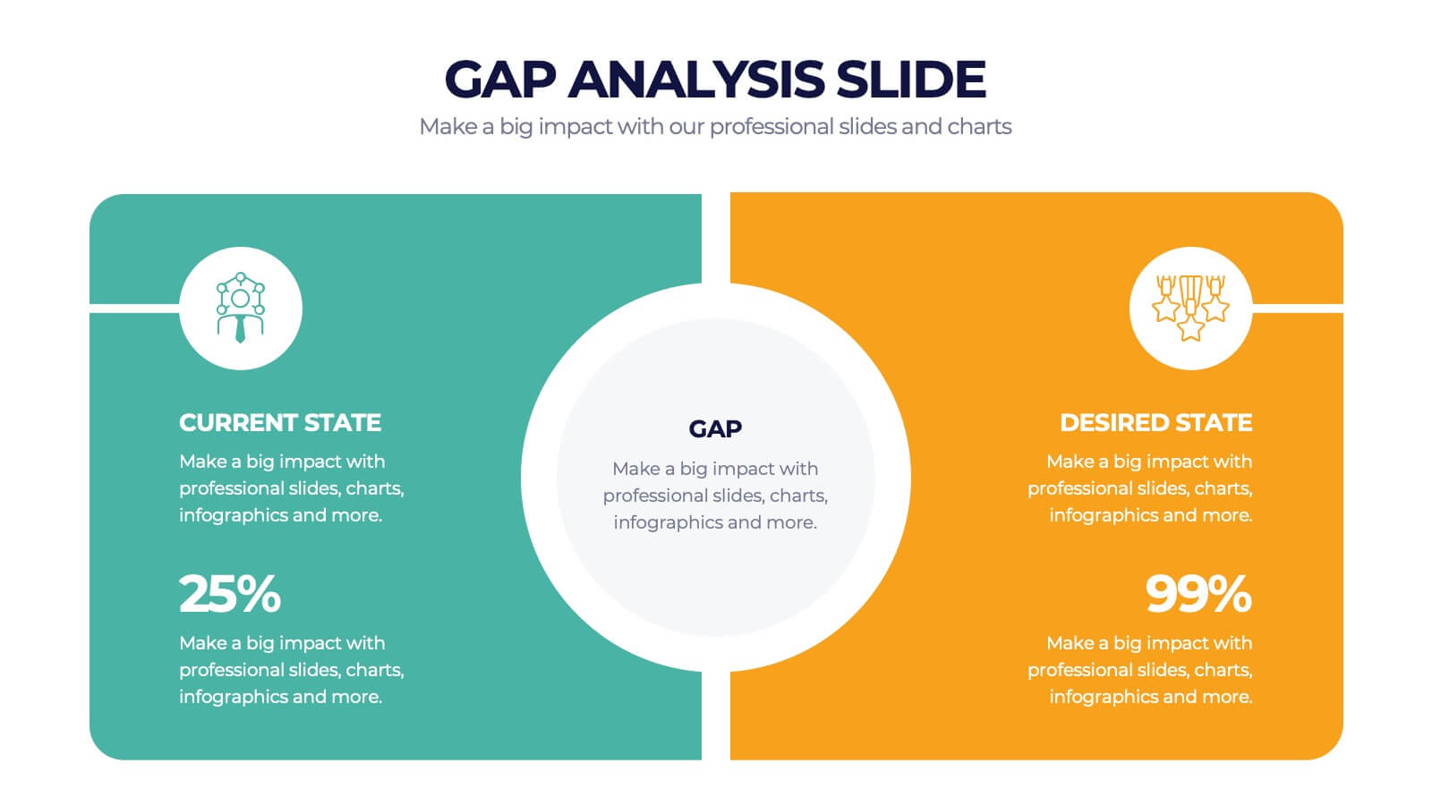
Problem Statement
Many diseases are detected only at advanced stages.
Existing systems have several limitations:
They use only one algorithm
They focus mainly on accuracy
They are not user-friendly
There is a need for a better and more complete solution.

Slide 5
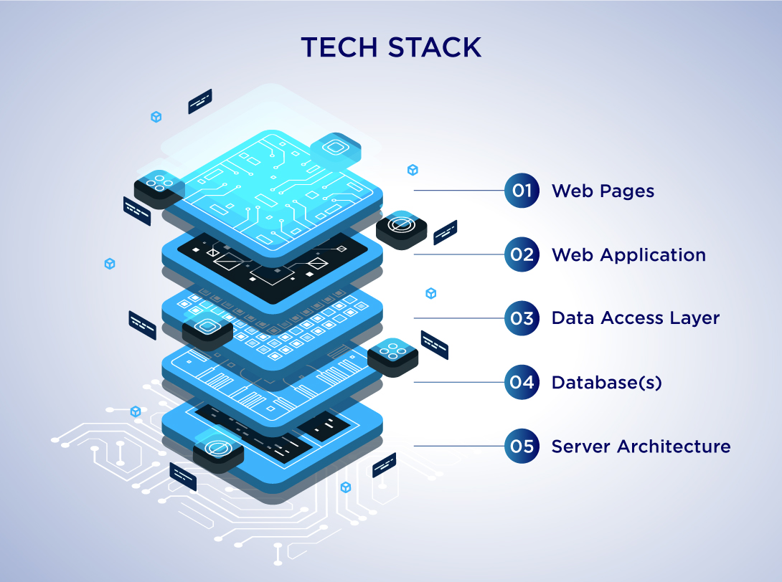
Project Objectives
Develop a system for early disease prediction
Use multiple machine learning algorithms
Compare their performance using different metrics
Create a simple web interface for users
The aim is to make the system practical and easy to use.

Slide 6
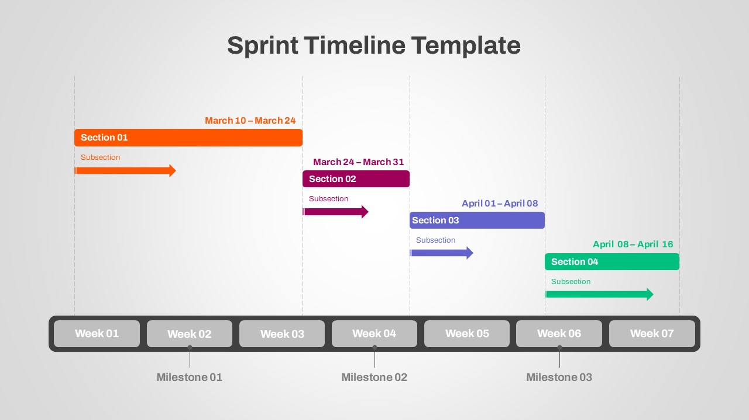
Methodology
The project follows the Agile development approach.
Work is divided into small phases or sprints.
Each phase focuses on a specific task such as data processing or model training.
This allows flexibility and continuous improvement during development.

Slide 7
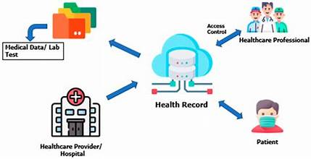
System Overview
The system works in a simple sequence:
User enters symptoms
Data is processed and cleaned
Machine learning models analyze the data
Results are displayed to the user
The process is fast and easy to follow.

Slide 8
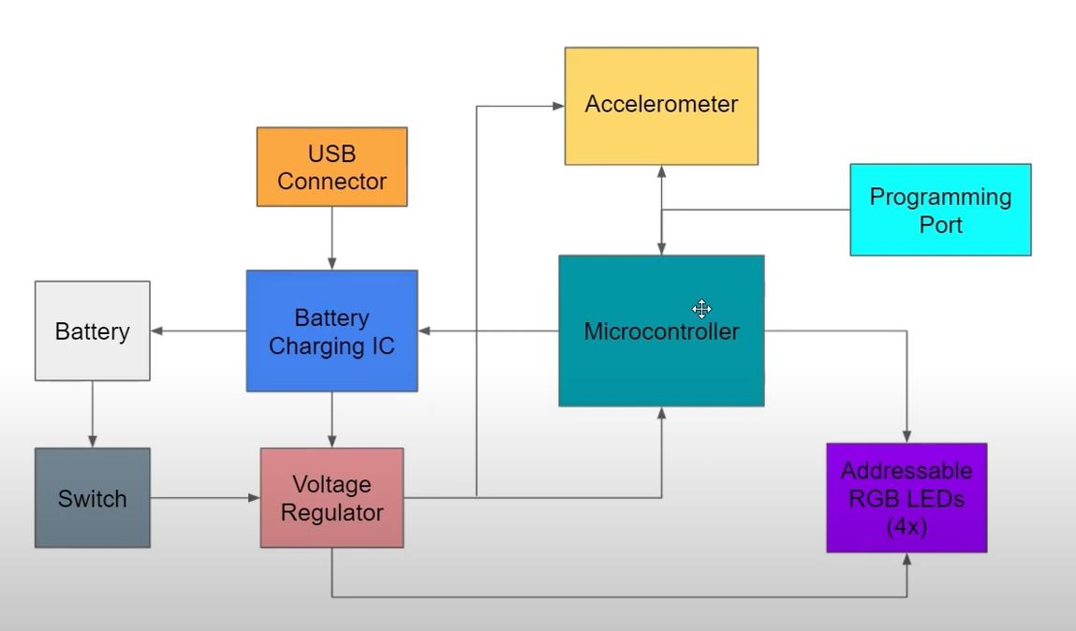
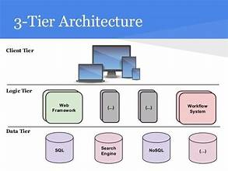
System Architecture
The system is divided into three main layers:
Input Layer → collects patient data
Processing Layer → runs machine learning models
Output Layer → shows predictions and results
This structure keeps the system organized and efficient.

Slide 9
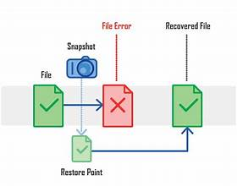
Dataset
The system uses a structured healthcare dataset in CSV format.
Each record includes:
Age and gender
17 symptoms
Disease label
This data is used to train and test the models.

Slide 10
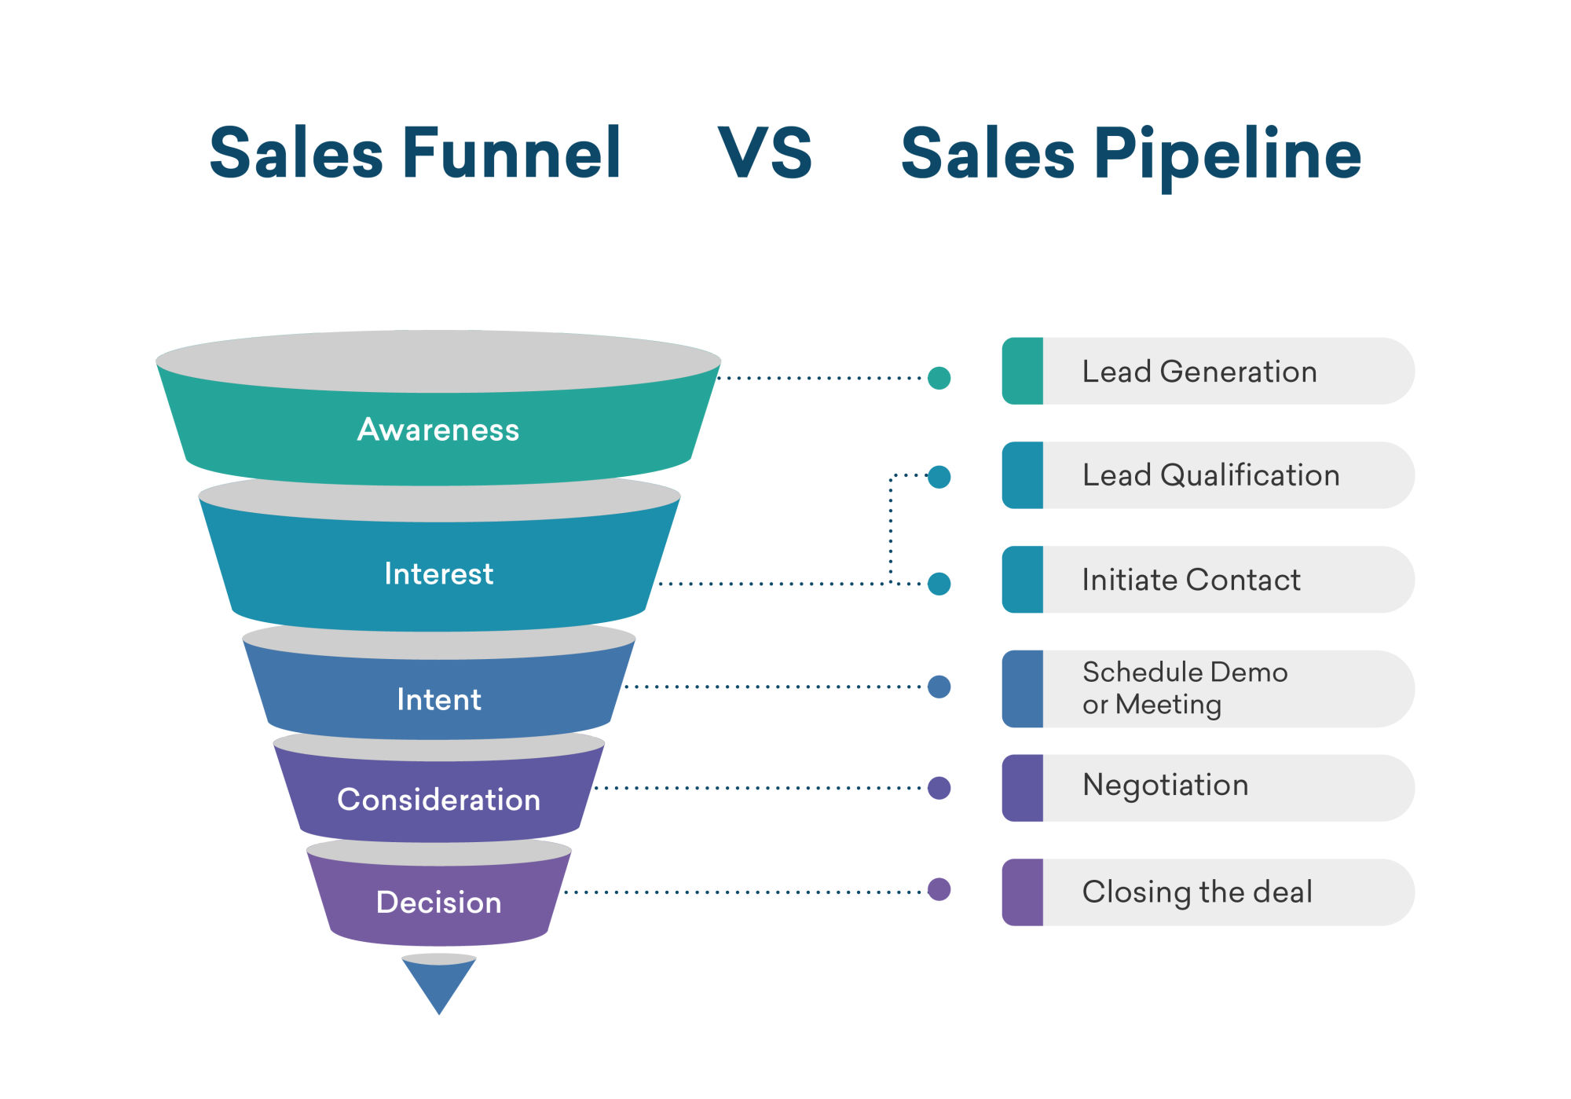
Data Preprocessing
Data is prepared before training the models:
Missing values are handled
Categorical data is converted into numbers
Data is normalized for better performance
Dataset is split into training and testing sets
This improves model accuracy and reliability.

Slide 11
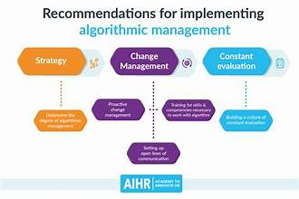
Machine Learning Models
Three models are used in this project:
Decision Tree → simple and easy to understand
Random Forest → combines multiple trees for better accuracy
logistic Regression → predicts probabilities
These models are compared to find the best one.

Slide 12
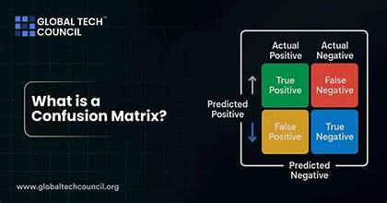
Evaluation Metrics
Models are evaluated using multiple metrics:
Accuracy → overall correctness
Precision → correctness of positive predictions
Recall → ability to detect actual diseases
F1 Score → balance between precision and recall
Using multiple metrics gives a better evaluation

Slide 13
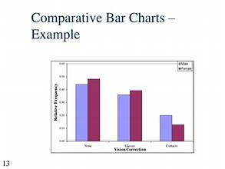
Results
All three models were tested under the same conditions.
Random Forest achieved the best performance overall.
It provided higher accuracy and better reliability.
Therefore, Random Forest is selected as the best model

Slide 14
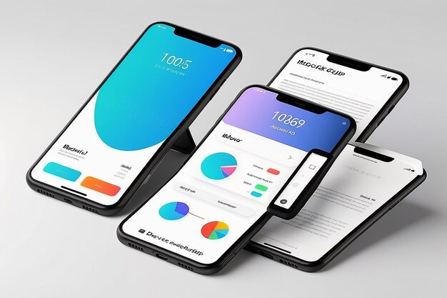
User Interface & Testing
A simple web interface is built using Flask.
Users can enter symptoms and view predictions easily.
The system is tested using:
Unit testing
Functional testing
Integration testing
This ensures the system works correctly and smoothly.

Slide 15
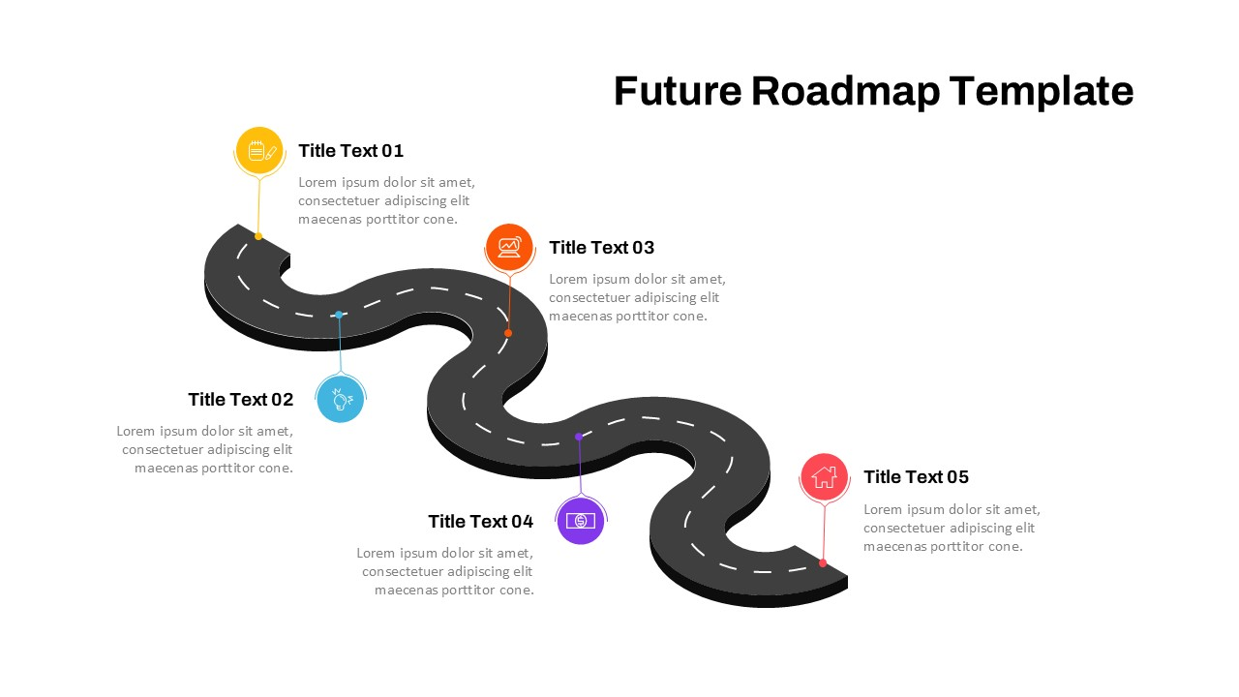
Conclusion & Future Work
This project successfully developed a disease prediction system.
It compares multiple models and selects the best one.
The system is simple, fast, and useful for early diagnosis.
Future Improvements:
Add more diseases and datasets
Use deep learning models
Connect with real hospital data
Develop a mobile application

