Slide 1
Project Proposal:
Unreveling human-specific genes in Pediatric Acute Lymphoid Leukemia (ALL)
Andrea Tonina, Thomas Sirchi, Lorenzo Santarelli, Sabri Kaci, Gloria Lugoboni

Slide 2
Introduction
Between us and chimpanzees many differences at the genetic level can be found. We talk of “human-specific” features, therefore human-specific genes
These genes are restricted to a known set of functions:
Neural functions,
Metabolic functions
Immunological functions
Structural growth
Functions at the cell level
Pediatric ALL is a malignant transformation that provokes an abnormal proliferation and differentiation of lymphoid progenitor cells, attacking mainly B-cells. It correlates with chromosomal aberrations and complex events such as rearrangement of multiple chromosomes

Slide 3
Statement of need
A world yet to be discovered and further analyzed
Could possibly help to discover new connections between complex diseases and human-specific genes
Objectives
Uncover the possible correlations between human-specific genes and ALL
Find hallmarks of the disease
Estimate sensibility to a treatment based on the genetic profile.

Slide 4
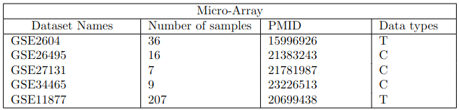
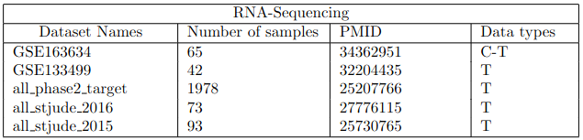
Datasets

Slide 5
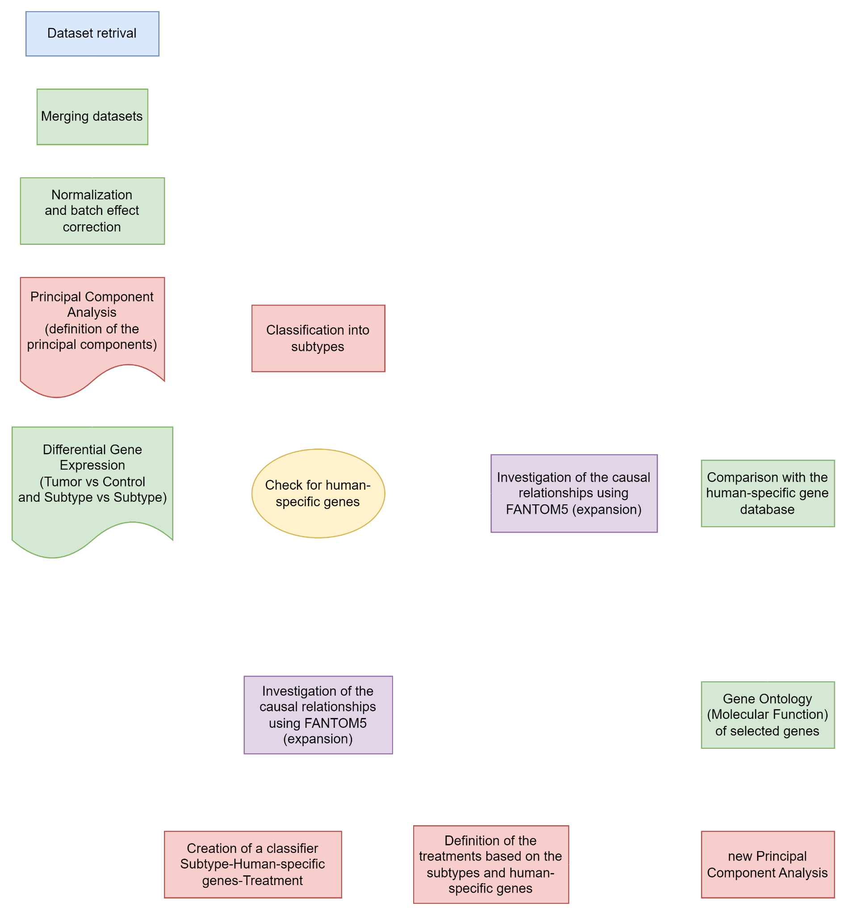
Pipeline

Slide 6
Expected outcomes
Find novel genes that could correlate to human-specific diseases.
Define hallmarks and subtypes of ALL
Create a connection between the genetic expression profile and possible treatments.

Slide 7
Thank you for your attention!

